Slide 1

MACHINE LEARNING / CLINICAL RESEARCH / SMALL-DATA CASE
Cascade-Based Input-Doubling
Classifier & Linear Regression
Predicting survival in pediatric allogeneic bone marrow transplantation
A reproducible, leak-free pipeline benchmarked against an OLS baseline
Reference: Izonin, Tkachenko, Hovdysh, Berezsky, Yemets & Tsmots (2025). Computation 13(3):80, MDPI Open Access.
CASCADE INPUT-DOUBLING PIPELINE | IZONIN ET AL. (2025), COMPUTATION 13(3):80
01

Slide 2
RESEARCH CONTEXT
187
Small data, big stakes
Two targets, two questions. One model estimates survival_time (days); the other classifies survival_status (0 = survived, 1 = deceased).
Imbalance. Deceased outcomes are the minority class, so naive accuracy is misleading.
Generalization gap. Deep networks overfit tiny clinical cohorts; the cascade is designed specifically for this regime.
Total
Patients
UCI DATASET ID: 565
Source: UCI Machine Learning Repository
Pediatric bone marrow transplant data used for survival rule induction and outcome prediction.
35 de-leaked baseline attributes available at transplant time.
CASCADE INPUT-DOUBLING PIPELINE | IZONIN ET AL. (2025), COMPUTATION 13(3):80
02

Slide 3
DATASET SPLIT
157
Development vs. External Test
157 Patients (84%)
Development dataset used for cleaning, EDA, training and internal validation.
30 Patients (16%)
External test dataset kept separate until final evaluation to ensure unbiased testing.
Development
Cohort
TRAINING SPLIT - 84%
Source: remaining_dataset.csv
Used for corruption testing, cleaning, EDA, model training and internal cross-validation.
Role: everything the models are allowed to learn from.
CASCADE INPUT-DOUBLING PIPELINE | IZONIN ET AL. (2025), COMPUTATION 13(3):80
03

Slide 4
CONTENTS
Roadmap
01
Problem & context
Small data, class imbalance, clinical stakes
02
Research foundation
Algorithm 1 - Cascade Input-Doubling
03
Pipeline architecture
Corruption, cleaning, leak-free design
04
Linear regression
OLS baseline + 100x bootstrapping
05
Cascade classifier
PNN expansion, doubling, RF meta-voting
06
Results & diagnostics
Metrics, confusion matrices, importance
07
Web application
FastAPI inference + dashboard
08
Findings & limitations
Conclusions, caveats, ethics
CASCADE INPUT-DOUBLING PIPELINE | IZONIN ET AL. (2025), COMPUTATION 13(3):80
04
CASCADE INPUT-DOUBLING PIPELINE | IZONIN ET AL. (2025), COMPUTATION 13(3):80
04

Slide 5
01 - MOTIVATION
The small-data problem in transplantology
Clinical constraints
— Datasets are strictly limited - N=157 training patients.
— Marked class imbalance: the event of interest is the minority.
— Heavy right-censoring and heterogeneous clinical attributes.
— High-stakes decisions carry real human cost.
Consequence: deep nets and complex non-linear classifiers overfit and fail to generalize.
Project response
— Implement Algorithm 1 end-to-end and test its small-data claims.
— Pair it with a transparent OLS + bootstrapping baseline.
— Evaluate on a strictly held-out clean test cohort.
— Ship a reproducible pipeline and an interactive web app.
Thesis: neural probability projection enriches low-dimensional clinical feature spaces.
CASCADE INPUT-DOUBLING PIPELINE | IZONIN ET AL. (2025), COMPUTATION 13(3):80
05
CASCADE INPUT-DOUBLING PIPELINE | IZONIN ET AL. (2025), COMPUTATION 13(3):80
05

Slide 6
02 - RESEARCH FOUNDATION
Algorithm 1: a three-stage cascade
STAGE 1
PNN probability expansion
STAGE 2
Quadratic input-doubling
STAGE 3
Random Forest meta-classifier
— Euclidean, Chebyshev & Cosine distances to support vectors
— Gaussian kernel with smooth factor sigma
— Appends probabilities: [x, P_E, P_Cheb, P_Cos]
— Concatenate sample pairs (x_i, x_j)
— Target becomes the difference z = y_i - y_j in {-1, 0, 1}
— Small N becomes thousands of comparisons
— Trained on the doubled feature space
— Plurality voting over reference training vectors
— Final discrete class from ensemble votes
CASCADE INPUT-DOUBLING PIPELINE | IZONIN ET AL. (2025), COMPUTATION 13(3):80
06
CASCADE INPUT-DOUBLING PIPELINE | IZONIN ET AL. (2025), COMPUTATION 13(3):80
06

Slide 7
03 - ARCHITECTURE
End-to-end pipeline
RAW DATA
157 train + 30 test
➜
STEP A
Artificial corruption
➜
STEP B
Cleaning & preprocessing
➜
MODELS
OLS + Cascade
➜
BENCHMARK
Metrics, plots, exports
Engineering principles
Strict train/test isolation. Imputers, IQR caps, scaler and encoder are fitted on train only, then applied to test - no leakage.
Reproducibility. Fixed seeds; one master script (pipeline.py) regenerates every CSV, metric and figure.
Modular source. Corruption, cleaning, regression, cascade, evaluation and visualization live in separate modules under src/.
CASCADE INPUT-DOUBLING PIPELINE | IZONIN ET AL. (2025), COMPUTATION 13(3):80
07
CASCADE INPUT-DOUBLING PIPELINE | IZONIN ET AL. (2025), COMPUTATION 13(3):80
07

Slide 8
03 - ARCHITECTURE
Step A - artificial data corruption
Injected distortions
— Random 10-15% NaN missingness across numerical features.
— Synthetic duplicate rows (dirty clinical records).
— Non-standard string casing & whitespace in Disease.
— Extreme outliers in CD34 dose, weights and ages.
Purpose: stress-test the cleaning pipeline under realistic hospital-data degradation.
Corruption -> cleaning contract
Output dirty_dataset.csv
Missingness 12% of numeric cells
Duplicates 14 injected rows
Outliers 8 extreme points
String noise casing + whitespace
Seed random_state = 42
Why corrupt on purpose? It makes cleaning robustness measurable and keeps the experiment reproducible.
CASCADE INPUT-DOUBLING PIPELINE | IZONIN ET AL. (2025), COMPUTATION 13(3):80
08
CASCADE INPUT-DOUBLING PIPELINE | IZONIN ET AL. (2025), COMPUTATION 13(3):80
08

Slide 9
03 - ARCHITECTURE
Step B - cleaning & preprocessing
STEP 01
Deduplicate
Drop exact duplicate rows injected in Step A.
STEP 02
Outlier capping
IQR clipping to [Q1 - 3*IQR, Q3 + 3*IQR].
STEP 03
Imputation
Median (numeric) & mode (categorical).
STEP 04
Encode & scale
One-hot categoricals + StandardScaler.
No-leakage guarantee
BoneMarrowPreprocessor.fit() is called only on the corrupted training set; transform() is then applied independently to train and to the clean 30-patient test cohort. All statistics are frozen from training.
Artifacts: cleaned_dataset.csv - cleaned_test_dataset.csv
CASCADE INPUT-DOUBLING PIPELINE | IZONIN ET AL. (2025), COMPUTATION 13(3):80
09
CASCADE INPUT-DOUBLING PIPELINE | IZONIN ET AL. (2025), COMPUTATION 13(3):80
09

Slide 10
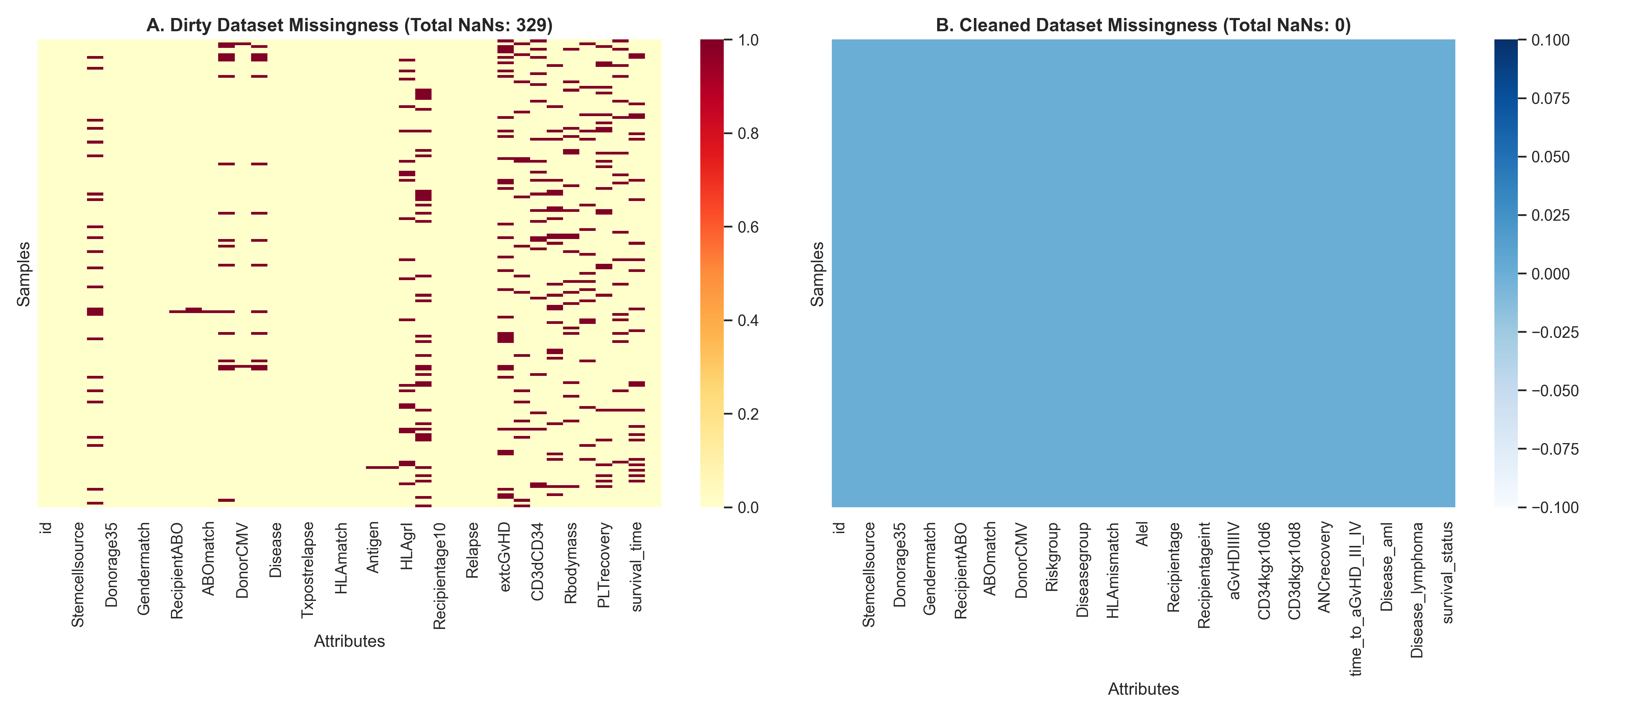
03 - DATA QUALITY
Exploratory analysis - feature distributions
Missingness heatmap: dirty (329 NaNs) vs. cleaned (0 NaNs)
CASCADE INPUT-DOUBLING PIPELINE | IZONIN ET AL. (2025), COMPUTATION 13(3):80
10
CASCADE INPUT-DOUBLING PIPELINE | IZONIN ET AL. (2025), COMPUTATION 13(3):80
10

Slide 11
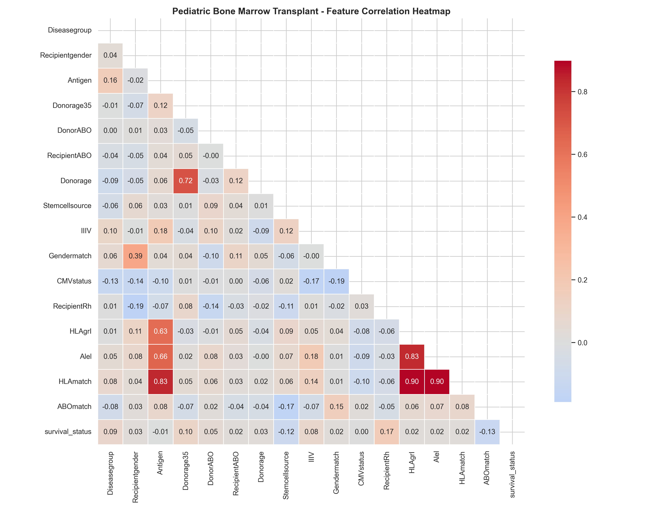
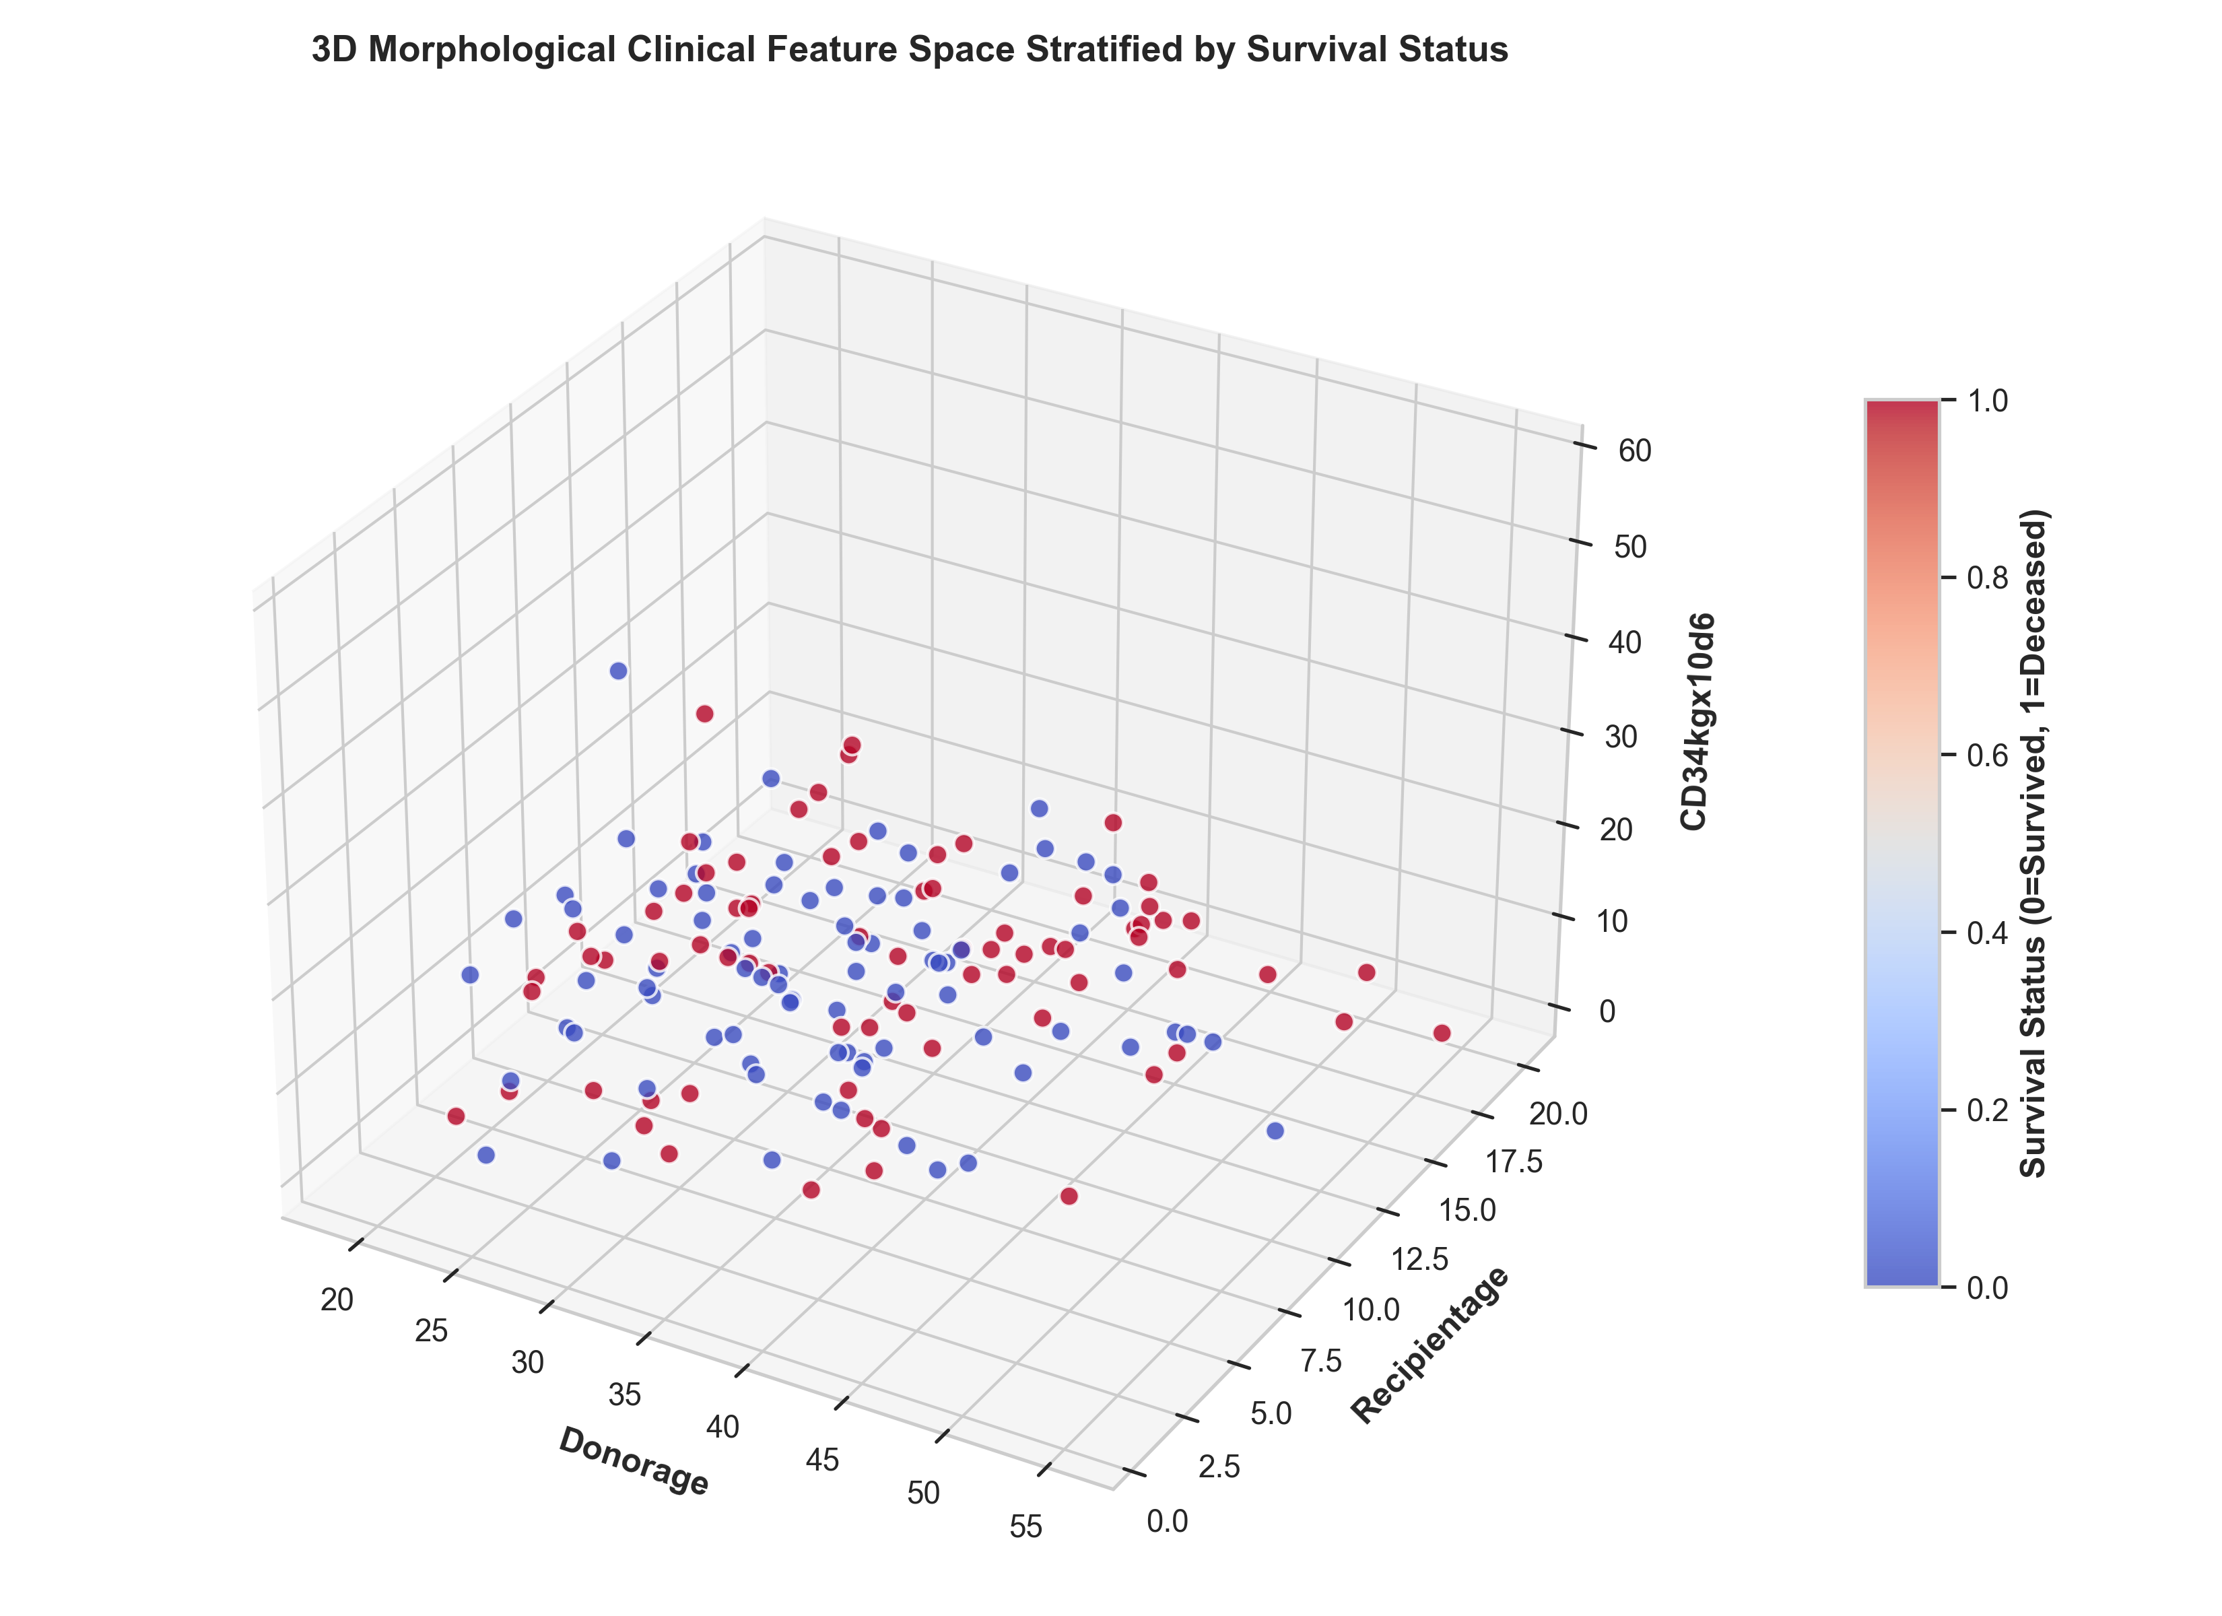
03 - DATA QUALITY
Correlation structure & feature space
Clinical correlation heatmap
3D space: donor/recipient age vs. CD34 dose
CASCADE INPUT-DOUBLING PIPELINE | IZONIN ET AL. (2025), COMPUTATION 13(3):80
11
CASCADE INPUT-DOUBLING PIPELINE | IZONIN ET AL. (2025), COMPUTATION 13(3):80
11

Slide 12
04
SECTION 04
Linear Regression
Model 1 - an interpretable OLS baseline with bootstrapped uncertainty
CASCADE INPUT-DOUBLING PIPELINE | IZONIN ET AL. (2025), COMPUTATION 13(3):80
12

Slide 13
04 - LINEAR REGRESSION
What Ordinary Least Squares does
The baseline model
— Fits a linear relationship between clinical features and the outcome.
— Continuous prediction of survival_status, thresholded at 0.5 for classes.
— Fully transparent: every coefficient is directly interpretable.
— Serves as the yardstick against which cascade gains are measured.
Why keep it? A stronger model is only convincing relative to a well-understood baseline.
Pipeline components
Fit - scikit-learn LinearRegression
Inference - statsmodels OLS (p-values)
Uncertainty - 100x bootstrap resampling
Diagnostics - residual + error tables
Metrics - RMSE, MAE, R^2, F1, MCC
CASCADE INPUT-DOUBLING PIPELINE | IZONIN ET AL. (2025), COMPUTATION 13(3):80
13
CASCADE INPUT-DOUBLING PIPELINE | IZONIN ET AL. (2025), COMPUTATION 13(3):80
13

Slide 14
04 - LINEAR REGRESSION
The linear model
y = β₀ + β₁x₁ + β₂x₂ + ... + βₚ xₚ + ε
β₀ = intercept | βᵢ = coefficient for feature xᵢ | ε = residual error
Objective
Choose coefficients that minimize the sum of squared residuals Σ(yᵢ - ŷᵢ)², i.e. the total squared prediction error.
In this project
~35 encoded predictors (after one-hot expansion), standardized so that coefficient magnitudes are comparable across features.
CASCADE INPUT-DOUBLING PIPELINE | IZONIN ET AL. (2025), COMPUTATION 13(3):80
14
CASCADE INPUT-DOUBLING PIPELINE | IZONIN ET AL. (2025), COMPUTATION 13(3):80
14

Slide 15
04 - LINEAR REGRESSION
100x bootstrapping for uncertainty
Procedure
— Resample the training set with replacement (100 iterations).
— Refit OLS on each resample and store every coefficient.
— Summarize mean coefficient, standard error and 95% percentile intervals.
— Cross-check p-values with the statsmodels OLS fit.
Why it matters
Bootstrapping builds an empirical sampling distribution without assuming normality - important for a small, non-Gaussian clinical cohort.
Output: bootstrapped_coefficients.csv
Seed: random_state = 42
CASCADE INPUT-DOUBLING PIPELINE | IZONIN ET AL. (2025), COMPUTATION 13(3):80
15
CASCADE INPUT-DOUBLING PIPELINE | IZONIN ET AL. (2025), COMPUTATION 13(3):80
15

Slide 16
04 - LINEAR REGRESSION
Coefficient estimates & 95% CI
Feature | Mean coef. | Std. err. | 95% CI lower | 95% CI upper | p-value
Relapse | +0.1178 | 0.0311 | +0.0591 | +0.1617 | 0.0002
Recipientage | +0.0958 | 0.0508 | -0.0060 | +0.2009 | 0.0285
HLAgrI | +0.1619 | 0.0937 | -0.0377 | +0.3375 | 0.0448
Disease_chronic | +0.1859 | 0.0854 | +0.0200 | +0.3408 | 0.0301
extcGvHD | -0.0835 | 0.0322 | -0.1410 | -0.0210 | 0.0104
survival_time | -0.3205 | 0.0310 | -0.3803 | -0.2648 | <0.0001
Disease_nonmalignant | +0.0031 | 0.0112 | -0.0178 | +0.0219 | <0.0001
Read-out: Relapse, recipient age, HLA-group I mismatch, chronic disease and extra-corporeal GvHD carry statistically meaningful coefficients - clinically sensible survivors of a small-data fit.
CASCADE INPUT-DOUBLING PIPELINE | IZONIN ET AL. (2025), COMPUTATION 13(3):80
16
CASCADE INPUT-DOUBLING PIPELINE | IZONIN ET AL. (2025), COMPUTATION 13(3):80
16

Slide 17
04 - LINEAR REGRESSION
Residual diagnostics
What we inspect
— Residual = actual - predicted, for every test patient.
— Absolute error and squared error tables per sample.
— Detect systematic bias, heteroscedasticity and outliers.
— Feeds RMSE and MAE - the headline error metrics.
Output: regression_errors.csv
Error metrics
RMSE 0.3186
MAE 0.2597
MSE 0.1015
R^2 (survival_time) near zero / negative
Caveat: day-level survival_time regression is heavily right-censored, so R^2 is unreliable - the binary classification view is more meaningful.
CASCADE INPUT-DOUBLING PIPELINE | IZONIN ET AL. (2025), COMPUTATION 13(3):80
17
CASCADE INPUT-DOUBLING PIPELINE | IZONIN ET AL. (2025), COMPUTATION 13(3):80
17

Slide 18
04 - LINEAR REGRESSION
From regression output to a decision
predicted class = 1 (deceased) if ŷ ≥ 0.5 else 0 (survived)
The OLS model outputs a continuous risk score; a fixed 0.5 threshold converts it into the binary survival label used for classification metrics.
Recall
1.00
catches every deceased patient
Precision
0.833
2 false positives
Accuracy
0.933
28 of 30 correct
CASCADE INPUT-DOUBLING PIPELINE | IZONIN ET AL. (2025), COMPUTATION 13(3):80
18
CASCADE INPUT-DOUBLING PIPELINE | IZONIN ET AL. (2025), COMPUTATION 13(3):80
18

Slide 19
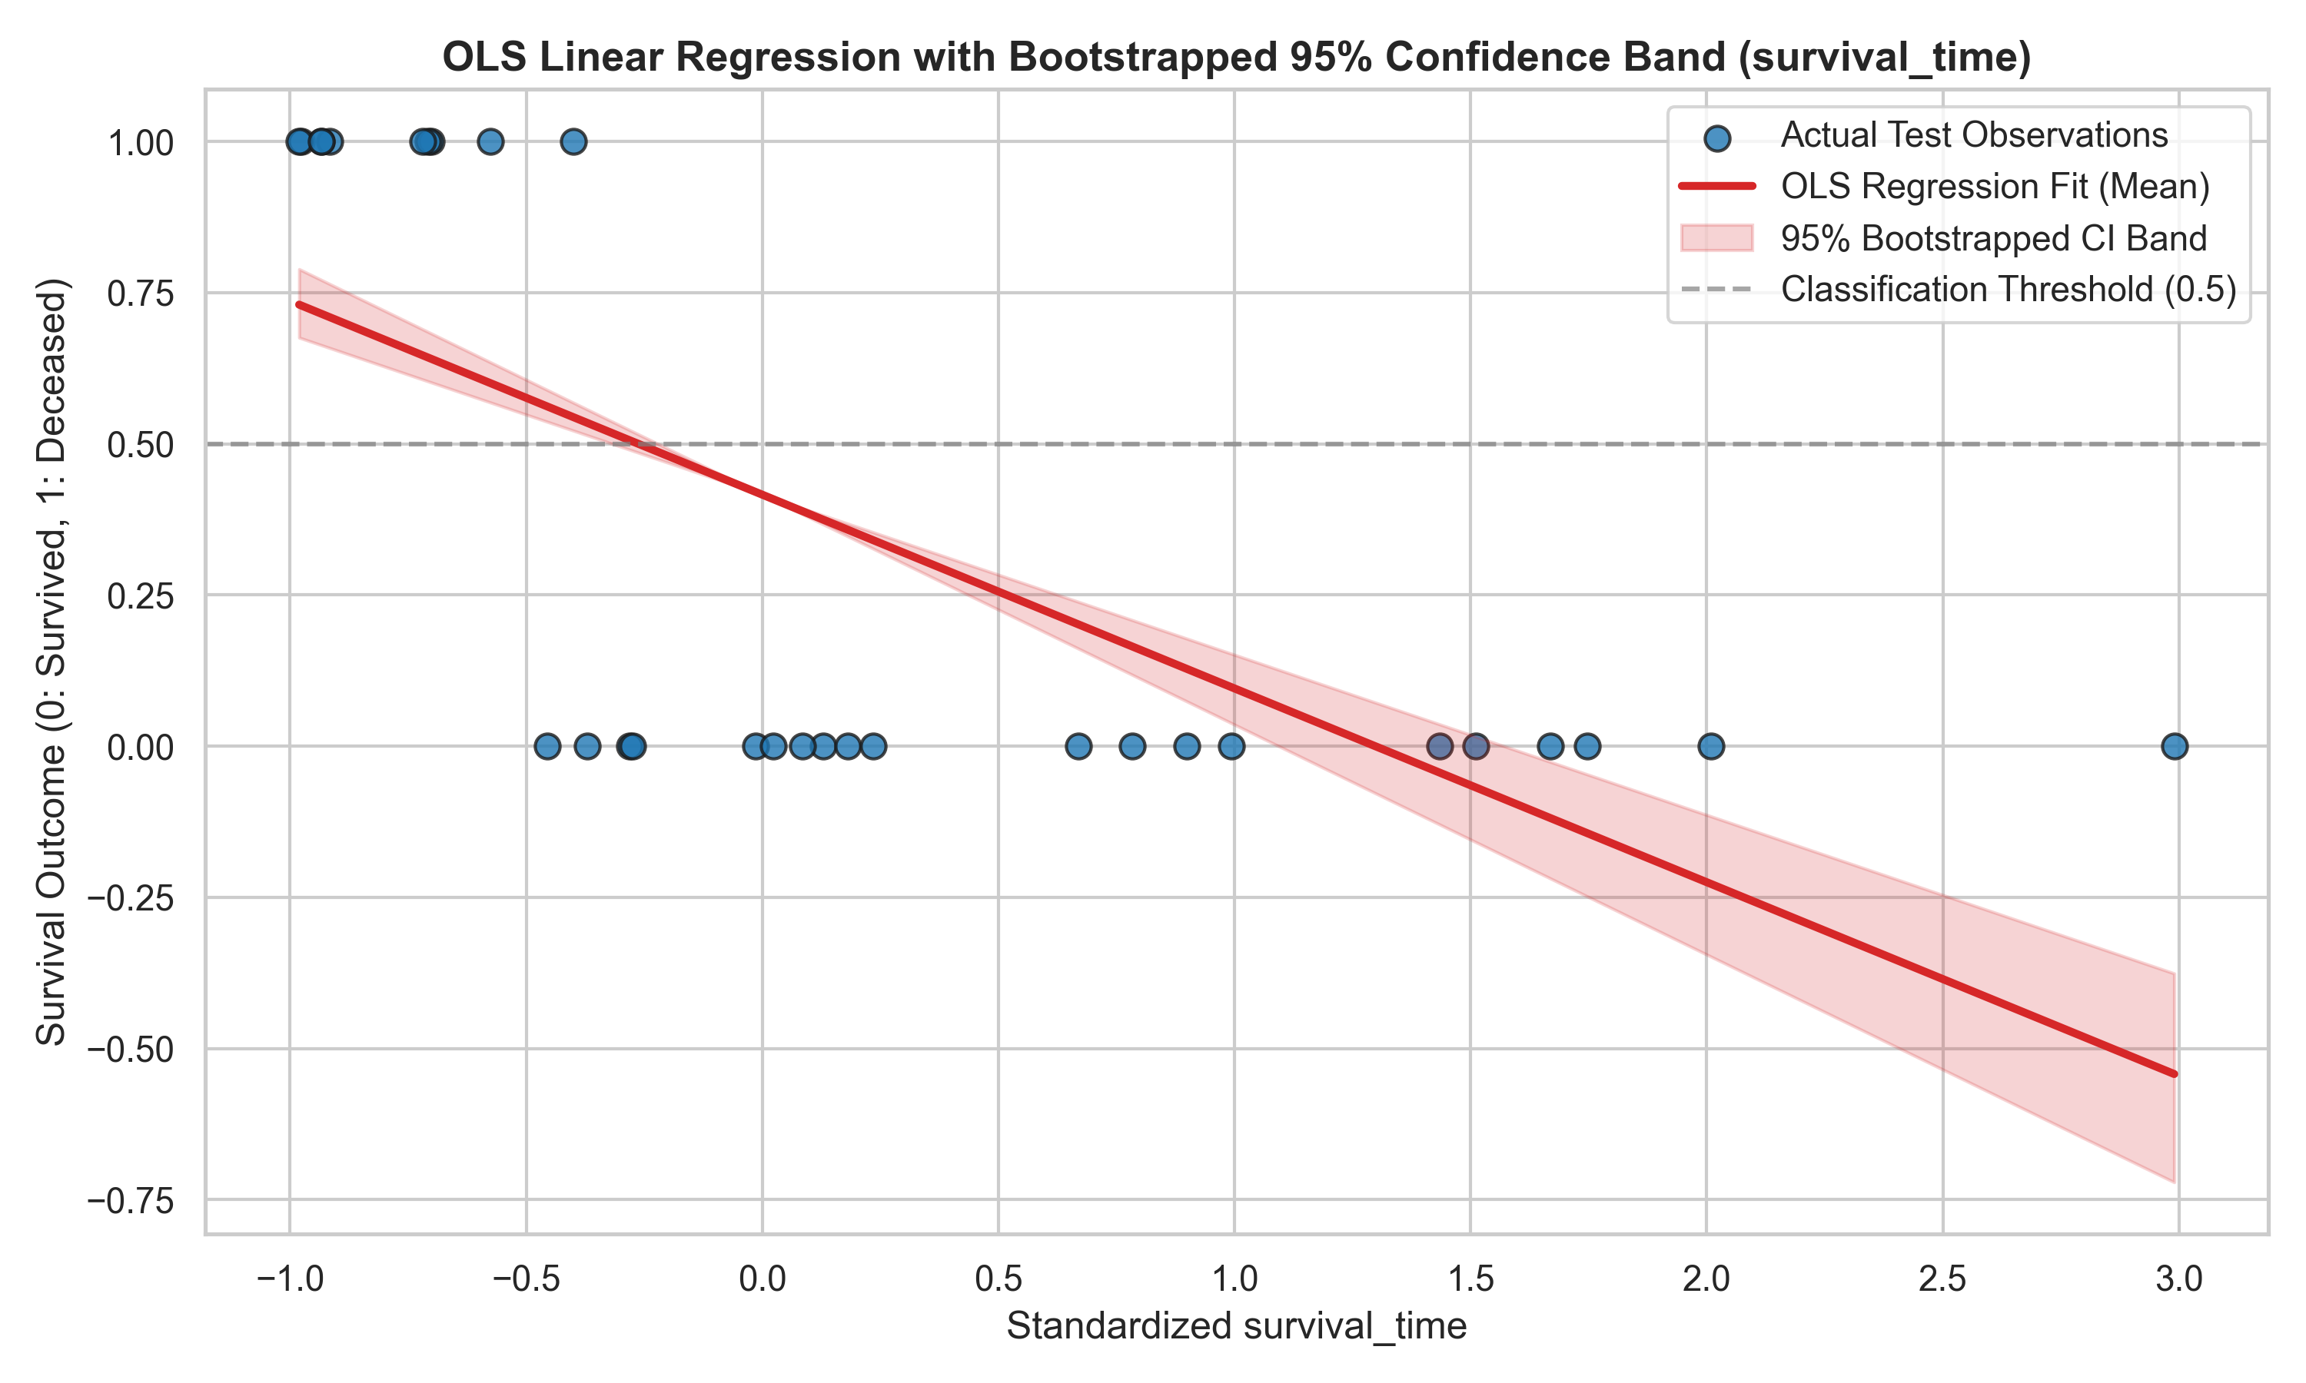
04 - LINEAR REGRESSION
Regression fit with 95% bootstrap band
OLS regression line with 95% bootstrapped confidence-interval band
CASCADE INPUT-DOUBLING PIPELINE | IZONIN ET AL. (2025), COMPUTATION 13(3):80
19
CASCADE INPUT-DOUBLING PIPELINE | IZONIN ET AL. (2025), COMPUTATION 13(3):80
19

Slide 20
04 - LINEAR REGRESSION
Baseline performance summary
0.9333
Accuracy
28 / 30 correct
0.9091
F1-score
harmonic mean
0.8660
MCC
balanced quality
0.2597
MAE
baseline error
Takeaway
The OLS baseline is a strong, sensitive classifier - but it flags some survivors as deceased (2 false positives). The cascade classifier explicitly targets that weakness in the next section.
CASCADE INPUT-DOUBLING PIPELINE | IZONIN ET AL. (2025), COMPUTATION 13(3):80
20
CASCADE INPUT-DOUBLING PIPELINE | IZONIN ET AL. (2025), COMPUTATION 13(3):80
20

Slide 21
05
SECTION 05
Cascade Classifier
Model 2 - PNN expansion, quadratic input-doubling and a Random Forest meta-learner
CASCADE INPUT-DOUBLING PIPELINE | IZONIN ET AL. (2025), COMPUTATION 13(3):80
21

Slide 22
05 - CASCADE / STAGE 1
PNN probability expansion
Distance & kernel mechanics
— Three distance matrices to the training support set:
  — Euclidean - Chebyshev - Cosine
— Gaussian kernel K = exp( -d^2 / (2 sigma^2) ).
— Class-1 posterior = mean(K | class 1) / (mean(K | class 0) + mean(K | class 1)).
— Appends [P_E, P_Cheb, P_Cos] to the original vector.
Effect: a richer, non-linear projection of a low-dimensional clinical space - the core thesis of Izonin et al. (2025).
Implementationclass PNNProbabilityExpander:
def fit(X, y) -> self
def transform(X) -> (N, 3)
[P_euclid,
P_cheb, P_cosine]
def expand_features(X):
hstack([X, probs])
CASCADE INPUT-DOUBLING PIPELINE | IZONIN ET AL. (2025), COMPUTATION 13(3):80
22
CASCADE INPUT-DOUBLING PIPELINE | IZONIN ET AL. (2025), COMPUTATION 13(3):80
22

Slide 23
05 - CASCADE / STAGE 2
Quadratic input-doubling
Augmentation recipe
— Pair each sample i with a random subset of samples j.
— Concatenate the two expanded vectors: [x_i | x_j].
— Target becomes the class difference z = y_i - y_j in {-1, 0, +1}.
— Up to 8,000 stratified pairs, capped for tractability.
— Turns 157 rows into thousands of informative comparisons.
Why it mitigates small data
1. Effective sample-size expansion without fabricating labels - every pair is grounded in two real patients.
2. Pairwise differences capture ordinal structure and reduce class-imbalance sensitivity.
3. The doubled space exposes relative clinical signatures to the meta-learner.
4. Redundant pairs average out idiosyncratic noise - regularization by construction.
CASCADE INPUT-DOUBLING PIPELINE | IZONIN ET AL. (2025), COMPUTATION 13(3):80
23
CASCADE INPUT-DOUBLING PIPELINE | IZONIN ET AL. (2025), COMPUTATION 13(3):80
23

Slide 24
05 - CASCADE / STAGE 3
Random Forest meta-classifier & voting
Meta-learner
— RandomForestClassifier trained on the doubled feature space.
— Learns the difference function z = y_i - y_j.
— Gini importances aggregated back to original + PNN features.
— n_estimators and max_depth set by global optimization.
Inference: plurality voting
— Pick fixed reference vectors (support set).
— Pair each test sample with every reference -> z_hat.
— Vote: y_test = y_ref + z_hat, clipped to {0, 1}.
— Class-1 probability = fraction of Deceased votes.
Benefit: an ensemble of many relative judgments instead of one brittle absolute prediction.
CASCADE INPUT-DOUBLING PIPELINE | IZONIN ET AL. (2025), COMPUTATION 13(3):80
24
CASCADE INPUT-DOUBLING PIPELINE | IZONIN ET AL. (2025), COMPUTATION 13(3):80
24

Slide 25
05 - CASCADE
Hyperparameter optimization - Dual Annealing
Search setup
— scipy.optimize.dual_annealing - global, derivative-free.
— Objective: maximize mean_F1 + 0.5 * mean_MCC under 3-fold Stratified CV.
— Bounds: sigma [0.2, 3.5], n_estimators [50, 150], max_depth [4, 14].
— 15 evaluated trials logged with CV F1 and MCC.
Optimal configuration
sigma = 3.2183 - n_estimators = 80 - max_depth = 9
Trial | Sigma | n_est | Depth | CV F1 | CV MCC
3 | 3.2183 | 80 | 9 | 0.8120 | 0.6504
9 | 2.2774 | 70 | 8 | 0.8071 | 0.6383
14 | 2.1533 | 50 | 4 | 0.7812 | 0.6007
8 | 1.2460 | 105 | 12 | 0.7674 | 0.5703
5 | 1.4686 | 93 | 11 | 0.7652 | 0.5603
Top 5 of 15 Dual Annealing trials. Trial 3 is the global optimum.
CASCADE INPUT-DOUBLING PIPELINE | IZONIN ET AL. (2025), COMPUTATION 13(3):80
25
CASCADE INPUT-DOUBLING PIPELINE | IZONIN ET AL. (2025), COMPUTATION 13(3):80
25

Slide 26
06 - RESULTS
Benchmark on the held-out test cohort
Independent clean test set - 30 patients (20 survived, 10 deceased), never seen during training or tuning.
Model | Acc. | Prec. | Recall | F1 | MCC | Kappa | RMSE | MAE
Linear Regression (OLS) | 0.9333 | 0.8333 | 1.0000 | 0.9091 | 0.8660 | 0.8571 | 0.3186 | 0.2597
Hybrid Cascade (Algorithm 1) | 0.9333 | 1.0000 | 0.8000 | 0.8889 | 0.8528 | 0.8421 | 0.2165 | 0.0637
Combined Ensemble Blend | 0.9333 | 1.0000 | 0.8000 | 0.8889 | 0.8528 | 0.8421 | 0.2083 | 0.1408
75.5%
MAE reduction
0.2597 -> 0.0637
32.1%
RMSE reduction
0.3186 -> 0.2165
0
False positives
precision = 1.00
CASCADE INPUT-DOUBLING PIPELINE | IZONIN ET AL. (2025), COMPUTATION 13(3):80
26
CASCADE INPUT-DOUBLING PIPELINE | IZONIN ET AL. (2025), COMPUTATION 13(3):80
26

Slide 27
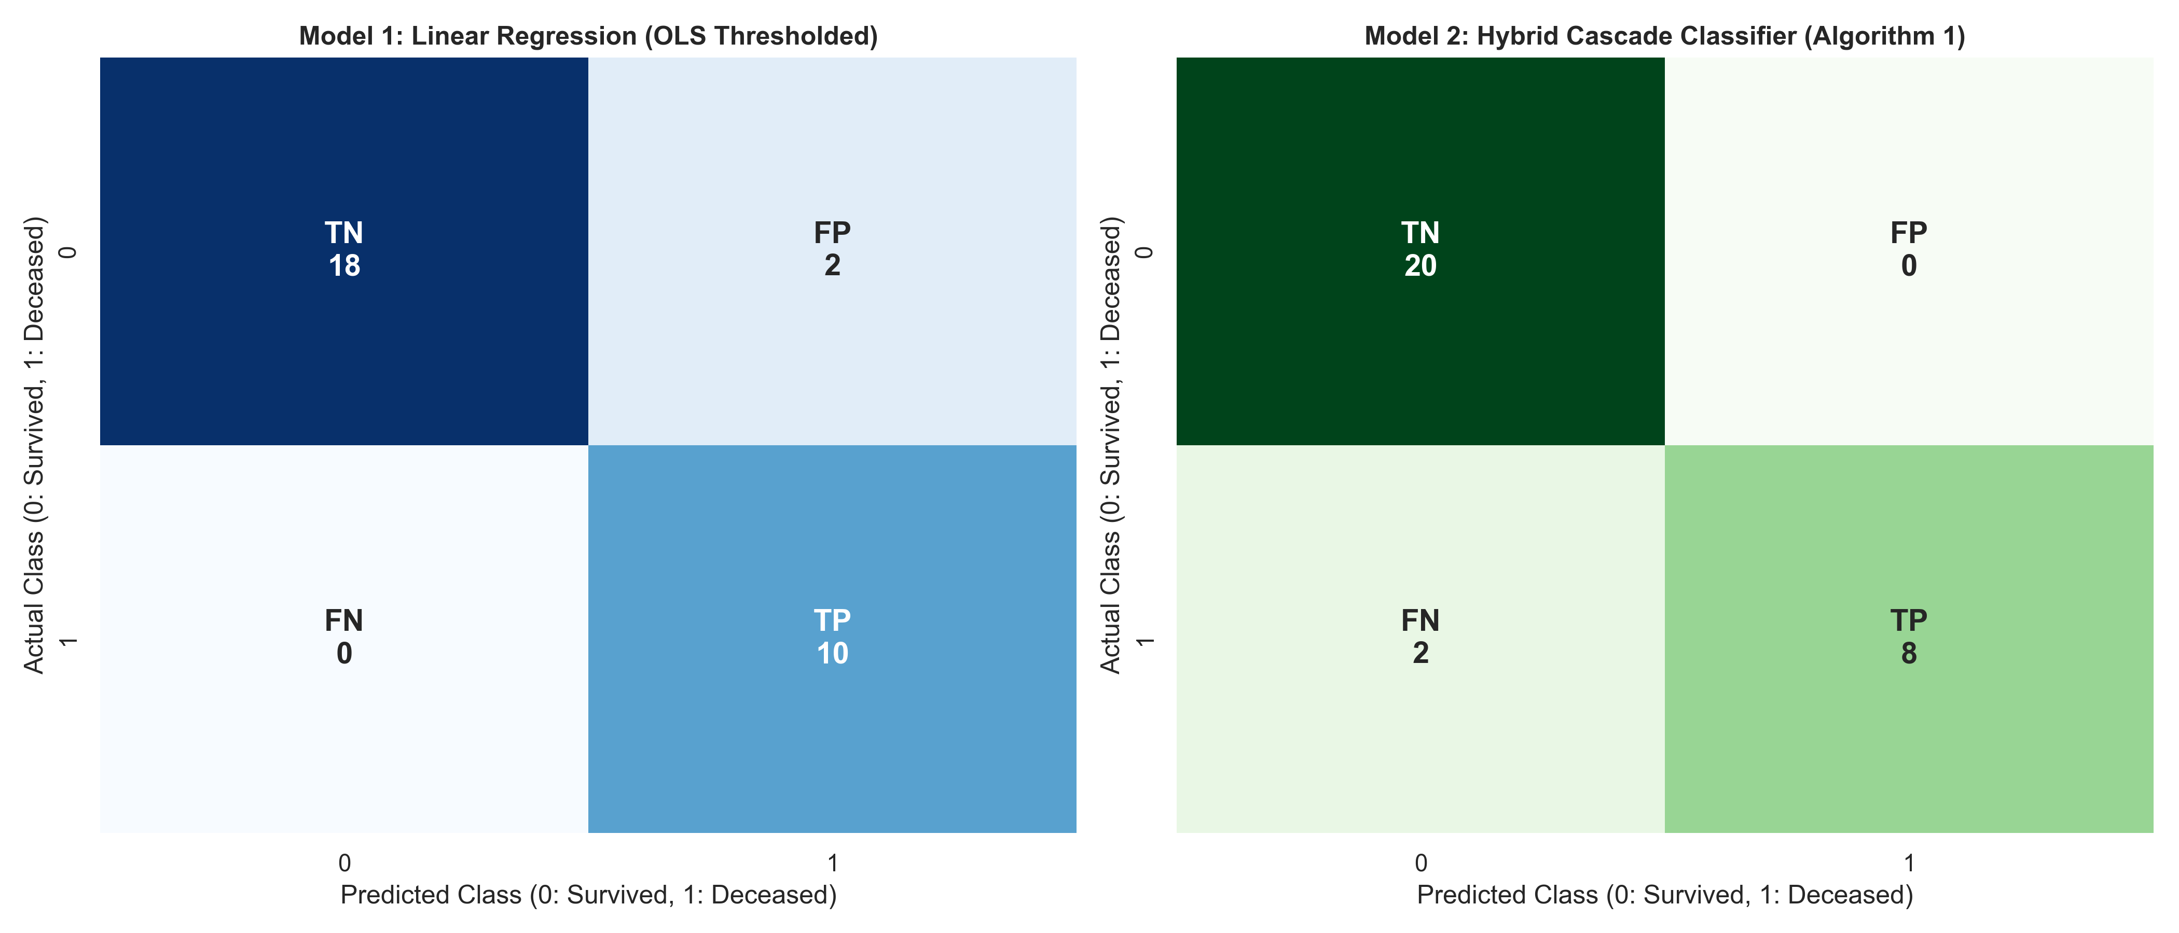
06 - RESULTS
Confusion matrices & the OLS trade-off
Model | TP | FP | TN | FN | Sens. | Spec. | PPV | NPV
Linear Regression (OLS) | 10 | 2 | 18 | 0 | 1.000 | 0.900 | 0.833 | 1.000
Hybrid Cascade (Algorithm 1) | 8 | 0 | 20 | 2 | 0.800 | 1.000 | 1.000 | 0.909
Combined Ensemble Blend | 8 | 0 | 20 | 2 | 0.800 | 1.000 | 1.000 | 0.909
OLS: sensitive but over-flags - 2 false positives.
Cascade: precision-first - zero false positives, trading 2 missed deceased.
In transplant triage, false alarms drive unnecessary invasive work-ups - the cascade avoids them.
OLS (left) vs. Cascade (right)
CASCADE INPUT-DOUBLING PIPELINE | IZONIN ET AL. (2025), COMPUTATION 13(3):80
27
CASCADE INPUT-DOUBLING PIPELINE | IZONIN ET AL. (2025), COMPUTATION 13(3):80
27

Slide 28
06 - RESULTS
Feature importance - the PNN signal dominates
PNN_Euclid
0.3560
survival_time
0.1981
PNN_Cosine
0.1153
PNN_Chebyshev
0.0794
CD34kgx10d6
0.0214
CD3dCD34
0.0191
Recipientage
0.0168
PLTrecovery
0.0162
Insight: the PNN projection (Euclid + Cosine + Chebyshev) is the strongest learned signal - empirical support for the paper's feature-enrichment hypothesis.
CASCADE INPUT-DOUBLING PIPELINE | IZONIN ET AL. (2025), COMPUTATION 13(3):80
28
CASCADE INPUT-DOUBLING PIPELINE | IZONIN ET AL. (2025), COMPUTATION 13(3):80
28

Slide 29
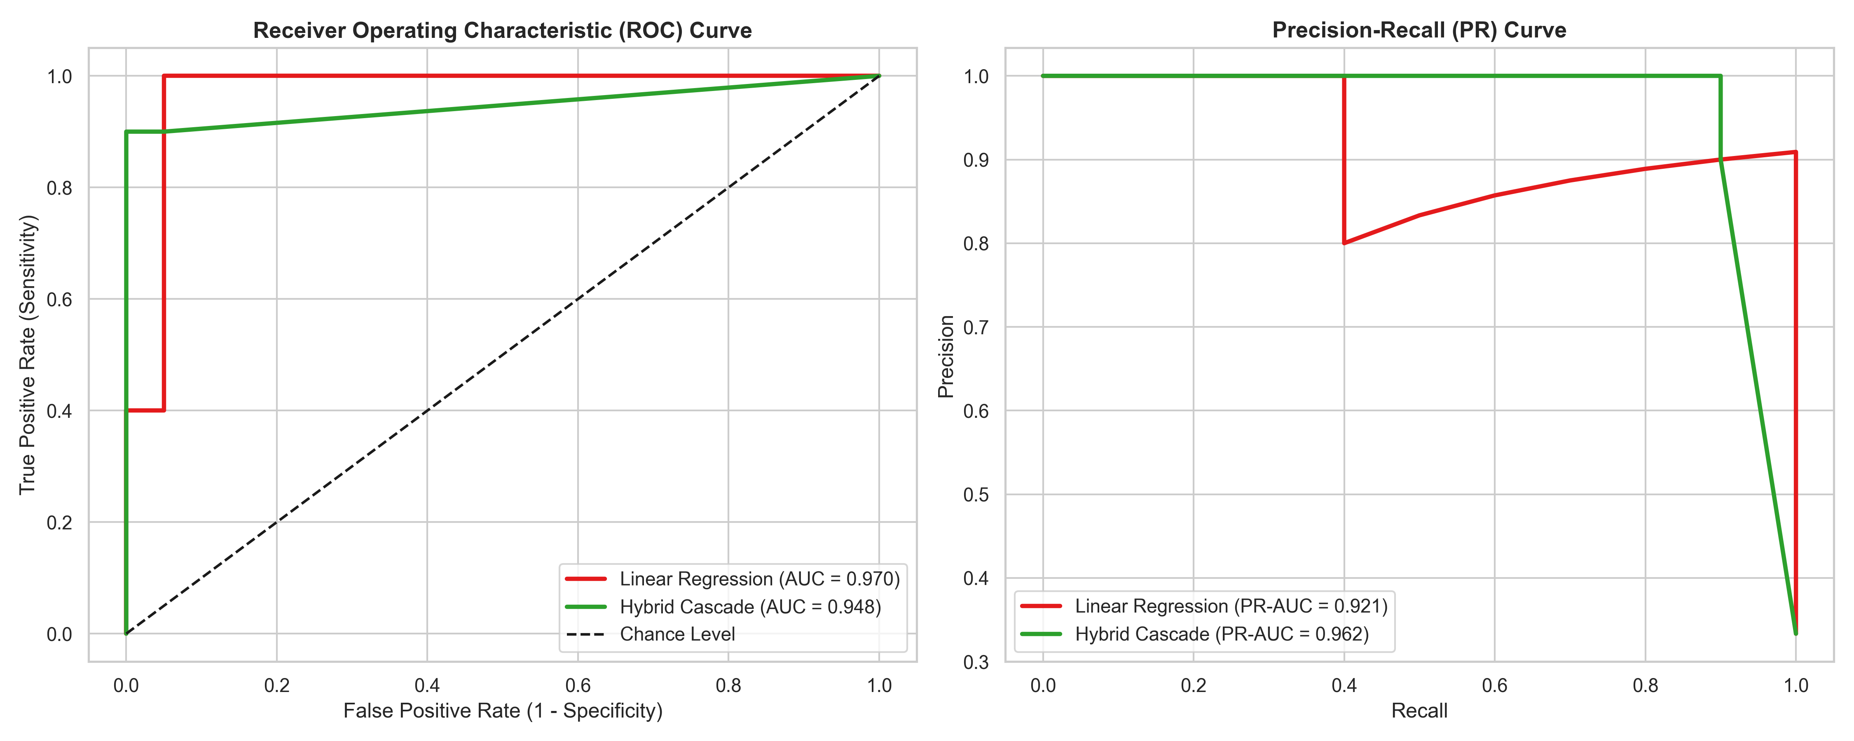
06 - DIAGNOSTICS
ROC-AUC & Precision-Recall curves
Discrimination curves for the OLS and cascade classifiers
CASCADE INPUT-DOUBLING PIPELINE | IZONIN ET AL. (2025), COMPUTATION 13(3):80
29
CASCADE INPUT-DOUBLING PIPELINE | IZONIN ET AL. (2025), COMPUTATION 13(3):80
29

Slide 30
07 - PRODUCTIONIZATION
Interactive clinical ML web application
Stack & architecture
— FastAPI backend with REST + auto Swagger/ReDoc docs.
— Singleton model service loading persisted joblib artifacts.
— Responsive dark 7-tab dashboard (vanilla JS + Chart.js).
— 9-case automated unittest suite.
— CSV export center with formula-injection sanitization.
Two models, kept distinct: Ridge for survival_time; cascade for survival_status.
Product surface
Endpoints - POST /predict, /compare, GET /health, /meta
Features - 35 de-leaked baseline attributes
Sections - demographics, disease, HLA, cell dose, serology, regimen
Outputs - class + probability; time + interval
Docs - 127.0.0.1:8000/docs
CASCADE INPUT-DOUBLING PIPELINE | IZONIN ET AL. (2025), COMPUTATION 13(3):80
30
CASCADE INPUT-DOUBLING PIPELINE | IZONIN ET AL. (2025), COMPUTATION 13(3):80
30

Slide 31
08 - CONCLUSIONS
Key findings
01
Prediction error slashed
Cascade cut MAE by 75.5% (0.2597 -> 0.0637) and RMSE by 32.1% vs. the OLS baseline.
02
Zero false positives
Specificity and precision both 1.00 - no healthy patient flagged.
03
PNN expansion is the signal
PNN_Euclid ranks #1 at 35.6% importance, validating the paper's thesis.
04
Input doubling beats small N
Pairwise differences turn 157 rows into thousands of grounded comparisons.
05
Reproducible by design
Seeded, modular, leak-free pipeline plus notebook and web app.
CASCADE INPUT-DOUBLING PIPELINE | IZONIN ET AL. (2025), COMPUTATION 13(3):80
31
CASCADE INPUT-DOUBLING PIPELINE | IZONIN ET AL. (2025), COMPUTATION 13(3):80
31

Slide 32
08 - CONCLUSIONS
Limitations & responsible use
Statistical caveats
— Test cohort is tiny (N=30); single-split metrics carry wide uncertainty.
— Reported benchmarks vary across runs/seeds - pipeline export, README and web-app summaries differ.
— Precision-first bias trades recall for specificity - model choice follows the clinical objective.
— survival_time regression is right-censored; R^2 near zero, so day-level prediction is unreliable.
Ethical disclaimer
— Research and educational demonstration ONLY.
— NOT tested in clinical trials, NOT FDA-approved, NOT CE-marked.
— Must NEVER guide diagnosis, prognosis or treatment.
— No PHI: only de-identified public benchmark data.
Bottom line: a rigorous methods showcase - not a medical device.
CASCADE INPUT-DOUBLING PIPELINE | IZONIN ET AL. (2025), COMPUTATION 13(3):80
32
CASCADE INPUT-DOUBLING PIPELINE | IZONIN ET AL. (2025), COMPUTATION 13(3):80
32

Slide 33
Thank you
Questions & discussion
Method: Izonin, I., Tkachenko, R., Hovdysh, N., Berezsky, O., Yemets, K. & Tsmots, I. (2025). Cascade-Based Input-Doubling Classifier for Predicting Survival in Allogeneic Bone Marrow Transplants: Small Data Case. Computation 13(3):80.
Data: Pediatric Bone Marrow Transplantation benchmark dataset (UCI ID 565).
Stack: Python, scikit-learn, SciPy, statsmodels, pandas, matplotlib/seaborn, FastAPI, Chart.js.
License: MIT License.
Repository: bone_marrow_cascade_pipeline - run python pipeline.py to reproduce
CASCADE INPUT-DOUBLING PIPELINE | IZONIN ET AL. (2025), COMPUTATION 13(3):80
33

