Slide 1


DEPARTMENT OF COMPUTER SCIENCE AND ENGINEERING
20CS7503 & DESIGN PROJECT - III
END SEMESTER PRACTICAL EXAMINATION- NOV / DEC 2025
REVIEW PRESENTATION
Batch No.: 6
Date: 29-11-25
Session: FN

Slide 2
NEXT-GEN PATHWAY TO SMART GROWTH LAUNCHPAD
Guide Name:
Ms. S.SHAHINA SHALU,M.E.,
ASSISTANT PROFESSOR
CSE
Team Members:
SERALATHAN S (811722104136)
UMA MAHESWARI M (811722104171)
VASAN S (811722104177)

Slide 3
OBJECTIVE OF THE PROJECT
To develop a web application that provides aptitude and interview preparation in a single platform.
To include categorized aptitude questions and interview repositories for systematic practice.
To implement automated test evaluation with instant feedback for learners.
To provide performance tracking and analytics to monitor user progress.
To ensure a user-friendly interface using HTML, CSS, and JavaScript with Python as backend support.

Slide 4
INTRODUCTION
Aptitude tests and interviews are critical components of the recruitment process, assessing a candidate’s problem-solving ability, logical reasoning, and communication skills.
Many candidates face difficulties due to scattered resources and lack of structured preparation methods.
This project aims to build a unified web application that integrates aptitude practice and interview question preparation.
The system leverages Python for backend processing and HTML, CSS, and JavaScript for frontend development to provide a smooth and interactive experience.
The application offers categorized practice, interview guidance, and performance tracking, helping users prepare efficiently for competitive exams and job interviews.

Slide 5
LITERATURE SURVEY
TITLE | AUTHORS | PUBLISHER | TECHNOLOGY USED
Oscar: The Generative AI student assistant, | Mansur Ali Khan, Abdullah Khan | openreview.net | ChatGPT-3.5 (OpenAI), Gemini 1.0 Pro (Alphabet Inc.)
Evaluation of Task Specific Productivity Improvements Using a Generative AI Personal Assistant Tool | Brian S. Freeman, Kendall Arriola, Dan Cottell, Emmett Lawlor, Matt Erdman, Trevor Sutherland, Brian Wells | rane Technologies | OpenAI GPT-3.5-Turbo-16k (via Microsoft Azure), GPT-4 (for LLM-as-a-judge evaluation)
Data Augmentation for Sparse Multidimensional Learning Performance Data Using Gen AI | Liang Zhang, Jionghao Lin, John Sabatini, Conrad Borchers, Daniel Weitekamp, Meng Cao | IEEE (Journal of IEEE Transactions on Learning Technologies) | Tensor Factorization, Vanilla Generative Adversarial Networks (GAN)
Using GAIM as digital assistants for enhancing motivation and retention proficiency of mathematics undergraduates | Yousef Metbkal Abd Algami, Mohanad Ahmad Shini | Research Journal in Translation, Literature, Linguistics, and Education (RJTLLE) | Generative AI Chatbots (e.g., ChatGPT, Google Bard, Microsoft Copilot)
Gen-AI, a Learning Assistant? Factors Influencing Higher-Ed Students' Technology Acceptance | Kraisila Kanont, Pawarit Pingmuang, Thewawuth Simasathien | The Electronic Journal of e-Learning (EJEL) | Generative AI (e.g., ChatGPT, DALL-E, Midjourney, Claude, etc.)

Slide 6
EXISTING SYSTEM ARCHITECTURE
Assistant Paltform
Pre-Defined Questions
Pre-Defined Answers
Evaluation matric

Slide 7
PROBLEM IDENTIFICAITON
Lack of unified platforms combining AI interviewing, aptitude training, and speech recognition for holistic job preparation.
Traditional aptitude and interview tools are static, offering no adaptive learning or personalized feedback.
Students and candidates struggle with real-time practice and voice-based interaction, limiting realism in preparation.

Slide 8
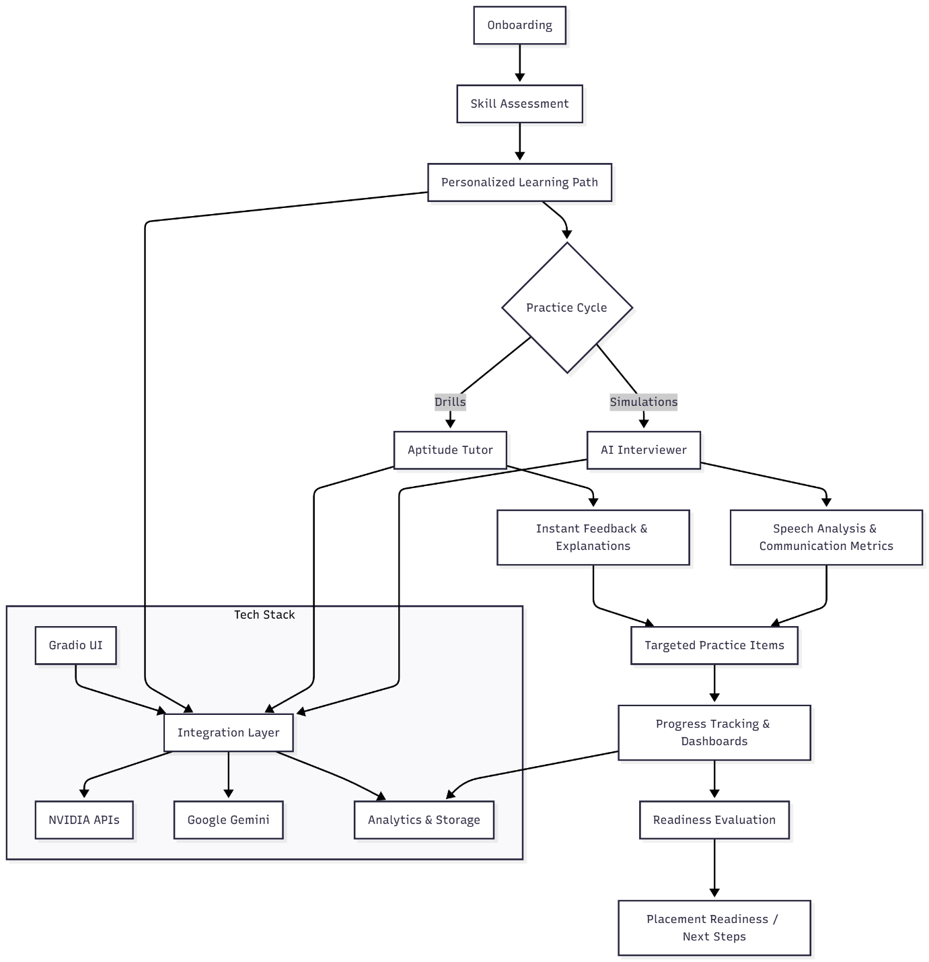
PROPOSED SYSTEM ARCHITECTURE

Slide 9
SOFTWARE AND HARDWARE REQUIREMENTS
HARDWARE
Processor: Intel Core i3/i5 or equivalent
RAM: Minimum 4 GB (8 GB recommended)
Storage: 256 GB SSD or 512 GB HDD
SOFTWARE
Frontend: HTML, CSS, JavaScript, Tailwind CSS framework.
Backend: Python (Flask/Django/FastAPI/Gardio
/StreamLit)
Database: MySQL / SQLite,Vector DB
Tools: VS Code / PyCharm, GitHub for version control, Browser for testing

Slide 10
MODULES
1. Aptitude Practice Module
2. Interview Preparation Module
3. Performance Tracking Module
4. Speech to Text Module

Slide 11
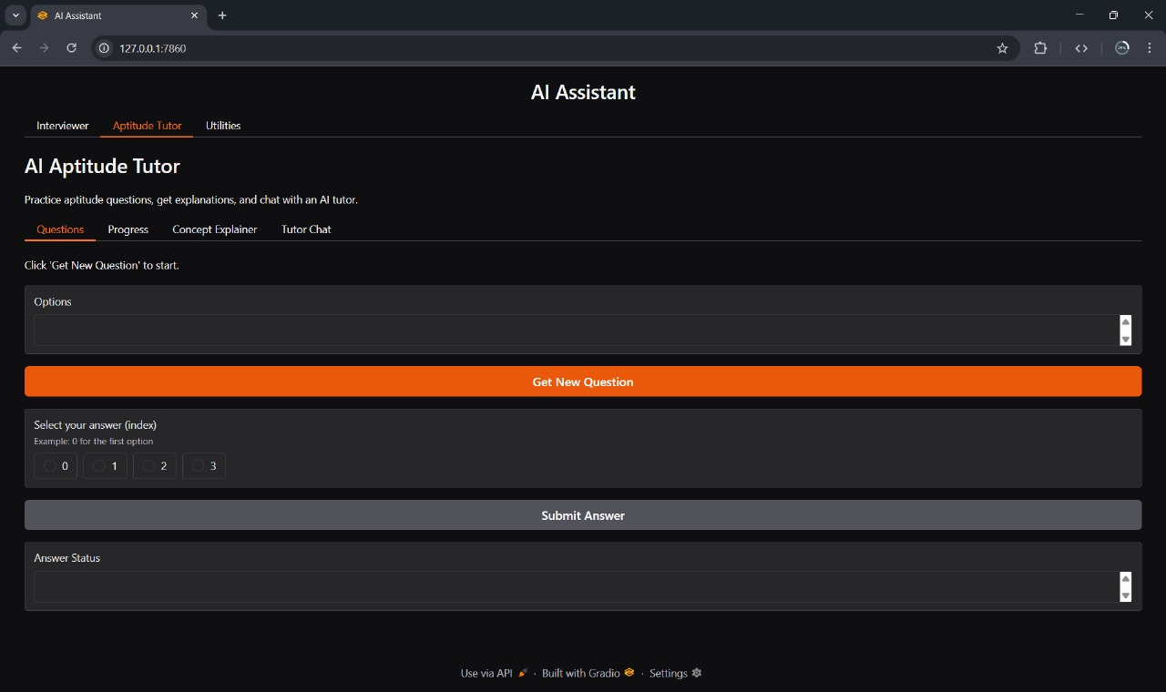
IMPLEMENTATION OF MODULE-1

Slide 12
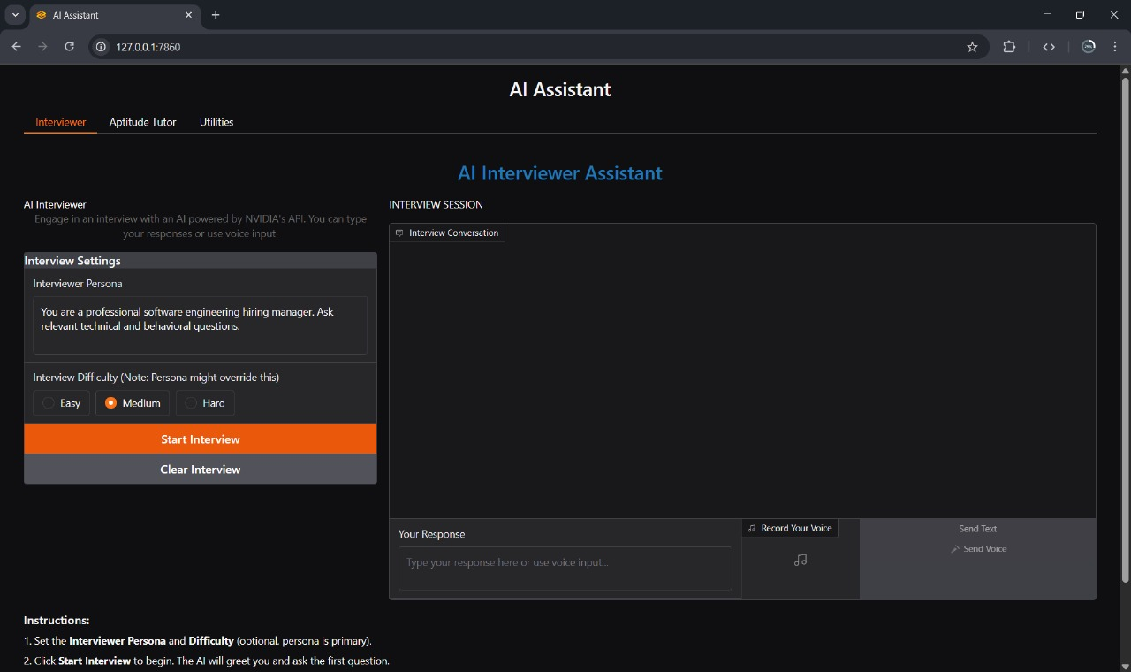
IMPLEMENTATION OF MODULE-2

Slide 13
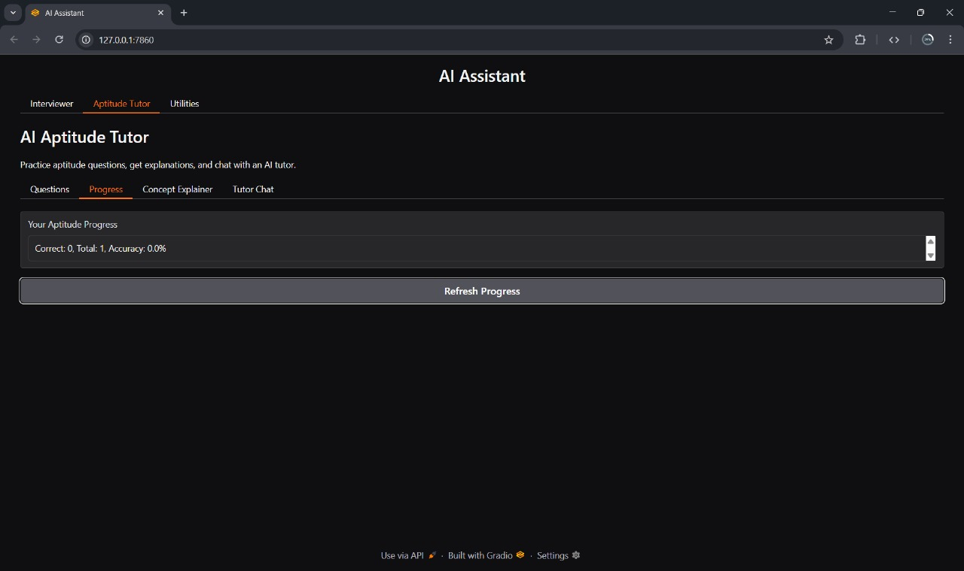
IMPLEMENTATION OF MODULE-3

Slide 14
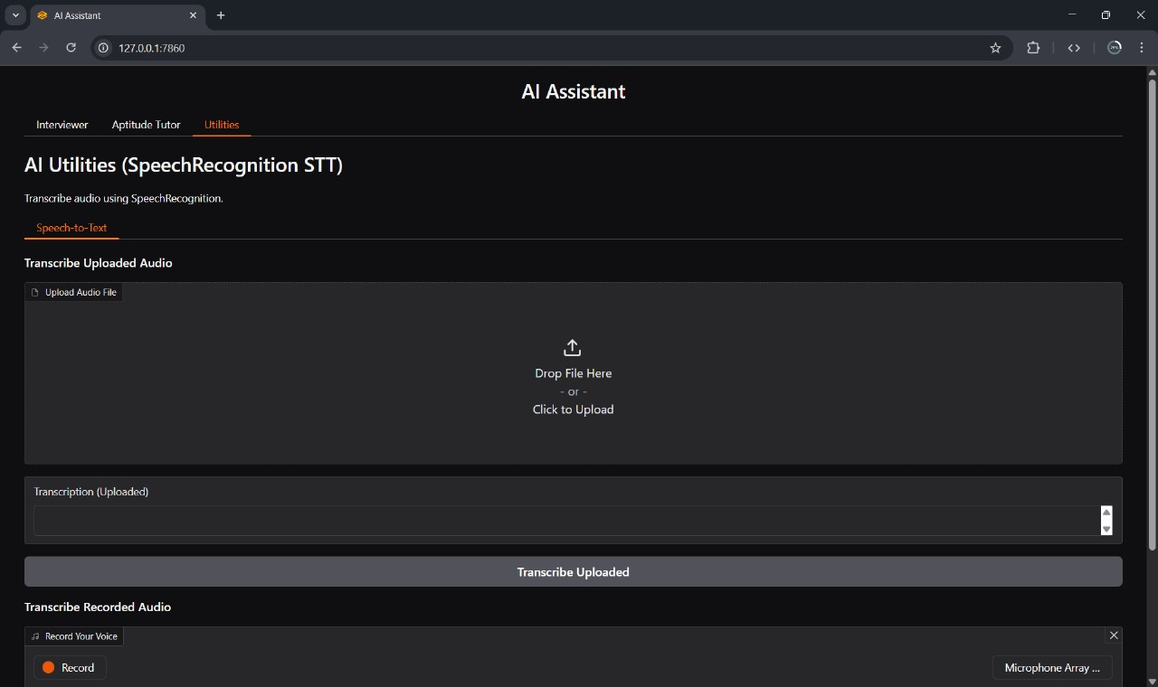
IMPLEMENTATION OF MODULE-4

Slide 15
CONCLUSION
The project successfully delivers a unified and systematic web platform for aptitude and interview preparation by integrating categorized question banks and company-specific repositories into a single application.
It effectively enhances the learning experience by providing instant, automated evaluation of tests and detailed performance analytics, enabling users to track their progress and identify areas for improvement efficiently.
The development goal is achieved through a robust and user-friendly interface built with HTML, CSS, and JavaScript for the frontend, supported by a reliable Python backend, ensuring a seamless and interactive user experience.

Slide 16
FUTURE ENHANCEMENTS
Integrate AI-driven evaluation metrics to score user confidence, fluency, and technical accuracy during interviews.
Add user authentication and progress persistence* with dashboards for analytics and long-term tracking.
Enable custom question uploads and multilingual support* to expand accessibility and content diversity.

