Slide 1

GEOINFORMATICS
By : 1) Vasant Dave – C10
2) Dhyanesh Patel – A46
3) Kirat Pathak – C08
4)Smit Hala – C16
5)Smit Kanabar – B28

Slide 2
Defination and Meaning of Geoinformatics
Geoinformatics is the science and the technology which develops and uses information science infrastructure to address the problems of geography, cartography, geosciences and related branches of science and engineering
Geomatics is a similarly used term which encompasses geoinformatics, but geomatics focuses more so on surveying. Geoinformatics has at its core the technologies supporting the processes of acquiring, analyzing and visualizing spatial data. Both geomatics and geoinformatics include and rely heavily upon the theory and practical implications of geodesy

Slide 3
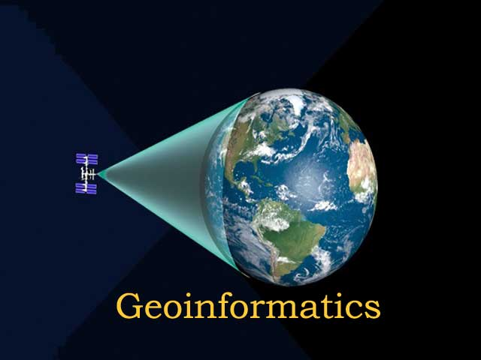

Slide 4
Uses Of Geoinformatics
Cartography
Geodesy
Global Navigation Satellite Systems
Photogrammetry
Remote Sensing
Spatial Analysis
Web mapping
Navigation.

Slide 5
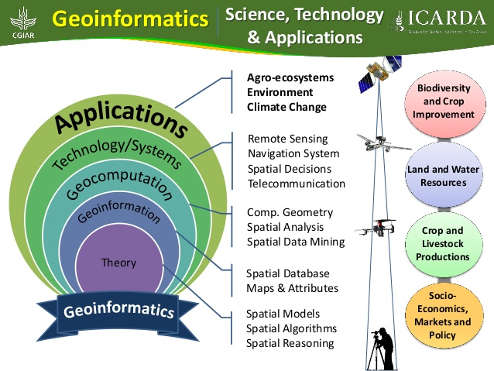

Slide 6
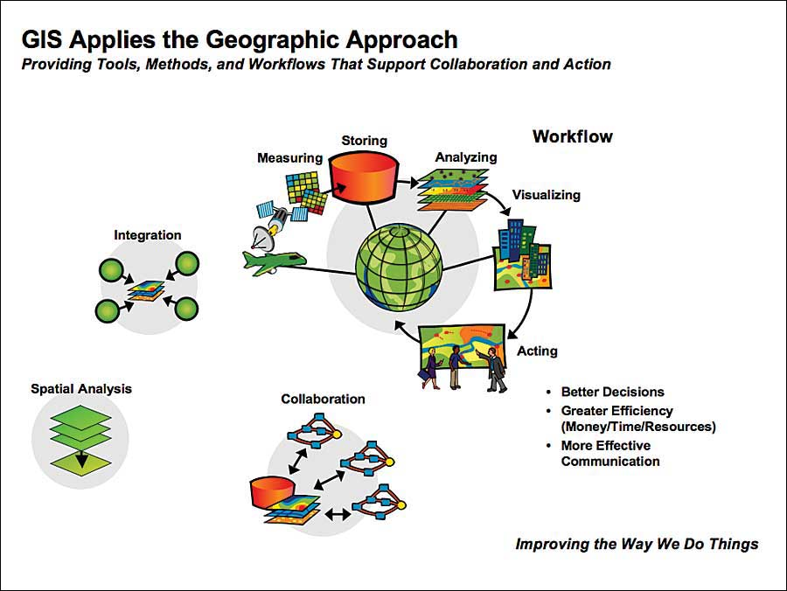
Modern Usage of Geoinformatics
Geospatial technology involves GPS (global positioning systems)
GIS (geographical information systems)
RS (remote sensing)
3D displays of geographic features
Analyze rock characteristics
Fields as industry,government,emergency

Slide 7
Geoinformatics Career prospects
The demand for GIS is growing. The U.S. government predicts Geographic Information System will be in high demand over the next decade, with annual salaries of $70,000.
GIS is an exciting and professional choice for people
In order to pursue a career in Geoinformatics, one must have a degree in science. Geography, agriculture, geology, engineering, IT or computer science students can also get admission to M.Sc., M.Tech. courses in Geoinformatics and Remote Sensing. People can also follow up with Ph.D programmes or diploma courses, certificate courses
Major users of geoinformatics applications and therefore employers are the Central and State governments. Central government agencies are under the Department of Space - National Remote Sensing Agency (NRSA Hyderabad), North East Space Application Centre, (NESAC Shillong), Regional Remote Sensing Application Centre (RRSAC Kharagpur, Dehradun, Jodhpur, Nagpur and Bangalore), Indian Space Research Organisation, (ISRO Bangalore).

Slide 8
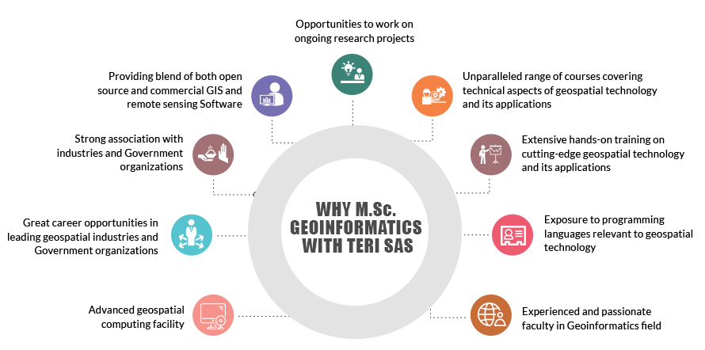

Slide 9
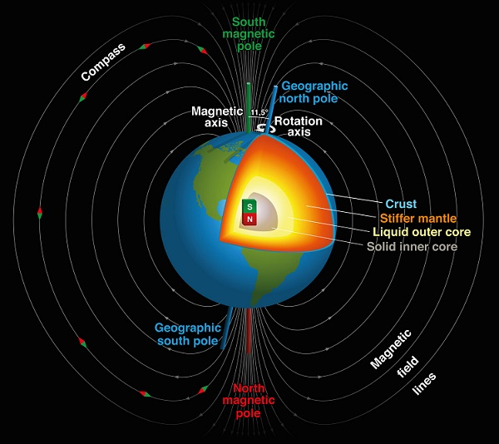
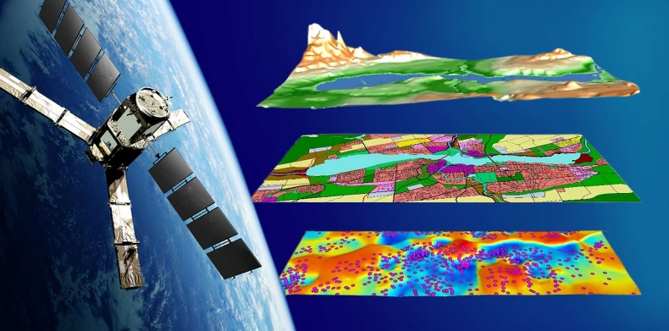
Geoinformatics vs Geophysics
Geophysics is a branch of science which uses quantitative physical methods to investigate aspects of the Earth’s physical structure. Most Geophysicists work in areas such as seismology (earthquakes)
Geoinformatics on the other hand is another branch of science that deals with gathering, analysing, interpreting, distributing and using geographic information. The focus of Geoinformatics is mainly on surveying, mapping and remote sensing. The areas where this is typically used are in in-car navigation systems (GPS), automatic vehicle location systems, transportation planning and engineering, environmental modeling and analysis

Slide 10
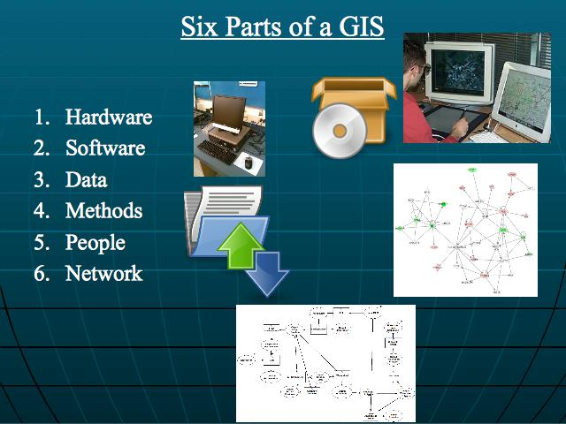
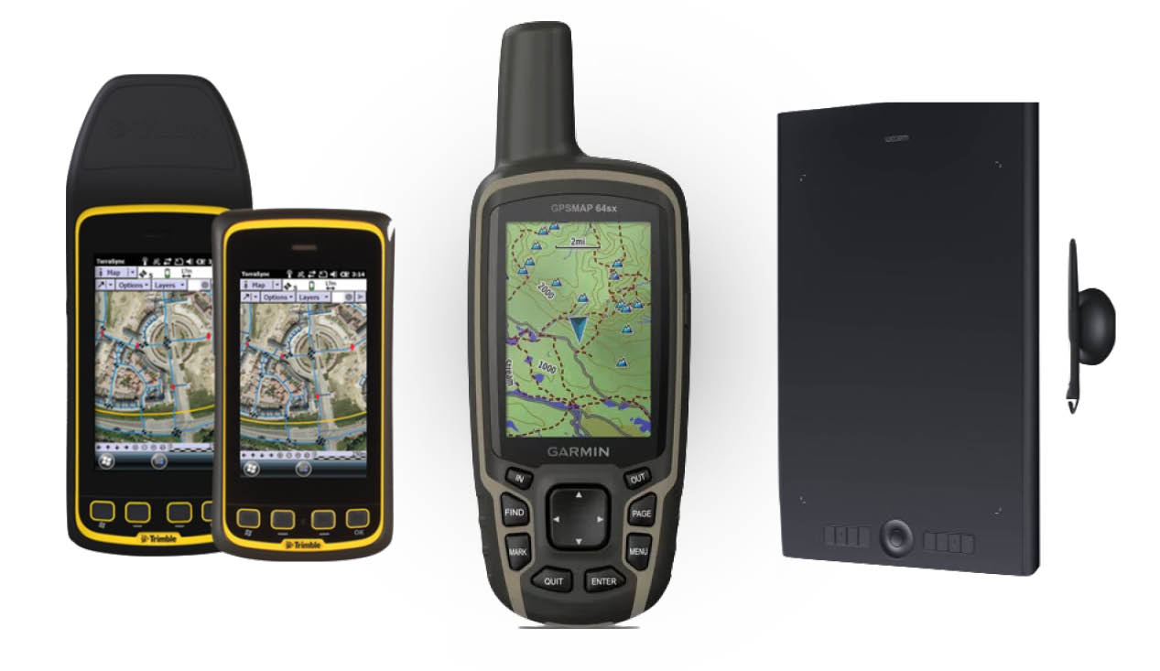
Geoinformatics Devices

Slide 11
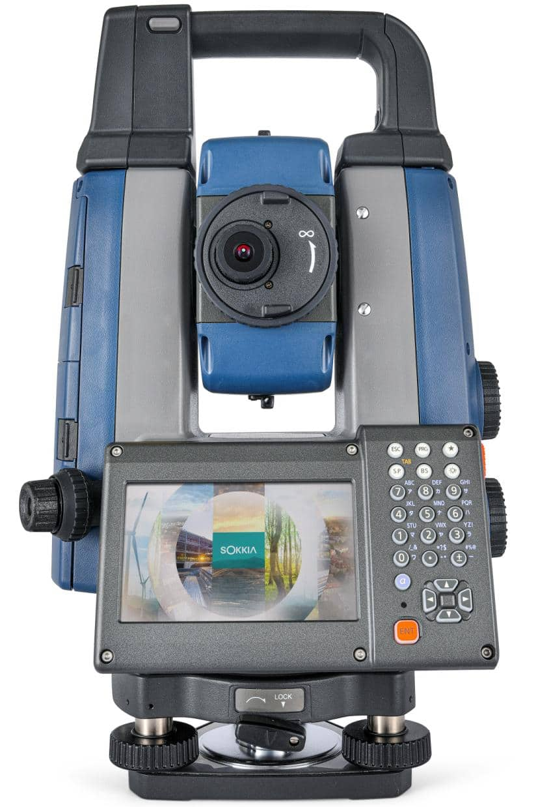
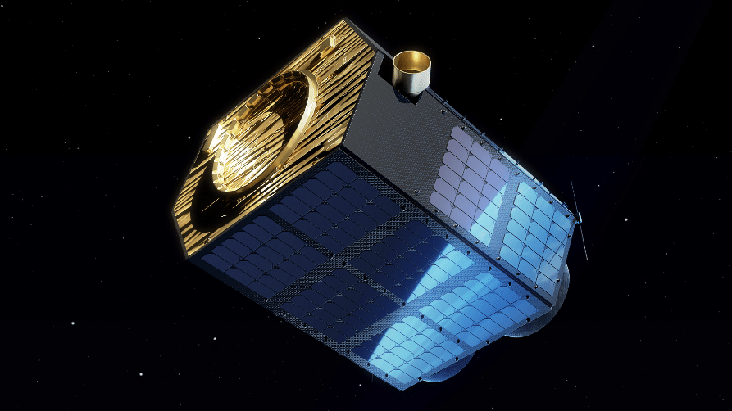
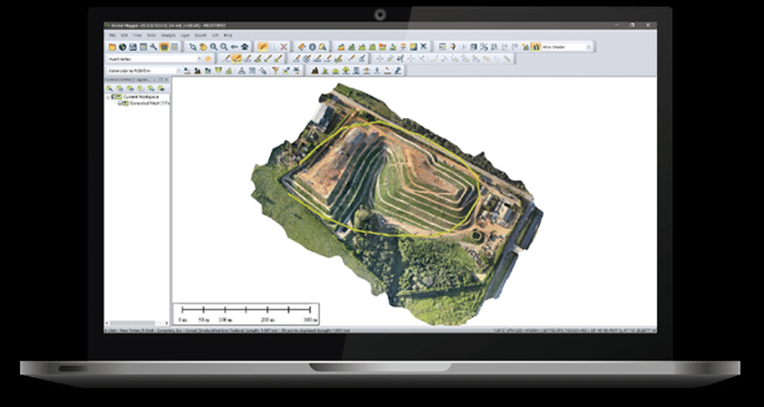
GI Devices
The iX-1200 and iX-600 total stations are professional-level positioning tools for survey and layout in the building construction and infrastructure trades.
EOS Data Analytics, a satellite imagery analytics provider, announced plans to launch seven optical EOS SAT satellites into a LEO (Low Earth orbit) by the year 2024.
Global Mapper is a cutting-edge GIS application that provides both novice and experienced geospatial professionals with a comprehensive array of spatial data processing tools. It provides access to an unparalleled variety of data formats and includes numerous spatial analysis tools at a genuinely affordable price

Slide 12
Conclusion
Geoinformatics is an important aspect of our everybody life
Results and conclusions: Analyses in geoinformatics predominantly focus on three types of large datasets available in molecular geology: macromolecular structures, genome sequences, and the results of functional genomics experiments (e.g. expression data)
We have to look ahead as how Geoinformation will shape the future

