Slide 1

Beneath the Surface
Mid-Term Presentation
(22nd Mar 2025)
Team 10
Indian Institute of Technology Tirupati

Slide 2
Contents
Introduction
Project Objective
Methodology
Survey
Tests
Prototype Description & Functionality
Future Steps
References

Slide 3
Introduction
Water is essential for all aspects of life, from drinking and agriculture to industrial processes and energy production.
Despite abundant water sources, water quality varies due to dissolved minerals, leading to the classification of water as hard or soft.
Hard water, rich in calcium and magnesium, is widely used in homes, industries, and agriculture, despite challenges like scaling and reduced efficiency in appliances.
How Hard Water affects us?
Home & Appliances: Limescale buildup in pipes, heaters, and washing machines reduces efficiency.
Health: Can cause dry skin, brittle hair, and increase the risk of kidney stones.
Industry & Agriculture: Reduces crop yield, clogs irrigation systems, and increases maintenance

Slide 4
Project Objective
Water quality has been a growing concern, significantly affecting the daily lives of students and faculty at IIT Tirupati, particularly regarding health issues such as skin irritation and hair damage.
This project's primary objective is to comprehensively analyze the water-related challenges on the IIT Tirupati campus and explore feasible, sustainable, and cost-effective solutions.
Aim
Water Quality Assessment
Analyze chemical composition and contaminants in campus water sources and nearby groundwater (Yerpedu)
Purification System Design
Develop a cost-effective water purification system to improve water quality for general use.
Sustainability & Impact Analysis
Evaluate environmental, industrial, and policy factors affecting groundwater availability and usage.

Slide 5
Methodology
Survey
Identify Water Sources
Sample Collection
Collect from Campus Sources Collect from Yerpedu Pond Label & Store Properly
Testing of Samples
Physical Properties (Turbidity, Odor)
Gather Usage Data
Take Students’ Feedback
Chemical Analysis (pH, Hardness, Acidity, Alkalinity)
Prototype Development
Design a Purification System
Cost Analysis & Feasibility
Pilot Testing & Optimization
Final Implementation Plan
Analyze the Results
Compare with Standards Identify Key Contaminants Assess Suitability for Different Uses
Steps

Slide 6
Methodology - Survey
Questionnaire Distribution:
Surveys were conducted across various campus locations to ensure diverse participation from students, faculty, and staff.
Response Count:
A total of 400 responses were collected, but only 269 were valid, as some entries were incomplete or inconsistent.
Survey Focus Areas:
Participants provided feedback on water quality, taste, hardness, and clarity, helping assess overall perception.
Rating System:
Water quality was rated on a scale of 1 to 5, providing quantifiable insights into user satisfaction.
Data Analysis:
Graphs and visual representations were created based on ratings to highlight trends and variations.

Slide 7
Methodology – Survey Results
Water Quality Concerns:
- Many residents reported hair fall, skin-irritation, and water hardness.
- Some mentioned the presence of impurities such as dust particles, mud, and worms.
- Unusual taste in water, sometimes resembling bleach.
- Water-discoloration, with reports of water appearing dark or murky.
Water Availability Issues:
- Frequent shortages of drinking and bathing water.
- Water dispensers in some hostels provide slow or inconsistent flow.
- Hot water availability is inconsistent, especially in winter.
Plumbing & Maintenance Problems:
- Leakage in pipes and bathrooms.
- Water coolers and taps are rusted and malfunctioning.
- Frequent motor issues leading to supply disruption.

Slide 8
Methodology - Sample Collection and Testing
Sample Collection:
Collected Water Samples from 12 different locations on campus and Yerpedu
Carefully stored them in lab under required pressure and temperature
Testing:
The collected samples were then tested for their physical and chemical properties.
The tests include :
Turbidity – Nephelometer
pH – Laboratory pH meter
Hardness – EDTA Titration
Acidity – Titration with a strong base
Alkalinity – Titration with a strong acid

Slide 9
Methodology – Test Results
Water Quality Parameters | Acceptable Limit | Permissible Limit in the absence of alternate source | Abheri | Malhar | AB-1 | Yerpedu | Pond 1 | Bhairav | LHC | Pond 2 | Des | Groundwater
Turbidity (NTU) | 1 | 5 | 0.22 | 0.81 | 1.05 | 0.91 | 16.2 | 0.24 | 0.53 | 6.35 | 0.8 | 2.82
Total Hardness as CaCO3 | 200 | 600 | 65 | 150 | 150 | 400 | 152.5 | 65 | 150 | 102.5 | 147.5 | 160
Alkalinity as CaCO3 | 200 | 600 | 100 | 125 | 150 | 350 | 180 | 100 | 175 | 160 | 150 | 200
Acidity as CaCO3 | - | - | 20 | 15 | 15 | 40 | 15 | 15 | 20 | 15 | 15 | 15
pH | - | - | 7.27 | 7.15 | 7.18 | 6.68 | 7.31 | 7.23 | 7.14 | 7.27 | 7.08 | 7.05
- Close to acceptable limit - Over the acceptable limit

Slide 10
Methodology – Result Analysis
After analyzing the results of the mentioned tests on the collected samples, we found the Key Contaminants to be:
Turbidity
Odor
Hardness
pH Imbalance
Sources of the Contaminants (On Campus) :
Hostel & Mess Wastewater – Soap, detergents, food particles, and organic waste increasing turbidity.
Laboratory & Industrial Waste – Chemical discharges from science labs affecting water quality.
Pipe Corrosion & Tank Scaling – Mineral deposits from old plumbing and storage tanks increasing hardness.
Construction Activities – Ongoing building projects can cause soil erosion, increasing sediment in water.

Slide 11
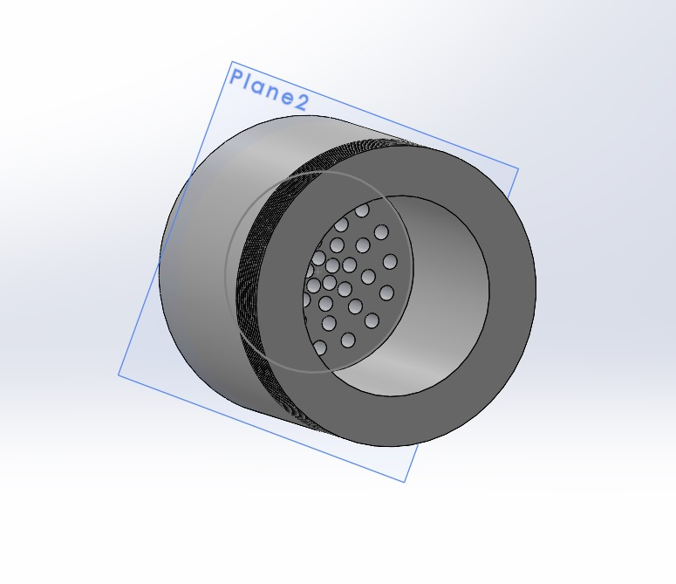
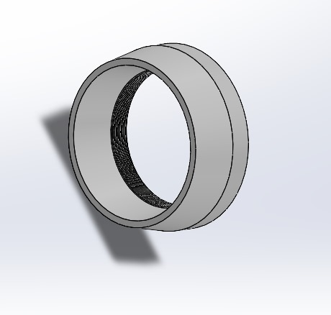
Solution - Prototype
To solve the problem of hardness of water, we have come up with a 5-layered filter prototype which softens the water.
Points of Use : Shower Heads and Taps
Portability: Compact, lightweight, and easily attachable to showerheads and taps without plumbing modifications.
Recyclability: Features replaceable filter cartridges and a durable, eco-friendly housing made from recyclable materials.
Materials: Soft Plastic, TPU, Citric Acid, Activated Carbon,

Slide 12
Prototype - Features
Compact & Portable
The device features a small, lightweight, and attachable design, making it easy to install on showerheads and taps without requiring plumbing modifications.
Multi-Layer Filtration
The system incorporates citric acid-based filtration to effectively reduce water hardness by dissolving calcium and magnesium deposits. Additionally, an activated carbon layer removes chlorine, odors, and other impurities, ensuring cleaner and better-tasting water.
Cost-Effective
Designed using affordable and easily available materials, the prototype provides an efficient solution for water softening without the high costs associated with traditional RO or ion-exchange systems.
Eco-Friendly
Unlike conventional water softening methods that result in significant water wastage, this device operates with minimal water loss. The replaceable filter components and recyclable materials used in its construction contribute to environmental sustainability.

Slide 13
Prototype - Functionality
Water Flow & Initial Filtration
Hardness Reduction Using Citric Acid
Chlorine & Impurity Removal
Final Water Output
Hard water enters the device and passes through a large filter cartridge, which removes large particles like dust, rust, and sediments.
The water moves through a citric acid-based filtration layer, which binds to calcium and magnesium ions, preventing scale formation and effectively softening the water.
An activated carbon filter absorbs chlorine, organic impurities, and odors, improving water quality, taste, and safety.
The softened and filtered water exits through the showerhead or tap, reducing scaling, enhancing soap lathering, and preventing skin and hair dryness caused by hard water.

Slide 14
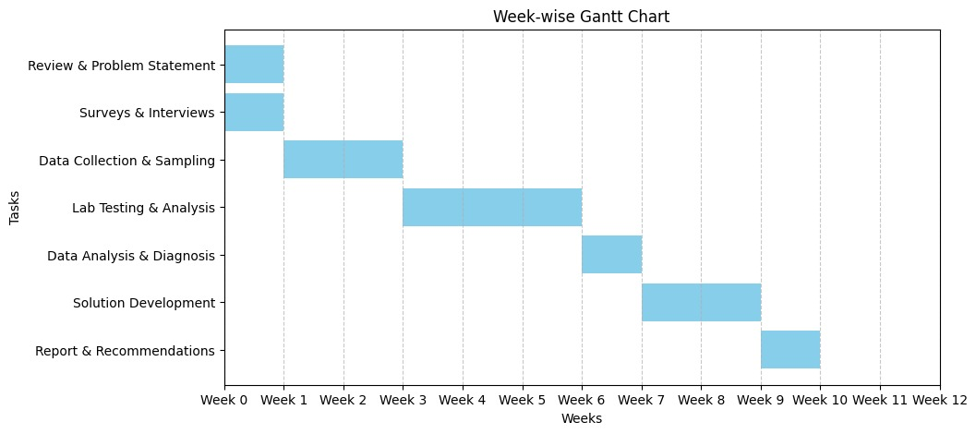









Future Steps
Completed
Pending

Slide 15
References
Subbaiah, P. V., Naidu, M. V. S., Krishna, Y. R., & Kaledhonkar, M. J. (2020). Assessment of Groundwater Quality for Irrigation in Chittoor District of Andhra Pradesh. The Andhra Agricultural Journal, 67(2), 46-55.
Swathi, K., Nikitha, B., Malleswari, M., Munisankar, M., Meena, S. D., & Roja, A. (2023). Water Quality Analysis Using Physicochemical Parameters and Estimation of Pesticides in Water from Various Sources of Tirupati, Andhra Pradesh, India.
Veeraswamy, G., Balaji, E., & Subba Rao, M. (2019). Ground water quality assessment for Central Ground Water Board. (2016). Ground water year book 2014-15: Andhra Pradesh. Ministry of Water Resources, River Development and Ganga Rejuvenation, Government of India.
Yang, Y., Zhang, S., Yang, G., Li, H., Wang, J., & Li, W. (2023). Biological Activated Carbon Filtration Controls Membrane Fouling and Reduces By-Products from Chemically Enhanced Backwashing during Ultrafiltration Treatment. Water, 15(21), 3803.
Li, C., Yang, J., Zhang, L., Li, S., Yuan, Y., Xiao, X., Fan, X., & Song, C. (2021). Carbon- based membrane materials and applications in water and wastewater treatment: a review. Environmental Chemistry Letters, 19, 1457-1475.

Slide 16
Thank you

