Slide 1

by
Michael Prince & Jessica Austin
Legal Aid of NorthWest Texas

Slide 2
What is SharePoint?
Formal Answer
  SharePoint is a general purpose platform used for connecting people with information.
  Street Answer
  Beast
  Monster
  Off the hook (exceptionally good)
  Off the chain (fun or exciting. See "off the hook.”)
  Off the heezy (or "off the heezy for sheezy" meaning very cool. See "off the hook." )
  Off the hizzle (see "off the hook" )

Slide 3

With or Without
With me or without me

Slide 4

With SharePoint

Slide 5

Without SharePoint

Slide 6

SharePoint is
Anybody can learn to use SharePoint!
SharePoint is as easy if not easier than using Word or Excel

Slide 7




SharePoint is a server based product to which users connect to.
Most common ways to connect to SharePoint:

Slide 8
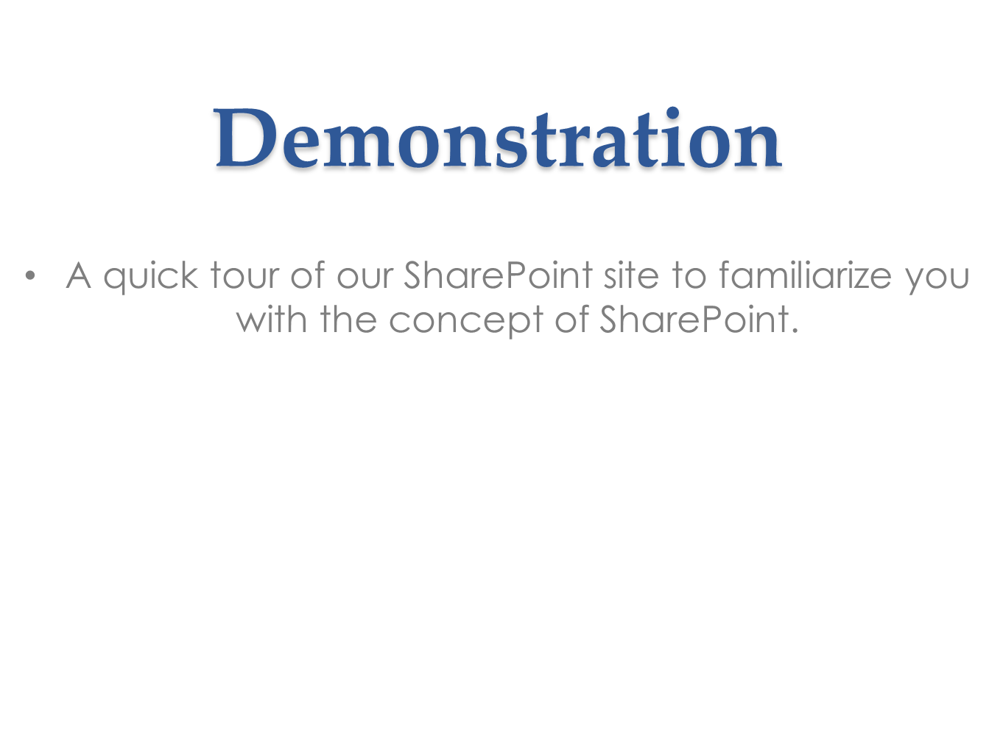

Slide 9











SharePoint Core Features

Slide 10









Core Feature - Sites

Slide 11
Sites
SharePoint makes easy to use collaborative websites.
Ask and you shall receive
  Individual Websites
  Team Websites
  Company Websites
Practice Groups Websites
    Housing
    Consumer
    Public Benefits
    Family
    Employment
    Economic

Slide 12
Sites Pt. 2
With SharePoint, you are meant to be a website
contributor not just a reader.
What can you do?
    Edit
    Collaborate

Slide 13


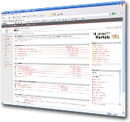



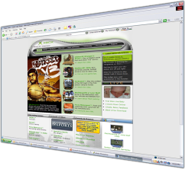






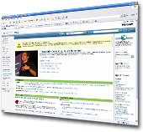





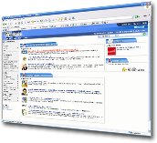


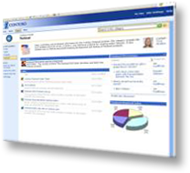

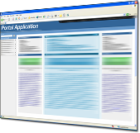

A Single Platform

Slide 14

Demonstration
Creating sites is easy!

Slide 15
SharePoint is a BEAST!

Slide 16








Core Feature - Communities

Slide 17

Communities
SharePoint provides the ability to easily access expertise and interact with other people in new and creative ways across the enterprise through both formal and informal networks.
SharePoint helps you work in Communities in several ways:
      Calendars
      Discussion Boards
      Task Lists
      Reminders
      Work Flows
      Blogs
      Document Libraries
      Tagging, Tag Cloud, Ratings
      Social Bookmarking
      Blogs and Wikis
      My Sites
      Activity Feeds
      Profiles and Expertise

Slide 18
Demonstration
My Site

Slide 19




Core Feature - Content

Slide 20
Core Feature - Content
Libraries
Enterprise Metadata
Document Sets
Web Publishing including Digital Asset Management
Governance and Records Management
Audio and Video Content Types

Slide 21
How We Use The Content Feature
At LANWT we developed a support ticket system in SharePoint so that IT could better track issues. This is currently our most complex piece in SharePoint; we are going to demonstrate this for you to give you some ideas for your own organization whether it is for legal staff, accounting or the IT department.
Support Tickets Features:
  5 custom workflows that e-mail specific people when certain events are triggered
  A large custom list with custom columns
  Custom forms created in Microsoft InfoPath
  A knowledgebase for the IT department
  Links to vendor knowledgebase websites

Slide 22

Demonstration
Support Tickets

Slide 23
SharePoint is a BEAST!

Slide 24


Core Feature - Search

Slide 25
Search Feature
With more content existing online and multiple people collaborating on such content, it is critical that people can quickly and easily locate relevant content across SharePoint lists, sites and external systems and data sources, such as:
File shares
Websites
Business applications

Slide 26
Demonstration
Search

Slide 27
SharePoint is a BEAST!

Slide 28


Core Feature - Insights

Slide 29

Insights Feature
  PerformancePoint Services
  Excel Services
  Chart Web Part
  Visio Services
  Web Analytics
  SQL Server Integration
  Power Pivot
Importing and Exporting

Slide 30








Core Feature - Composites

Slide 31

Composites Features
Business users of all roles need the ability to quickly create customized solutions without involving corporate IT in each request. At the same time, the IT staff needs the capability to empower business users to create these applications while ensuring the environment’s stability and availability.
  Business Connectivity Services
  InfoPath Form Services
  External Lists
  Workflow
  SharePoint Designer
  Visual Studio
  API Enhancements
  REST/ATOM/RSS
Web developer required!
Nerd Stuff!

Slide 32

SharePoint 2010 Implementation
SharePoint is a BEAST as far as what it can do, but implementing
SharePoint is as easy as this puppy is cute!

Slide 33
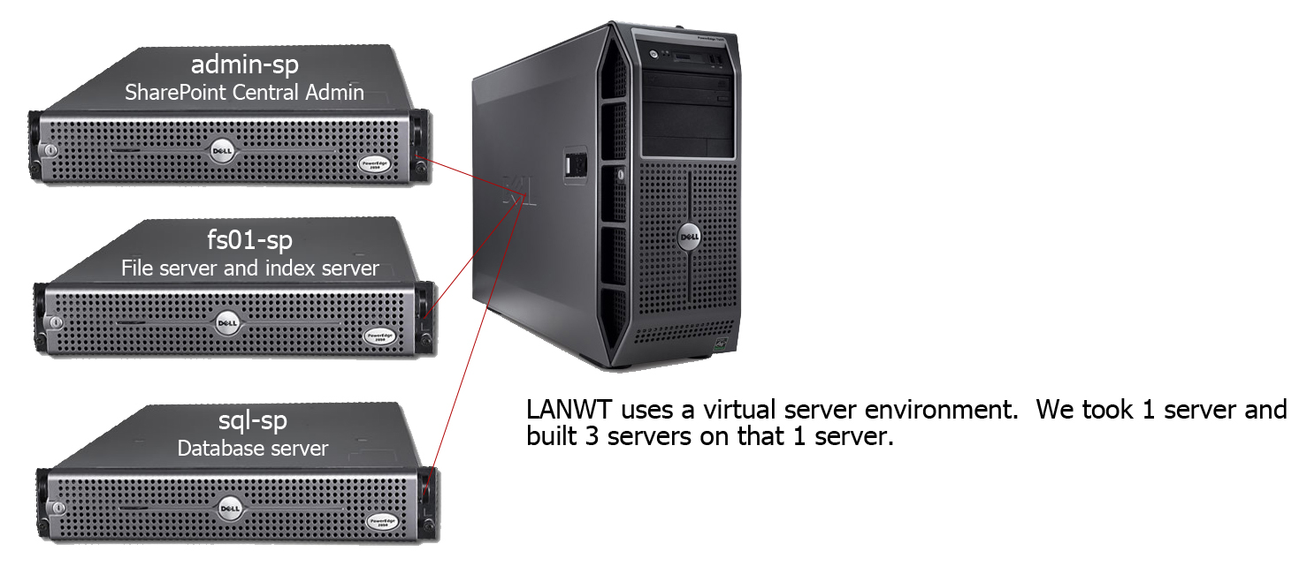
SharePoint 2010 Implementation
SharePoint is relatively easy to install and administer. First you need to have your SharePoint server(s) in place. SharePoint 2010 can be installed on a single server, this setup is only advisable for small deployments, and if your legal aid organization is small, say less than 300 users you can consider this an option.
At LANWT we have around 255 users in 14 offices across the state of Texas. We have a virtual server farm with 3 servers in our setup.

Slide 34
System Requirements
Central Administration & File Servers
SQL Server
Processor | 64 Bit
RAM | 4 GB for Development
RAM | 8 GB for Production
Hard Disk | 80 GB
Windows | The 64-bit edition of Windows Server 2008 Standard, Enterprise, Data Center, or Web Server with SP2
Processor | 64 Bit
RAM | 4 GB for Development
RAM | 8 GB for Production
Hard Disk | 80 GB
Windows | The 64-bit edition of Windows Server 2008 Standard, Enterprise, Data Center, or Web Server with SP2
SQL | The 64-bit edition of Microsoft SQL Server 2008 R2
Client PC
Browser | Internet Explorer 8 (32 Bit)
Browser | Internet Explorer 7 (32 Bit) | Seems to be less problems with IE 7
Browser | Mozilla Firefox 3.6 on Windows | Supported with limitations
Browser | Mozilla Firefox 3.6 (on non-Windows operating systems) | Supported with limitations
Browser | Safari 4.04 (on non-Windows operating systems) | Supported with limitations
Plugins | Microsoft Silverlight 3

Slide 35
Pricing
CDW
Price | Product
$1179.00 | SharePoint Server 2010 Enterprise
$22.00 | SharePoint User CAL
$2059.00 | SQL Server Enterprise 2008
$38.00 | SQL Server User CAL
$319.00 | Windows Server 2008
$6.70 | Windows Server 2008 User CAL
$20.83 | Terminal Server CAL
Tech Soup
Price | Product
$296.00 | SharePoint Server 2010 Enterprise
$4.00 | SharePoint User CAL

Slide 36
5 Main Reasons to Implement
SharePoint 2010
Empower Users
Delivers Relevant Information
Supports Compliance and Requirements
All Mighty $$$$$

Slide 37
What SharePoint Can’t Do
It won’t make you look younger
It will not tell you the jeans don’t make your butt look big.
Does not pay bills.
Will not lower taxes.

Slide 38
Questions?
Michael Prince
IT Manager
Legal Aid of NorthWest Texas
214-748-1234 ext. 2252
princem@lanwt.org
Jessica Austin
Webmaster
Legal Aid of NorthWest Texas
214-748-1234 ext. 2257
austinj@lanwt.org

