Slide 1
ARITIFICAL INTELLIGENCE –TUTORIAL 2
VASANTH 20MCR079

Slide 2
Problem Solving in Artificial Intelligence
The reflex agent of AI directly maps states into action. Whenever these agents fail to operate in an environment where the state of mapping is too large and not easily performed by the agent, then the stated problem dissolves and sent to a problem-solving domain which breaks the large stored problem into the smaller storage area and resolves one by one. The final integrated action will be the desired outcomes.
On the basis of the problem and their working domain, different types of problem-solving agent defined and use at an atomic level without any internal state visible with a problem-solving algorithm. The problem-solving agent performs precisely by defining problems and several solutions. So we can say that problem solving is a part of artificial intelligence that encompasses a number of techniques such as a tree, B-tree, heuristic algorithms to solve a problem.
We can also say that a problem-solving agent is a result-driven agent and always focuses on satisfying the goals.
Steps problem-solving in AI: The problem of AI is directly associated with the nature of humans and their activities. So we need a number of finite steps to solve a problem which makes human easy works.

Slide 3
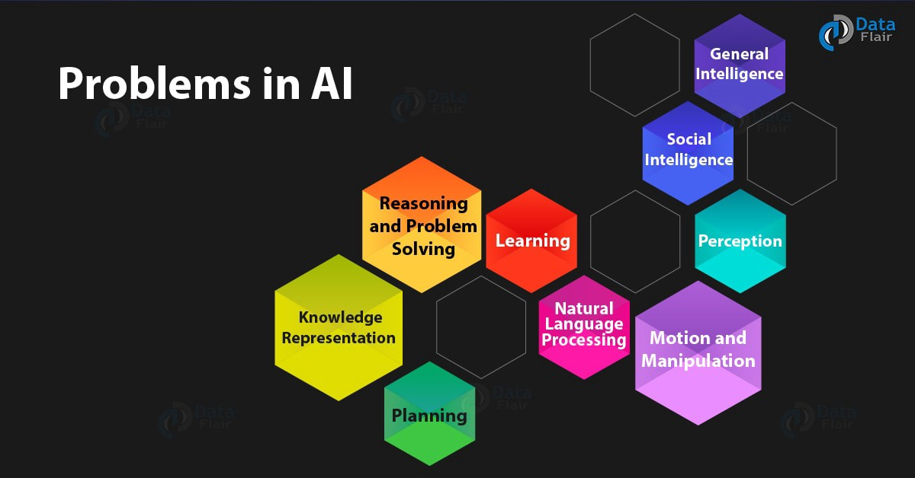
PROBLEMS IN AI

Slide 4
SOLUTION
These are the following steps which require to solve a problem :
Goal Formulation: This one is the first and simple step in problem-solving. It organizes finite steps to formulate a target/goals which require some action to achieve the goal. Today the formulation of the goal is based on AI agents.
Problem formulation: It is one of the core steps of problem-solving which decides what action should be taken to achieve the formulated goal. In AI this core part is dependent upon software agent which consisted of the following components to formulate the associated problem.

Slide 5
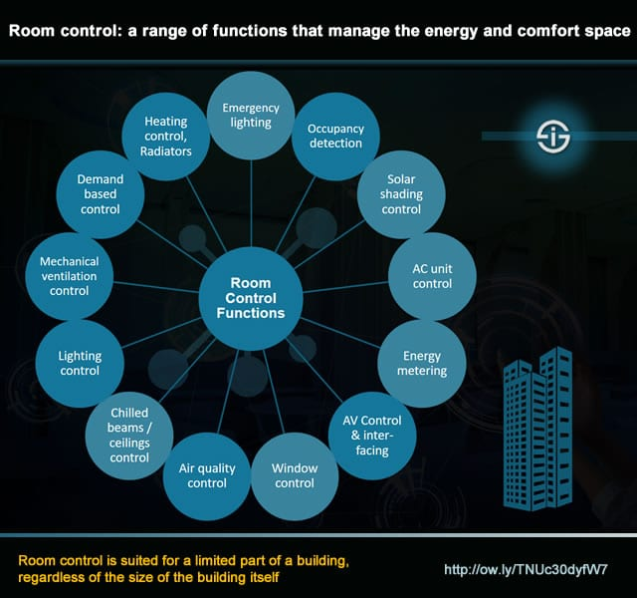
ROOM CONTROL

Slide 6
SOLUTIONS
Safety : There at situation arise when parents have to leave outstation and kids stay alone at home , in this scenario Automation helps in securing kids safety . One can install surveillance cameras and keep monitoring through mobile from anywhere in the globe. Also there are devices which won't allow to unclok the main door from outside once it is locked from inside. Also you can place few Sensors out side which can turn on light automatically in the night if some one try to intrude into your home.
Home automation devices are an excellent answer for a simple, luxurious, comfortable and energy-efficient way of living. With the help of communication of interconnected devices, this technology offers simple and better management of a house's various aspects. Some common problems that can be easily solved using home automation devices are:
Easy, remote management and control of crucial energy-consuming factors like security, HVAC, lighting, etc.
Transparent energy data display that helps in making informed decisions.
Reduced energy consumption due to smart predictability, which means reduced costs.
Lessening the dependency on fossil fuels and reducing carbon emission.
Creating a safe, comfortable and manageable living space.

