Slide 1
TELEMATICS: Risks and Mitigation Techniques in Vehicle Cybersecurity
By:
Vasanth Kandagatla
Sharanya Battar
Saichaithanya Bollam
Vijaya Maneesha Reddy Duggimpudi

Slide 2
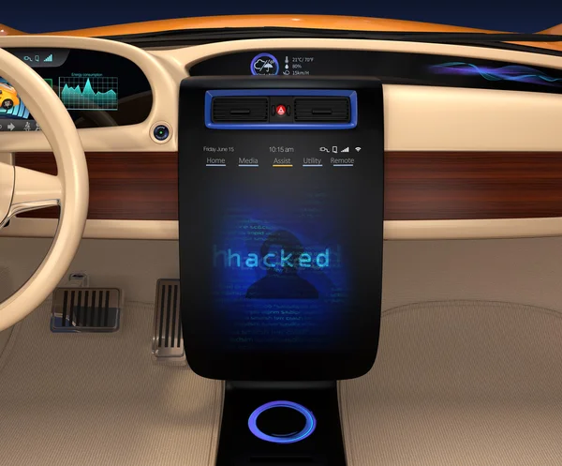
Introduction

Slide 3
Table of contents
01
02
03
04
Vehicle Cybersecurity
Problem
Telematics
Risks & Mitigation Techniques

Slide 4
01
Vehicle Cybersecurity

Slide 5
Vehicle Cybersecurity
Cybersecurity, within the context of road vehicles, is the protection of automotive electronic systems, communication networks, control algorithms, software, users, and underlying data from malicious attacks, damage, unauthorized access, or manipulation.
Source: https://www.nhtsa.gov/crash-avoidance/automotive-cybersecurity

Slide 6
Why is Vehicle Cybersecurity Important?
A system becomes vulnerable to cyber-attack the instant it is linked to a network. Depending on how secure the network is, the attack may or may not be effective. We have heard several reports of website/email hacking or social media account hijacking. Movies go a step farther by depicting a full-fledged cyber-attack on a government installation. That may appear to be an exaggeration, but such assaults are theoretically feasible.
Now that autos have joined the digital revolution, the security danger has become a reality for them as well. A connected automobile, for example, is analogous to a computer on a network with open interfaces such as steering, braking, and other essential information about the occupants.
Attacks Against Cars Nearly Doubled in One Year
Upstream Security’s 2020 Automotive Cybersecurity Report shows that the past decade has demonstrated a marked increase in automotive cyber incidents. From 2018 to 2019, there was a 99% increase in automotive cyber security incidents. Now, that their Auto Threat Intelligence data covers both physical and remote attacks, although 82% of the attacks in 2019 involved short- and long-range remote attacks.

Slide 7

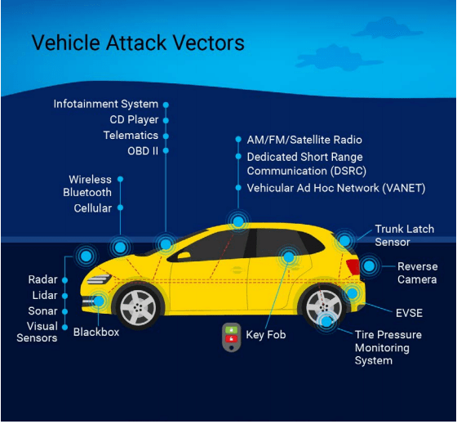
Attack Vectors
Source: Joelynn Schroeder, NREL

Slide 8
Modern Vehicles
Categories - Attack Vectors
Telematics
CAVs
EVSE

Slide 9
02
Problem

Slide 10
Problem Statement
Network and telecommunications capabilities in modern automobiles include cellular, wireless, machine-to-machine, transaction processing management systems, Bluetooth, OTA updates, and CAV sensory technology. With this functionality, vehicle data can be transferred and evaluated at remote databases to assist vendors and data aggregators in improving vehicle performance, increasing vehicle safety, and optimizing vehicle-to-vehicle operations on the road. Despite these benefits, these capabilities expand the possible assault surface area. We will discuss risks and mitigation techniques on both levels, Physical and remote way.

Slide 11
03
Telematics

Slide 12
Vehicle Telematics
Vehicle telematics is a multidisciplinary area that integrates telecommunications, informatics, computer science, electrical engineering, and vehicular technology. It attempts to enhance the overall efficiency and safety of the driver experience by delivering real-time data on how their cars are doing.
Vehicle Telematics System
A vehicle telematics system consists of tracking devices installed in vehicles that enable the transmission and storage of telemetry data via wireless networks and the vehicle's own onboard modem and diagnostics (ODBII). Telematics companies manage the transmission of data from the vehicle to computers or mobile devices. GPS tracking, cloud-based systems with easy interaction for many partners, and fleet management software are examples of device kinds. Artificial intelligence integration in real time for early alerts and fast insights.

Slide 13

How it works?
Source: https://www.geotab.com/blog/what-is-telematics/

Slide 14
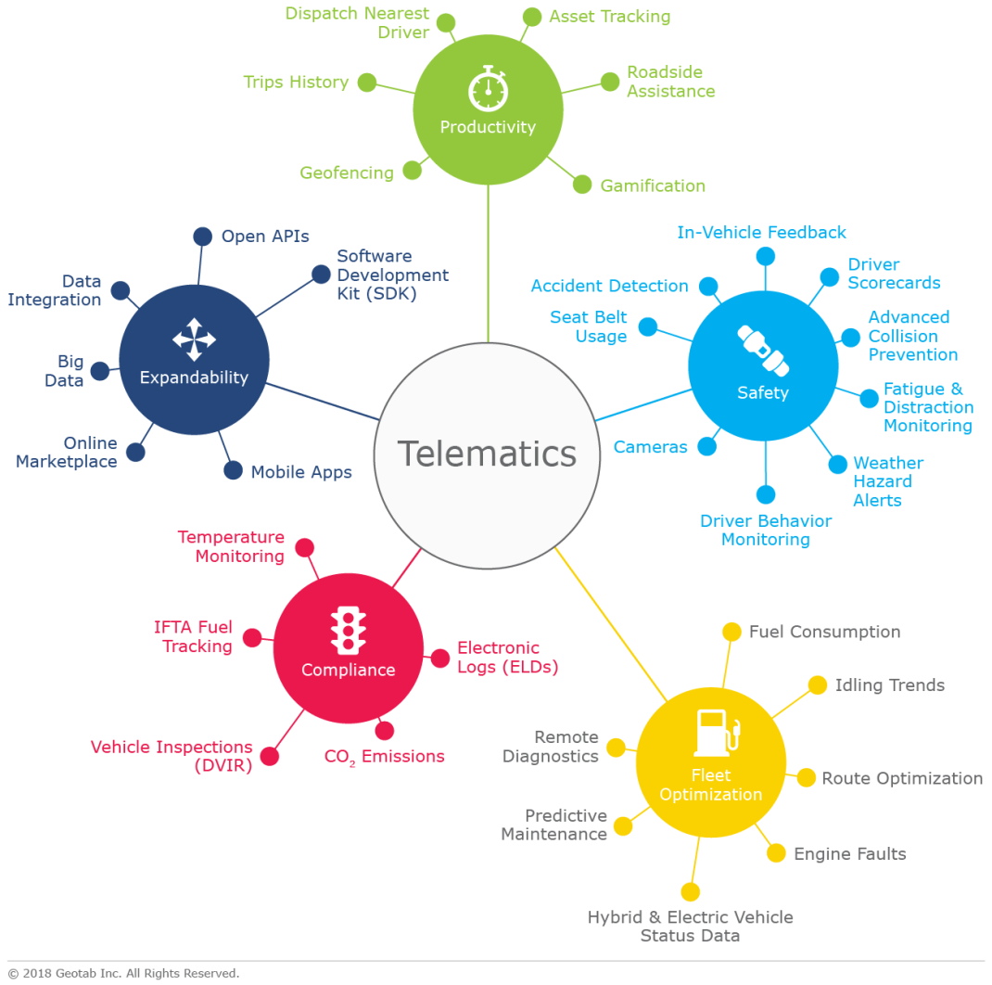
Telematics Applications
Source: https://www.geotab.com/blog/what-is-telematics/

Slide 15
Which vehicles can Telematics be used
Single
axle
Cargo
Vans
Buses &
Coaches
Cars
Heavy Equipment

Slide 16
04
Risks & Mitigation Techniques

Slide 17
Physical Access Risks
Physical access to most telematics devices could potentially allow access to components and functions of modern vehicles, but it would require the additional step of compromising the telematics system before attempting to attack the vehicle.
The telematics system can only compromise vehicle functionality if the telematics have write access to the vehicle system or if telematics firmware can be reprogrammed to provide write access. This has been accomplished with aftermarket telematics in a research setting to take control of vehicle functions, including braking. Let me break down this from three perspectives.
Telematics Managers
Fleet Managers
Vehicle/Fleets

Slide 18
Physical Access Risks
Adopting an agency system security plan
Working with reputable, trusted partners
Third-party examination of telematics
Fleet Managers

Slide 19
Physical Access Risks
Adding anti-tampering or layered security methods
Assigning unique cryptographic keys
Employing secure coding practices and auditing
Disabling the ability for external users to read firmware code
Telematics Managers

Slide 20
Physical Access Risks
Monitor network activity and install a tampering alarm
Favorable background investigations
Follow recommendations & guidance presented by the U.S
Ensure devices are compliant with authority to operate (ATO) requirements
Vehicle/Fleets

Slide 21
Remote Access Risks
The most vulnerable hacking opportunity for telematics is access to the data collected by the system. Collecting data from telematics is possible without write access or bridging different networks. It still requires hacking the telematics network and is inherently a remote risk. However, the most threatening method for controlling a vehicle through telematics would be to reflash the firmware remotely, which could give a malicious actor insight, control, and ability to manipulate functions of the vehicle as they desire.
Geotab, a telematics provider, developed a System Security Plan that provides a cybersecurity overview for themselves and other providers. The plan addresses topics from system interconnections, ports, protocols, system environments, network architectures, and owner operator functionalities. These security controls follow the FIPS 199standards, as well as NIST 800-53, Revision 4. A list of 15 security recommendations is set forth by Geotab for building a telematics platform resilient to cyberthreats and attacks

Slide 22
Remote Access Risks
Mitigation Techniques for Remote Threats to Telematics
Using multi-factor authentication to verify authorized access
Securing remote endpoints
Using false data injection mitigation methods
Encrypting OTA firmware updates, transmission of telematics data
Incorporating the ability to revert to the prior firmware version
Requiring user authorization and authentication for mobile OTA updates

Slide 23
Remote Access Risks
Procurement Recommendations for Remote Threats to Telematics
Require vendors to comply with all areas of FedRAMP security requirement
Implement whitelisting and blacklisting of messages sent from network
Strong, unique passwords to have defense in-depth for communications
Require two-factor authentication to access the telematics device remotely
Encrypt any messages sent OTA or data at rest using FIPS 197 AES 256 algorithm and cryptographic modules that have been validated under FIPS 140, National Security Agency Type 1 or Type 2 standards

Slide 24
ISO/SAE 21434:2021 Road vehicles — Cybersecurity engineering
The purpose of the above standard addresses the cybersecurity perspective in engineering of electrical and electronic (E/E) systems within road vehicles. By ensuring appropriate consideration of cybersecurity, this document aims to enable the engineering of E/E systems to keep up with state-of-the-art technology and evolving attack methods.
This Standard provides vocabulary, objectives, requirements and guidelines related to cybersecurity engineering as a foundation for common understanding throughout the supply chain. This enables organizations to:
— define cybersecurity policies and processes;
— manage cybersecurity risk; and
— foster a cybersecurity culture.

Slide 25
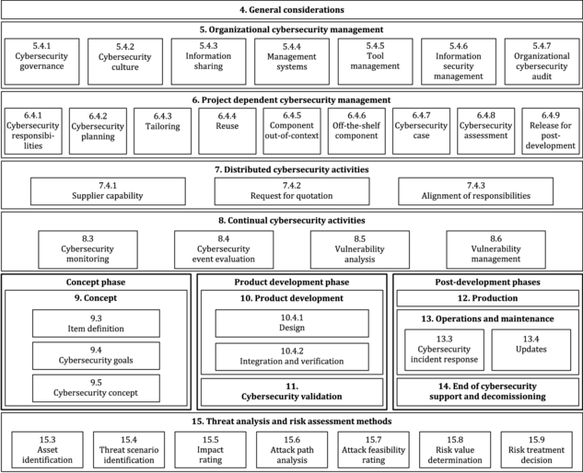
ISO/SAE 21434:2021 Road vehicles — Cybersecurity engineering

Slide 26
Telematics Cybersecurity Summary
Telematics devices are not typically the end target when dealing with intrusion into modern vehicles. They are, however, a very vulnerable remote attack vector for modern vehicles, as they offer a single point of failure to gain access to an entire fleet if compromised. The main goals for attackers when attacking telematics devices are to either collect data or disrupt, manipulate, and potentially cause significant harm to vehicle functionality. To facilitate best practices for procurement, and even to catch mistakes that slip through the process, standards such as the NIST 800 series, the “Telematics Cybersecurity Primer for Federal Agencies,” Geotab’s System Security Plan, and experience from other agencies including DHS and Navy can be referenced to ensure telematics devices for the federal fleet meet industry standards for cybersecurity.

Slide 27
References:
https://www.nrel.gov/docs
https://www.nhtsa.gov/sites/nhtsa.gov/files/documents/vehicle_cybersecurity_best_practices_01072021.pdf
https://blackberry.qnx.com/en/ultimate-guides/wp-29-vehicle-cybersecurity
https://en.wikipedia.org/wiki/Vehicular_ad_hoc_network
https://www.iso.org/standard/70918.html
https://www.geotab.com/blog/what-is-telematics/

Slide 28
Thanks!
Do you have any questions?

