Slide 1
GAIT CLASSIFICATION WITH GAIT INHERENT ATTRIBUTE IDENTIFICATION FROM ANKLE KINEMETICS
MEMBERS:
SURYA S S
VASANTH KUMAR R
GUIDE:
Mrs. R VENITTA RAJ
Department of Information Technology

Slide 2
AIM
To detect whether the person is making the correct gait pattern.
To develop a medical device that helps for physiotherapist in treatment for gait
Department of Information Technology

Slide 3
OBJECTIVES
  To have continuous IMU recordings
  To determine and analyze the gait event
  To have a report of gait pattern of the patient via
  mobile application
Department of Information Technology

Slide 4
LITERATURE SURVEY-1
APPLICATION OF SUPERVISED MACHINE LEARNING ALGORITHMS IN THE CLASSIFICATION OF SAGITTAL GAIT PATTERNS OF CEREBRAL PALSY CHILDREN WITH SPASTIC DIPLEGIA
ADVANTAGES
  It’s is a simple method
  Having a good accuracy
LIMITATIONS
  No live data
  Computation Load is poor
Y. Zhang and Y. Ma, “Application of supervised machine learning algorithms in the classification of sagittal gait patterns of cerebral palsy children with spastic diplegia,” Comput. Biol. Med., vol. 106, pp. 33–39,Mar. 2019.

Slide 5
LITERATURE SURVEY-2
ADAPTIVE BAYESIAN INFERENCE SYSTEM FOR RECOGNITION OF WALKING ACTIVITIES AND PREDICTION OF GAIT EVENTS USING WEARABLE SENSORS
ADVANTAGES
  Higher Accuracy
  Helps to avoid unnecessary noises
LIMITATIONS
  Delays in output
  No live updates
1.U. Martínez-Hernandez and A. A. Dehghani-Sanij, “Adaptive Bayesian inference system for recognition of walking activities and prediction of gait events using wearable sensors,” Neural Netw., vol. 102, pp. 107–119, Jun. 2018.

Slide 6
LITERATURE SURVEY-3
SIMULTANEOUS BAYESIAN RECOGNITION OF LOCOMOTION AND GAIT PHASES WITH WEARABLE SENSORS
ADVANTAGES
  Fast Process
  Less work Load
LIMITATIONS
  Unaware of different walking pattern
  No smooth real-time updates
U. Martinez-Hernandez, I. Mahmood, and A. A. Dehghani-Sanij, “Simultaneous Bayesian recognition of locomotion and gait phases with wearable sensors,” IEEE Sensors J., vol. 18, no. 3, pp. 1282–1290, Feb. 2018.

Slide 7
LITERATURE SURVEY-4
A COMPARATIVE STUDY ON HUMAN ACTIVITY RECOGNITION USING INERTIAL SENSORS IN A SMARTPHONE
ADVANTAGES
  Reduce the power consumption
  Work in any environmental condition
LIMITATIONS
  No proper readings
  User behavior problem
A. Wang, G. Chen, J. Yang, S. Zhao, and C.-Y. Chang, “A comparative study on human activity recognition using inertial sensors in a smartphone,” IEEE Sensors J., vol. 16, no. 11, pp. 4566–4578, Jun. 2016.

Slide 8
LITERATURE SURVEY-5
RECOGNIZING HUMAN ACTIVITY IN FREE LIVING USING MULTIPLE BODY-WORN ACCELEROMETER
ADVANTAGES
  Able to categorize a lot of activity
  Real-time application
LIMITATIONS
  Device is designed in an uncomfortable manner and
  can get damaged easily
  Only gives the exact result based on the small input
E. Fullerton, B. Heller, and M. Munoz-Organero, “Recognizing human activity in free-living using multiple body-worn accelerometers,” IEEE Sensors J., vol. 17, no. 16, pp. 5290–5297, Aug. 2017.

Slide 9


PROJECT FLOW
Receiving data
Sending data
DOCTOR
THING SPEAK
PATIENT
Giving prescription /medical advice
Department of Information Technology

Slide 10
TECHNICAL WORK FLOW
Setting up the wearable device
Record all the live data
Doctor will check the data
Classify the gait movement
Identify whether the event occurs or not
Department of Information Technology

Slide 11
MODULES
Event Detection
Calibration phase
Gait Classification
Department of Information Technology

Slide 12
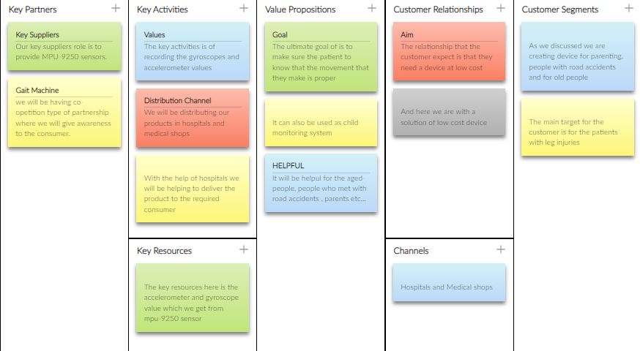
APPLICATION OF IDEA GENERATION TOOL
Department of Information Technology

Slide 13
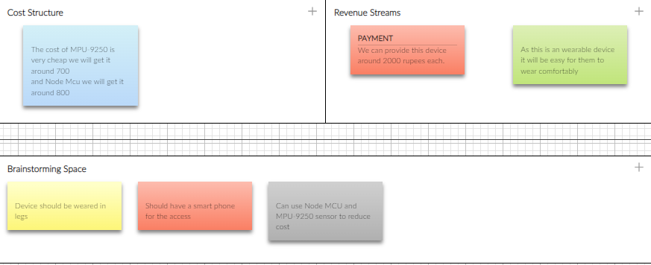
Department of Information Technology

Slide 14
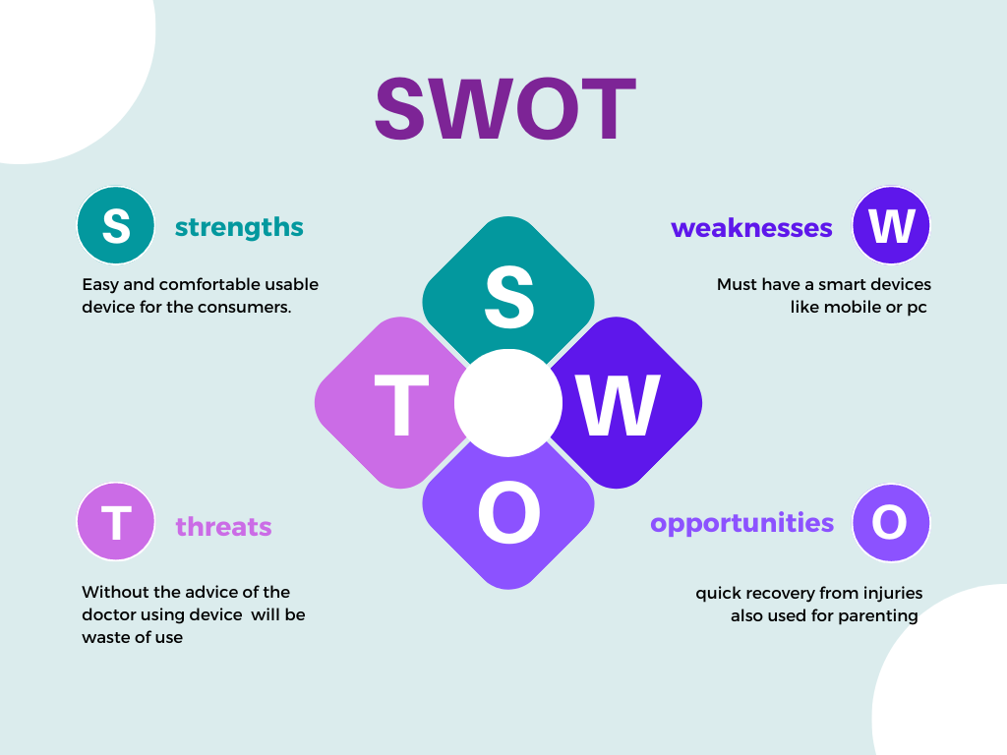
Department of Information Technology

Slide 15
Identification of Criteria
Camera
Wearable Sensors
Mobile Phones
Department of Information Technology

Slide 16
APPLICATION OF DECISION MAKING TOOLS
Arduino IDE
Its an open software tool.
The code will be similar to C, C++
First we will write the code , compile and then we will upload to the Arduino and check the results.
Department of Information Technology

Slide 17
Colab/Jupyter Notebook
We used colab and jupyter notebook to write the python codes and Python IDLE to develop a website
Department of Information Technology

Slide 18
Used Decision Techniques
Long Short Term Memory
Decision Tree
Gaussian Naïve-Bayes
Random Forest
K Nearest Neighbor
Event-based algorithm
Department of Information Technology

Slide 19
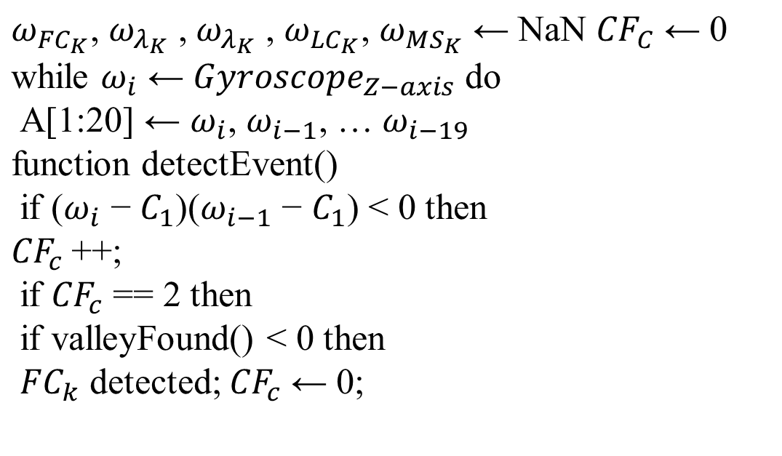
ALGORITHM 1: EVENT DETECTION
Department of Information Technology

Slide 20
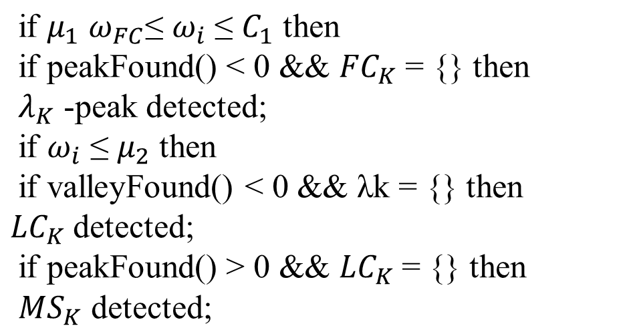
ALGORITHM -1 contd….
Department of Information Technology

Slide 21
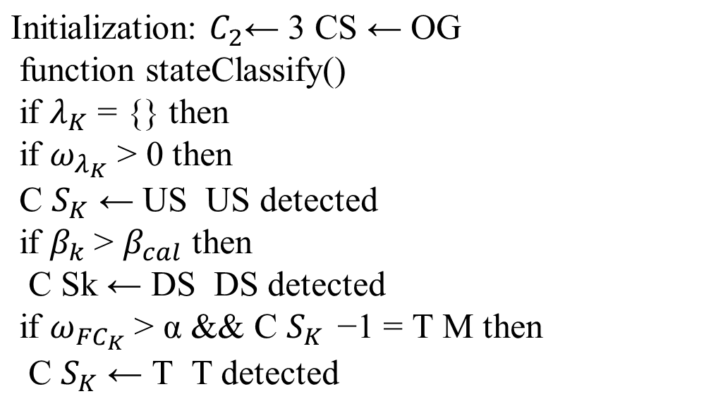
ALGORITHM 2: GAIT CLASSIFICATION
Department of Information Technology

Slide 22
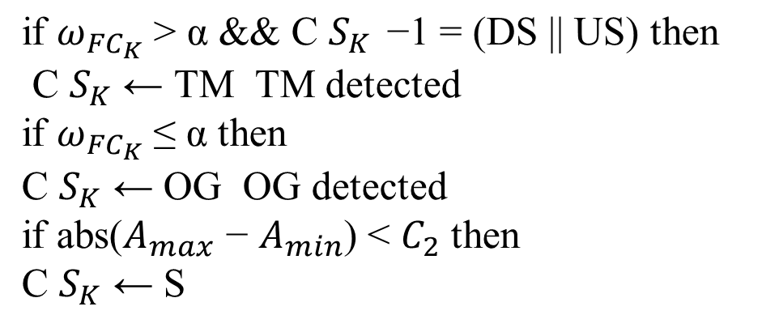
ALGORITHM-2 contd…
Department of Information Technology

Slide 23
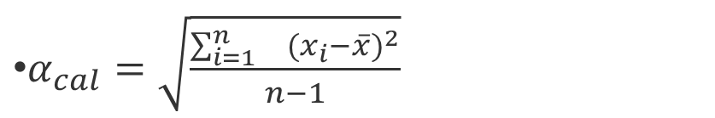
FORMULA USED
x̄ = Σfx/Σf
where,
x̄ = the mean value of the set of given data.
f = frequency of each class
x = mid-interval value of each class
Department of Information Technology

Slide 24
SOFTWARE REQUIMENTS SPECIFICATION
/JOURNAL
SRS
Journal
Department of Information Technology

Slide 25
CODE
Paper Code
Website
ML and DL
ThingSpeak
Department of Information Technology

Slide 26
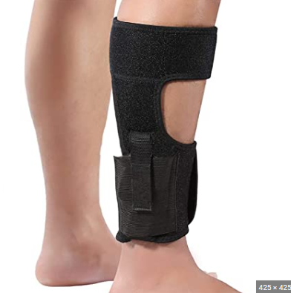
Department of Information Technology

Slide 27
APPLICATIONS
A medical application
Python Flask Website
Department of Information Technology

Slide 28
THANK YOU
Department of Information Technology

