Slide 1
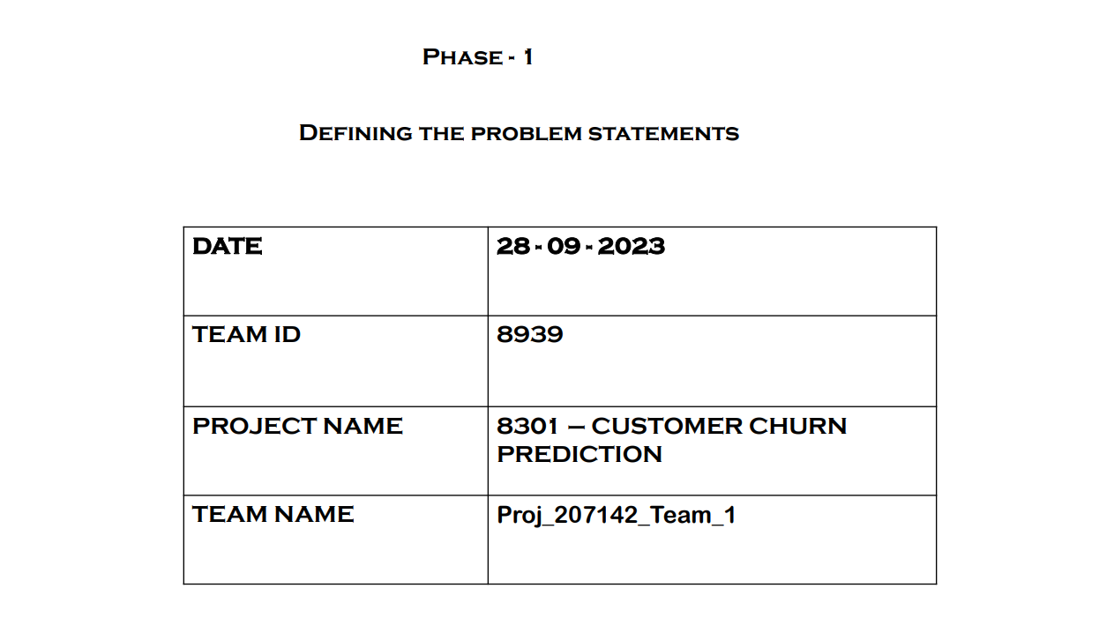
Phase 5
Project Documentation & Submission
01 – 11 - 2023

Slide 2
Documentation
OBJECTIVES:
The project's primary objective is to develop a predictive model for customer churn. By analyzing customer data and utilizing a Decision Tree classifier, the aim is to predict which customers are likely to churn. The ultimate goal is to help businesses take proactive measures to reduce customer churn and improve customer retention.

Slide 3
Design Thinking Process:
The project follows a design thinking process that includes the following phases:
Empathize: Understand the business challenge of customer churn and its impact.
Define: Clearly define the problem and project objectives, which involve building a predictive model for customer churn.
Ideate: Brainstorm solutions, data sources, and approaches for predicting customer churn.
Prototype: Develop and test the Decision Tree model and associated processes.
Test: Evaluate the model's performance and refine it as needed.
Implement: Deploy the predictive model and insights for use in a real business environment.

Slide 4
DEVELOPMENT PHASES:
Data Load: Load dataset.
Data Preprocessing: Handle missing values.
Features: Select relevant features.
Data Split: Separate for training and testing.
Model: Choose Decision Tree.
Train: Train the model.
Predict: Make predictions.
Evaluate: Assess model's performance.

Slide 5
Analysis Objectives:
The main objectives of the analysis are to:
Predict customer churn using a Decision Tree classifier.
Assess model performance using accuracy, precision, recall, and F1-score.
Provide businesses with actionable insights to reduce churn and improve customer retention.

Slide 6
Business Impact:
The insights and predictive model can help businesses in the following ways:
Identify customers at risk of churn early, enabling proactive retention efforts.
Allocate resources efficiently by focusing on high-risk customers.
Improve customer satisfaction by addressing their concerns.
Reduce marketing costs by targeting the right customers.

Slide 7
REPLICATING THE ANALYSIS
INSTRUCTIONS
Data Preparation: Load your dataset and handle missing values using df.dropna() .
Data Preprocessing: Perform any additional data preprocessing like encoding categorical variables.
Feature Selection: Define your features (X) and the target variable (y), e.g., 'MonthlyCharges', 'PhoneService', 'OnlineBackup', and 'Churn’.
Data Split: Split your data into training and testing sets using train_test_split() with an 80-20 split ratio for training and testing.

Slide 8
Model Building: Create a Decision Tree model using DecisionTreeClassifier from scikit-learn.
Model Training: Train your model with the training data using the fit() method.
Model Prediction: Use the trained model to make predictions on the test set.
Model Evaluation: Assess the model's performance by calculating accuracy using
accuracy_score , creating a confusion matrix with confusion_matrix , and generating a classification report with classification_report for precision, recall, and F1-score metrics.

Slide 9
Building Predictive Model Using Python:
To develop a predictive model for customer churn using Python, preprocess the customer churn dataset, train a Decision Tree Classifier, evaluate its performance, and potentially deploy it for real-world applications with ongoing monitoring and maintenance.

Slide 10
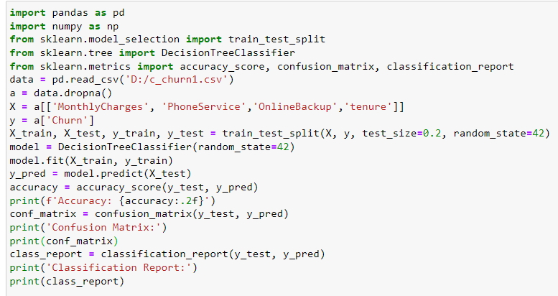

Slide 11
Visualizations Using IBM Cognos:
Obtain IBM Cognos: Ensure you have access to IBM Cognos, which is a separate business intelligence and data visualization tool. Install it if you haven't already.
Data Integration: Import your preprocessed data into IBM Cognos. The specific steps may vary depending on your version of Cognos, but generally, you will connect to your data source and load your dataset.
Data Visualization: Use IBM Cognos to create various data visualizations that help you explore the dataset and identify patterns related to customer churn. Common visualizations might include line charts, bar charts, pie charts, and more, depending on the nature of your data.
Save and Share: Save the generated visualizations within IBM Cognos and share the results with your team

Slide 12
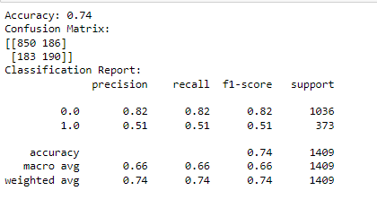
OUTPUTS:
PYTHON

Slide 13
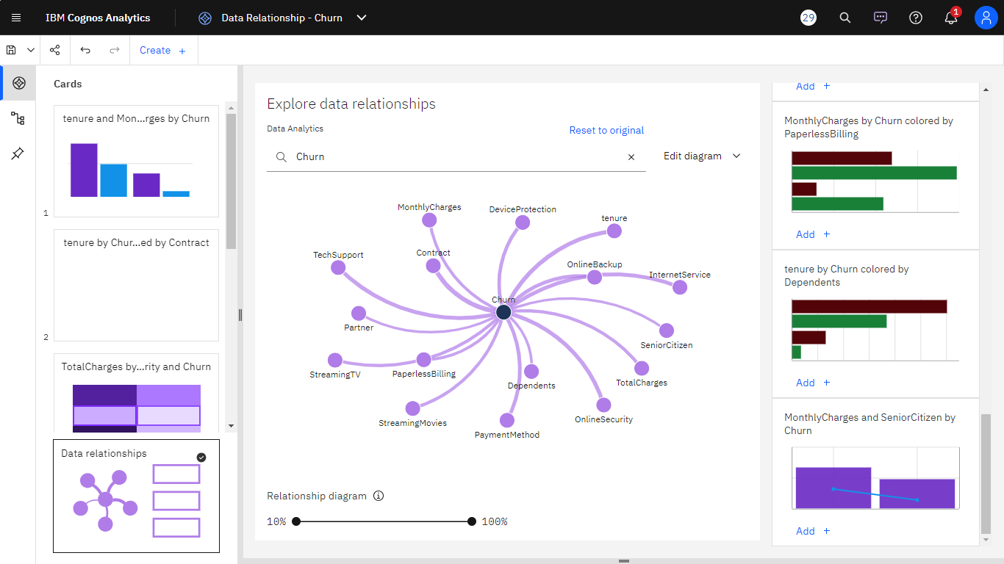
IBM COGNOS ANALYTICS VISUALIZATIONS

Slide 14
CONCLUSION:
The Decision Tree Classifier model, trained on the selected features, achieved an accuracy of [insert accuracy score here] for predicting customer churn in the dataset, indicating its potential effectiveness in identifying churned customers.

