Slide 1
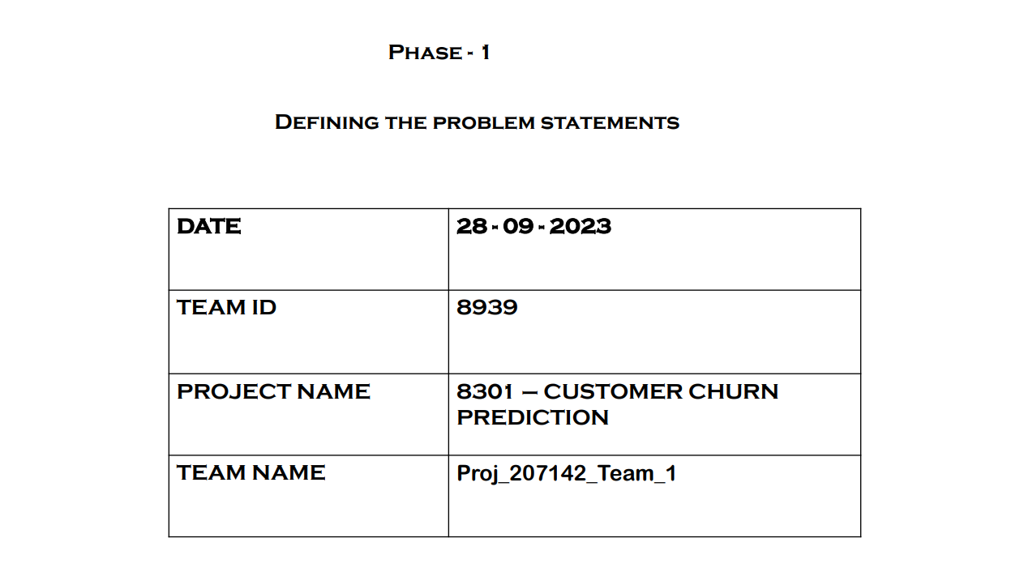
PHASE - 4
Development Part 2
29 - 10 - 2023

Slide 2
DEVELOPING A PREDICTIVE MODEL
Create interactive dashboards and reports in IBM Cognos to visualize churn patterns, retention rates, and key factors influencing churn.
Use machine learning algorithms to build a predictive model that identifies potential churners based on historical data and relevant features.

Slide 3
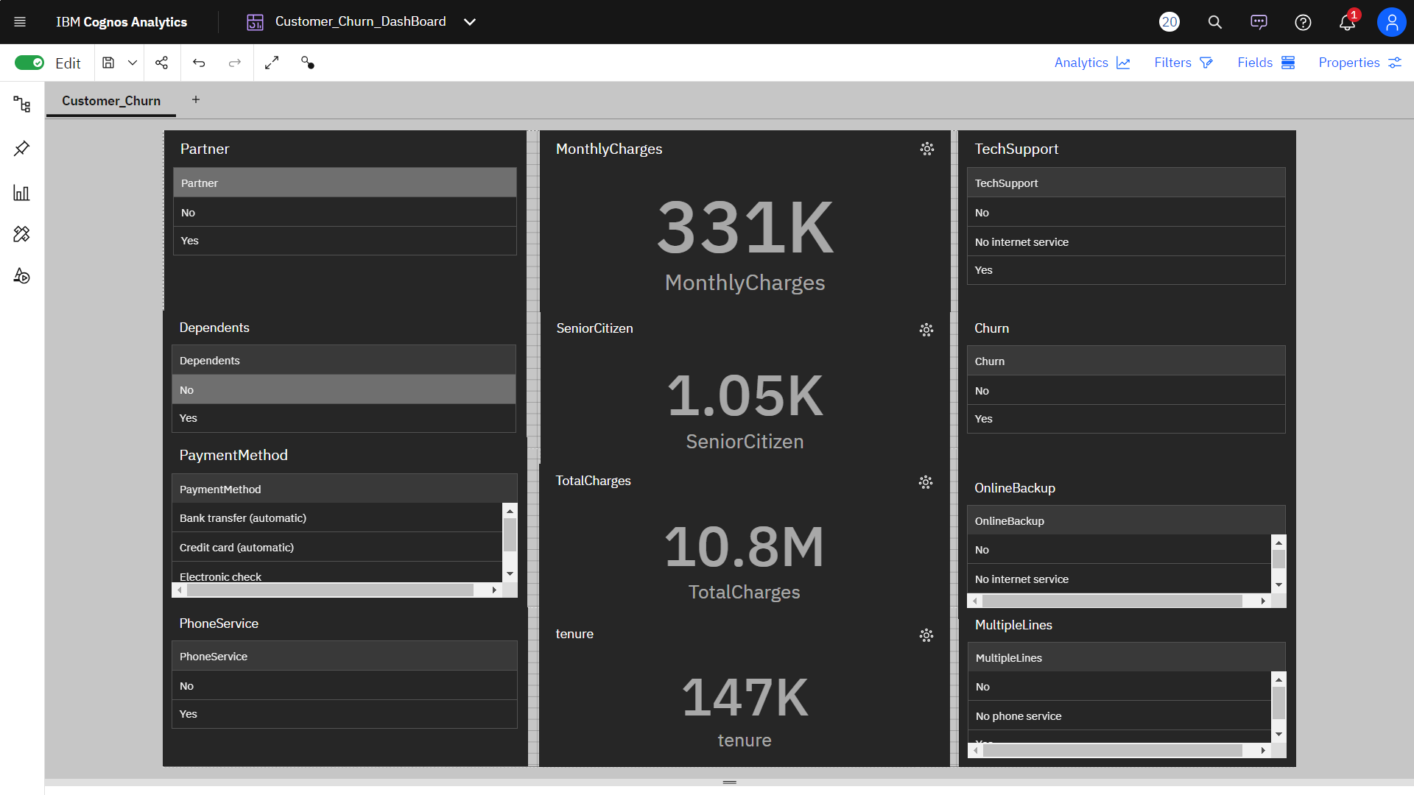
CREATING THE DASHBOARD

Slide 4
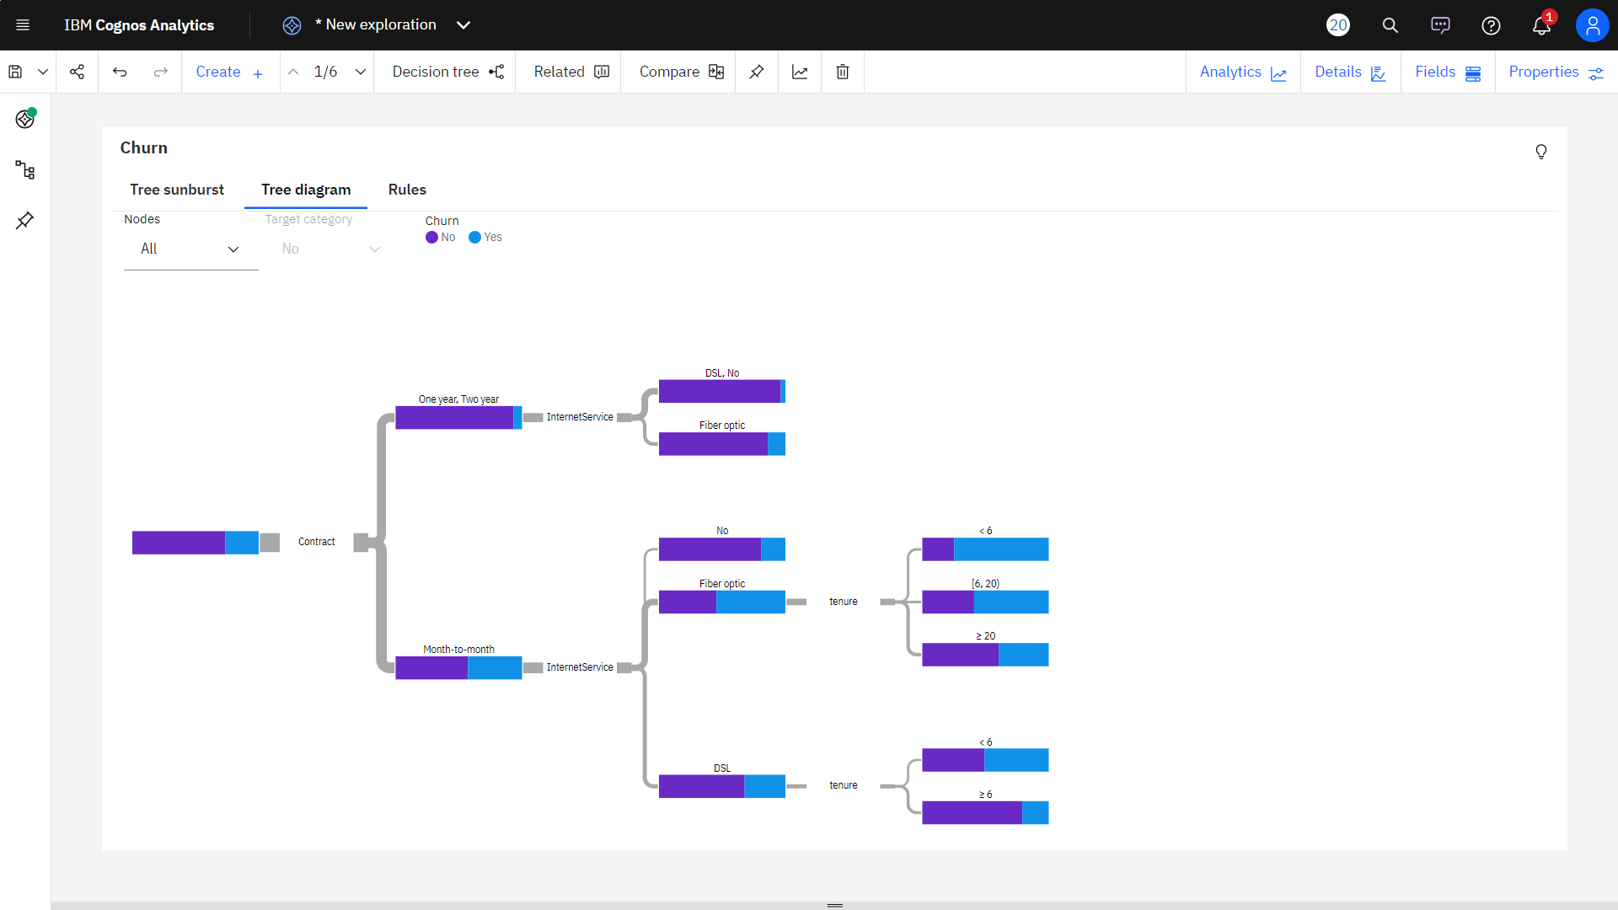
IBM COGNOS VISUALIZATION

Slide 5
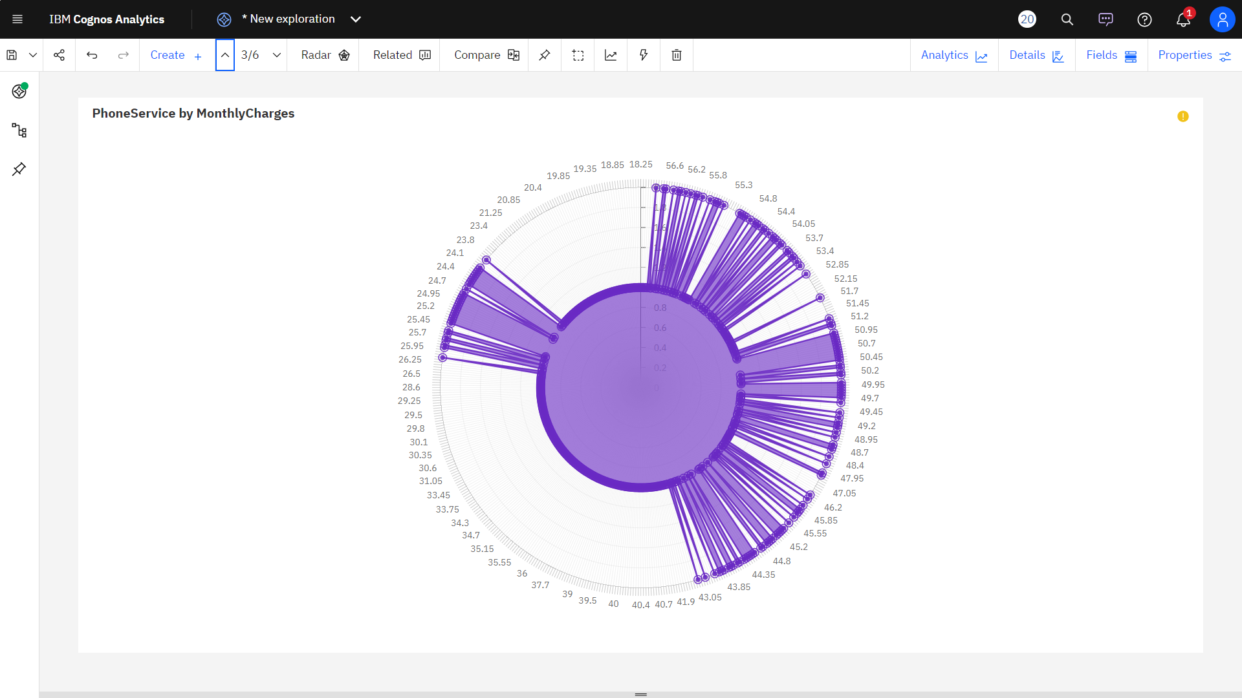

Slide 6
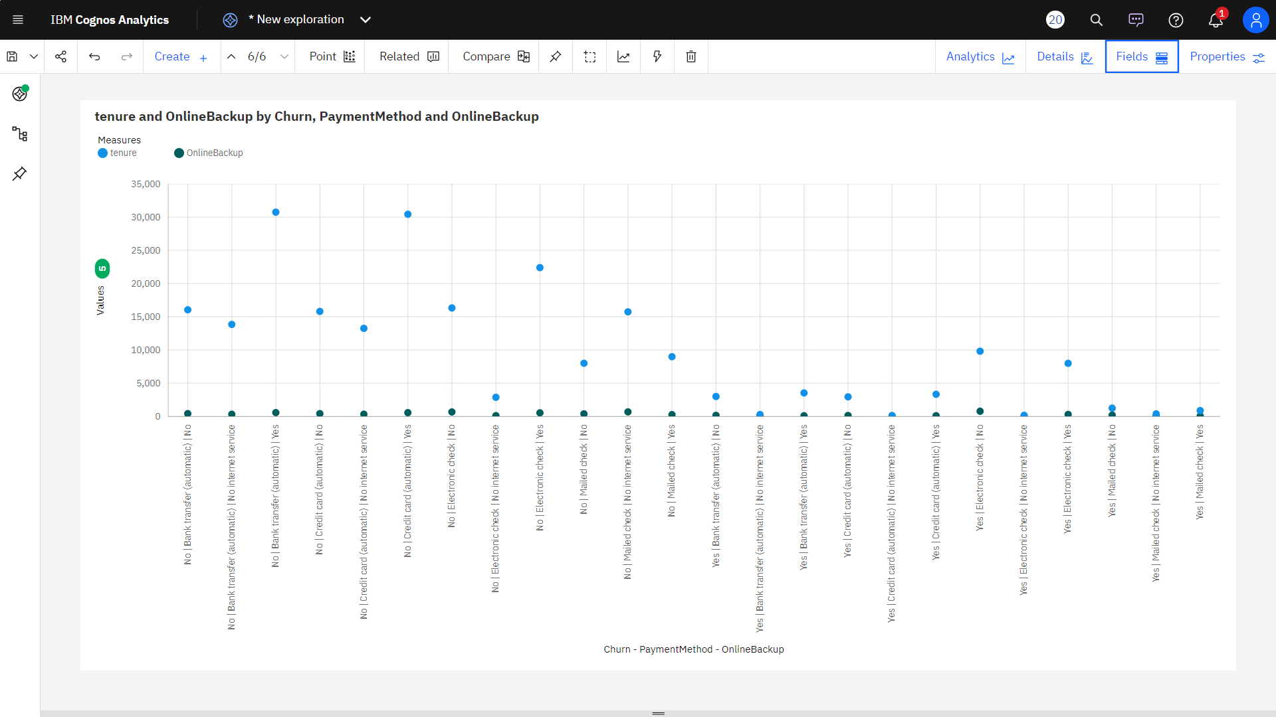

Slide 7
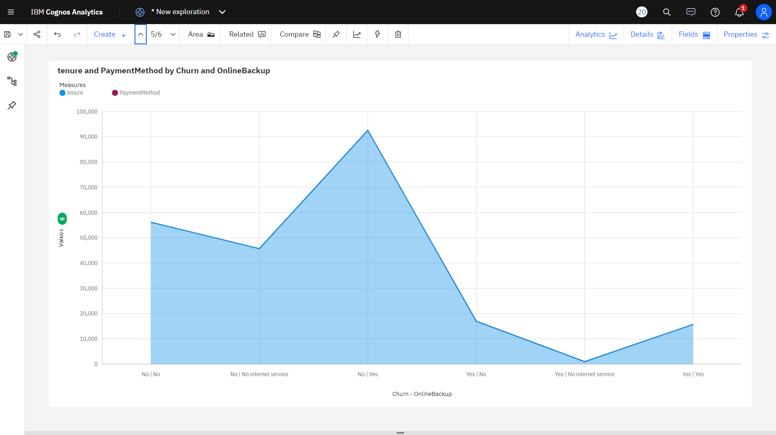

Slide 8
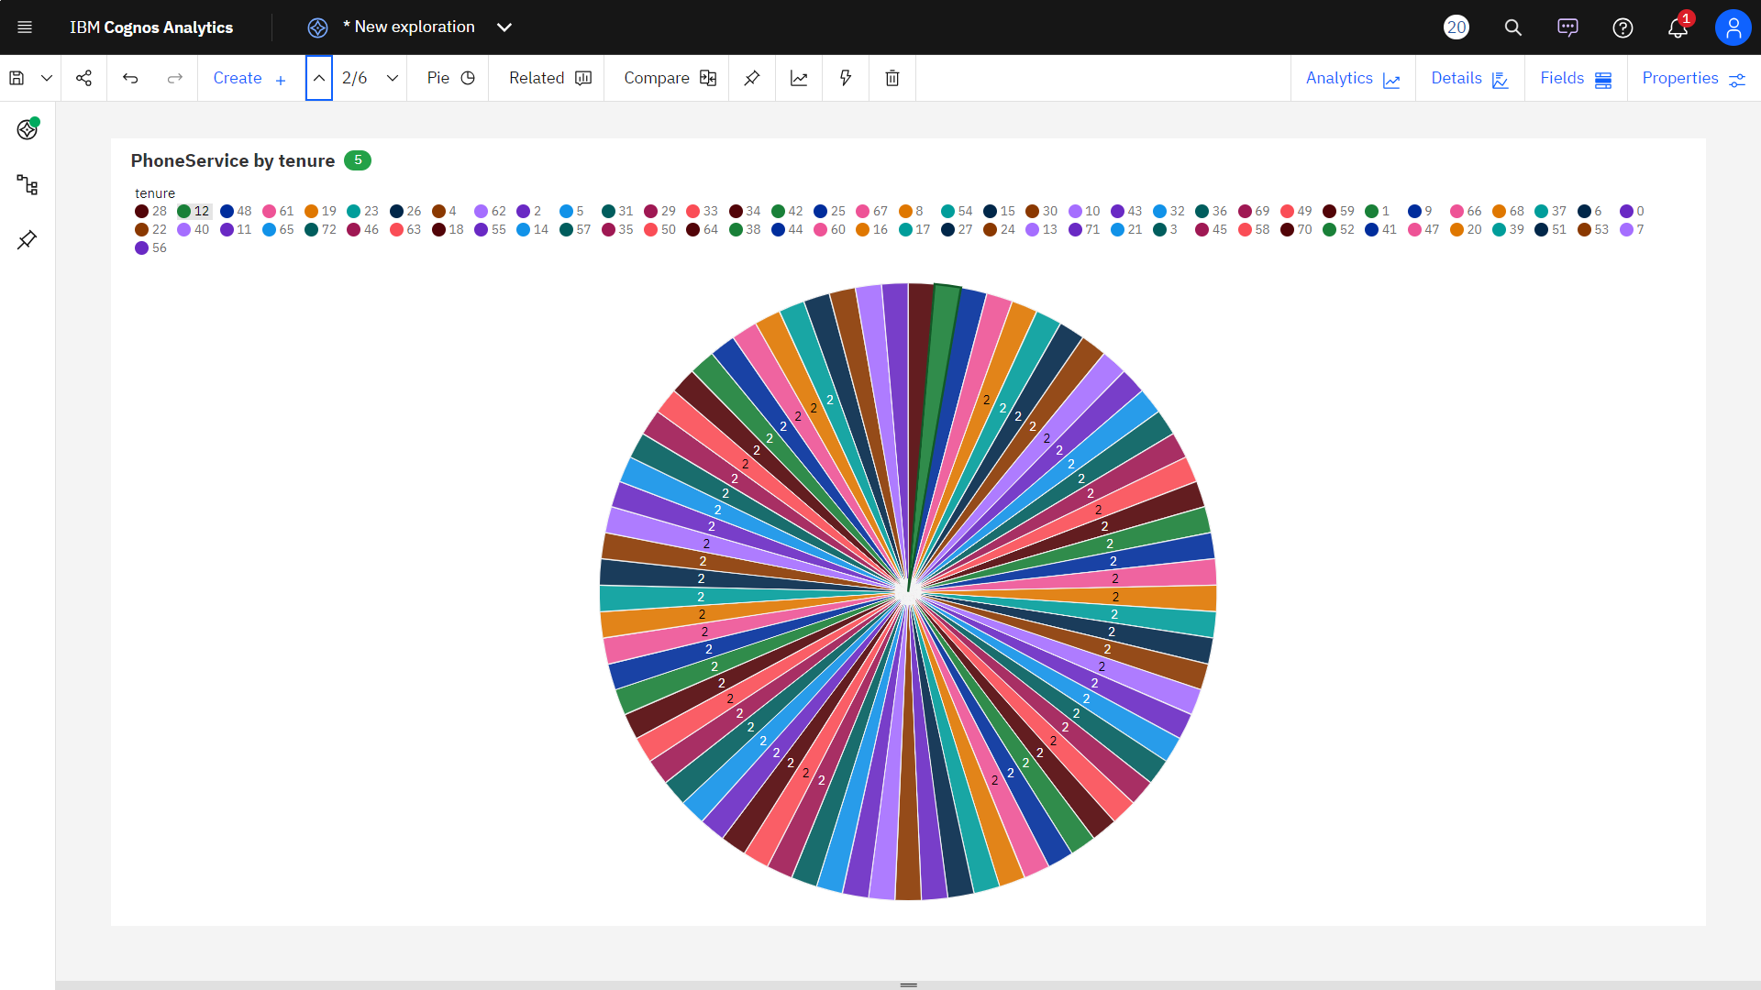

Slide 9
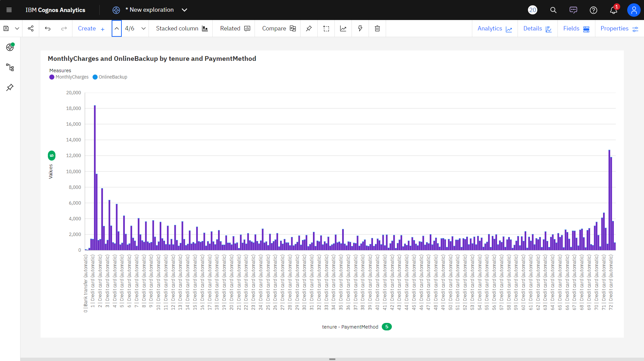

Slide 10
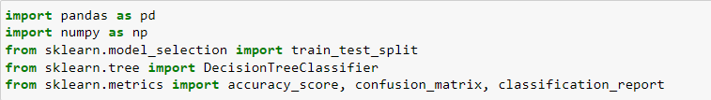
Step 1: Import Libraries Start by importing the necessary Python libraries for data manipulation, visualization, and machine learning. Common libraries include pandas, numpy, scikit-learn, and matplotlib.

Slide 11
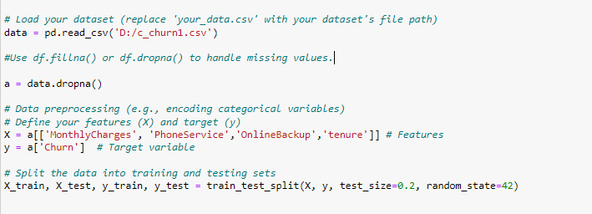
Step 2: Load and Prepare Data Load your customer churn dataset and perform data preprocessing, which may include handling missing values, encoding categorical variables, and splitting the data into training and testing sets.

Slide 12
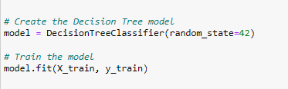
Step 3: Build and Train the Decision Tree Model Create a DecisionTreeClassifier and train it on your training data.

Slide 13

Step 4: Make Predictions Use the trained model to make predictions on the test data.

Slide 14
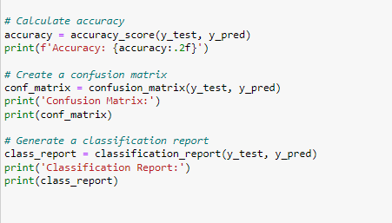
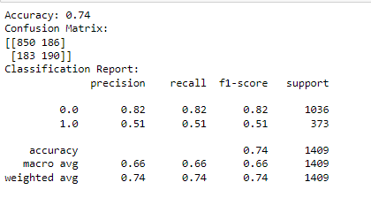
Step 5: Evaluate the Model Evaluate the model's performance using various metrics, including accuracy, confusion matrix, and classification report.

Slide 15
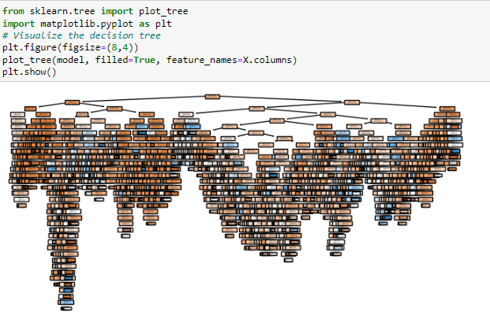
Step 6: Visualize the Decision Tree You can visualize the decision tree to understand the splits and decisions made by the model.

Slide 16
Conclusion:
The code successfully builds and evaluates a Decision Tree classifier for customer churn prediction. It provides an accuracy score, a confusion matrix, and a classification report to assess the model's performance. These metrics offer valuable insights into how well the model is performing and help in understanding its strengths and weaknesses in predicting customer churn. Depending on the specific requirements and dataset, further model tuning, feature engineering, or the use of different algorithms may be considered to improve predictive accuracy.

