Slide 1


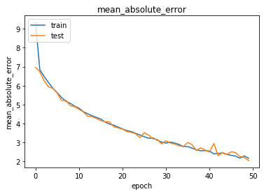
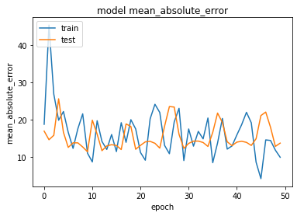
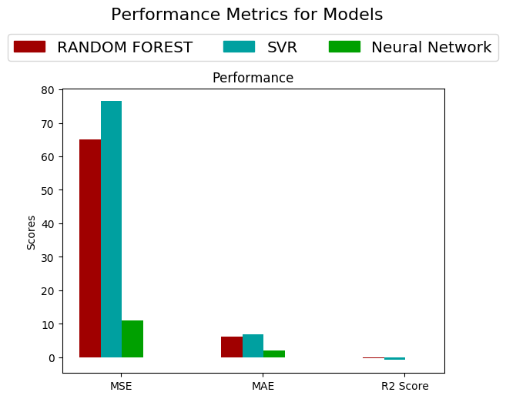

[Crop Yield Prediction through
Different Machine Learning
Algorithms]
[Tanmay Jain, Vasanthagokul S, Shaik Sazid,
Arsh Srivastava]
[Anjali Yadav, Archana Das]
Abstract
The farming assumes a predominant job in the development of the nation's economy. AI (ML) is a essential methodology for accomplishing viable and compelling answers for this issue. Crop Yield Prediction includes anticipating yield of the harvest from accessible verifiable information like climate parameters,season parameter and previous yield.This poster centers around foreseeing the yield of the harvest dependent on the current information by utilizing diverse Machine learning and Deep Neural Netwok Techniques. The prediction will serves to the farmers to foresee the yield of the harvest before cultivating onto the agriculture field.
Introduction
Cultivating is a significant source of pay for many individuals in developing nations. In Ghana cultivating speaks to 36 percent of the nation's Gross domestic product and is the primary wellspring of pay for 60 percent of the population. (http://earthtrends.wri.org, 2003 p. 1). Crop yield prediction is a significant rural issue. Every single farmer is consistently attempts to know, how much yield will get from his desire. In the past, yield expectation was determined by analysing farmer's past experience on a specific harvest. The agricultural yield basically relies upon climate conditions, pests and planning of harvest activity. Exact data about history of harvest yield is something essential for settling on choices identified with agricultural hazard management.Therefore, this paper proposes a plan to anticipate the yield of the harvest .The farmer will check the yield of the harvest according to the section of land ,before developing onto the field.
Figure 1 MAE vs Epoch graph for RNN
In case of the image data-set CNN is applied the results are:
Mean Absolute Error: 9.974
loss: 145.040
Validation Absolute Error: 13.771
The MAE vs Epoch graph for CNN is shown below:
Proposed Method
As this is a regression problem, basically we have applied
three different algorithms :
Random Forest Regression
Support Vector Regression
Deep Neural Network
Convolution Neural Network
Basically we have applied CNN Regression for our image dataset part.
Experimental Results and Discussion
Fig 2. MAE vs Epoch graph for CNN
The performance was analysed on the basis of various
factors such as:
Mean Absolute Error
Mean Squared Error
R2 Score
Mean Absolute Error is taken as the base for comparing the
different models.
All the results given
below are calculated for the second data-set.
In case of Random Forest regression the results are as follows:
Mean Squared Error: 64.986
Mean Absolute Error: 6.160
R2 Score: -0.355
Conclusions
Fig 3:
In case of Support Vector regression the results are as
follows:
Mean Squared Error: 76.452
Mean Absolute Error: 6.869
R2 Score: -0.912
In case of Deep Neural Network the results are as follows:
Mean Absolute Error: 2.162
loss: 11.148
Validation Absolute Error: 2.049
Validation loss: 10.961
The MAE vs EPOCH graph for RNN is shown below:
From the results shown above in we can conclude
that Deep Neural Networks is preferably the best model for
predicting the crop yield as it has the lowest Mean Absolute
error.
References
[1] Yuan, Jun Ni, Bingbing Kassim, Ashraf. (2014). Half-CNN: A General
Framework for Whole-Image Regression.
[2] Keras, Regression, and CNNs, Adrian Rosebrock, January 28 2019,
Unpublised.
Team No. - 30

