Slide 1


Crop Yield Prediction
TEAM MEMBERS : MENTORS :
Tanmay Jain Ms. Anjali Yadav
Vasanthagokul S Ms Archana Das
Shaik Sazid
Arsh Srivastava

Slide 2
Introduction
Precise yield estimation is essential in agriculture.
In this paper, we propose an efficient method that uses computer vision to accurately count crops in a digital image.
We have also devised algorithms which can accurately determine the yield on the basis of given factors such as soil precipitation, Area, humidity Index and more such factors which plays an important role in determining the yield.

Slide 3
Dataset Used
First data-set is taken from the website of Government of India which consist of following fields area, production, state and season. This data consists of data of Andhra Pradesh state for 10 years.
Second dataset: GitHub[aerialintel.blob.core.windows.net/recruiting/datasets/wheat-2013-supervised.csv] which consisted of more number of features such as Humidity, Precipitation, NDVI, Pressure, temperature, wind Speed etc. We have two years worth of Winter Wheat data. These data are geolocated to specific lat-longs and counties.
Third dataset consist of 10 UAV images taken from drone

Slide 4
Models Used
Random Forest Regression
Support Vector Regression
Deep Neural Network
Convolution Neural Network Regressor

Slide 5
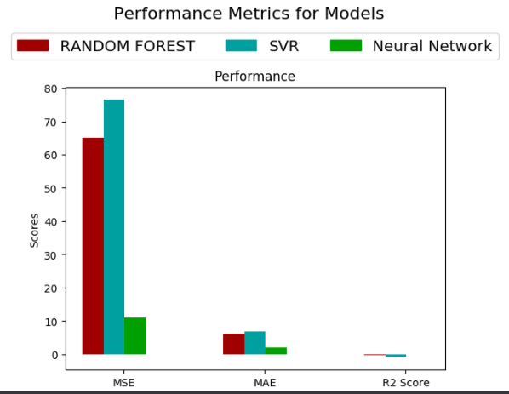
Results Achieved
Fig . 1

Slide 6
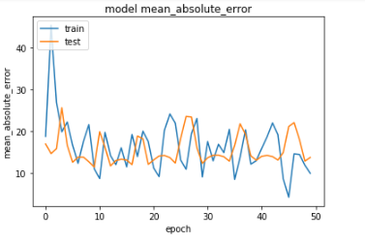
MAE Vs Epoch Curve for CNN
Fig . 2

Slide 7
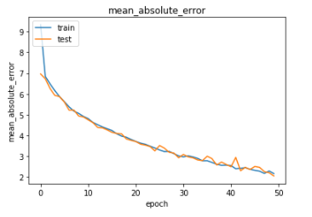
MAE Vs Epoch Curve for RNN
Fig . 3

Slide 8
Conclusion
From the results given in the previous graph we can conclude that Deep Neural Networks is preferably the best model for predicting the crop yield as it has the lowest Mean Absolute error.
In case of counting the crops from the images the accuracy is not very good due to small data-set but in feature the accuracy can be improved and the model can be made more accurate by increasing the size of the dataset.

Slide 9
References
Yuan, Jun Ni, Bingbing Kassim, Ashraf. (2014). Half-CNN: A General
Framework for Whole-Image Regression.
Keras, Regression, and CNNs, Adrian Rosebrock, January 28 2019,
unpublished
Choudhury, A. Jones, J.. (2014). Crop yield prediction using time series
models. Journal of Economics and Economic Education Research. 15.
53-68.

Slide 10
Thank You

