Slide 1

ML22/23-15 Approve Prediction of Multisequence Learning
1439256 - Vasanthakumar Ramesh Lakshmi
Notes:
Script is mentioned in notes for detail understanding while going through the presentation:
Slide 1:
Introduce yourself and name of experiment

Slide 2
Introduction
Analyse the existing code and understand algorithm
Generate learning sequences and save to file
Generate testing sequences out of learning sequences (subsequences) and save to file
Learn the sequence, test the subsequence and
Calculate prediction accurracy
Notes:
Slide 2: Introduction
In this experiment
1. I have tried to understand the multisequence learning and how the whole experiment works
2. How I could generate different and multiple sequences for learning purpose and save them to file
3. Create a subsequence which will be a subset of the learning sequences and save those to file as well
4. Of course we learn the sequences and predict using Multisequence learning
5. Calculate the prediction accuracy which is final goal

Slide 3
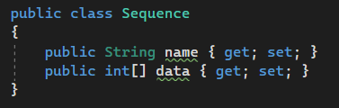
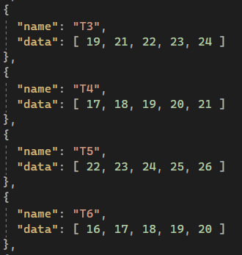
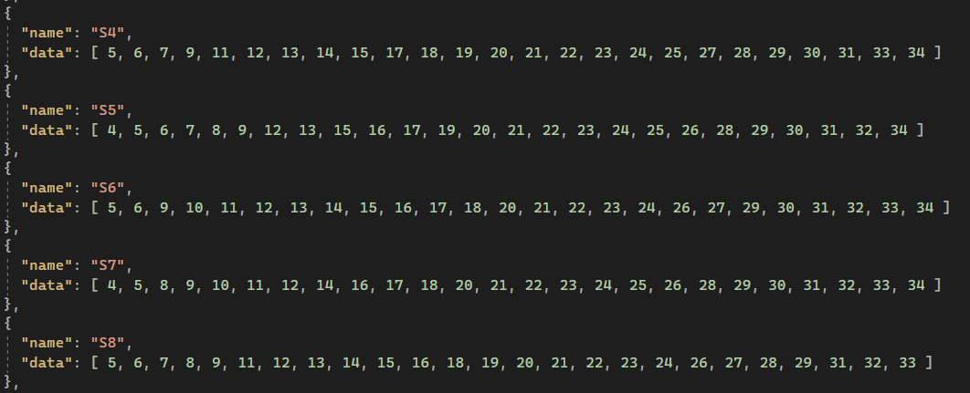
Approach: Sequence
A particular order in which related things follow each other
Sequence is the model of how we process and store the dataset.
Notes:
Slide 3: Approach Sequence
1. What is a sequence? A particular order in which related things follow each other
2. How are we using it? Sequence is the model of how we process and store the dataset
Show Image:
On the top you see is the class of Sequence and bottom left is acutal dataset and on right is test dataset

Slide 4
Implementation: Methods
MultisequenceHelper
HTM and Encoding Configs
Read and Save data
Get and Write to Log file
DatasetHelper
Creating dataset and validating config
Generating synthetic sequences
TestDatasetHelper
Creating test dataset and validating config
Creating subsequences from dataset
Notes:
Slide 4: Implementation Methods
I have divided the methods into 3 Helper classes
1. MultisequenceHelper Class: This class has methods which retrives HTM and Encoding configurations, Reads and Saves data to a file, Get and write data to log file
2. DatasetHelper Class: This class is maninly for creating dataset as per configurations which we will see further and validing the configurations before creating dataset
3. TestDatasetHelper Class: This class creates test dataset and these test dataset are created outof datataset

Slide 5
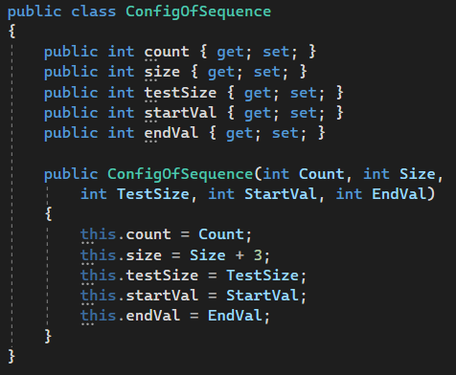
Implementation: Synthetic dataset and config
Count – number of sequences to be created
Size – length of each sequence (+3 is min. size)
TestSize – length of each subsequence
StartVal – start number of range
EndVal – end number of range
Notes:
Slide 5: Implementation Synthetuc dataset and config
Creating synthetic dataset with a given config is the main feature of this project where the dataset are created randomly within in a given range of number and the length of this sequence can be varied by adjusting the parameters.
Also the test dataset which are create a subset of the dataset and if the learning is done perfectly then it should have 100% accuracy theoritacally but we will discuss those number during results.

Slide 6
Implementation: Calculating Accuracy
Pseudocode
var matchCount = 0, prediction = 0
foreach( item in testSequence)
predictedNextItem = predict(item)
if(nextItem == predictedNextItem)
matchCount++
prediction++
var accuracy = matchCount / prediction * 100
Notes:
Slide 6: Implementation Caluclating Accuracy
When the prediction runs with the test sequence which are subset of dataset so we expect that the match should be 100% correct.
For a given then sequence, we take an element from test sequence and the predict the next element and compare the predicted next element with actual next element and if it matches the the matchedCounter is incremented, the predicttionCounter increments on each call of prection function.
We calculate accuracy when matched count compared to total prediction and we get the accuracy in precentage.

Slide 7
Results
Ran the experiments 20times in sprint
Learned over 1000 sequence of size 25 and tested with 200 sequence
Each run has different dataset and test data
Average run time was around 3.5hr
8runs 0% accuracy, 36runs 100% accuracy 58runs 75% accracy
Notes:
Slide 7: Results
1. Ran the experiment 20 times and the average time for each run was around 3.5hr
2. During those multiple runs, the algorithm learned over 1000sequences of size 25 or consisted of 25 elements and the test sequence counted as 200
3. Each run had different dataset and test data to get variety of data
4. Some numbers, only 8 sequencs gave 0% accuracy, 36 gave 100 accuracy which is the expected one since the test sequences are subset of dataset.

Slide 8

Improvements
Create a config json file for creating dataset
Runs the experiment with different configuration in cloud
Notes:
Slide 8: Improvements
Create a config json so that the experiment has more felixiblity and can be run in cloud with large sequences.

Slide 9

Thank you
Notes:
Thankyou!

