Slide 1
Analyzing Movie Popularity and Revenue with PySpark
TEAM ALPHA:
BHANU VENAKAT SIVA KUMAR
KHALIDA PARVEEN MOHAMMAD
MALAYA SUGANDHINI
VASANTHI YAKKALA

Slide 2




Vasanthi Yakkala
Bhanu venakata siva kumar
Malaya Sugandhini Seerapu
Khalida Mohammad

Slide 3
OUTLINE
INTRODUCTION
ARCHITECTURE FLOW
GOALS
RESULTS
CONCULSION

Slide 4
Introduction
The project analyzes a movie dataset with metrics like budget, release dates, genres, and popularity to identify success factors. Using PySpark ensures efficient data processing, while Power BI and Tableau help visualize trends, offering insights and recommendations for the film industry.
Notes:
This is bigdata final presentation

Slide 5
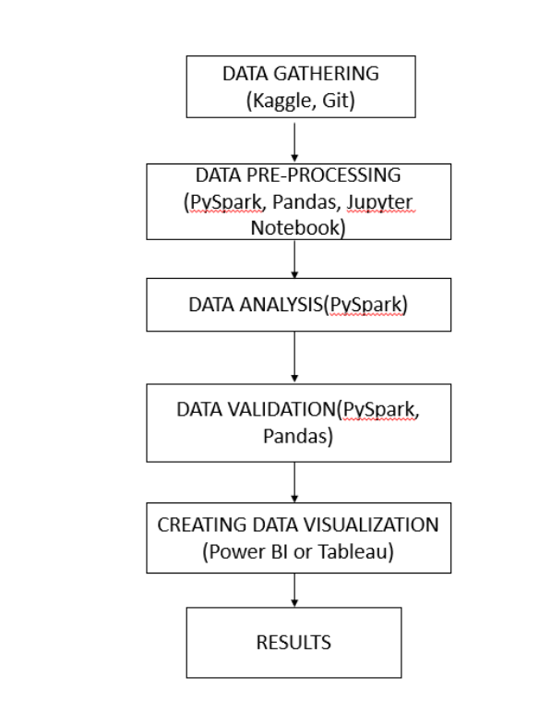
Architecture Flow

Slide 6
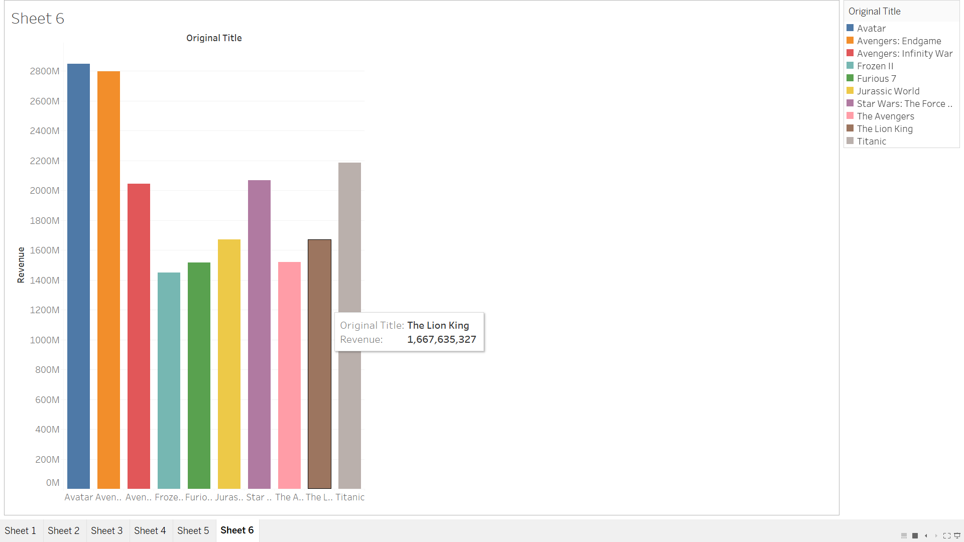
Top 10 Highest-Grossing Movies and Earnings
Goals
TopMovies =
spark . sql (””” SELECT originaltitle , revenue
FROM movies
ORDER BY
revenue DESC LIMIT 10 ””” )
topMovies . show ( )

Slide 7
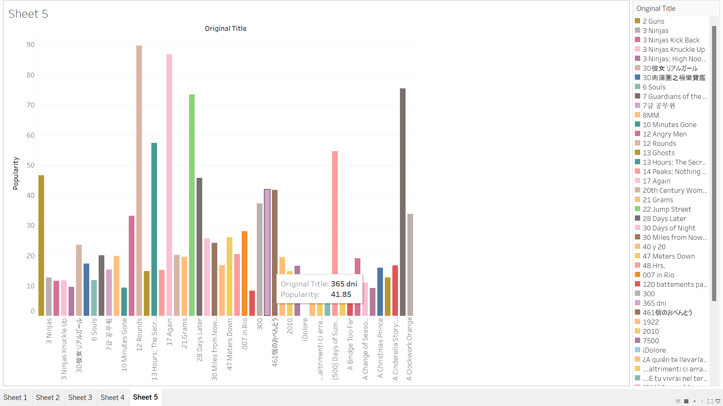
2. Movies Ordered by Popularity Score
sorted_by_popularity = movies_df .select(col("original_title").alias("Title"), col("popularity").cast("float").alias("Popularity")) .orderBy(desc("Popularity"))

Slide 8
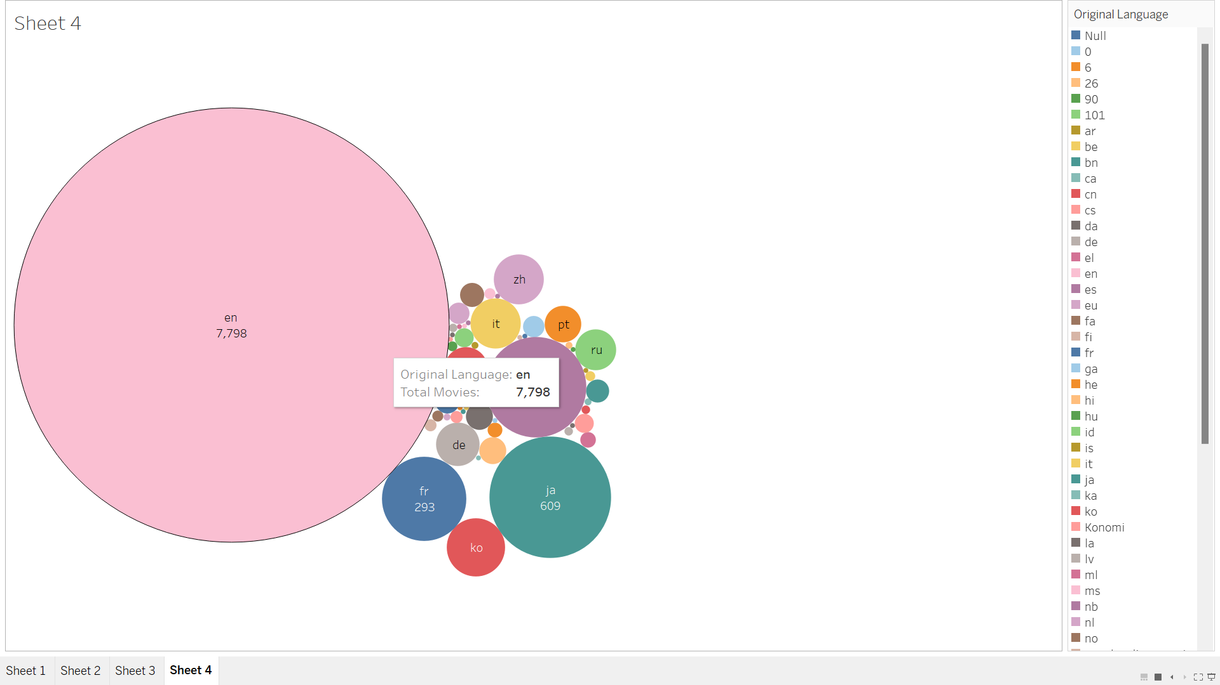
3. Total Movies Produced by Language
movies_by_language = movies_df .groupBy("original_language") .count() .orderBy("count", ascending=False)

Slide 9
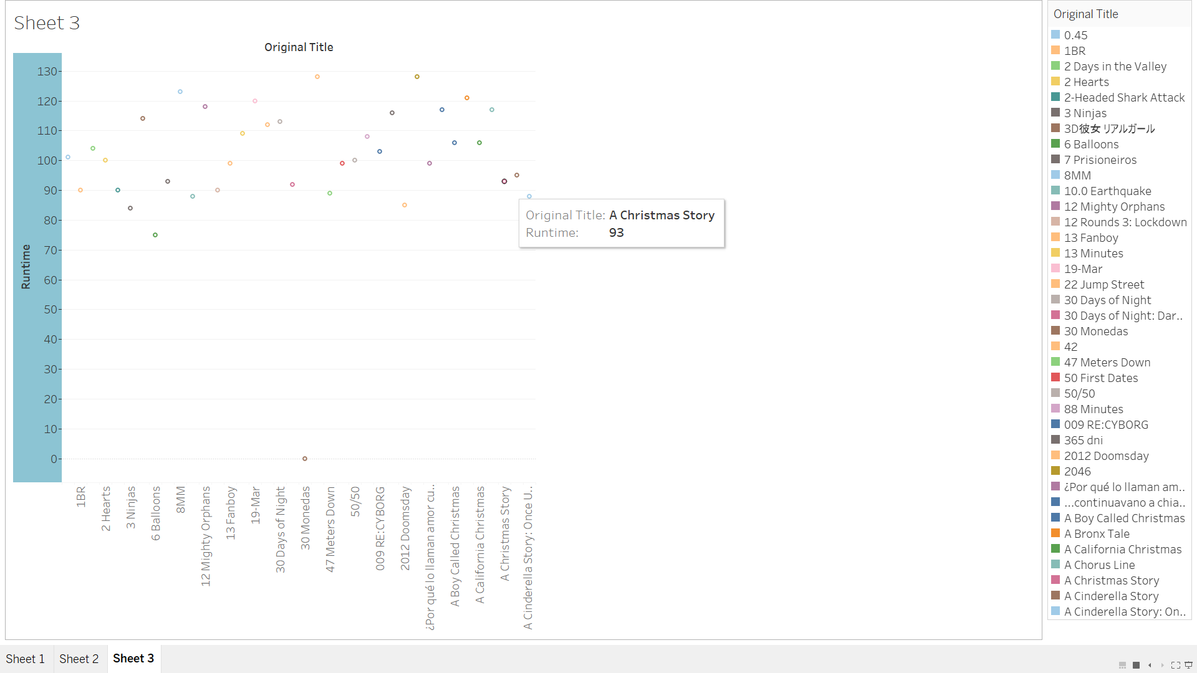
4. Fetch movies names with Longest Runtime
longest_runtime_movies = spark.sql("""
SELECT original_title, runtime
FROM movies
WHERE runtime IS NOT NULL
ORDER BY runtime DESC
""")
longest_runtime_movies.show()

Slide 10
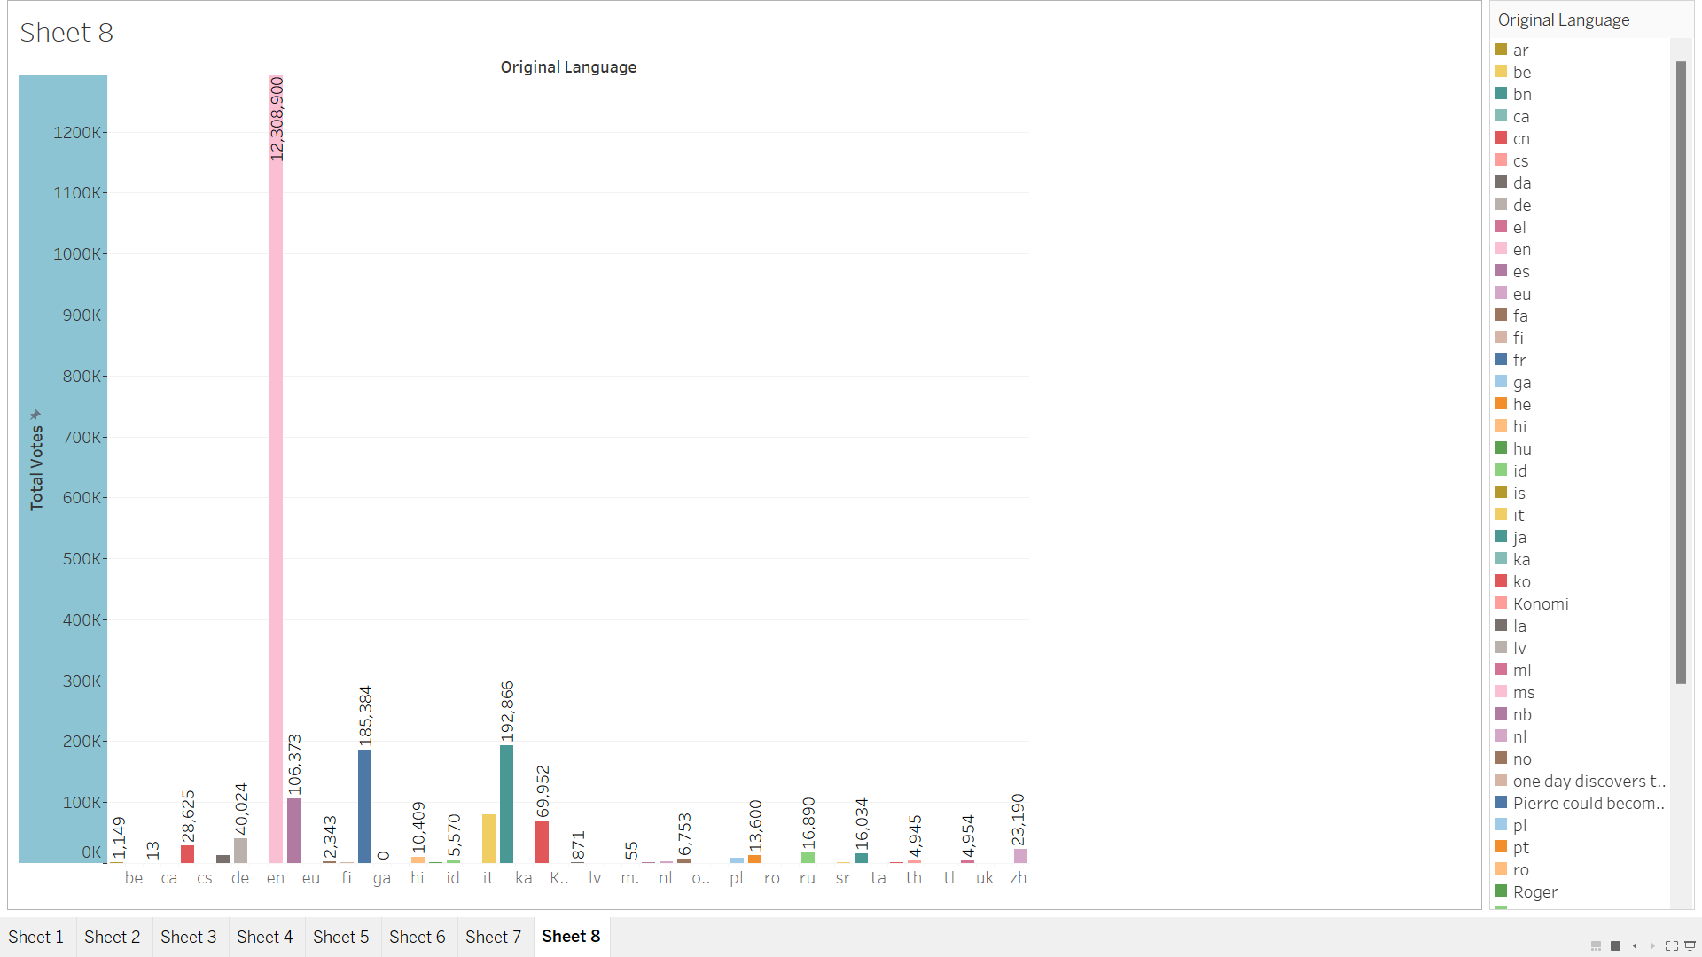
5. Determine the vote Count Per Language
vote_count_per_language = spark.sql("""
SELECT original_language, SUM(vote_count) AS total_votes
FROM movies
GROUP BY original_language
ORDER BY total_votes DESC
""")
vote_count_per_language.show()

Slide 11
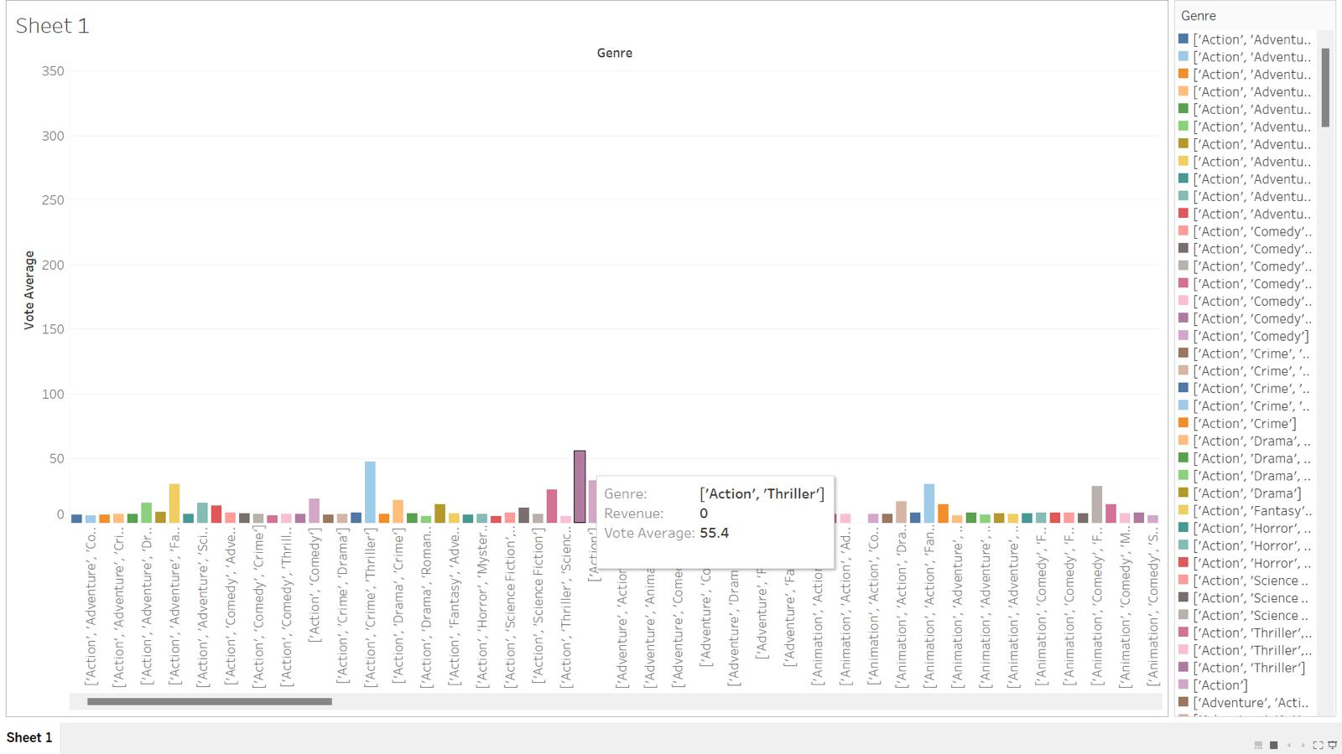
6. Determine the vote average per language
vote_average_per_language = spark.sql("""
SELECT original_language, AVG(vote_average) AS average_votes
FROM movies
GROUP BY original_language
ORDER BY average_votes DESC
""")
vote_average_per_language.show()

Slide 12
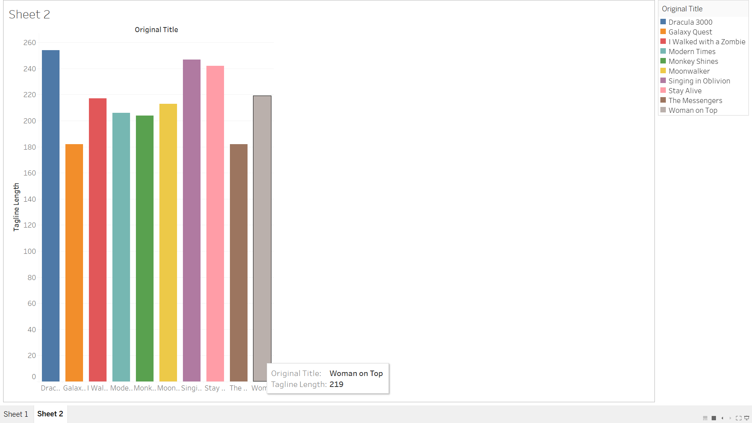
7. Determine the top Original titles with largest tagline
largest_tagline = spark.sql("""
SELECT original_title, tagline, LENGTH(tagline) AS tagline_length
FROM movies
WHERE tagline IS NOT NULL
ORDER BY tagline_length DESC
LIMIT 10
""")
largest_tagline.show()

Slide 13
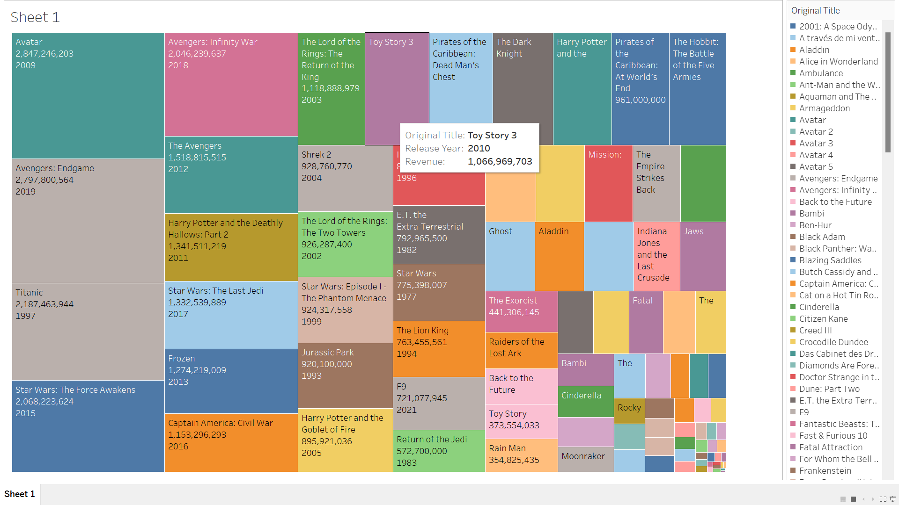
8. Determine the Highest Revenue Film in Each Year
highest_revenue_per_year = spark.sql("""
SELECT m.release_year, m.original_title, m.revenue
FROM (SELECT release_year, MAX(revenue) AS max_revenue FROM movies_with_year
WHERE revenue IS NOT NULL GROUP BY release_year) AS max_revenue_per_yearJOIN movies_with_year mON m.release_year = max_revenue_per_year.release_yearAND m.revenue = max_revenue_per_year.max_revenue""")highest_revenue_per_year.show()

Slide 14
9. Retrieve all movies Released in a given year
# Replace '2021' with the desired year
specific_year = 2021
movies_in_year = spark.sql(f"""
SELECT original_title, release_date, genre, revenue, runtime, vote_average
FROM movies_with_year
WHERE release_year = {specific_year}""")movies_in_year.show()

Slide 15
Conclusion
The analysis highlighted significant trends in movie success metrics using PySpark. Insights on audience preferences, revenue trends, and production strategies enable data-driven decision-making in the film industry.

Slide 16


