Slide 1


SMART INDIA HACKATHON 2025
Problem Statement ID – 25034
Problem Statement Title - AI-Based Internship Recommendation Engine for PM Internship Scheme.
Theme – Smart Education.
PS Category – Software.
Team ID-
Team Name (Registered on portal)-
FUTURE FIT AI POWERED INTERNSHIP NAVIGATOR

Slide 2
Future fit Navigator – An AI Powered
Internship Ecosystem
FUTURE FIT AI NAVIGATOR
Proposed Solution:
• An intelligent, all in one platform design to guide students to achieve their ideal internships.
• Inclusive system for rural, tribal, and remote students.
• Personalized matching using skills, education, interests, career goals
Innovation & Uniqueness:
• First-generation learners friendly
• Skill-gap analysis + AI matching
• Multilingual, user-friendly interface
How we address the problem:
- Reduces Overwhelm: Provides 3-5 personalized, AI-curated internship suggestions instead of hundreds of confusing listings.
- Empowers Inexperienced Applicants: Features an AI Resume Analyzer for ATS optimization and an AI Interview Dojo for practice and confidence-building.
- Offers On-Demand Guidance: The AI Career Assistant chat bot answers questions and guides users through the platform at any time.

Slide 3
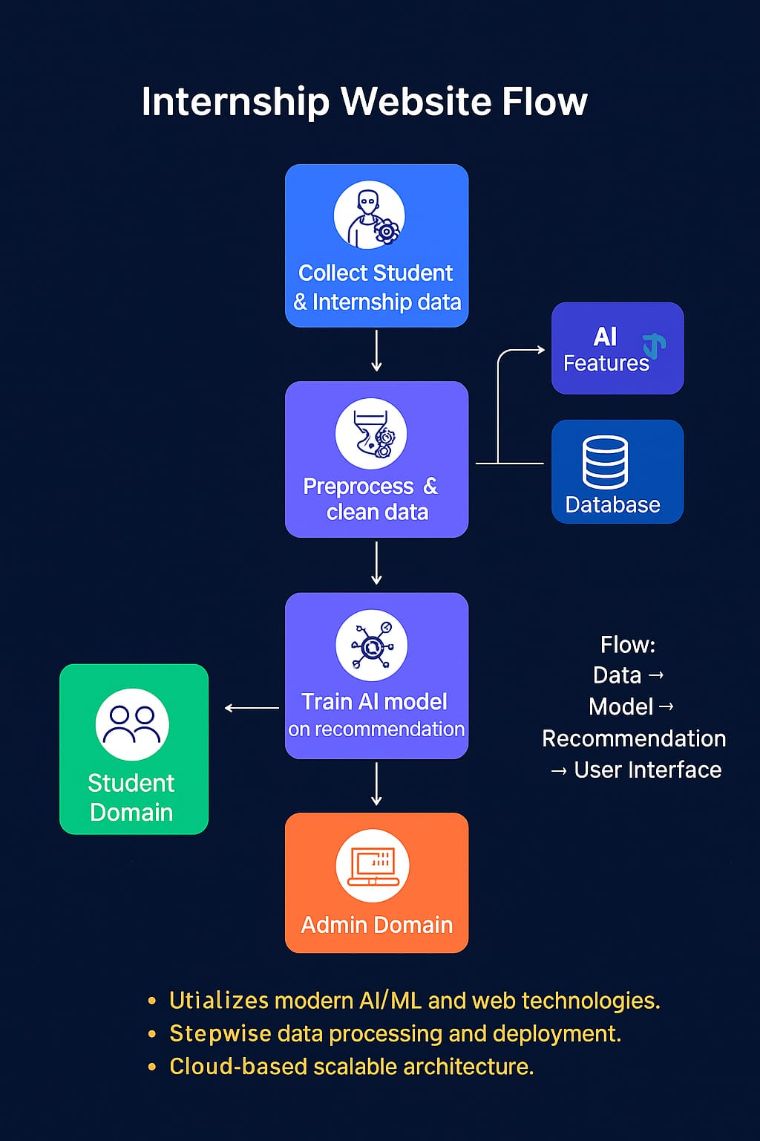
TECHNICAL APPROACH
FUTURE FIT AI NAVIGATOR
Internship Website Flow (Step-by-Step)
1. Collect Student & Internship Data
Students: profiles (skills, education, preferences)
Providers: internship details (requirements, duration, domain)
2. Preprocess & Clean Data
Remove errors, duplicates, missing values
Standardize & structure data for accuracy
3. Database & AI Features
Store cleaned data in database
Generate AI features: skill extraction, similarity scores, ranking
4. Train AI Model (Recommendation System)
Train model on student–internship patterns
Recommend best-fit internships
5. Student Domain
Students log in for personalized recommendations
Matches shown based on skills & preferences
6. Admin Domain
Manage data & internships
Update details, view analytics, monitor performance

Slide 4
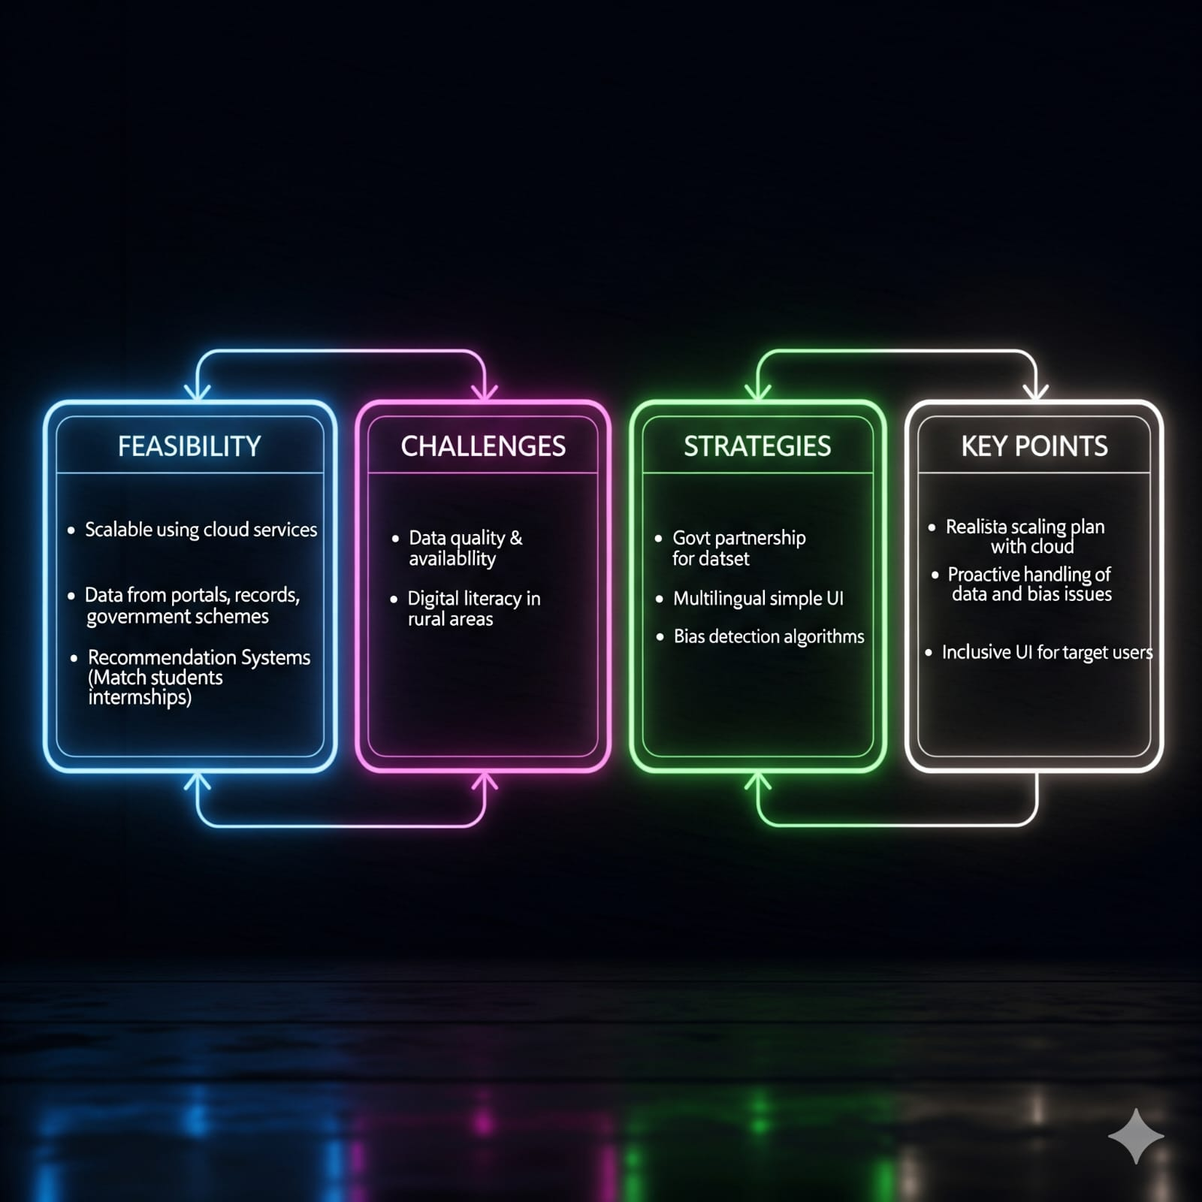
FEASIBILITY AND VIABILITY
FUTURE FIT AI NAVIGATOR
Feasibility:
Scalable using cloud services
Data from portals, records, government schemes
Recommendation Systems
(Match students internships)
Challenges:
Data quality & availability
Digital literacy in rural areas
Strategies:
Govt partnership for dataset
Multilingual simple UI
Bias detection algorithms
Key Points:
Realistic scaling plan with cloud
Proactive handling of data and bias issues
Inclusive UI for target users

Slide 5
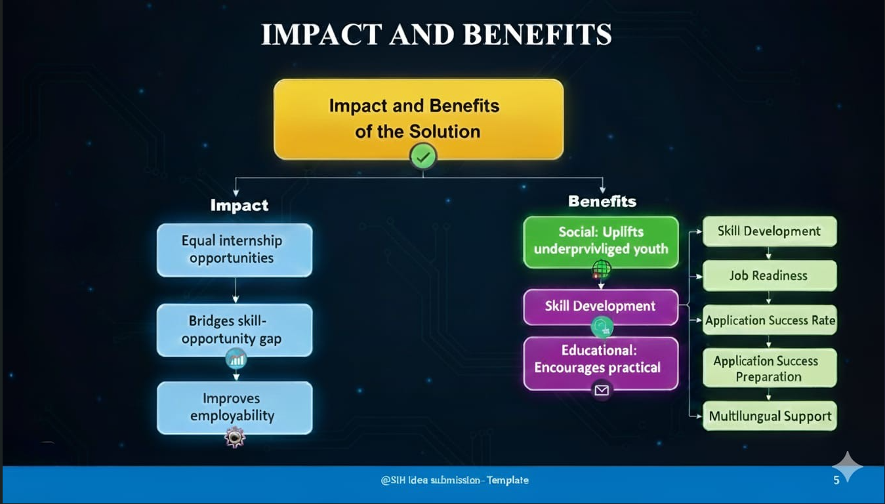
IMPACT AND BENEFITS
FUTURE FIT AI NAVIGATOR
Target Audience:
Students from rural, tribal, remote areas &
first-gen learners
Impact:
Equal internship opportunities
Bridges skill-opportunity gap
Improves employability
Benefits:
Social: Uplifts underprivileged youth
Economic: Workforce readiness
Educational: Encourages practical learning
Key Points:
Focused on social and economic upliftment
Enhances employability through practical access
Supports marginalized student groups

Slide 6
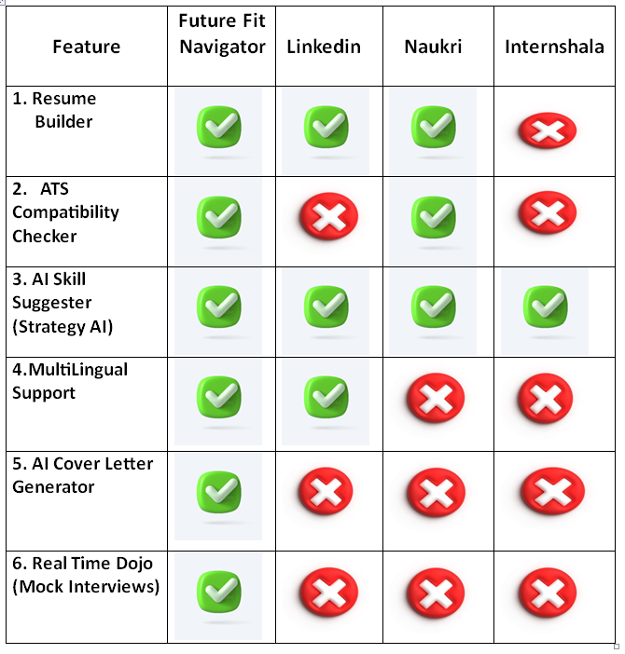
RESEARCH AND REFERENCES
FUTURE FIT AI NAVIGATOR
Research Sources:
LinkedIn Jobs, Naukri, Internshala
recommendation systems
AI/ML recommendation research papers
Govt reports on PM Internship Scheme
& rural education
References:
Ministry of Corporate Affairs website
https://www.mca.gov.in/content/mca/global/en/home.html
NITI Aayog, World Bank employability reports
https://www.niti.gov.in/

