Slide 1
Chapter 10: Project Communications Management
Information Technology Project Management, Ninth Edition
Note: See the text itself for full citations

Slide 2
Project Communications Management
The processes required to ensure timely and appropriate generation, collection, distribution, storage, retrieval, and ultimate disposition of project information
Strong verbal and non-technical skills are a key factor in career advancement for IT professionals

Slide 3
Learning Objectives (1 of 2)
Discuss the role of soft skills in IT project management, and highlight the importance of good communications as one means of achieving project success
Review key concepts related to communications
Explain the elements of planning project communications and how to create a communications management plan
Describe how to manage communications, including communication technologies, media, and performance reporting
Discuss methods for controlling communications to ensure that information needs are met throughout the life of the project
List various methods for improving project communications, such as running effective meetings, using various technologies effectively, and using templates

Slide 4
Learning Objectives (2 of 2)
Describe how software can enhance project communications management
Discuss considerations for agile/adaptive environments

Slide 5
The Importance of Project Communications Management (1 of 2)
Greatest threat to many projects is a failure to communicate
You cannot totally separate technical skills and soft skills when working on IT projects
For projects to succeed, every project team member needs both types of skills
Main processes in project communications management
Planning communications management
Managing communications
Monitoring communications

Slide 6
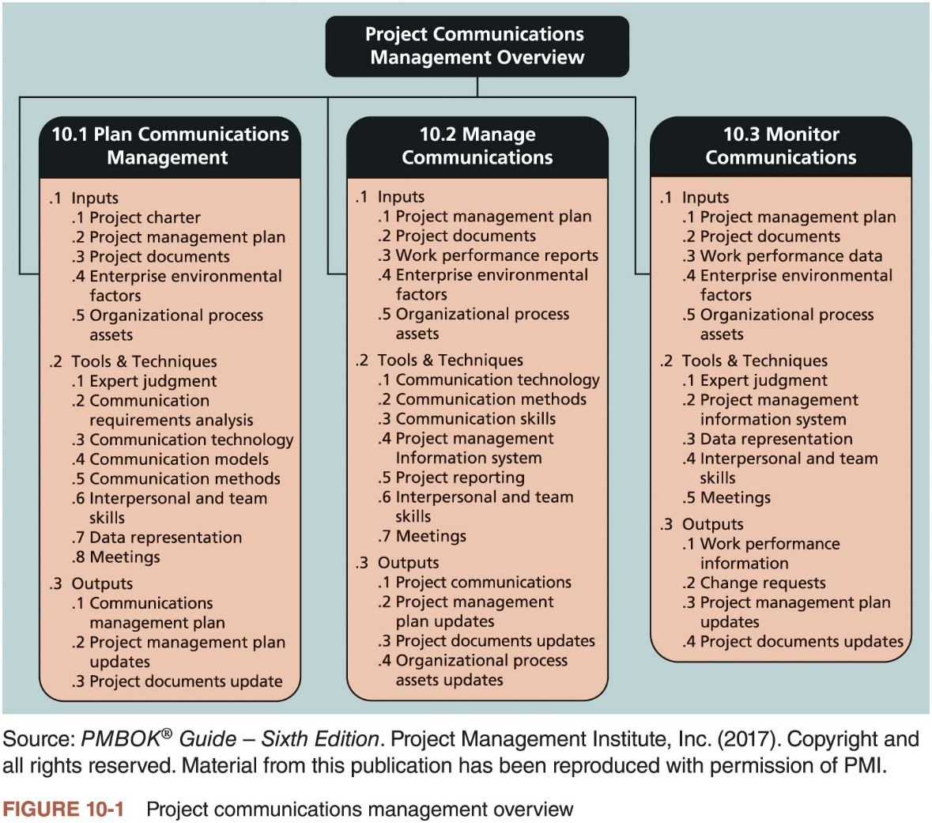
The Importance of Project Communications Management (2 of 2)
Notes:
.

Slide 7
Keys to Good Communications
Project managers say they spend as much as 90 percent of their time communicating
Several important concepts can help
Focus on group and individual communication needs
Use formal and informal methods for communicating
Distribute important information in an effective and timely manner
Set the stage for communicating bad news
Determine the number of communication channels

Slide 8
Focusing on Group and Individual Communication Needs
People are not interchangeable parts
As illustrated in Brooks’ book The Mythical Man-Month, you cannot assume that a task originally scheduled to take two months of one person’s time can be done in one month by two people
Nine women cannot produce a baby in one month
Every person is unique, so you cannot simply generalize based on a personality profile or other traits
Seek first to understand, as author Stephen Covey suggests in The 7 Habits of Highly Effective People
Put yourself in someone else’s shoes before you can truly communicate

Slide 9
Formal and Informal Methods for Communicating
Many people prefer informal communications
Several colleagues and managers want to know the people working on their projects and develop a trusting relationship with them
Oral communication also helps build stronger relationships among project personnel and project stakeholders
Effective creation and distribution of information depends on project managers and project team members having good communication skills

Slide 10
Distributing Information in an Effective and Timely Manner
Important considerations
Include detailed technical information that affects critical performance features of products or services
Document any changes in technical specifications that might affect product performance
Report bad news
Have short, frequent meetings

Slide 11
Setting the Stage for Communicating Bad News
It is important to put information in context, especially if it’s bad news
If there is a problem, know how it will affect the whole project and the organization
Recommend steps to take to mitigate a problem
Project managers should know how a major problem might affect the bottom line of the organization
Use leadership skills to handle the challenge

Slide 12
Determining the Number of Communications Channels (1 of 2)
As the number of people involved increases, the complexity of communications increases
More communications channels or pathways through which people can communicate
Number of communications channels = n(n-1)/2
(where n is the number of people involved)

Slide 13
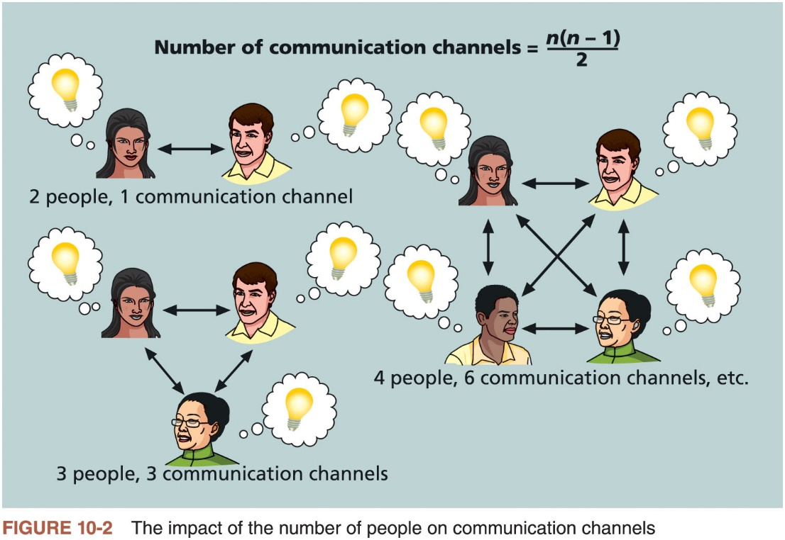
Determining the Number of Communications Channels (2 of 2)

Slide 14
The Importance of Project Communications Management (1 of 2)
Greatest threat to many projects is a failure to communicate
You cannot totally separate technical skills and soft skills when working on IT projects
For projects to succeed, every project team member needs both types of skills
Main processes in project communications management
Planning communications management
Managing communications
Monitoring communications

Slide 15
Planning Communications Management (1 of 3)
Every project should include some type of communications management plan
Guides project communications
Varies with the needs of the project, but some type of written plan should always be prepared
For small projects, the communications management plan can be part of the team contract
For large projects, it should be a separate document

Slide 16
Planning Communications Management (2 of 3)
Communications management plan contents
Stakeholder communications requirements
Information to be communicated, including format, content, and level of detail
Who will receive the information and who will produce it
Suggested methods or technologies for conveying the information
Frequency of communication
Escalation procedures for resolving issues
Revision procedures for updating the communications management plan
A glossary of common terminology

Slide 17
Planning Communications Management (3 of 3)
Stakeholders | Document Name | Document Format | Contact Person | Due
Customer management | Monthly status report | Hard copy and meeting | Tina Erndt, Tom Silva | First of month
Customer business staff | Monthly status report | Hard copy | Julie Grant, Sergey Cristobal | First of month
Customer technical staff | Monthly status report | E-mail | Li Chau, Nancy Michaels | First of month
Internal management | Monthly status report | Hard copy and meeting | Bob Thomson | First of month
Internal business and technical staff | Monthly status report | Intranet | Angie Liu | First of month
Training subcontractor | Training plan | Hard copy | Jonathan Kraus | November 1
Software subcontractor | Software implementation plan | E-mail | Najwa Gates | June 1
Comments: Put the titles and dates of documents in e-mail headings and have recipients acknowledge receipt.
Table 10-1 Sample stakeholder communications analysis

Slide 18
The Importance of Project Communications Management (1 of 2)
Greatest threat to many projects is a failure to communicate
You cannot totally separate technical skills and soft skills when working on IT projects
For projects to succeed, every project team member needs both types of skills
Main processes in project communications management
Planning communications management
Managing communications
Monitoring communications

Slide 19
Managing Communications
Managing communications is a large part of a project manager’s job
Getting project information to the right people at the right time and in a useful format is just as important as developing the information in the first place
Important considerations
Use of technology
Appropriate methods and media to use
Performance reporting

Slide 20
Using Technology to Enhance Creation and Distribution
Technology can facilitate the process of creating and distributing information, when used effectively
It is important to select the appropriate communication method and media

Slide 21
Selecting the Appropriate Communication Methods and Media
Classifications for communication methods
Interactive communication: two or more people interact to exchange information via meetings, phone calls, or video conferencing
Most effective way to ensure common understanding
Push communication: information is sent or pushed to recipients without their request via reports, e-mails, faxes, voice mails, and other means
Ensures that the information is distributed, but does not ensure that it was received or understood
Pull communication: information is sent to recipients at their request via websites, bulletin boards, e-learning, knowledge repositories like blogs, and other means

Slide 22
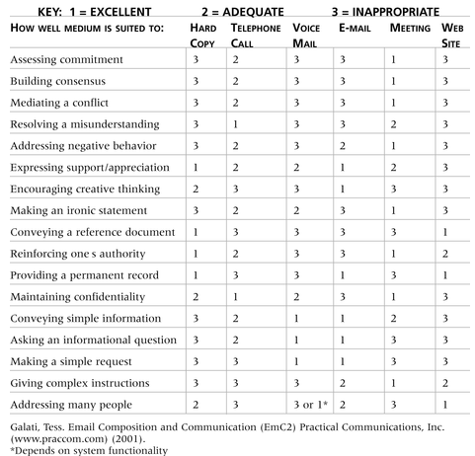
Media Choice Table

Slide 23
Reporting Performance
Performance reporting keeps stakeholders informed about how resources are being used to achieve project objectives
Progress reports describe what the project team has accomplished during a certain period of time
Status reports describe where the project stands at a specific point in time
Forecasts predict future project status and progress based on past information and trends

Slide 24
The Importance of Project Communications Management (1 of 2)
Greatest threat to many projects is a failure to communicate
You cannot totally separate technical skills and soft skills when working on IT projects
For projects to succeed, every project team member needs both types of skills
Main processes in project communications management
Planning communications management
Managing communications
Monitoring communications

Slide 25
Monitoring Communications
Main goal of monitoring communications is to
The project manager ensure the optimal flow of information throughout the entire project life cycle and project team should use expert judgment, project management information systems, data representation, interpersonal and team skills, and meetings to assess how well communications are working
If problems exist, the project manager and team need to take action, which often requires changes to the earlier processes of planning and managing project communications
It is often beneficial to have a facilitator from outside the project team assess how well communications are working

Slide 26
Suggestions for Improving Project Communications
Good communication is vital to the management and success of IT projects
Develop better communication skills
Run effective meetings
Use e-mail and other technologies effectively
Employ templates for project communications

Slide 27
Developing Better Communication Skills
Most companies spend a lot of money on technical training for employees, even when employees might benefit more from communications training
Individual employees are more likely to enroll voluntarily in classes to learn the latest technology than in classes that develop soft skills
As organizations become more global, they realize they must invest in ways to improve communication with people from different countries and cultures
It takes leadership to improve communication

Slide 28
Running Effective Meetings
Guidelines to help improve time spent at meetings
Determine if a meeting can be avoided
Define the purpose and intended outcome of the meeting
Determine who should attend the meeting
Provide an agenda to participants before the meeting
Prepare handouts and visual aids, and make logistical arrangements ahead of time
Run the meeting professionally
Set the ground rules for the meeting
Build relationships

Slide 29
Using E-Mail, Instant Messaging, Texting, Kanban Boards, and Collaborative Tools Effectively (1 of 2)
Guidelines to use e-mail as a more effective communication tool
Be sure to send information to the right people
Use meaningful subject lines and limit the content of emails to one main subject
Be as clear and concise as possible
Reread your e-mail before you send it
Limit the number and size of e-mail attachments
Delete e-mail that you do not need to save or that does not require a response
Make sure the virus protection software is up to date
Respond to e-mail quickly
If you need to keep e-mail, file each message appropriately

Slide 30
Using E-Mail, Instant Messaging, Texting, Kanban Boards, and Collaborative Tools Effectively (2 of 2)
Guidelines to help use other communication tools more effectively
Make sure that your team is using a good tool
Be sure to authorize the right people to share your collaborative documents
Make sure that the right person can authorize changes to shared documents and that you back up files
Develop a logical structure for organizing and filing shared documents

Slide 31
Using Templates for Project Communications (1 of 4)
Many people are afraid to ask for help
Providing examples and templates for project communications saves time and money
Finding, developing, and sharing relevant templates and sample documents are important tasks for many project managers
The project manager and project team members should prepare a lessons-learned report
Reflective statement that documents important information they have learned from working on the project
Project teams can use one of the many software products available to assist in project communications through the Web
Vary considerably in price and functionality

Slide 32
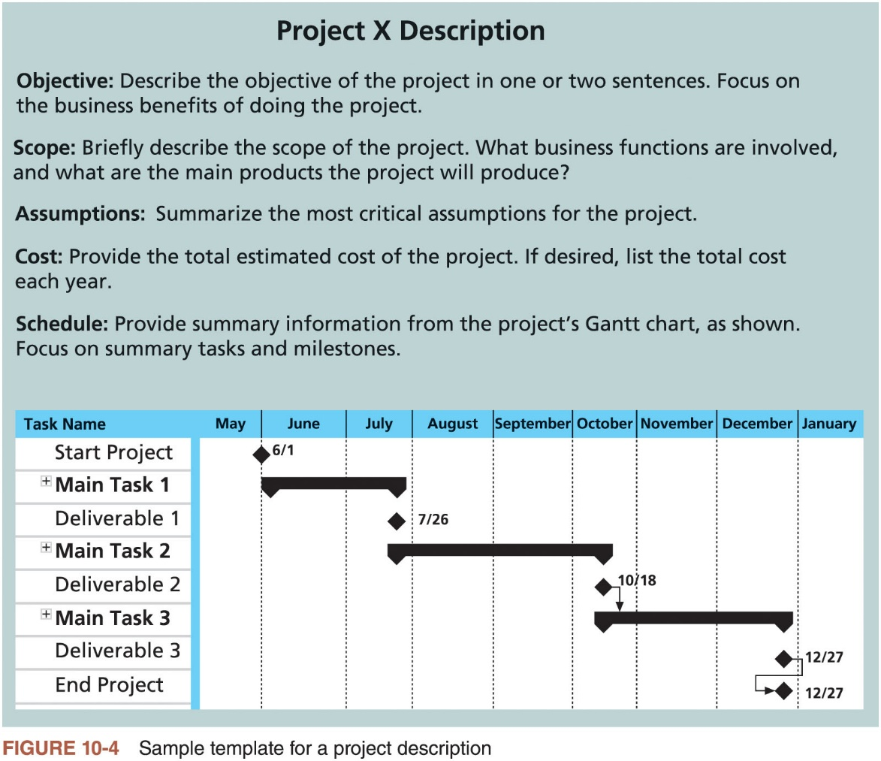
Using Templates for Project Communications (2 of 4)

Slide 33
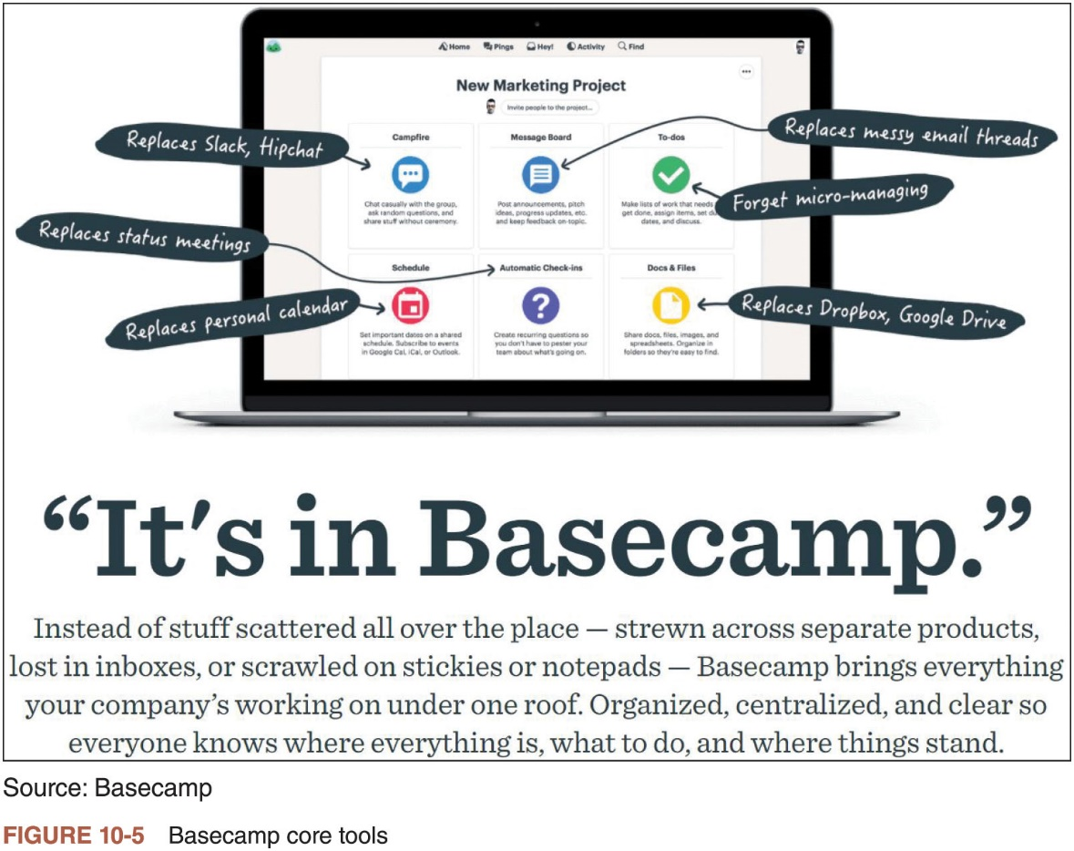
Using Templates for Project Communications (3 of 4)

Slide 34
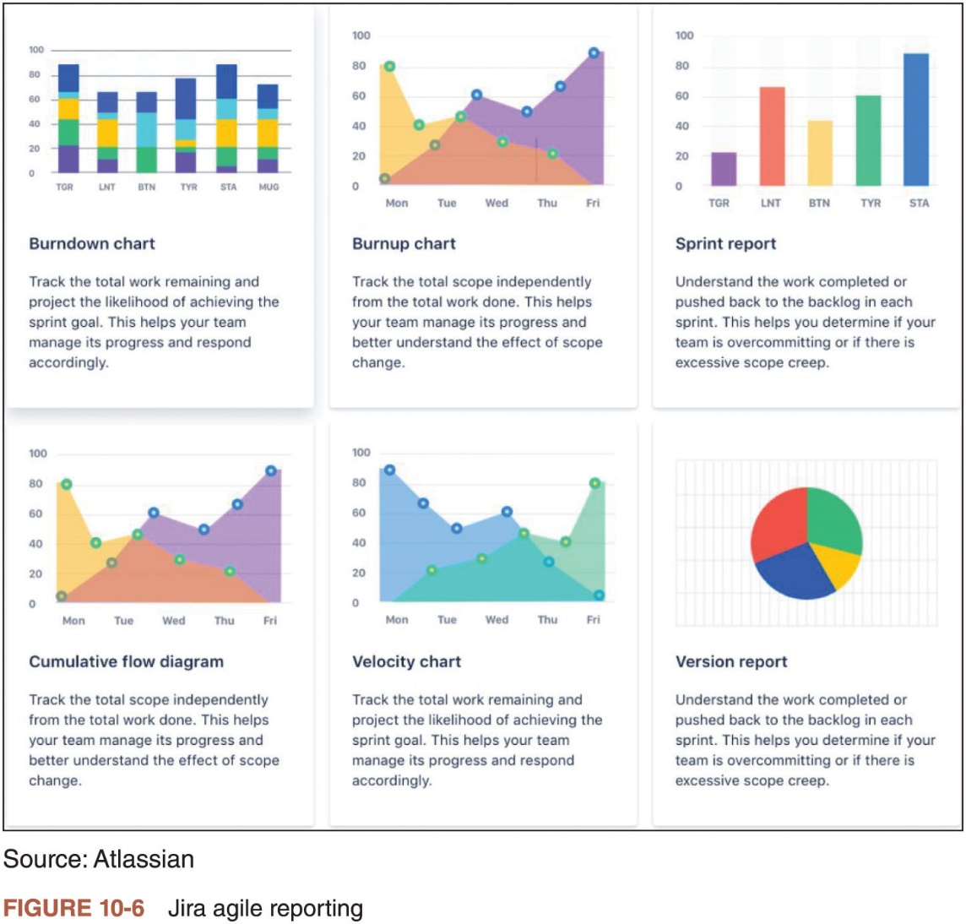
Using Templates for Project Communications (4 of 4)

Slide 35
Using Software to Assist in Project Communications (1 of 2)
Many organizations are discovering how valuable project management software can be in communicating project information across the organization
Project management software can provide different views of information to help meet various communication needs
Often, one of the biggest communication problems on projects is providing the most recent project plans, Gantt charts, specifications, meeting information, and change requests to stakeholders in a timely fashion
Most project management software allows users to insert hyperlinks to other project-related files

Slide 36
Using Software to Assist in Project Communications (2 of 2)
Many project management software products also provide tools to enhance communications
Portfolio management
Resource management
Project collaboration
Even with all of the technology available, many organizations have problems communicating on global projects
Issues with timing, audio, and video
Differences in culture and language

Slide 37
Considerations For Agile/Adaptive Environments (1 of 2)
Communications should be up to date, easily available, and reviewed regularly with stakeholders
Many projects involve people who do not work in close proximity to each other
Effectively planning for good project communications and using appropriate technology become even more important in these situations

Slide 38
Considerations For Agile/Adaptive Environments (2 of 2)
Communication is among the more important factors for success in project management
Technology can aid in the communications process and be the easiest aspect of the process to address, it is not the most important
Improving an organization’s ability to communicate is vital; often requires a cultural change in an organization that takes a lot of time, hard work, and patience

Slide 39
Chapter Summary (1 of 2)
Failure to communicate is often the greatest threat to the success of any project, especially IT projects
Communication is the oil that keeps a project running smoothly
Project communications management involves planning communications management, managing communications, and controlling communications
Project managers can spend as much as 90 percent of their time on communicating
There are several keys to good communications
A communications management plan of some type should be created for all projects to help ensure good communications
Contents will vary based on the needs of the project

Slide 40
Chapter Summary (2 of 2)
Managing communication includes creating and distributing project information
Various methods for distributing project information include formal, informal, written, and verbal
To improve project communications, project managers and their teams must develop their communication skills
Suggestions for improving project communications include learning how to run more effective meetings, how to use e-mail, instant messaging, texting, kanban boards, and collaborative software more effectively, and how to use templates for project communications
New hardware and software continue to become available to help improve communications.

