Slide 1
Chapter 11: Project Risk Management
Information Technology Project Management, Ninth Edition
Note: See the text itself for full citations

Slide 2
Learning Objectives (1 of 2)
Explain the concept of risk as it relates to project management, and list the advantages of managing project risks according to best practices
Discuss the elements of planning risk management and the contents of a risk management plan
List common sources of risks on information technology (IT) projects
Describe the process of identifying risks and create a risk register and risk report
Discuss qualitative risk analysis and explain how to calculate risk factors, create probability/impact matrixes, and apply the Top Ten Risk Item Tracking technique to rank risks

Slide 3
Learning Objectives (2 of 2)
Explain quantitative risk analysis and how to apply decision trees, simulation, and sensitivity analysis to quantify risks
Provide examples of using different risk response planning strategies to address both negative and positive risks
Discuss how to monitor risks
Describe how software can assist in project risk management
Discuss considerations for agile/adaptive environments

Slide 4
The Importance of Project Risk Management (1 of 7)
Project risk management is the art and science of identifying, analyzing, and responding to risk throughout the life of a project and in the best interests of meeting project objectives
Risk management is often overlooked in projects, but it can help improve project success by helping select good projects, determining project scope, and developing realistic estimates

Slide 5
The Importance of Project Risk Management (2 of 7)
Research shows a need to improve project risk management
Study by Ibbs and Kwak shows risk management has the lowest maturity rating of all knowledge areas
A similar survey was completed with software development companies in Mauritius, South Africa, and risk management also had the lowest maturity
KLCI study shows the benefits of following good software risk management practices

Slide 6
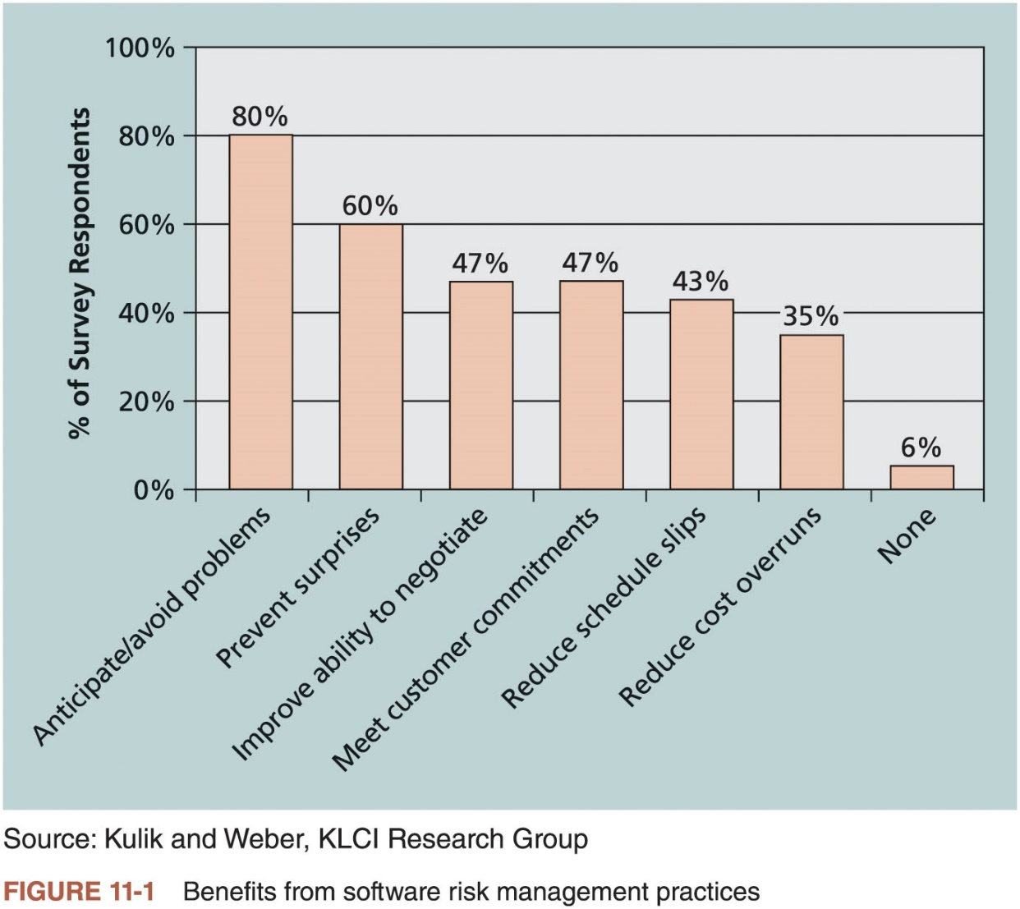
The Importance of Project Risk Management (3 of 7)

Slide 7
The Importance of Project Risk Management (4 of 7)
A dictionary definition of risk is “the possibility of loss or injury”
General definition of a project risk: an uncertainty that can have a negative or positive effect on meeting project objectives
Managing negative risks involves a number of possible actions that project managers can take to avoid, lessen, change, or accept the potential effects of risks on their projects
Positive risk management is like investing in opportunities

Slide 8
The Importance of Project Risk Management (5 of 7)
Risk utility is the amount of satisfaction or pleasure received from a potential payoff
Utility rises at a decreasing rate for people who are risk-averse
Those who are risk-seeking have a higher tolerance for risk and their satisfaction increases when more payoff is at stake
Risk-neutral approach achieves a balance between risk and payoff

Slide 9
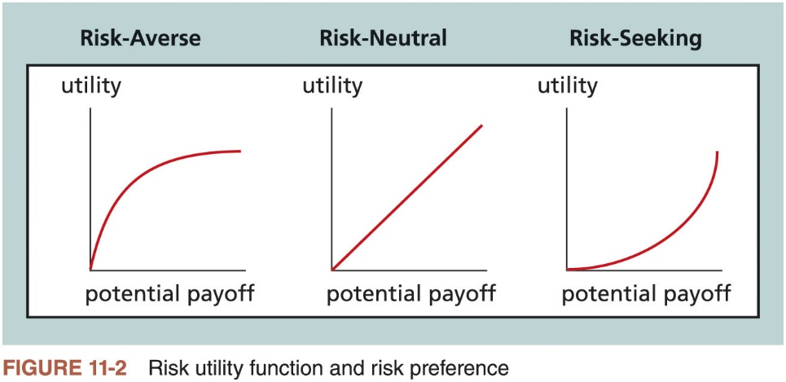
The Importance of Project Risk Management (6 of 7)

Slide 10
The Importance of Project Risk Management (7 of 7)
Project risk management processes
Planning risk management: deciding how to approach and plan the risk management activities for the project
Identifying risks: determining which risks are likely to affect a project and documenting the characteristics of each
Performing qualitative risk analysis: prioritizing risks based on their probability and impact of occurrence
Performing quantitative risk analysis: numerically estimating the effects of risks on project objectives
Planning risk responses: taking steps to enhance opportunities and reduce threats to meeting project objectives
Implementing risk responses: implementing the risk response plans
Monitoring risk: monitoring identified and residual risks, identifying new risks, carrying out risk response plans, and evaluating the effectiveness of risk strategies throughout the life of the project

Slide 11
Planning Risk Management (1 of 3)
Main output of this process is a risk management plan
Documents the procedures for managing risk throughout a project
The project team should review project documents as well as corporate risk management policies, risk categories, lessons-learned reports from past projects, and templates for creating a risk management plan
It is also important to review the risk tolerances of various stakeholders

Slide 12
Planning Risk Management (2 of 3)
Additional plans
Contingency plans: predefined actions that the project team will take if an identified risk event occurs
Fallback plans: developed for risks that have a high impact on meeting project objectives, and are put into effect if attempts to reduce the risk are not effective
Contingency reserves or allowances: funds included in the cost baseline that can be used to mitigate cost or schedule overruns if known risks occur
Management reserves: funds held for unknown risks that are used for management control purposes

Slide 13
Planning Risk Management (3 of 3)
Topic | Questions to Answer
Methodology | How will risk management be performed on this project? What tools and data sources are available and applicable?
Roles and responsibilities | Which people are responsible for implementing specific tasks and providing deliverables related to risk management?
Budget and schedule | What are the estimated costs and schedules for performing risk-related activities?
Risk categories | What are the main categories of risks that should be addressed on this project? Is there a risk breakdown structure for the project? (See the information on risk breakdown structures later in this chapter.)
Risk probability and impact | How will the probabilities and impacts of risk items be assessed? What scoring and interpretation methods will be used for the qualitative and quantitative analysis of risks? How will the probability and impact matrix be developed?
Revised stakeholders’ tolerances | Have stakeholders’ tolerances for risk changed? How will those changes affect the project?
Tracking | How will the team track risk management activities? How will lessons learned be documented and shared? How will risk management processes be audited?
Risk documentation | What reporting formats and processes will be used for risk management activities?
Table 11-2 Topics addressed in a risk management plan

Slide 14
Common Sources of Risk on IT Projects (1 of 3)
Several studies show that IT projects share some common sources of risk
The Standish Group developed an IT success potential scoring sheet based on potential risks
Other broad categories of risk help identify potential risks
Market risk
Financial risk
Technology risk
People risk
Structure/process risk
A risk breakdown structure is a hierarchy of potential risk categories for a project

Slide 15
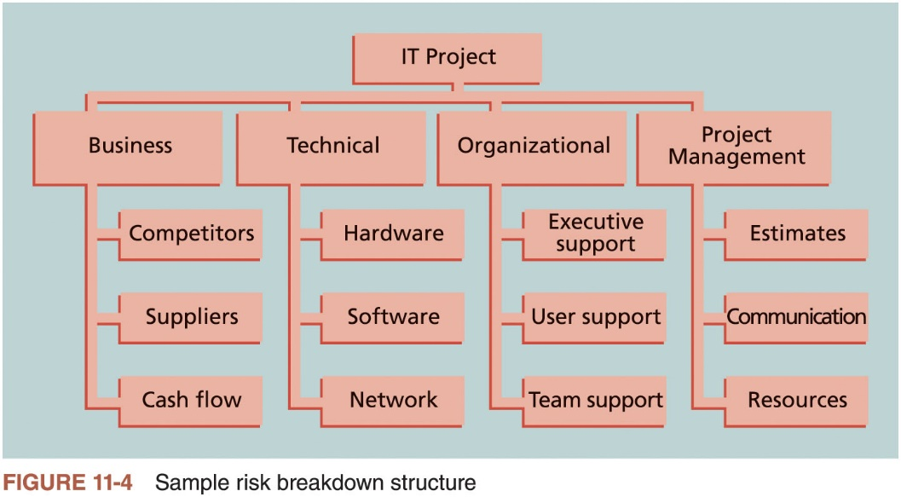
Common Sources of Risk on IT Projects (2 of 3)

Slide 16
Common Sources of Risk on IT Projects (3 of 3)
Knowledge Area | Risk Conditions
Integration | Inadequate planning; poor resource allocation; poor integration management; lack of post-project review
Scope | Poor definition of scope or work packages; incomplete definition
Time | Errors in estimating time or resource availability; errors in determining the critical path; poor allocation and management of float; early release of competitive products
Cost | Estimating errors; inadequate productivity, cost, change, or contingency
Quality | Poor attitude toward quality; substandard design, materials, and workmanship; inadequate quality assurance program
Human resource | Poor conflict management; poor project organization and definition of responsibilities; absence of leadership
Communications | Carelessness in planning or communicating
Risk | Ignoring risk; unclear analysis of risk; poor insurance management
Procurement | Unenforceable conditions or contract clauses; adversarial relations
Stakeholders | Lack of consultation with key stakeholder; poor sponsor engagement
Table 11-3 Potential negative risk conditions associated with each knowledge area. *Source: R.M. Wideman

Slide 17
The Importance of Project Risk Management (7 of 7)
Project risk management processes
Planning risk management: deciding how to approach and plan the risk management activities for the project
Identifying risks: determining which risks are likely to affect a project and documenting the characteristics of each
Performing qualitative risk analysis: prioritizing risks based on their probability and impact of occurrence
Performing quantitative risk analysis: numerically estimating the effects of risks on project objectives
Planning risk responses: taking steps to enhance opportunities and reduce threats to meeting project objectives
Implementing risk responses: implementing the risk response plans
Monitoring risk: monitoring identified and residual risks, identifying new risks, carrying out risk response plans, and evaluating the effectiveness of risk strategies throughout the life of the project

Slide 18
Identifying Risks (1 of 3)
Understanding what potential events might hurt or enhance a particular project
You cannot manage risks if you do not identify them first
Another consideration is the likelihood of advanced discovery
Often viewed at a program level rather than a project level
Suggestions for identifying risks: tools and techniques
Brainstorming
The Delphi Technique
Interviewing
SWOT analysis

Slide 19
Identifying Risks (2 of 3)
Brainstorming
Group attempts to generate ideas or find a solution for a specific problem by amassing ideas spontaneously and without judgment
An experienced facilitator should run the brainstorming session
Be careful not to overuse or misuse brainstorming
Psychology literature shows that individuals produce a greater number of ideas working alone than they do through brainstorming in small, face-to-face groups
Group effects often inhibit idea generation
Delphi Technique
Used to derive a consensus among a panel of experts who make predictions about future developments
Provides independent and anonymous input regarding future events
Uses repeated rounds of questioning and written responses and avoids the biasing effects possible in oral methods

Slide 20
Identifying Risks (3 of 3)
Interviewing
Fact-finding technique for collecting information in face-to-face, phone, e-mail, or virtual discussions
Interviewing people with similar project experience is an important tool for identifying potential risks
SWOT analysis
Strengths, weaknesses, opportunities, and threats
Helps identify the broad negative and positive risks that apply to a project

Slide 21
The Risk Register (1 of 4)
Important output of the risk identification process
List of identified risks and other information needed to begin creating a risk register
Contains the results of various risk management processes and that is often displayed in a table or spreadsheet format
Tool for documenting potential risk events and related information
Risk events refer to specific, uncertain events that may occur to the detriment or enhancement of the project

Slide 22
The Risk Register (2 of 4)
Risk register contents
Identification number for each risk event
Rank for each risk event
Name of each risk event
Description of each risk event
Category under which each risk event falls
Root cause of each risk
Triggers for each risk; indicators or symptoms of actual risk events
Potential responses to each risk
Risk owner or person who will own or take responsibility for each risk
Probability and impact of each risk occurring
Status of each risk

Slide 23
The Risk Register (3 of 4)
No. | Rank | Risk | Description | Category | Root Cause | Triggers | Potential Responses | Risk Owner | Probability | Impact | Status
R44 | 1
R21 | 2
R7 | 3
Table 11-4 Sample risk register

Slide 24
The Risk Register (4 of 4)
Risk report contents
Sources of overall project risk
Important drivers of overall project risk exposure
Summary information on risk events

Slide 25
The Importance of Project Risk Management (7 of 7)
Project risk management processes
Planning risk management: deciding how to approach and plan the risk management activities for the project
Identifying risks: determining which risks are likely to affect a project and documenting the characteristics of each
Performing qualitative risk analysis: prioritizing risks based on their probability and impact of occurrence
Performing quantitative risk analysis: numerically estimating the effects of risks on project objectives
Planning risk responses: taking steps to enhance opportunities and reduce threats to meeting project objectives
Implementing risk responses: implementing the risk response plans
Monitoring risk: monitoring identified and residual risks, identifying new risks, carrying out risk response plans, and evaluating the effectiveness of risk strategies throughout the life of the project

Slide 26
Performing Qualitative Risk Analysis
Assess the likelihood and impact of identified risks to determine their magnitude and priority
Risk quantification tools and techniques
Probability/impact matrixes
The Top Ten Risk Item Tracking
Expert judgment

Slide 27
Using Probability/Impact Matrixes to Calculate Risk Factors (1 of 3)
Lists relative probability of a risk occurring on one side of a matrix or axis on a chart and the relative impact of the risk occurring
List the risks and then label each one as high, medium, or low in terms of its probability of occurrence and its impact if it did occur
Calculates risk factors
Numbers that represent the overall risk of specific events based on their probability of occurring and the consequences to the project if they do occur

Slide 28
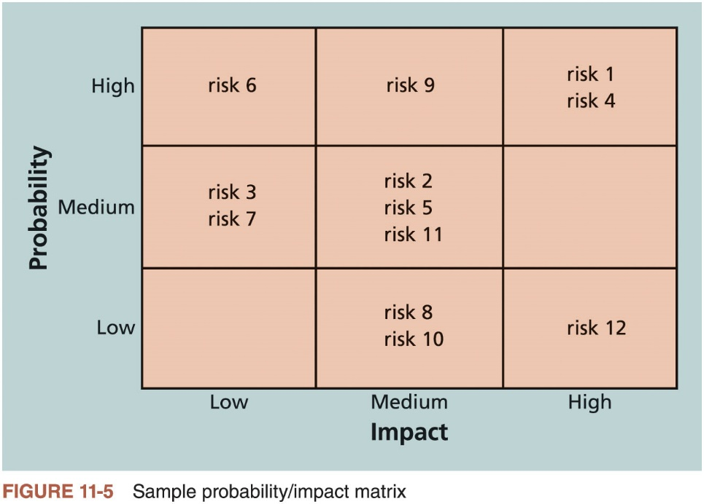
Using Probability/Impact Matrixes to Calculate Risk Factors (2 of 3)

Slide 29
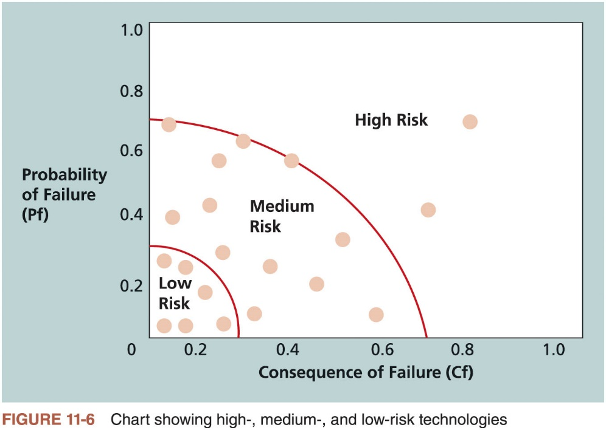
Using Probability/Impact Matrixes to Calculate Risk Factors (3 of 3)

Slide 30
Top Ten Risk Item Tracking (1 of 2)
Qualitative risk analysis tool that helps to identify risks and maintain an awareness of risks throughout the life of a project
Involves establishing a periodic review of the top ten project risk items
Includes the current ranking, previous ranking, number of times the risk appears on the list over a period of time, and a summary of progress made in resolving the risk item
A watch list is a list of risks that are low priority, but are still identified as potential risks
Qualitative analysis can also identify risks that should be evaluated quantitatively

Slide 31
Top Ten Risk Item Tracking (2 of 2)
 | Monthly Ranking | Monthly Ranking | Monthly Ranking
Risk Event | Rank This Month | Rank Last Month | Number of Months in Top Ten | Risk Resolution Progress
Inadequate planning | 1 | 2 | 4 | Working on revising the entire project management plan
Poor definition | 2 | 3 | 3 | Holding meetings with project customer and sponsor to clarify scope
Absence of leadership | 3 | 1 | 2 | Assigned a new project manager to lead the project after the previous one quit
Poor cost estimates | 4 | 4 | 3 | Revising cost estimates
Poor time estimates | 5 | 5 | 3 | Revising schedule estimates
Table 11-5 Example of top ten risk item tracking

Slide 32
The Importance of Project Risk Management (7 of 7)
Project risk management processes
Planning risk management: deciding how to approach and plan the risk management activities for the project
Identifying risks: determining which risks are likely to affect a project and documenting the characteristics of each
Performing qualitative risk analysis: prioritizing risks based on their probability and impact of occurrence
Performing quantitative risk analysis: numerically estimating the effects of risks on project objectives
Planning risk responses: taking steps to enhance opportunities and reduce threats to meeting project objectives
Implementing risk responses: implementing the risk response plans
Monitoring risk: monitoring identified and residual risks, identifying new risks, carrying out risk response plans, and evaluating the effectiveness of risk strategies throughout the life of the project

Slide 33
Performing Quantitative Risk Analysis
Often follows qualitative risk analysis, but both can be done together
Large, complex projects involving leading edge technologies often require extensive quantitative risk analysis
Main techniques
Decision tree analysis
Simulation
Sensitivity analysis

Slide 34
Decision Trees and Expected Monetary Value (EMV) (1 of 2)
A decision tree is a diagramming analysis technique used to help select the best course of action in situations in which future outcomes are uncertain
Estimated monetary value (EMV) is the product of a risk event probability and the risk event’s monetary value
You can draw a decision tree to help find the EMV

Slide 35
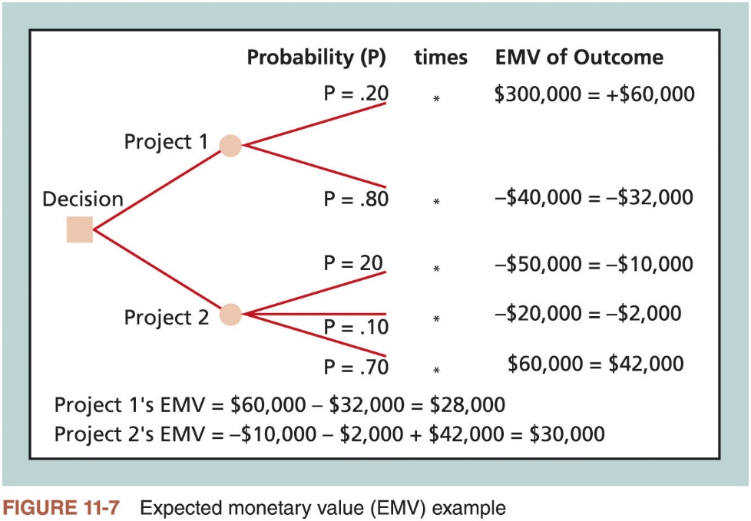
Decision Trees and Expected Monetary Value (EMV) (2 of 2)

Slide 36
Simulation (1 of 3)
Uses a representation or model of a system to analyze the expected behavior or performance of the system
Monte Carlo analysis simulates a model’s outcome many times to provide a statistical distribution of the calculated results
Predict the probability of finishing by a certain date or the probability that the cost will be equal to or less than a certain value
You can use several different types of distribution functions when performing a Monte Carlo analysis

Slide 37
Simulation (2 of 3)
Steps of a Monte Carlo analysis
Collect the most likely, optimistic, and pessimistic estimates for the variables in the model
Determine the probability distribution of each variable
Select a random value based on the probability distribution for each variable
Run a deterministic analysis or one pass through the model
Repeat steps three and four many times to obtain the probability distribution of the model’s results

Slide 38
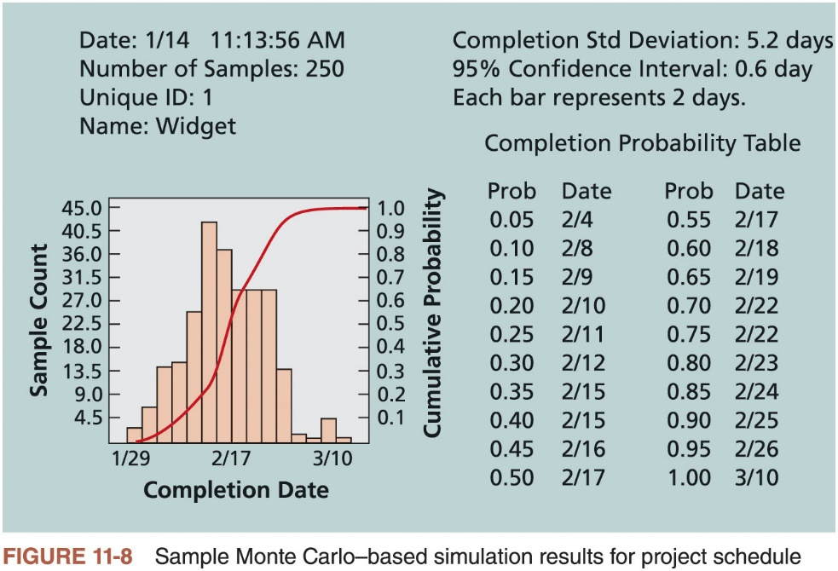
Simulation (3 of 3)

Slide 39
Sensitivity Analysis (1 of 2)
Used to show the effects of changing one or more variables on an outcome
For example, many people use it to determine what the monthly payments for a loan will be given different interest rates or periods of the loan
Spreadsheet software, such as Microsoft Excel, is a common tool for performing sensitivity analysis

Slide 40
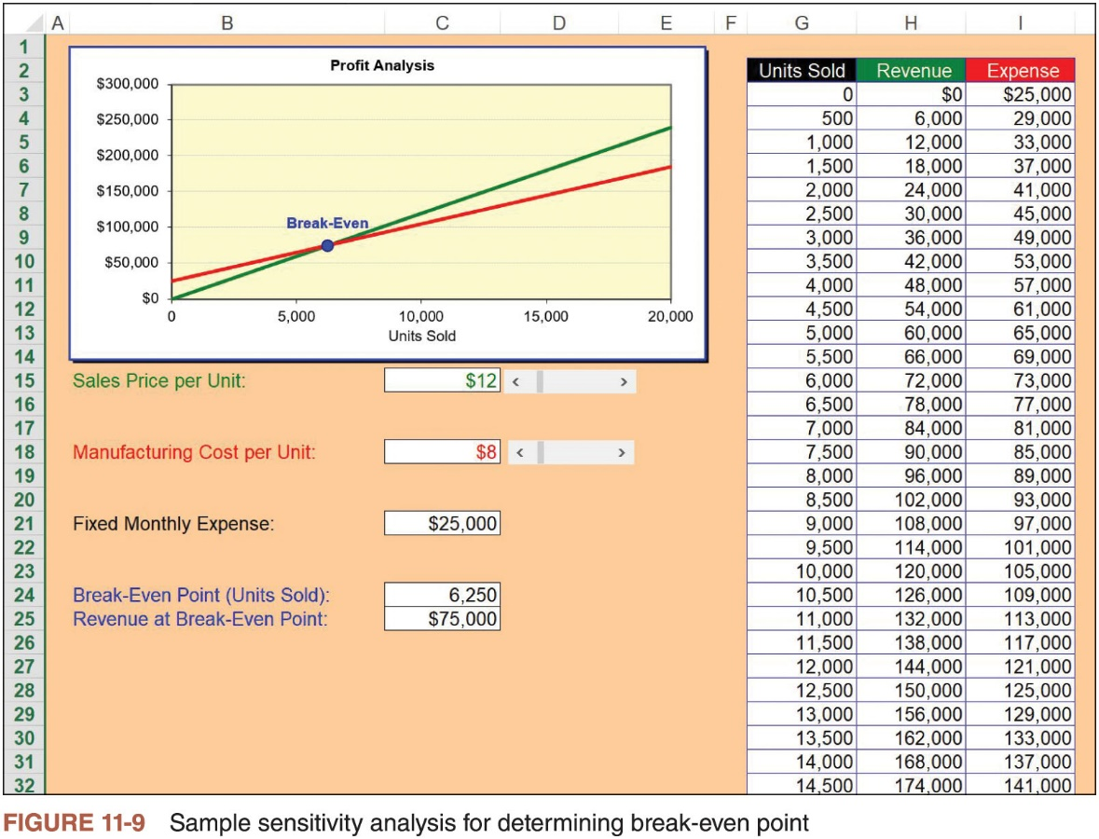
Sensitivity Analysis (2 of 2)

Slide 41
The Importance of Project Risk Management (7 of 7)
Project risk management processes
Planning risk management: deciding how to approach and plan the risk management activities for the project
Identifying risks: determining which risks are likely to affect a project and documenting the characteristics of each
Performing qualitative risk analysis: prioritizing risks based on their probability and impact of occurrence
Performing quantitative risk analysis: numerically estimating the effects of risks on project objectives
Planning risk responses: taking steps to enhance opportunities and reduce threats to meeting project objectives
Implementing risk responses: implementing the risk response plans
Monitoring risk: monitoring identified and residual risks, identifying new risks, carrying out risk response plans, and evaluating the effectiveness of risk strategies throughout the life of the project

Slide 42
Planning Risk Responses (1 of 3)
After identifying and quantifying risks, the organization must decide how to respond to them
Basic response strategies for negative risks
Risk avoidance
Risk acceptance
Risk transference
Risk mitigation
Risk escalation
Basic response strategies for positive risks
Risk exploitation
Risk sharing
Risk enhancement
Risk acceptance
Risk escalation

Slide 43
Planning Risk Responses (2 of 3)
Technical Risks | Cost Risks | Schedule Risks
Emphasize team support and avoid stand-alone project structure | Increase the frequency of project monitoring | Increase the frequency of project monitoring
Increase project manager authority | Use WBS and CPM | Use WBS and CPM
Improve problem handling and communication | Improve communication, understanding of project goals, and team support | Select the most experienced project manager
Increase the frequency of project monitoring | Increase project manager authority
Use WBS and CPM
Table 11-6 General risk mitigation strategies for technical, cost, and schedule risks. *Source: J. Couillard

Slide 44
Planning Risk Responses (3 of 3)
It’s also important to identify residual and secondary risks
Residual risks: risks that remain after all of the response strategies have been implemented
Secondary risks: direct result of implementing a risk response

Slide 45
The Importance of Project Risk Management (7 of 7)
Project risk management processes
Planning risk management: deciding how to approach and plan the risk management activities for the project
Identifying risks: determining which risks are likely to affect a project and documenting the characteristics of each
Performing qualitative risk analysis: prioritizing risks based on their probability and impact of occurrence
Performing quantitative risk analysis: numerically estimating the effects of risks on project objectives
Planning risk responses: taking steps to enhance opportunities and reduce threats to meeting project objectives
Implementing risk responses: implementing the risk response plans
Monitoring risk: monitoring identified and residual risks, identifying new risks, carrying out risk response plans, and evaluating the effectiveness of risk strategies throughout the life of the project

Slide 46
Implementing Risk Responses
Main executing process performed as part of project risk management is implementing risk responses
Key outputs
Change requests
Project documents updates

Slide 47
The Importance of Project Risk Management (7 of 7)
Project risk management processes
Planning risk management: deciding how to approach and plan the risk management activities for the project
Identifying risks: determining which risks are likely to affect a project and documenting the characteristics of each
Performing qualitative risk analysis: prioritizing risks based on their probability and impact of occurrence
Performing quantitative risk analysis: numerically estimating the effects of risks on project objectives
Planning risk responses: taking steps to enhance opportunities and reduce threats to meeting project objectives
Implementing risk responses: implementing the risk response plans
Monitoring risk: monitoring identified and residual risks, identifying new risks, carrying out risk response plans, and evaluating the effectiveness of risk strategies throughout the life of the project

Slide 48
Monitoring Risks
Involves ensuring the appropriate risk responses are performed, tracking identified risks, identifying and analyzing new risk, and evaluating effectiveness of risk management throughout the entire project
Project risk management does not stop with the initial risk analysis
Carrying out individual risk management plans involves monitoring risks based on defined milestones and making decisions regarding risks and their response strategies
Project teams sometimes use workarounds—unplanned responses to risk events—when they do not have contingency plans in place

Slide 49
Using Software to Assist in Project Risk Management
Risk registers can be created in a simple Microsoft Word or Excel file or as part of a sophisticated database
More sophisticated risk management software, such as Monte Carlo simulation tools, help develop models and use simulations to analyze and respond to various risks

Slide 50
Considerations for Agile/Adaptive Environments
All types of projects should share knowledge related to risks as quickly as possible and keep documents up to date
Risk is considered during each iteration for agile/adaptive projects, which does elevate its importance
Changing priorities can be addressed more easily by changing the product backlog for each iteration

Slide 51
Chapter Summary
Risk is an uncertainty that can have a negative or positive effect on meeting project objectives
Many organizations do a poor job of project risk management, if they do any at all
Successful organizations realize the value of good project risk management
Risk management is an investment
Costs are associated with identifying risks, analyzing those risks, and establishing plans to address them
Implementing risk responses involves putting the appropriate risk response plans into action
Monitoring risks involves monitoring implementation of risk response plans, tracking identified risks, identifying and analyzing new risks, and evaluating effectiveness of risk management throughout the entire project

