Slide 1

Chapter 2: The Project Management and Information Technology Context
Information Technology Project Management, Eighth Edition
Note: See the text itself for full citations.

Slide 2
Learning Objectives
Describe the systems view of project management and how it applies to information technology (IT) projects
Understand organizations, including the four frames, organizational structures, and organizational culture
Explain why stakeholder management and top management commitment are critical for a project’s success

Slide 3
Learning Objectives
Understand the concept of a project phase and the project life cycle, and distinguish between project development and product development
Discuss the unique attributes and diverse nature of IT projects
Describe recent trends affecting IT project management, including globalization, outsourcing, virtual teams, and agile project management

Slide 4
A Systems View of Project Management
A systems approach emerged in the 1950s to describe a more analytical approach to management and problem solving
Three parts include:
Systems philosophy: an overall model for thinking about things as systems
Systems analysis: problem-solving approach
Systems management: address business, technological, and organizational issues before making changes to systems

Slide 5
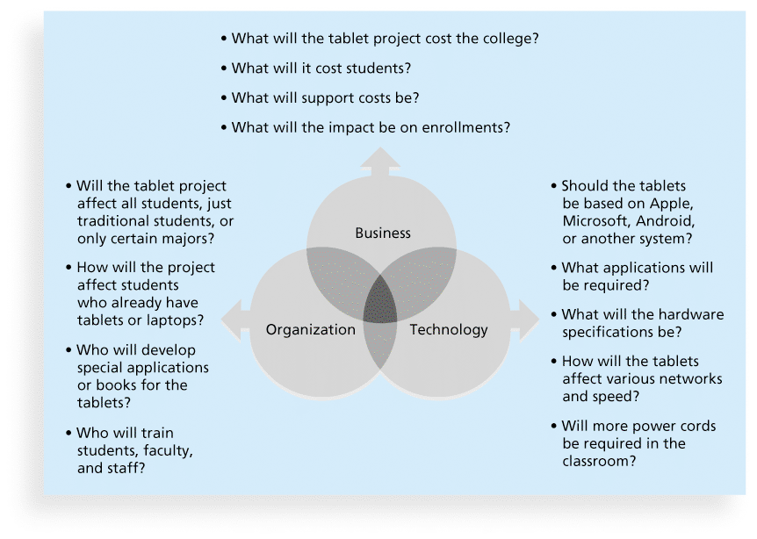
Figure 2-1. Three Sphere Model for Systems Management

Slide 6
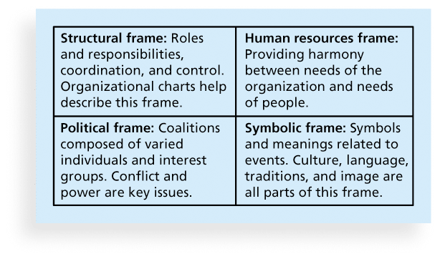
Figure 2-2. Perspectives on Organizations

Slide 7
Organizational Structures
3 basic organization structures
Functional: functional managers report to the CEO
Project: program managers report to the CEO
Matrix: middle ground between functional and project structures; personnel often report to two or more bosses; structure can be weak, balanced, or strong matrix

Slide 8
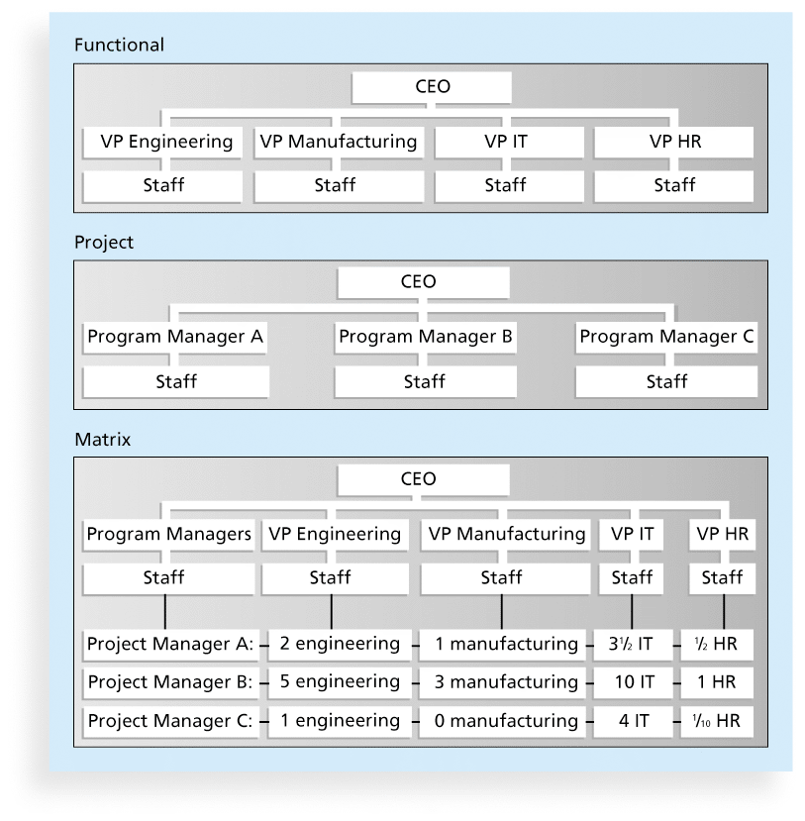
Figure 2-3. Functional, Project, and Matrix Organizational Structures

Slide 9
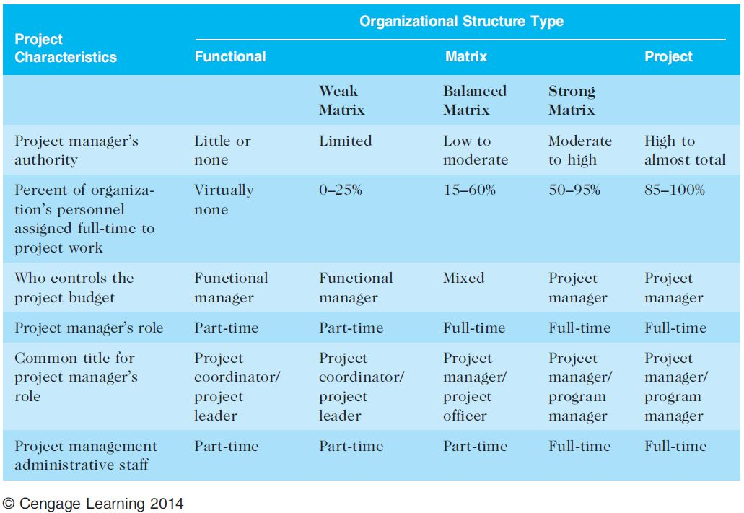
Table 2-1. Organizational Structure Influences on Projects

Slide 10
Organizational Culture
Organizational culture is a set of shared assumptions, values, and behaviors that characterize the functioning of an organization
Many experts believe the underlying causes of many companies’ problems are not the structure or staff, but the culture

Slide 11
Ten Characteristics of Organizational Culture
Member identity*
Group emphasis*
People focus
Unit integration*
Control
Risk tolerance*
Reward criteria*
Conflict tolerance*
Means-ends orientation
Open-systems focus*
*Project work is most successful in an organizational culture where these items are strong/high and other items are balanced.

Slide 12
Project Phases and the Project Life Cycle
A project life cycle is a collection of project phases that defines
what work will be performed in each phase
what deliverables will be produced and when
who is involved in each phase, and
how management will control and approve work produced in each phase
A deliverable is a product or service produced or provided as part of a project

Slide 13
More on Project Phases
In early phases of a project life cycle
resource needs are usually lowest
the level of uncertainty (risk) is highest
project stakeholders have the greatest opportunity to influence the project
In middle phases of a project life cycle
the certainty of completing a project improves
more resources are needed
The final phase of a project life cycle focuses on
ensuring that project requirements were met
the sponsor approves completion of the project

Slide 14
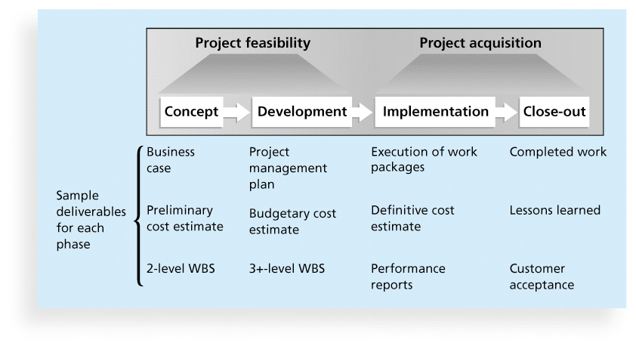
Figure 2-4. Phases of the Traditional Project Life Cycle

Slide 15
Product Life Cycles
Products also have life cycles
The Systems Development Life Cycle (SDLC) is a framework for describing the phases involved in developing and maintaining information systems
Systems development projects can follow
Predictive life cycle: the scope of the project can be clearly articulated and the schedule and cost can be predicted
Adaptive Software Development (ASD) life cycle: requirements cannot be clearly expressed, projects are mission driven and component based, using time-based cycles to meet target dates

Slide 16
Predictive Life Cycle Models
Waterfall model: has well-defined, linear stages of systems development and support
Spiral model: shows that software is developed using an iterative or spiral approach rather than a linear approach
Incremental build model: provides for progressive development of operational software
Prototyping model: used for developing prototypes to clarify user requirements
Rapid Application Development (RAD) model: used to produce systems quickly without sacrificing quality

Slide 17
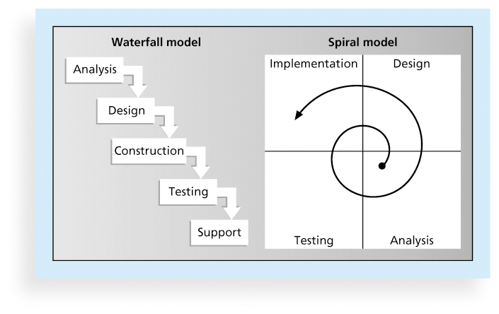
Figure 2-5. Waterfall and Spiral Life Cycle Models

Slide 18
Agile Software Development
Agile software development has become popular to describe new approaches that focus on close collaboration between programming teams and business experts
See the last section of this chapter and Chapter 3 for more information on agile

Slide 19
The Importance of Project Phases and Management Reviews
A project should successfully pass through each of the project phases in order to continue on to the next
Management reviews, also called phase exits or kill points, should occur after each phase to evaluate the project’s progress, likely success, and continued compatibility with organizational goals

Slide 20
Recent Trends Affecting IT Project Management
Globalization
Outsourcing: Outsourcing is when an organization acquires goods and/or sources from an outside source.
Offshoring is sometimes used to describe outsourcing from another country
Virtual teams: A virtual team is a group of individuals who work across time and space using communication technologies
Agile project management

Slide 21
Important Issues and Suggestions Related to Globalization
Issues
Communications
Trust
Common work practices
Tools
Suggestions
Employ greater project discipline
Think global but act local
Keep project momentum going
Use newer tools and technology

Slide 22
Outsourcing
Organizations remain competitive by using outsourcing to their advantage, such as finding ways to reduce costs
Their next challenge is to make strategic IT investments with outsourcing by improving their enterprise architecture to ensure that IT infrastructure and business processes are integrated and standardized (See Suggested Readings)
Project managers should become more familiar with negotiating contracts and other outsourcing issues

Slide 23
Virtual Teams Advantages
Increasing competiveness and responsiveness by having a team of workers available 24/7
Lowering costs because many virtual workers do not require office space or support beyond their home offices.
Providing more expertise and flexibility by having team members from across the globe working any time of day or night
Increasing the work/life balance for team members by eliminating fixed office hours and the need to travel to work.

Slide 24
Virtual Team Disadvantages
Isolating team members
Increasing the potential for communications problems
Reducing the ability for team members to network and transfer information informally
Increasing the dependence on technology to accomplish work
See text for a list of factors that help virtual teams succeed, including team processes, trust/relationships, leadership style, and team member selection

Slide 25
Agile software development
The Agile Manifesto[ introduced the term in 2001.
is a group of software development methods based on iterative and incremental development, where requirements and solutions evolve through collaboration between self-organizing, cross-functional teams.
Methods
Iterative
Incremental
Goal: outline values and principles to allow software teams to
develop quickly and
respond to change.

Slide 26
Manifesto for Agile Software Development
In February 2001, a group of 17 people that called itself the Agile Alliance developed and agreed on the Manifesto for Agile Software Development, as follows:
“We are uncovering better ways of developing software by doing it and helping others do it. Through this work we have come to value:
Individuals and interactions over processes and tools
Working software over comprehensive documentation
Customer collaboration over contract negotiation
Responding to change over following a plan”*
*Agile Manifesto, www.agilemanifesto.org.

Slide 27
Agile Project Management
Agile means being able to move quickly and easily, but some people feel that project management, as they have seen it used, does not allow people to work quickly or easily.
Early software development projects often used a waterfall approach, as defined earlier in this chapter. As technology and businesses became more complex, the approach was often difficult to use because requirements were unknown or continuously changing.
Agile today means using a method based on iterative and incremental development, in which requirements and solutions evolve through collaboration.
See the Resources tab from www.pmtexts.com for more info

Slide 28
Agile Makes Sense for Some Projects, But Not All
Many seasoned experts in project management warn people not to fall for the hype associated with Agile.
For example, J. Leroy Ward, Executive Vice President at ESI International, said that “Agile will be seen for what it is … and isn’t….Project management organizations embracing Agile software and product development approaches will continue to grow while being faced with the challenge of demonstrating ROI through Agile adoption.”*
*J. Leroy Ward, “The Top Ten Project Management Trends for 2011,” projecttimes.com
(January 24, 2011).

Slide 29
The two dominant Agile approaches are Scrum and eXtreme Programming (XP).
XP was arguably the first method deemed to be “Agile”.
Scrum – very popular and in very wide use today!

Slide 30
Scrum
According to the Scrum Alliance, Scrum is the leading agile development method for completing projects with a complex, innovative scope of work.
The term was coined in 1986 in a Harvard Business Review study that compared high-performing, cross-functional teams to the scrum formation used by rugby teams.

Slide 31
Scrum: a definite project management emphasis.
Scrum Master: A Scrum project Is managed by a Scrum Master, who can be considered as much a consultant or coach as a manager.
Sprint. Scrum has a fundamental 30-day development cycle called a Sprint, preceded by
pre-Sprint activities and post-Sprint activities.
Daily Scrum: A short (less than 30 minutes) daily Scrum Meeting allows the team to monitor status and communicate problems.

Slide 32
Project planning is based on a Product Backlog, which contains
functions and
technology enhancements
envisioned for the project.

Slide 33
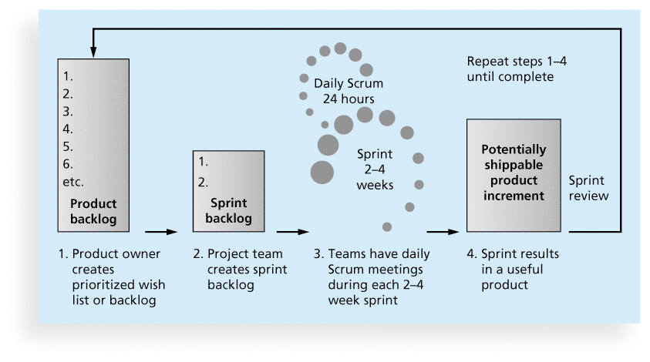
Figure 2-6. Scrum Framework

Slide 34
Kanban
Technique that can be used in conjunction with scrum
Developed in Japan by Toyota Motor Corporation
Uses visual cues to guide workflow
Kanban cards show new work, work in progress, and work completed

Slide 35
Agile, the PMBOK® Guide, and a New Certification
The PMBOK® Guide describes best practices for what should be done to manage projects.
Agile is a methodology that describes how to manage projects.
The Project Management Institute (PMI) recognized the increased interest in Agile, and introduced a new certification in 2011 called Agile Certified Practitioner (ACP).
Seasoned project managers understand that they have always had the option of customizing how they run projects, but that project management is not easy, even when using Agile.

Slide 36
Chapter Summary
Project managers need to take a systems approach when working on projects
Organizations have four different frames: structural, human resources, political, and symbolic
The structure and culture of an organization have strong implications for project managers
Projects should successfully pass through each phase of the project life cycle
Project managers need to consider several factors due to the unique context of information technology projects
Recent trends affecting IT project management include globalization, outsourcing, virtual teams, and Agile

