Slide 1
CampusCare

Slide 2
DESCRIPTION
CampusCare is a simple website made for college students to help them with two things – submitting complaints and reporting lost or found items. If a student has any problem in college (like classroom, hostel, water, electricity, etc.), they can open the website, fill a small form, and send their complaint. They can also upload a photo if needed. The complaint is saved safely and can be seen by the college staff to take action. In the Lost & Found section, students can say if they lost something or found something, so the right person can get it back. The whole website is made using HTML, CSS, JavaScript, and Firebase. CampusCare makes it easy for students to share problems and find lost items without any confusion. It helps keep the campus better and more organized.

Slide 3
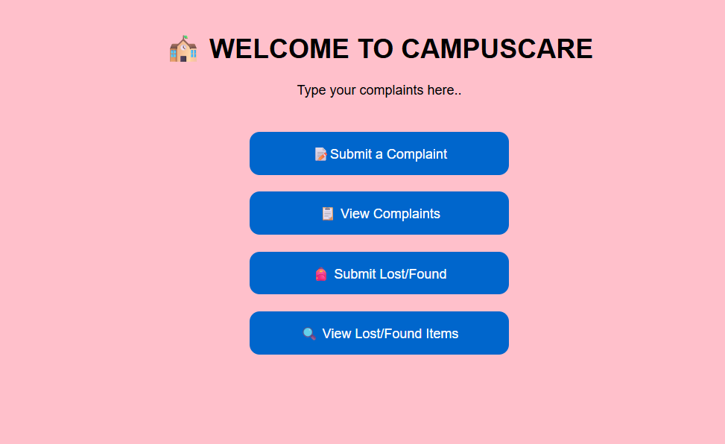
OUTPUT

Slide 4
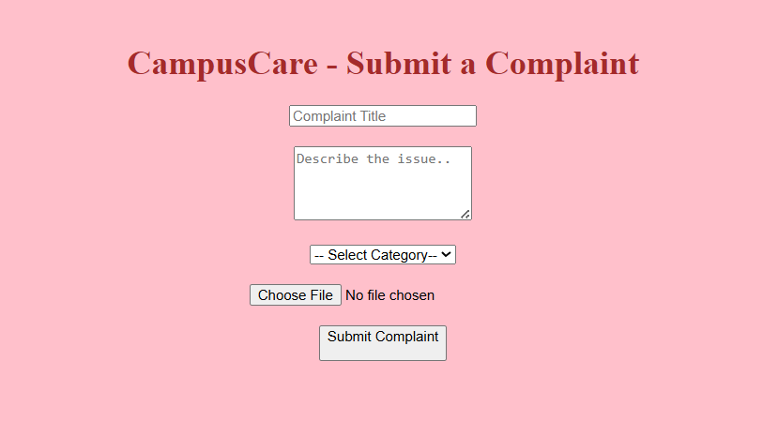


Slide 5
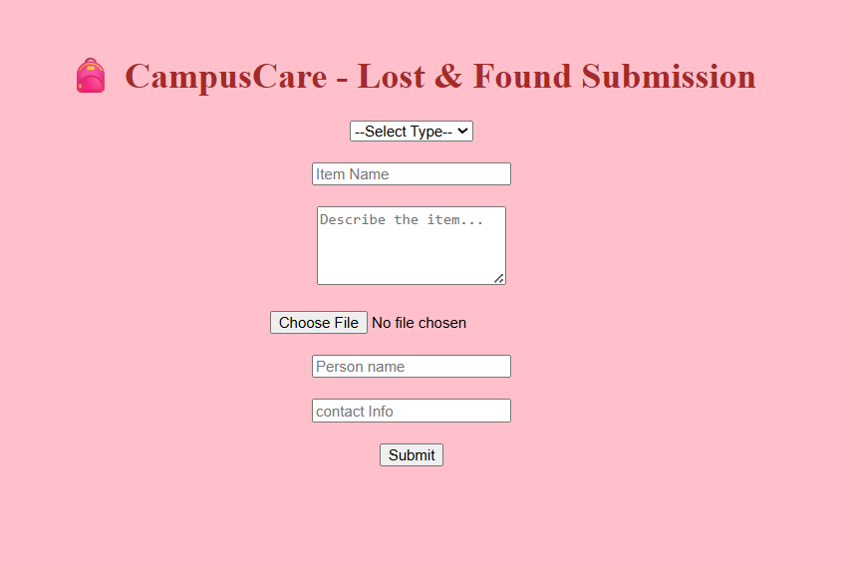


Slide 6
THANK YOU
buddevasavi@gmail.com

