Slide 1
E-commerce Sales Analytics Pipeline
Data-driven insights for better sales & marketing decisions
Hareesh Kathula
Raju Mungala
Vasavi Kota
Akhilesh Thakare

Slide 2

CONTENTS
Projective Overview and Objective
Technical Specifications
Design solutions with HLD and LLD
Development of Lakehouse in Databricks
Testing the ELT pipelines in AWS AND Data Bricks
Business outcomes

Slide 3
PROBLEMS
E-commerce platforms generate huge volumes of sales and customer data daily.
Manual reporting is slow, inconsistent, and prone to errors.
Lack of standardized data makes it difficult to derive accurate insights.
Business teams struggle to track key metrics like revenue, promotions, and customer lifetime value efficiently.
MOTIVATION
Automating the data pipeline enables faster and more accurate sales analytics.
Standardized, cleaned data improves decision-making for marketing and operations.
Scalable architecture ensures performance even as transaction volumes grow.
Reliable insights help optimize promotions and improve overall revenue growth.

Slide 4
PROJECT OVERVIEW
Build ETL Pipelines using AWS,DATABRICKS Kaggle Dataset as source for performing below activities:
Implementing Lakehouse's as part of Databricks
Establishing Raw Data store in Databricks Bronze layer Unity Data Catalogs
Perform Data Cleansing, Data Scrubbing activities using Bronze layer Data catalog information
Derive Metrics information with various aggregates using Transformed Silver Layer Data Catalogs Information.

Slide 5
Design Solutions for building pipelines
ØHigh level design
ØLow level design

Slide 6
HIGH LEVEL DESIGN

Slide 7
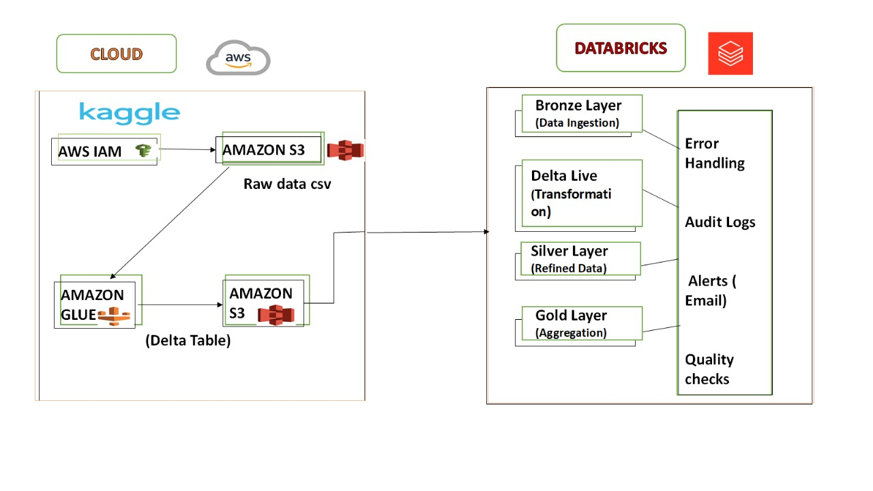
E-commerce ETL Pipeline

Slide 8
LOW LEVEL DESIGN

Slide 9
LOW LEVEL DESIGN
Building ETL Pipelines in AWS and Databricks
Pipeline Orchestration in AWS AND DATABRICKS
Error Handling mechanisms in AWS AND DATABRICKS
Building ALERTS , Audit and error logs in Databricks
Data Visualisation for better analysis
Git Integration

Slide 10
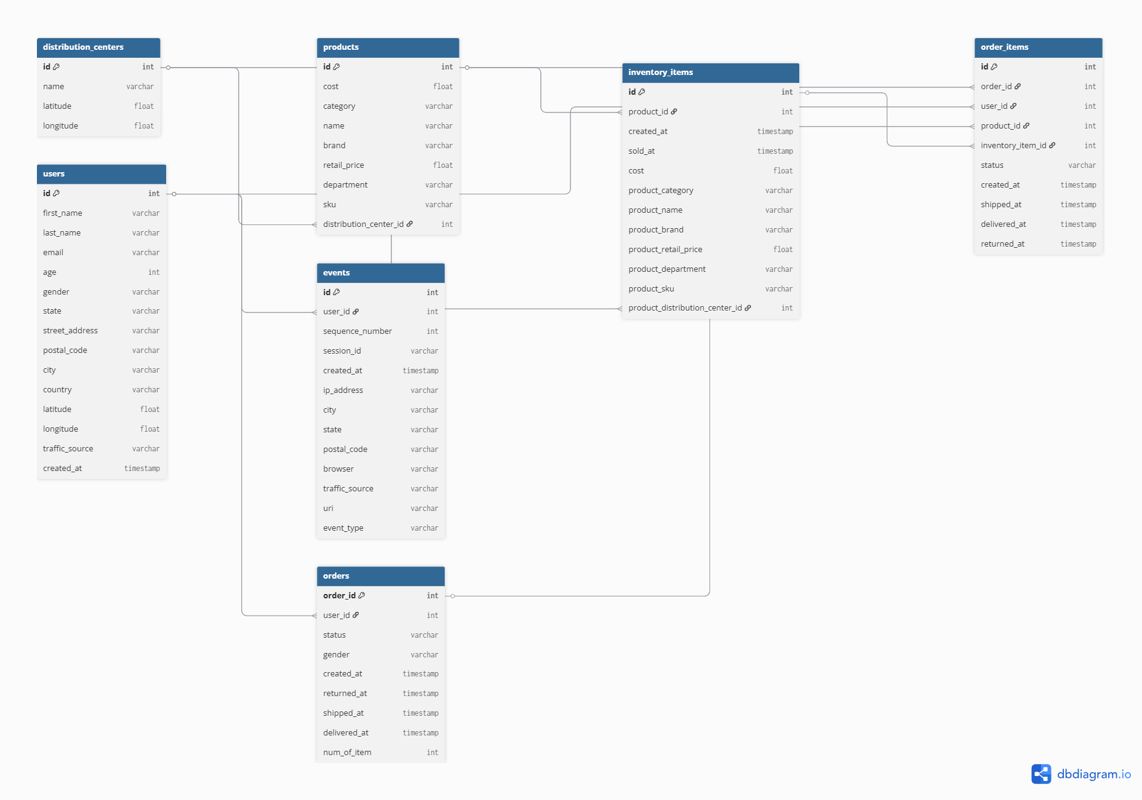
E-R Diagram

Slide 11
Error handling and data
Schema Validation – Enforce expected schema (column names, data types, mandatory fields) to detect malformed records.
Deduplication & Integrity Checks – Remove duplicate applications, validate primary keys.
Null Handling – Apply default values, imputation, or rejection rules for missing/invalid fields.
Error Logging – Capture failed records in a dedicated error table/logs with timestamp & error reason.

Slide 12
Pipeline orchestration
Workflow Orchestration – Use AWS Glue Workflows (AWS setup) or Databricks Workflows (Databricks setup) to chain ETL jobs in sequence (Bronze → Silver → Gold).
Job Scheduling – Configure daily batch runs at 5 AM UTC using Event Bridge (AWS) or built-in scheduler (Databricks).
Dependency Management – Ensure downstream jobs (Silver/Gold) run only after upstream tasks (Bronze/Silver) succeed.
Failure Handling & Alerts – On job failure, send alerts via SNS/email and rerun failed tasks without reprocessing entire pipeline.

Slide 13
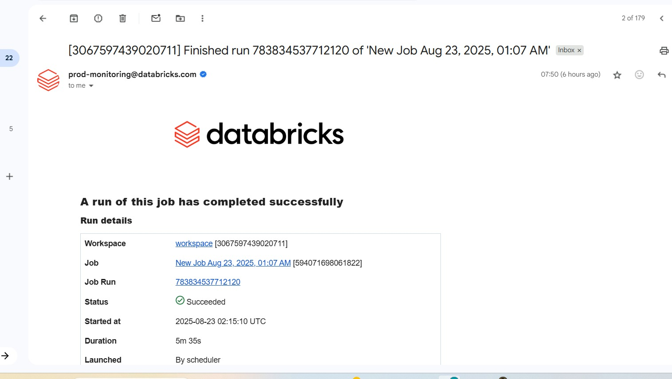
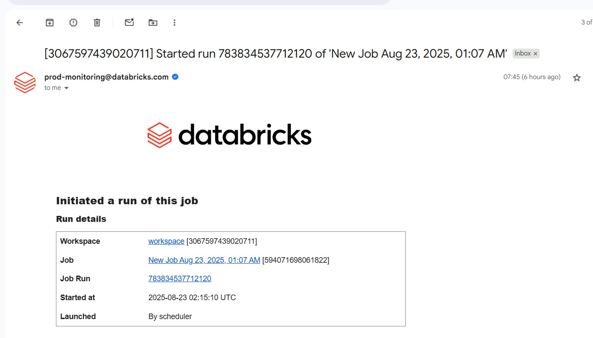
Alerts & Notifications

Slide 14
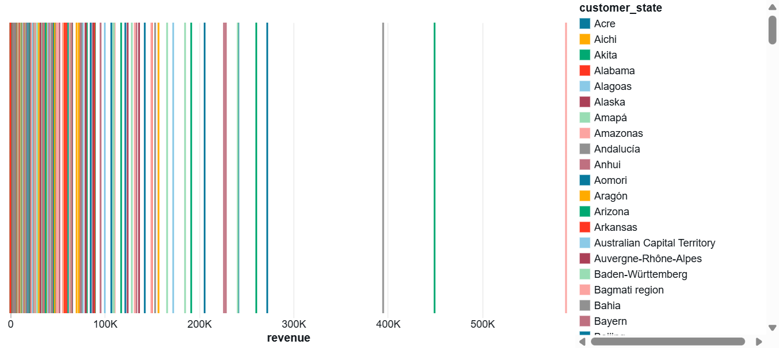
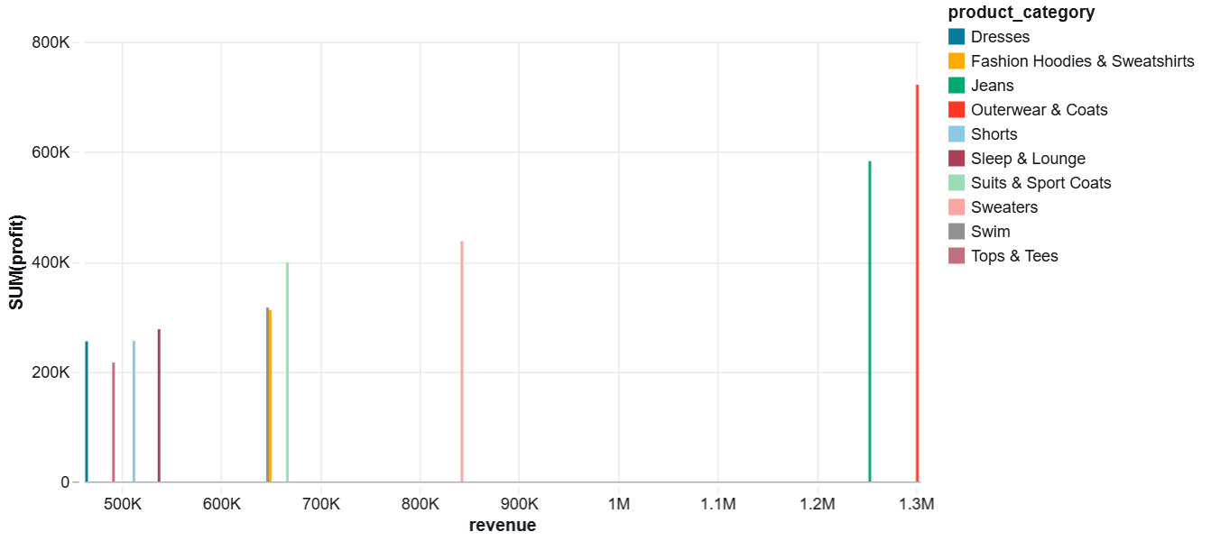
.
Visualizations
Revenue by State
This graph shows total revenue contribution by customer state.
Helps identify top-performing regions areas with high sales volume.
Useful for regional business strategy such as targeted marketing, optimization.
Top Product Categories
This graph shows the top 10 product categories by revenue along with their profitability.
Helps understand which categories drive sales vs. profitability.
Supports inventory planning and product strategy decisions.

Slide 15
TESTING ETL PIPELINES
1.Null Value Check (Silver Layer): Test No values in the columns.
2. Duplicate Record Check (Silver Layer): Verifies that cleaned data has unique transaction IDs with no duplicates.
3. Data Type Validation (Silver Layer)
4. Range & Format Validation (Silver Layer)
5. Aggregation Accuracy (Gold Layer)
6. Record Count Consistency (Gold Layer): Ensures the Gold layer has fewer or equal records than Silver after aggregations

Slide 16
Business outcomes & impact
🔹 Accurate, Transparent Sales Insights Comprehensive data pipeline ensures reliable reporting with full audit trail.
🔹 Faster, Automated Analytics Streamlined process replaces manual reporting, reducing time-to-insight.
🔹 Better Revenue Optimization Data-driven decisions improve promotions, pricing, and customer retention strategies.
🔹 Scalable Solution for Growing Data Volumes Architecture designed to handle increasing transaction loads without performance degradation.
🔹 Foundation for Advanced Analytics & ML Structured data pipeline enables future demand forecasting and AI-driven recommendations.

Slide 17
THANK YOU

