Slide 1
SoulSwipe
Ishaaq Shaik
JayaChandra Narala
Jyothsna Chaparala
Vasavi Devineni
Venkata Rayudu Adapa
Venkata Sravan Telu

Slide 2
Outline
Existing Situation
Proposed Solution
Requirements
Tools and Technology
Demo
Tasks Accomplished
Tasks Which Needs To Be Accomplished
Problems Faced and Lessons Learned

Slide 3
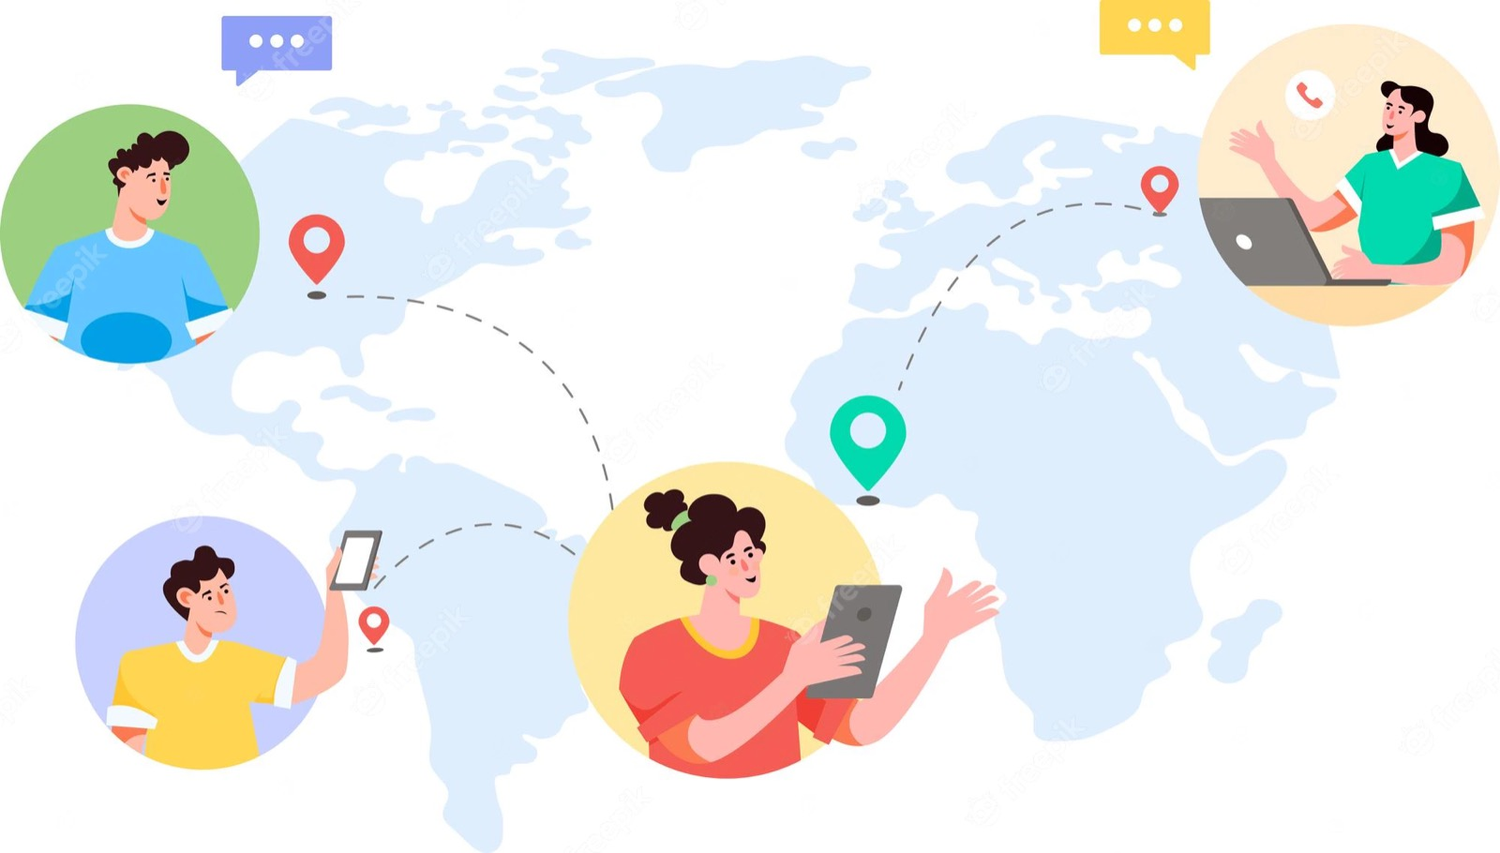



Existing Situation
Geographic constraints for meeting new people
Finding a partner
Social Anxiety
Limited Social Circle
Venkata Sravan Telu

Slide 4
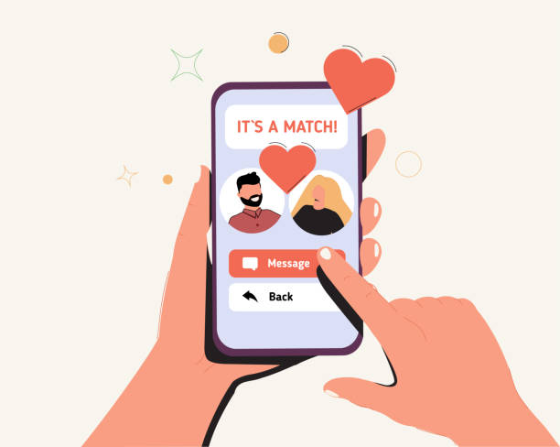
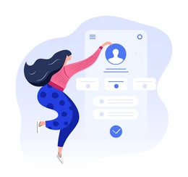
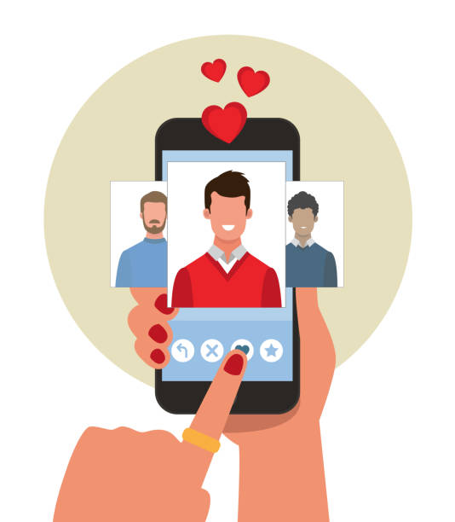


Proposed Solution - User
Finding a compatible person
Profile Creation
Chatting with different users
Completing a compatibility Quiz
iOS Mobile Application
Venkata Sravan Telu

Slide 5
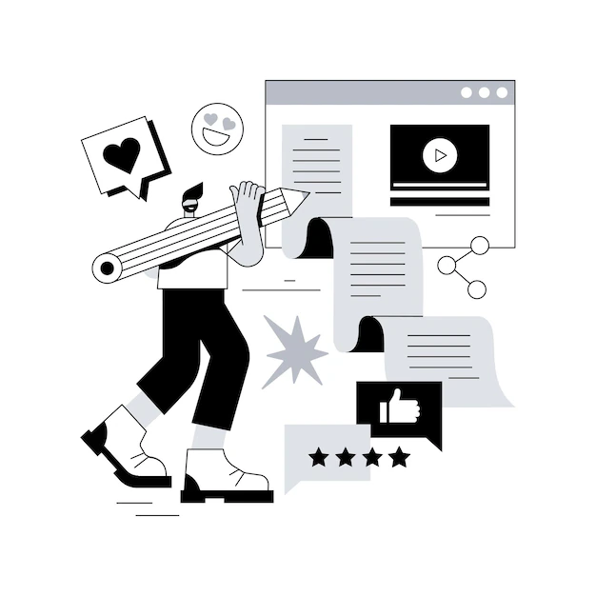



Proposed Solution - Admin
View user history
Web application
Blocking reported users
Statistics
Jayachandra Narala

Slide 6
Functional Requirements
Requirements | User | Admin
Profile Creation | Yes | No
Partner Searching | Yes | No
Profile Privacy and Security | Yes | No
Communication and Interaction | Yes | No
User Verification | Yes | No
Jayachandra Narala

Slide 7
Functional Requirements(Cont.)
Requirements | User | Admin
Notifications and Alerts | Yes | No
Profile Management and Editing | Yes | No
Account Blocking | No | Yes
Send Alerts to User that Account is Reported | No | Yes
Displaying List of Users and their Details | No | Yes
Jyothsna Chaparala

Slide 8
Non-Functional Requirements
Application must ensure secure user registration, login, and authentication to prevent unauthorized access
Application must have fast and responsive performance to ensure a smooth user experience
Application must have a user-friendly interface
Application must be compatible with various devices
Application must be easy to maintain and update
Jyothsna Chaparala
Notes:
Security:
The application must ensure secure user registration, login, and authentication to prevent unauthorized access
Usability:
The application must have a user-friendly interface that is easy to navigate and use
Compatibility:
The application must be compatible with various devices and operating systems to ensure accessibility for all users
Maintainability:
The application must be easy to maintain and update with new features and functionality

Slide 9
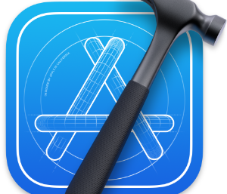


Tools and Technology (Mobile Application - User)
Backend/Server
DB Request
DB Response
Database
Frontend
Vasavi Devineni

Slide 10




Tools and Technology (Web Application - Admin)
Frontend
Backend/Server
DB Request
API Calls
Response for
API Calls
DB Response
Database

Slide 11

Demo

Slide 12
Tasks Accomplished
Completed frontend UI of all screens (User)
Connected app with Firebase
Completed compatibility quiz
Completed profile creation

Slide 13
Tasks Which Needs To Be Accomplished
Compatibility match between two profiles
Developing Admin pages
Implementation of chat
Implementing remaining functionalities such as liking a profile, blocking a profile, adding liked profile to Favorites

Slide 14
Problems Faced and Lessons Learned
Problems Faced
Lessons Learned
Integrating Xcode with GitHub
Integrating of chat in the app
Making Compatibility quiz
Working on UI (same file) by team members simultaneously is not possible
Firebase has one of the features which is chat
Referred few dating applications for reference

Slide 15
Thank You

