Slide 1
Operating System Concepts Overview
Understanding the fundamentals of operating systems

Slide 2
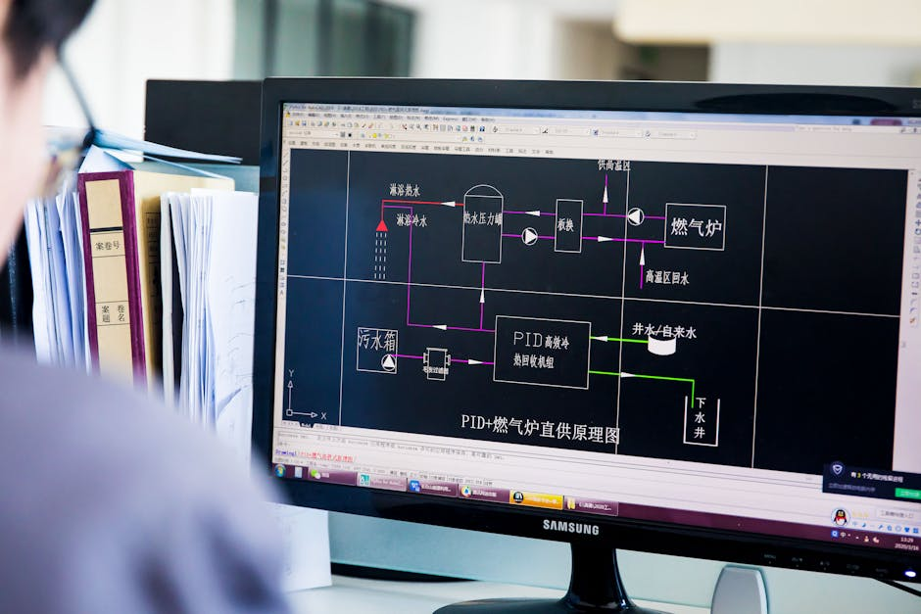
Introduction to Operating Systems
• Operating systems manage computer hardware resources efficiently always • Providing a platform for running application software seamlessly always • Controlling input output devices and memory allocation effectively • Enabling multitasking and multithreading capabilities simultaneously • Supporting various file systems and storage devices securely

Slide 3
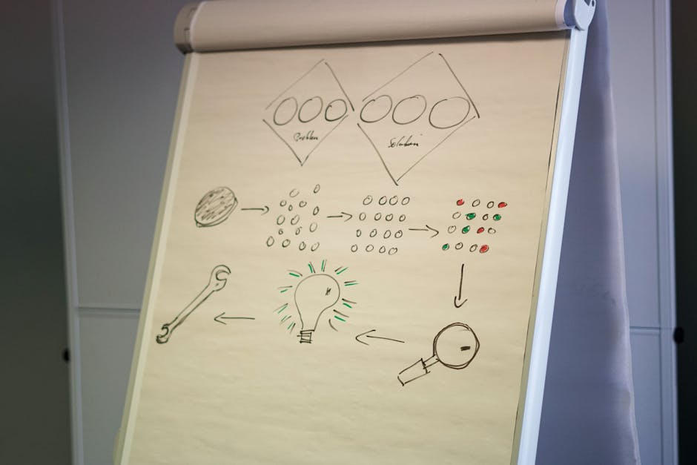
Process Management Concepts
• Processes are independent units of execution and computation always • Threads are lightweight processes sharing resources efficiently always • Context switching enables process scheduling and switching quickly • Synchronization mechanisms prevent data inconsistencies always • Deadlock prevention and avoidance techniques are essential always

Slide 4
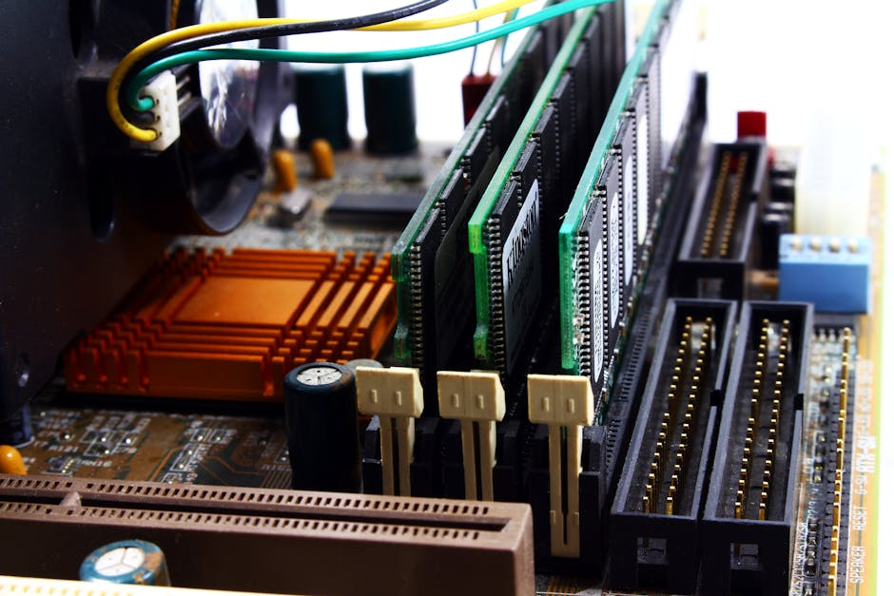
Memory Management Techniques
• Memory allocation and deallocation are critical system functions always • Paging and segmentation enable efficient memory utilization always • Virtual memory extends physical memory capacity effectively always • Cache memory improves system performance significantly always • Memory protection mechanisms prevent data corruption always

Slide 5
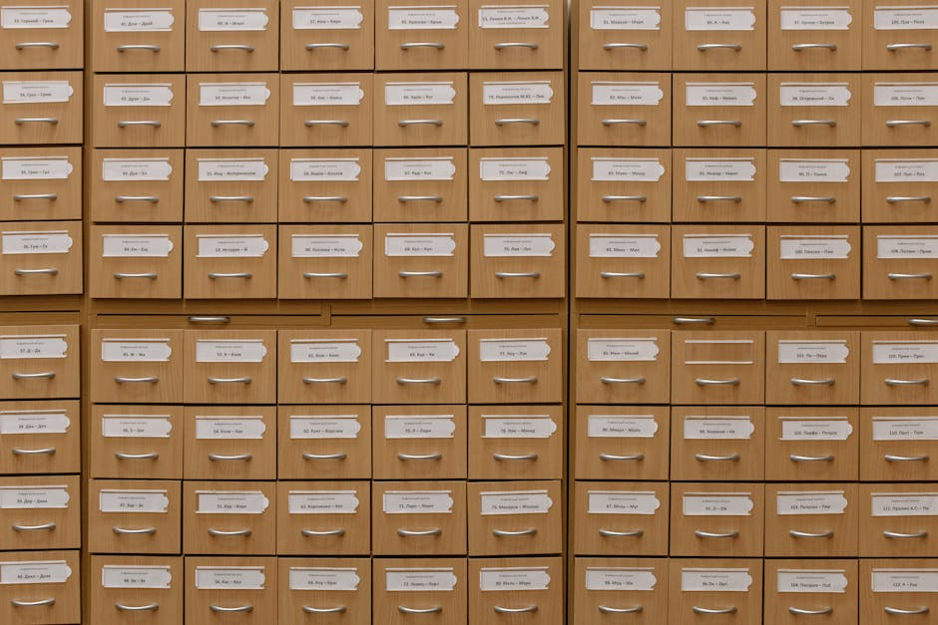
File System and Storage Management
• File systems provide a hierarchical organization of data always • Storage devices such as disks and tapes store data persistently • File allocation methods optimize storage space utilization always • File protection and security mechanisms prevent unauthorized access • Disk scheduling algorithms optimize data retrieval and storage

Slide 6

Security and Networking Concepts
• Security mechanisms prevent unauthorized system access always • Firewalls and intrusion detection systems protect networks always • Networking protocols enable communication between devices always • Encryption methods secure data transmission and storage always • Access control mechanisms regulate user privileges effectively

Slide 7
Conclusion
Operating system concepts are fundamental to understanding computer systems
process management memory management file system management

