Slide 1
Thread

Slide 2
Thread
1.Introduction
2.the ways to define a thread
.by extends thread class
.by implemented runnable interface
3.getting and setting name of thread
4.Thread priorities
5.The method to prevent the thread execution
1.yield()
2.join()
3.sleep()
6.Synchronization

Slide 3
What is Multithreading/Multitasking?
Executing several task simultaneously is the concept of multitasking.
There are two types of multitasking:
Process Based multitasking
Thread Based multitasking

Slide 4
Process Based multitasking
Executing several task simultaneously where each task is a separate independent program(Process), is called process based multitasking.
E.g. while typing program in editor we can listen audio from same system at the same time we can download a file from internet.
All the task will be executed simultaneously under independent of each of other hence it is process.
Its at Operating system level

Slide 5
Thread Based multitasking
Executing several task independently where each task is separate independent part of the same program is called thread based multitasking. Each independent part is called thread.

Slide 6
MultiTaksing
The main objective of the multitasking is reduce the response time of the system and to improve the performance

Slide 7
Thread Scheduler
It’s a part of JVM
It’s responsible for thread execution.If multiple threads are waiting for getting executed then which order the threads will be executed is decided by thread scheduler.
Its scheduling the thread schedule.
Some algorithm is followed by thread scheduler.
We cant expect the exact algorithm followed by thread scheduler its varied from JVM to JVM so we cant expect threads execution order and exact output. Hence whenever we do multithreading there is no guarantee for exact output but we can provide several possible outputs.

Slide 8


class mythread extends Thread{
public void run()
{
for(int i=0;i<10;i++)
{
System.out.println("Child thread");
}
}}
class ThreadDemo{
public static void main(String [] args)
{
mythread t=new mythread();
t.start();
for(int i=0;i<10;i++)
{
System.out.println("main thread");
}
}
}

Slide 9
Thread.start()
Start() is responsible to registers the thread with thread scheduler
Perform all other mandatory activities hence without executing thread class start method there is no way to start new thread in java.Thats why thread class start method is known as important method of multithreading.
Invoke run method();

Slide 10
Run() method overloading
We can overload run() method in class. But with different parameter and we have to call it explicitely. Start() method will call no – arg run method.
If we are not overriding run() method: the thread class run() method will get called which is empty method.
Note: Its recommended to override run() method else don’t go for multithreading.

Slide 11
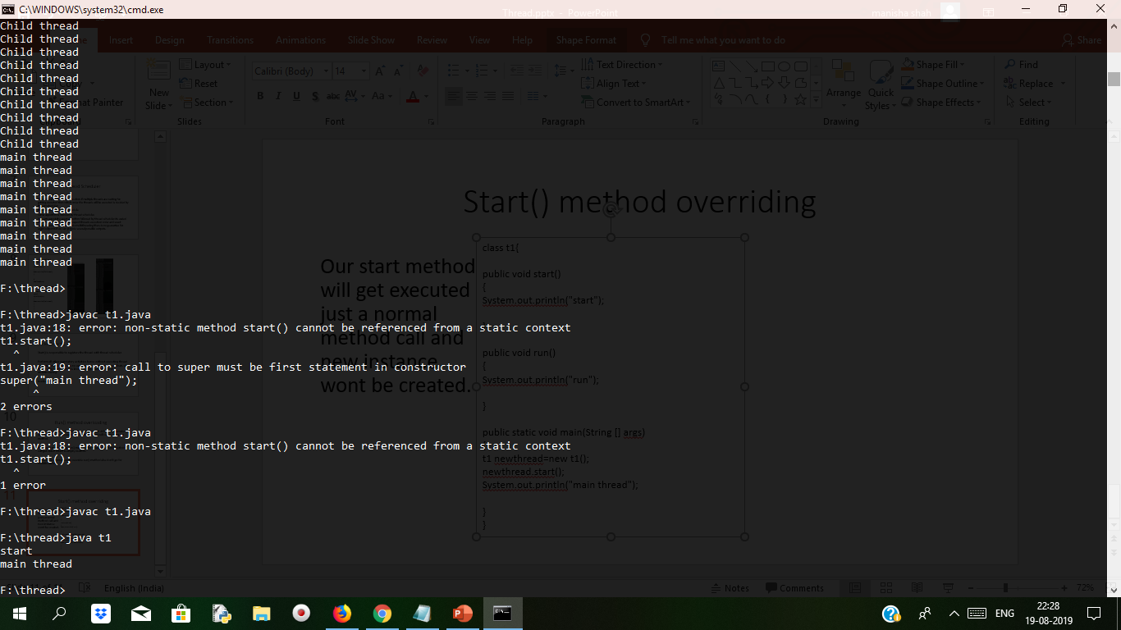
Start() method overriding
class t1{
public void start()
{
System.out.println("start");
}
public void run()
{
System.out.println("run");
}
public static void main(String [] args)
{
t1 newthread=new t1();
newthread.start();
System.out.println("main thread");
}
}
Our start method will get executed just a normal method call and new instance wont be created.
Its not recommentd to override start() method else don’t go for multithreading

Slide 12
Thread constructors
Thread() This allocates a new Thread object.
2 | Thread(Runnable target) This allocates a new Thread object.
3 | Thread(Runnable target, String name) This allocates a new Thread object.
4 | Thread(String name) This constructs allocates a new Thread object.
5 | Thread(ThreadGroup group, Runnable target) This allocates a new Thread object.
6 | Thread(ThreadGroup group, Runnable target, String name) This allocates a new Thread object so that it has target as its run object, has the specified name as its name, and belongs to the thread group referred to by group.
7 | Thread(ThreadGroup group, Runnable target, String name, long stackSize) This allocates a new Thread object so that it has target as its run object, has the specified name as its name, belongs to the thread group referred to by group, and has the specified stack size.
8 | Thread(ThreadGroup group, String name) This allocates a new Thread object.

Slide 13
Thread Priority
Thread.MinPriority➔1
Thread.NormPriority➔5
Thread.MaxPriority➔10
It may be default priority generated by JVM or customized priority provide by programmer.
Thread scheduler will decide the priority which has to executed first.
If two threads have same priority then we cant expect exact execution order. It depends on thread schedular. The default priority will be inherited from parent to child. Only for main thread is 5.
Some platform wont provide for thread priority support.

Slide 14
Java Concurrency / Multithreading Basics
Concurrency is the ability to do more than one thing at the same time.
Back in early days, computers could execute only one program at a time. But now, modern computers are capable of running a whole lot of tasks at the same time. For example -
You can browse my blog on a web browser and listen to music on a media player, at the same time.
You can edit a document on a word processor, while other applications can download files from the internet, at the same time.

Slide 15
Contd…
Concurrency doesn’t necessarily involve multiple applications. Running multiple parts of a single application simultaneously is also termed as concurrency. For example -
A word processor formats the text and responds to keyboard events, at the same time.
An audio streaming application reads the audio from the network, decompresses it and updates the display, all at the same time.
A web server, which is essentially a program running on a computer, serves thousands of requests from all over the world, at the same time.
Softwares that are able to do more than one thing at a time are called concurrent software.
The following screenshot of my computer shows an example of concurrency. My computer system is doing multiple things simultaneously - It is running a video on a media player, accepting keyboard input on a terminal, and building a project in IntelliJ Idea

Slide 16
Executors Framework
While it is easy to create one or two threads and run them, it becomes a problem when your application requires creating 20 or 30 threads for running tasks concurrently.
Also, it won’t be exaggerating to say that large multi-threaded applications will have hundreds, if not thousands of threads running simultaneously. So, it makes sense to separate thread creation and management from the rest of the application.

Slide 17
What is Executors?
Enter Executors, A framework for creating and managing threads. Executors framework helps you with –
Thread Creation: It provides various methods for creating threads, more specifically a pool of threads, that your application can use to run tasks concurrently.
Thread Management: It manages the life cycle of the threads in the thread pool. You don’t need to worry about whether the threads in the thread pool are active or busy or dead before submitting a task for execution.
Task submission and execution: Executors framework provides methods for submitting tasks for execution in the thread pool, and also gives you the power to decide when the tasks will be executed. For example, You can submit a task to be executed now or schedule them to be executed later or make them execute periodically.

Slide 18
Java Concurrency API
JCA defines the following three executor interfaces that covers everything that is needed for creating and managing threads -
Executor - A simple interface that contains a method called execute() to launch a task specified by a Runnable object.
ExecutorService - A sub-interface of Executor that adds functionality to manage the lifecycle of the tasks. It also provides a submit() method whose overloaded versions can accept a Runnable as well as a Callable object. Callable objects are similar to Runnable except that the task specified by a Callable object can also return a value.
ScheduledExecutorService - A sub-interface of ExecutorService. It adds functionality to schedule the execution of the tasks.

Slide 19
ExecutorService example
import java.util.concurrent.ExecutorService;
import java.util.concurrent.Executors;
public class ExecutorsExample {
public static void main(String[] args) {
System.out.println("Inside : " + Thread.currentThread().getName());
System.out.println("Creating Executor Service...");
ExecutorService executorService = Executors.newSingleThreadExecutor();
System.out.println("Creating a Runnable...");
Runnable runnable = () -> {
System.out.println("Inside : " + Thread.currentThread().getName());
};
System.out.println("Submit the task specified by the runnable to the executor service.");
executorService.submit(runnable);
}
}
# Output
Inside : main
Creating Executor Service...
Creating a Runnable...
Submit the task specified by the runnable to the executor service.
Inside : pool-1-thread-1
The above example shows how to create an executor service and execute a task inside the executor. We use the Executors.newSingleThreadExecutor() method to create an ExecutorService that uses a single worker thread for executing tasks. If a task is submitted for execution and the thread is currently busy executing another task, then the new task will wait in a queue until the thread is free to execute it.
If you run the above program, you will notice that the program never exits, because, the executor service keeps listening for new tasks until we shut it down explicitly.

Slide 20
Shutting down the ExecutorService
ExecutorService provides two methods for shutting down an executor -
shutdown() - when shutdown() method is called on an executor service, it stops accepting new tasks, waits for previously submitted tasks to execute, and then terminates the executor.
shutdownNow() - this method interrupts the running task and shuts down the executor immediately.
Let’s add shutdown code at the end of our program so that it exits gracefully -
System.out.println("Shutting down the executor");
executorService.shutdown();

Slide 21
ExecutorService example with multiple threads and tasks
Following example shows how you can create an executor service that uses a thread pool and execute multiple tasks concurrently -
import java.util.concurrent.ExecutorService;
import java.util.concurrent.Executors;
import java.util.concurrent.TimeUnit;
public class ExecutorsExample {
public static void main(String[] args) {
System.out.println("Inside : " + Thread.currentThread().getName());
System.out.println("Creating Executor Service with a thread pool of Size 2");
ExecutorService executorService = Executors.newFixedThreadPool(2);
Runnable task1 = () -> {
System.out.println("Executing Task1 inside : " + Thread.currentThread().getName());
try {
TimeUnit.SECONDS.sleep(2);
} catch (InterruptedException ex) {
throw new IllegalStateException(ex);
}
};
Runnable task2 = () -> {
System.out.println("Executing Task2 inside : " + Thread.currentThread().getName());
try {
TimeUnit.SECONDS.sleep(4);
} catch (InterruptedException ex) {
throw new IllegalStateException(ex);
}
};
Runnable task3 = () -> {
System.out.println("Executing Task3 inside : " + Thread.currentThread().getName());
try {
TimeUnit.SECONDS.sleep(3);
} catch (InterruptedException ex) {
throw new IllegalStateException(ex);
}
};
System.out.println("Submitting the tasks for execution...");
executorService.submit(task1);
executorService.submit(task2);
executorService.submit(task3);
executorService.shutdown();
}
}

Slide 22
Output
# Output
Inside : main
Creating Executor Service with a thread pool of Size 2
Submitting the tasks for execution...
Executing Task2 inside : pool-1-thread-2
Executing Task1 inside : pool-1-thread-1
Executing Task3 inside : pool-1-thread-1
we created an executor service with a fixed thread pool of size 2. A fixed thread pool is a very common type of thread pool that is frequently used in multi-threaded applications.
In a fixed thread-pool, the executor service makes sure that the pool always has the specified number of threads running. If any thread dies due to some reason, it is replaced by a new thread immediately.
When a new task is submitted, the executor service picks one of the available threads from the pool and executes the task on that thread. If we submit more tasks than the available number of threads and all the threads are currently busy executing the existing tasks, then the new tasks will wait for their turn in a queue.

Slide 23
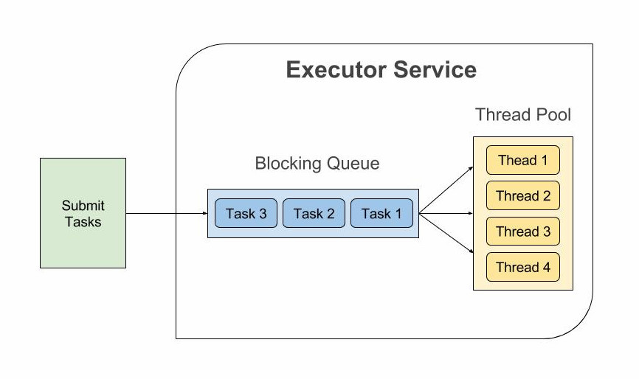
Executor Service
Tasks are submitted to a thread pool via an internal queue called the Blocking Queue. If there are more tasks than the number of active threads, they are inserted into the blocking queue for waiting until any thread becomes available. If the blocking queue is full than new tasks are rejected.

Slide 24
ScheduledExecutorService example
import java.util.concurrent.Executors;
import java.util.concurrent.ScheduledExecutorService;
import java.util.concurrent.TimeUnit;
public class ScheduledExecutorsExample {
public static void main(String[] args) {
ScheduledExecutorService scheduledExecutorService = Executors.newScheduledThreadPool(1);
Runnable task = () -> {
System.out.println("Executing Task At " + System.nanoTime());
};
System.out.println("Submitting task at " + System.nanoTime() + " to be executed after 5 seconds.");
scheduledExecutorService.schedule(task, 5, TimeUnit.SECONDS);
scheduledExecutorService.shutdown();
}
}
# Output
Submitting task at 2909896838099 to be executed after 5 seconds.
Executing Task At 2914898174612
scheduledExecutorService.schedule() function takes a Runnable, a delay value, and the unit of the delay. The above program executes the task after 5 seconds from the time of submission.

Slide 25
Volatile Keyword
Volatile keyword is used to avoid memory consistency errors in multithreaded programs. It tells the compiler to avoid doing any optimizations to the variable. If you mark a variable as volatile, the compiler won’t optimize or reorder instructions around that variable.
Also, The variable’s value will always be read from the main memory instead of temporary registers.
volatile keyword in java guarantees that value of thevolatile variable will always be read from main memory and "happens-before" relationship in Java Memory model will ensure that content of memory will be communicated to different threads.

Slide 26
Use
1) You can use Volatile variable if you want to read and write long and double variable atomically. long and double both are 64 bit data type and by default writing of long and double is not atomic and platform dependence. Many platform perform write in long and double variable 2 step, writing 32 bit in each step, due to this its possible for a Thread to see 32 bit from two different write. You can avoid this issue by making long and double variable volatile in Java.
2) A volatile variable can be used as an alternative way of achieving synchronization in Java in some cases, like Visibility. with volatile variable, it's guaranteed that all reader thread will see updated value of the volatile variable once write operation completed, without volatile keyword different reader thread may see different values.
3) volatile variable can be used to inform the compiler that a particular field is subject to be accessed by multiple threads, which will prevent the compiler from doing any reordering or any kind of optimization which is not desirable in a multi-threaded environment. Without volatile variable compiler can re-order the code, free to cache value of volatile variable instead of always reading from main memory. like following example without volatile variable may result in an infinite loop

Slide 27
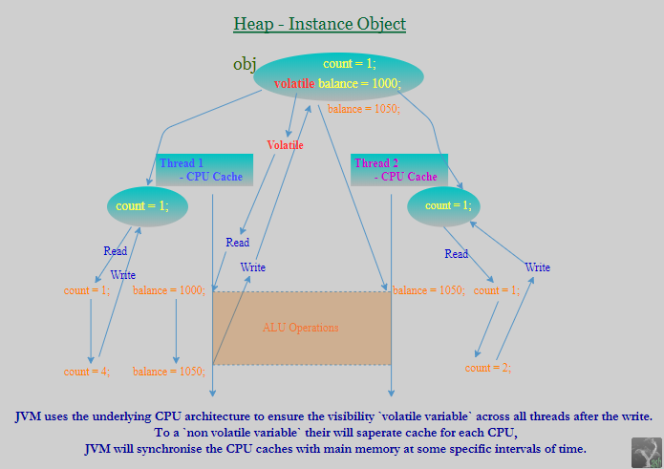
Volatile Field: An indication to the VM that multiple threads may try to access/update the field's value at the same time. To a special kind of instance variables which has to shared among all the threads with Modified value. Similar to Static(Class) variable, Only one copy of volatile value is cached in main memory, So that before doing any ALU Operations each thread has to read the updated value from Main memory after ALU operation it has to write to main memory direclty. (A write to a volatile variable v synchronizes-with all subsequent reads of v by any thread) This means that changes to a volatile variable are always visible to other threads.

