Slide 1
Retinal Fundus Classification
Vasavi Udupa

Slide 2
Overview
The project explores various deep learning models to classify retinal fundus images into 11 categories, aiming to improve diagnostic accuracy and address challenges like class imbalance and image variability.

Slide 3
Motivation
Early and accurate diagnosis of retinal conditions can prevent irreversible vision loss.
Automating this process reduces reliance on manual interpretation, improving efficiency in clinical settings.
Challenges like class imbalance, image variability, and subtle differences in conditions make it a complex and impactful problem.
11 classes: Dry AMD, Wet AMD, Mild DR, Moderate DR, Severe DR, Proliferative DR, Cataract, Glaucoma, Hypertensive Retinopathy, Pathological Myopia, Normal Fundus

Slide 4
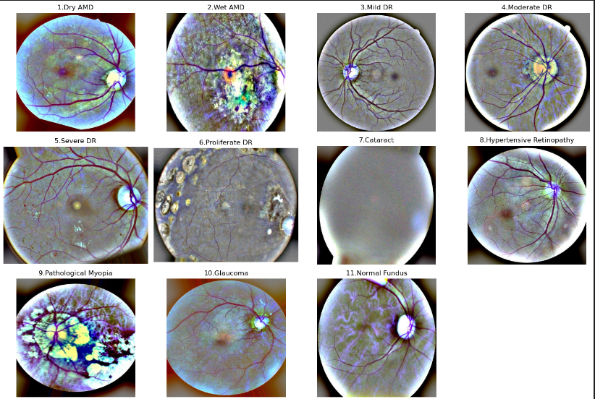

Slide 5
Data
Dataset Overview:
Retinal fundus images sourced from Kaggle which contains 11 classes.
Data Distribution:
Training Set: 19,577 images.
Validation Set: 459 images.
Test Set: 1,106 images.
Challenges:
Significant class imbalance (e.g., some classes have far fewer samples).
High variability in image quality and dimensions.
Preprocessing:
Images resized to 224x224 for compatibility with deep learning models.

Slide 6
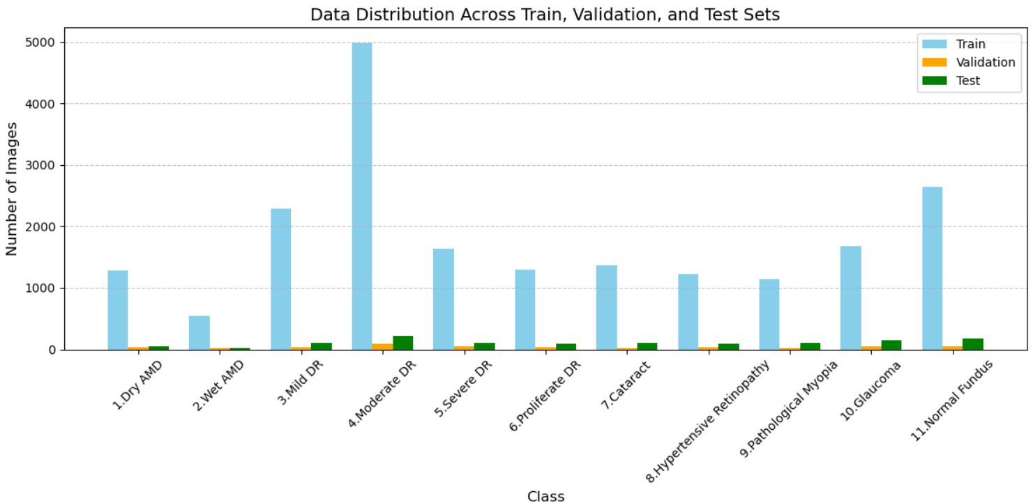

Slide 7
Baseline CNN: Model and Results
Architecture: Simple CNN with 3 convolutional layers and fully connected layers for 11 classes (input size: 128x128).
Training Details: Batch size 64, 5 epochs, Adam optimizer (lr=0.001).
Overall Test Accuracy: 72.73%, with high performance on "Normal Fundus" (98.32%) and "Cataract" (83.93%).
Challenges: Struggled with "Severe DR" (48.60%) and "Hypertensive Retinopathy" (48.94%).
Conclusion: Provides a basic starting point, but lacks the sophistication for handling subtle class differences.

Slide 8
Transfer Learning
Pretrained Models Advantages:
Leverage transfer learning from massive datasets
Extract more generalizable visual features
Reduce training data requirements
Improve model performance and generalization
Lower computational overhead for fine-tuning
Mitigate overfitting risk

Slide 9
ResNet-18
Architecture: ResNet-18 with pretrained weights, modified for 11-class classification.
ResNet-18: A powerful convolutional neural network pretrained on over a million images from ImageNet, capable of classifying images into 1000 object categories.
Loss Function: Focal Loss (gamma=2, alpha-weighted) to address class imbalance.
Overall Test Accuracy: 78.16%, with high performance on "Normal Fundus" (100%) and "Glaucoma" (98.72%).
Challenges: Struggled with "Mild DR" (36.27%) and "Proliferate DR" (60.44%).
Conclusion: Effective handling of imbalanced data but requires further tuning for underperforming classes

Slide 10

Focal Loss Function
Purpose: Designed to handle class imbalance by focusing more on hard-to-classify examples and less on easy ones.
Mechanism: Adds a modulating factor to the standard cross-entropy loss, reducing the relative impact of well-classified examples.
Parameters:
Gamma (γ): Controls the focus on hard examples (higher gamma increases focus).
Alpha (α): Adds weight to specific classes to further address imbalance.
Impact in This Project:
Improved performance on underrepresented classes like Wet AMD and Hypertensive Retinopathy.
Mitigated the effects of severe class imbalance in the retinal fundus dataset.
Comparison: Unlike Weighted Cross-Entropy Loss, Focal Loss dynamically adjusts weights during training based on the model's confidence, making it more adaptive.

Slide 11
EfficientNet-B0
Architecture: EfficientNet-B0 with pretrained weights, modified for 11-class classification.
EfficientNet-B0: A state-of-the-art CNN known for efficient scaling and high accuracy with fewer parameters, pretrained on ImageNet.
Loss Function: Cross-entropy, optimized using AdamW.
Overall Test Accuracy: 87.22%.
Per-Class Accuracy:
Strong Performers: "Dry AMD", "Wet AMD", "Normal Fundus", and "Cataract" achieved 100% accuracy.
Challenges: "Mild DR" remains the weakest class at 42.16%.
Conclusion: EfficientNet-B0 demonstrated superior performance, effectively handling imbalanced data, but further tuning is required for underperforming classes like "Mild DR".

Slide 12
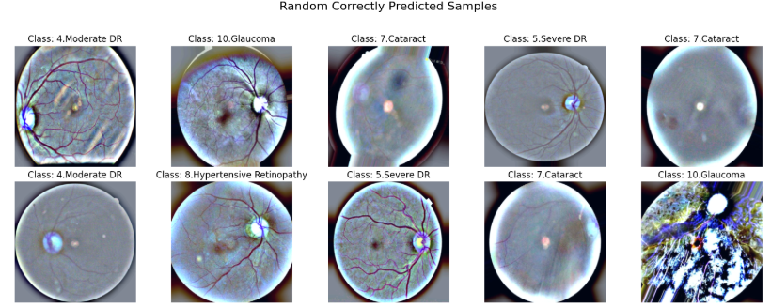
Results

Slide 13
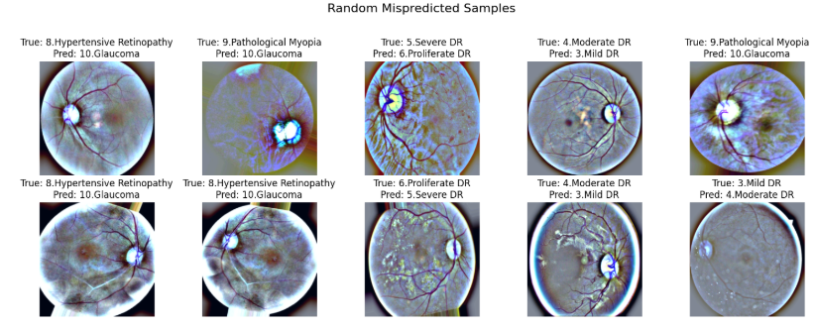
Results

Slide 14
Class-wise Accuracy
Class 1.Dry AMD: 100.00% , Class 10.Glaucoma: 92.95%
Class 11.Normal Fundus: 100.00%, Class 2.Wet AMD: 100.00%
Class 3.Mild DR: 42.16%, Class 4.Moderate DR: 86.57%
Class 5.Severe DR: 85.05%, Class 6.Proliferate DR: 78.02%
Class 7.Cataract: 100.00%, Class 8.Hypertensive Retinopathy: 88.30%
Class 9.Pathological Myopia: 88.24%

Slide 15
EfficientNet-B4 : Exploration and Challenges
Why EfficientNet-B4?: Larger and more powerful model compared to EfficientNet-B0, designed for improved accuracy on challenging datasets.
High Resource Requirements: Slower training due to deeper architecture and higher input resolution (380x380).
Initial Observations: Performance in early epochs was lower than EfficientNet-B0.
Training Challenges: Required more memory, leading to smaller batch sizes and longer training times.
Conclusion: EfficientNet-B0 was chosen for this project to balance accuracy and training efficiency.

Slide 16
Summary and Future Directions
1. Summary:
Built a classification pipeline using CNNs, ResNet-18, and EfficientNet models.
Applied Focal Loss and tried data augmentation to handle class imbalance.
2. Challenges:
Model performance decreases when augmentation techniques are used because they distort the subtle, distinctive visual features critical for differentiating between complex medical conditions.
Class imbalance impacted some results irrespective of focal loss.
3. Future Directions:
Use ensemble methods for better accuracy.
Explore semi-supervised learning and advanced loss functions.

Slide 17
Questions? Thankyou!

Slide 18
Appendix
Cross-entropy
A loss function that's commonly used to optimize classification models, such as artificial neural networks and logistic regression. Cross-entropy loss is calculated by taking the negative logarithm of predicted probabilities.
Focal loss
An improved version of cross-entropy loss that's particularly useful when there's an imbalance in the number of training samples in each class. Focal loss assigns more weight to difficult examples and less weight to easy examples. This helps the model focus on minority classes and improves accuracy, especially for imbalanced datasets

