Slide 1



INTRODUÇÃO À ENGENHARIA DE SOFTWARE
Readease Management.

Slide 2

Team Presentation.
Pedro Rei
Tiago Cruz​
Miguel Soares
Vasco Faria
Team Manager​
PRODUCT OWNER​
ARCHITECTURE​
DevOps

Slide 3





Objectives.
Innovative Solution: ReadEaseManagement transforms library management, optimizing processes and enhancing the overall experience for users.​
Streamlined Reservation: Users benefit from a more agile and personalized interaction by simplifying the reservation of resources such as rooms and books.​
Empowering Librarians: Beyond physical organization, the system provides librarians with valuable insights through detailed statistics, enabling a deep understanding of user behavior and the overall state of the library.​

Slide 4
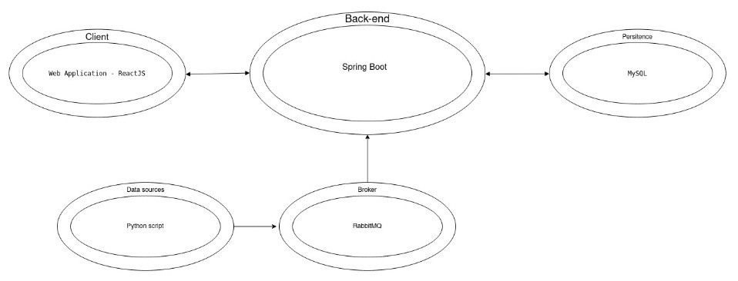
Architecture.

Slide 5


Devops.

Slide 6
DEMO

