Slide 1
Wild Fires: Statistical Investigation
Fundamentos de Ciência e Engenharia de Dados – MDSE
Cátia Teixeira e Vasco Bartolomeu

Slide 2
Agenda
Research Question
Data Source
Data Exploration
Inferences
Conclusions
Look back and ahead

Slide 3
1. Research Question
What patterns can be found in data from re-ignition fires?
Are the frequencies of our variables of interest normally distributed?
Positive correlation between intervention time and total burnt area?
Increase in extinguish time results in a increase in total burnt area?
Is there a higher frequency of re-ignition fires observed in inland area opposed to coastal area?
Variables of interest | Type
Extinguish time | Quant
Intervention time | Quant
Total burnt area | Quant
Coastal proximity (coastal / inland) | Qual
Occurrences magnitude (higher / lower occurrences) | Qual

Slide 4
2. Data Source
Data was obtained via ICNF website and collected by ANPC.
The dataset includes information on wildfires occurring in Portugal territory, during the period of 2015.
ICNF: Instituto da Conservação da Natureza e Florestas
ANPC: Associação Nacional de Proteção Civil

Slide 5
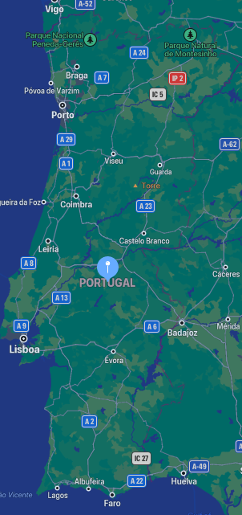
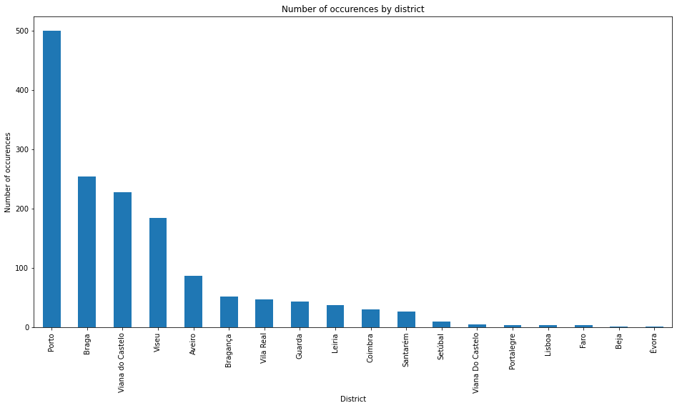
3. Data Exploration
Coastal
Inland
Districts with higher occurrences
Districts with lower occurrences

Slide 6
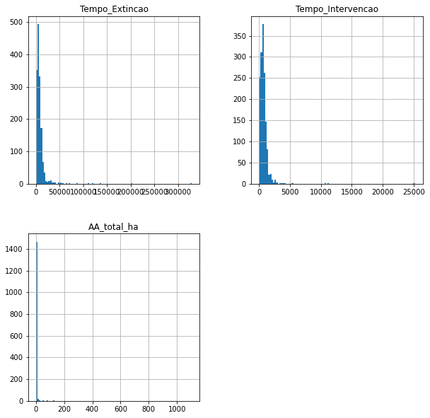
3. Data Exploration
Histograms
Apparently, data does not a follow a normal distribution;
The three variables seem to follow a similar behavior;
The data is highly right skewed;
We can infer there is a high number of small re-ignition fires (with low total burn area).

Slide 7
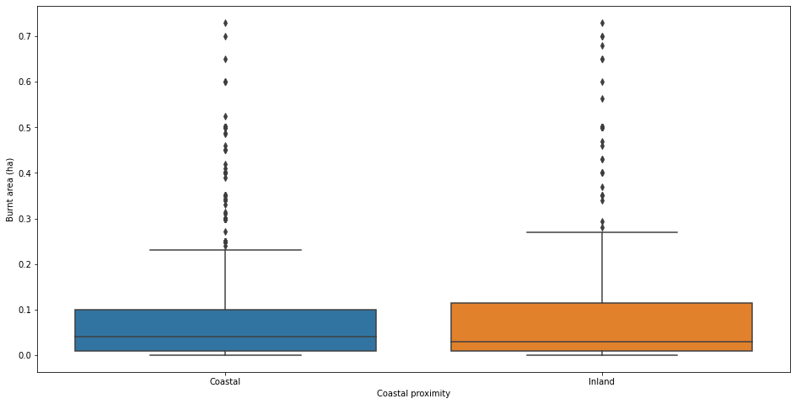
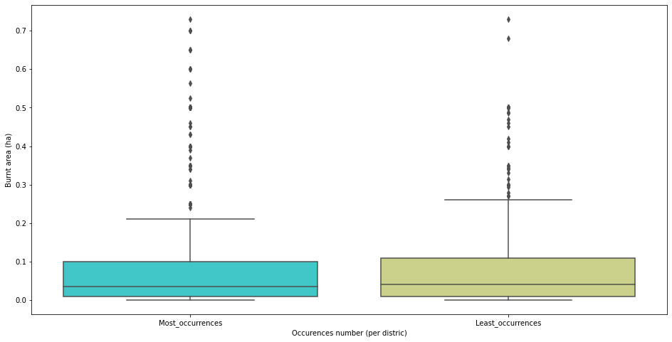
3. Data Exploration
Total burnt area per qualitive group
Inland and Least_occurrences has a higher range of values;
Both groups appear to have similar statistics.
Coastal proximity | Occurrences number (per district)

Slide 8
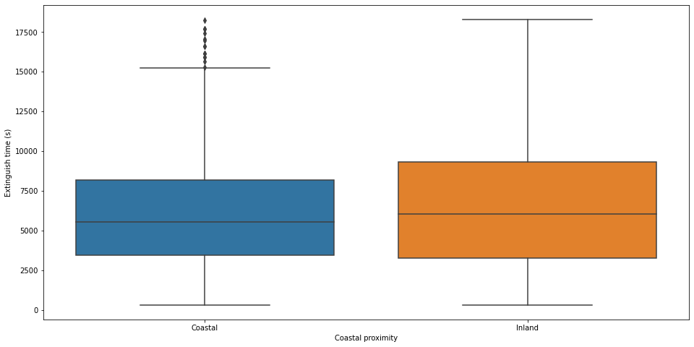
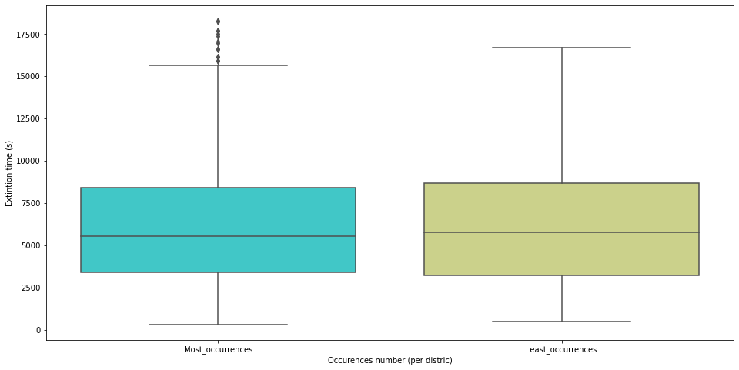
3. Data Exploration
Extinction time per group
Inland and Least_occurrences has a higher range of values;
Both groups appear to have similar statistics.
Coastal proximity | Occurrences number (per district)

Slide 9
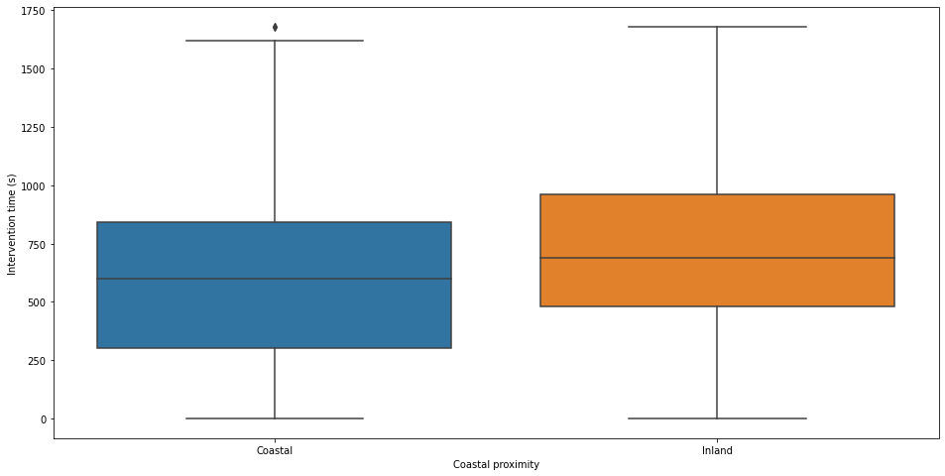
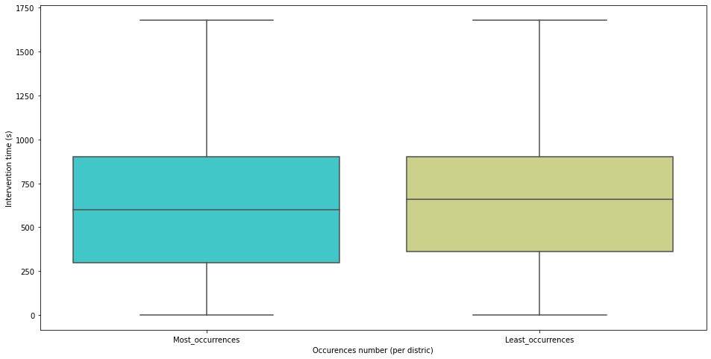
3. Data Exploration
Intervention time per group
Inland and Least_occurrences has a higher range of values;
Both groups appear to have similar statistics.
Coastal proximity | Occurrences number (per district)

Slide 10
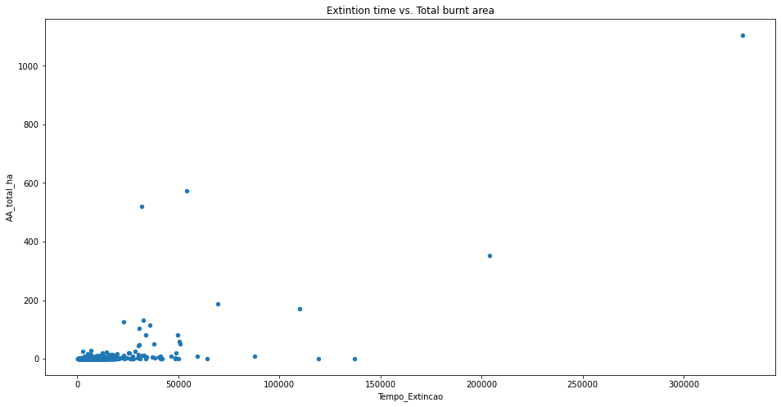
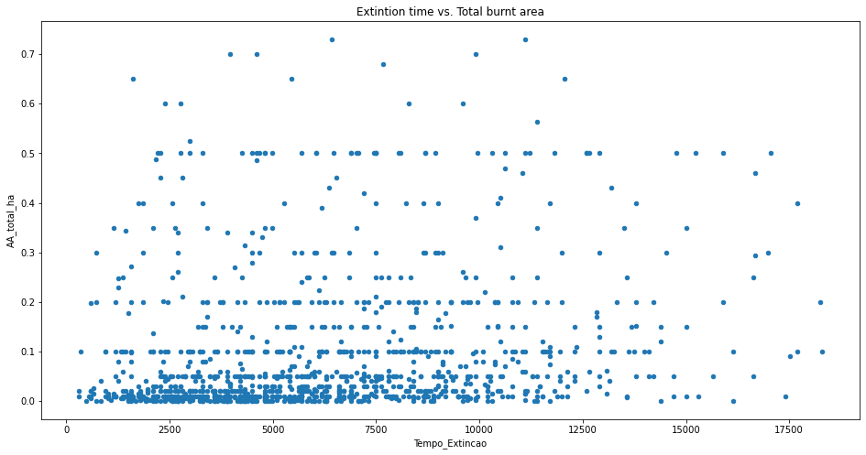
3. Data Exploration
Scatterplot Extinction time vs Total burnt area
Data seems to not have a linear relationship.
Complete data | Without potential outliers

Slide 11
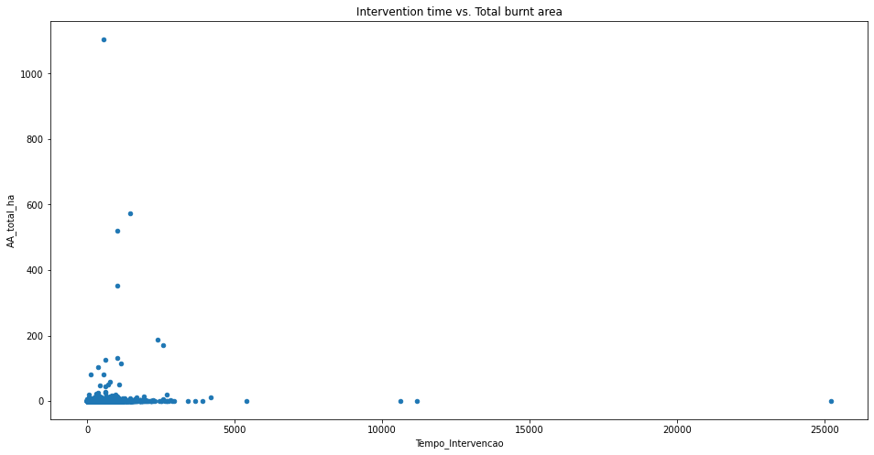
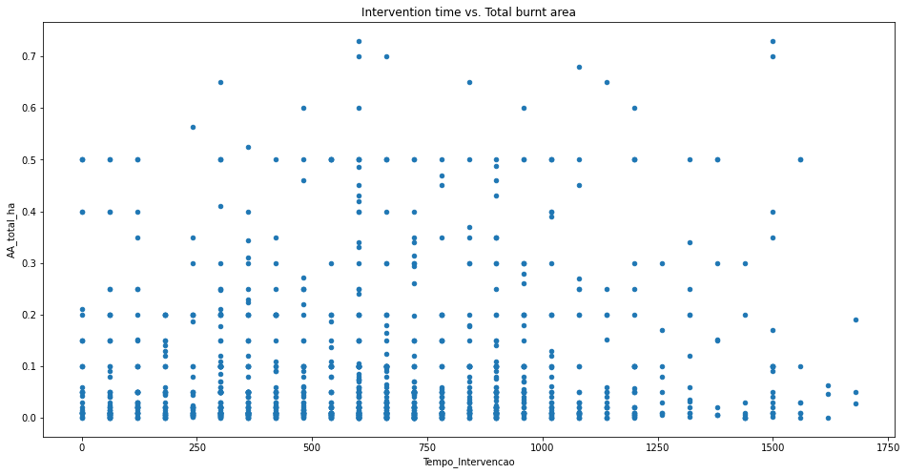
3. Data Exploration
Scatterplot Intervention time vs Total burnt area
Data seems to not have a linear relationship.
Complete data | Without potential outliers

Slide 12
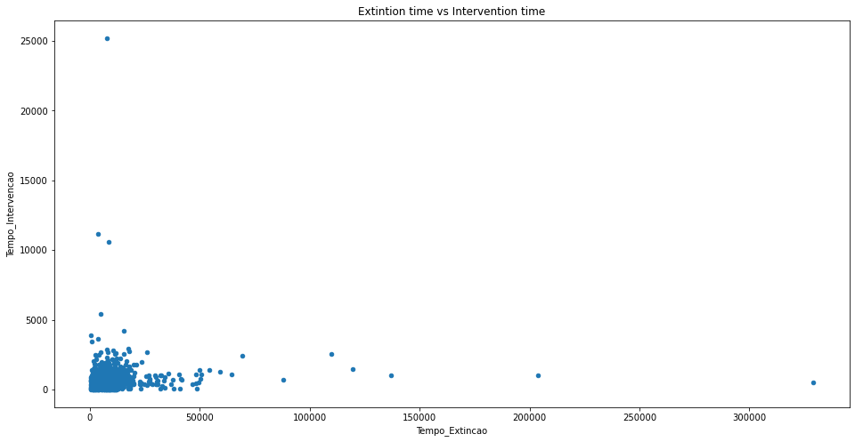
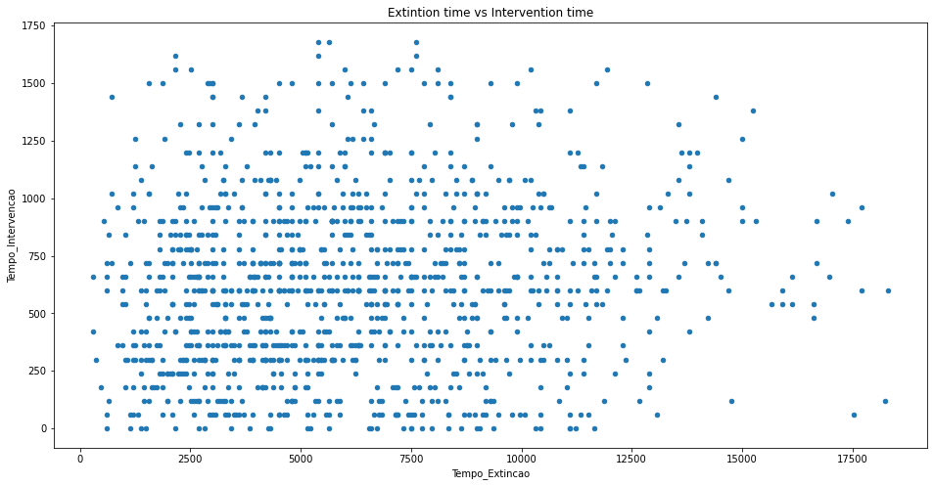
3. Data Exploration
Scatterplot Extinction time vs Total burnt area
Data seems to not have a linear relationship.
Complete data | Without potential outliers

Slide 13
4. Inferences
Do our variables follow a normal distribution?
Is there a significant relationship between our two categorical groups in terms of number of occurrences per group?
If yes, how strong is this relationship?
Is there a significant statistical difference between burnt areas according to our categorical groups?
Is there a correlation between our variables of interest?

Slide 14
4. Inferences
Do our variables follow a normal distribution?
Kolmogorov-Smirnov goodness of fit test
H0: The samples came from a population with a normal distribution
Since p-value is less than 0.05 we reject the null hypothesis for all variables.
variable | p-value
Total burnt area | 0.0
Extinction time | 0.0
Intervention time | 0.0
Our variables of interest do not follow a normal distribution
Non- parametric tests will be preferred to continue our investigation

Slide 15
4. Inferences
Is there a significant relationship between our two categorical groups in terms of number of occurrences per group?
Chi-Square
H0: No relation exists between the two variables.
Since p-value is less than 0.05 we reject the null hypothesis
 | Least Occurrences | Most Occurrences
Coastal | 169 | 929
Inland | 175 | 235
p-value | 5.83 x 10⁻²⁹
Our categorical variables have a relation between them
Coastal proximity occurrences’ number is related with number of occurrences of re-ignition fires higher and lower districts group.

Slide 16
4. Inferences
Given there is a relationship between our two categorical groups, how strong is this relationship?
Phi-Coefficient
Ranges from 0 to 1 (the closer to 1 the stronger the association)
 | Least Occurrences | Most Occurrences
Coastal | 169 | 929
Inland | 175 | 235
Χ² p-value | 5.83 x 10⁻²⁹
Φ coeff. | ≈ 0.29
Φ coefficient is very close to 0
The relation of occurrences between our categorical variable is very weak.

Slide 17
4. Inferences
Is there a significant statistical difference between burnt areas according to our categorical groups?
Mann-Whitney U
H0: The two populations are equal.
The test was repeated for batches of 20 samples at random, for each categorical.
 | Mean p-value
Burnt area and Coastal proximity | ≈ 0.48
Burnt area and Occurrences number (per district) | ≈ 0.16
With mean p-values obtained above 0.05 we ca’t reject the null hypotesis.
There is no evidence to say burnt area of coastal group is different from burnt area of interior group.
The same conclusion is valid for burnt area of higher occurrence districts group and lower occurrence districts group.

Slide 18
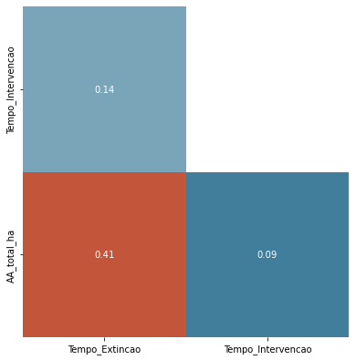

4. Inferences
Is there a correlation between our variables of interest?
Spearman correlation test
H0: There is no (monotonic) association between the two variables
Burnt area + Extinction time | Reject the null hypothesis; Positive correlation.
Burnt area + Intervention time | Reject the null hypothesis; Positive (weak) correlation.
Extinction time + Intervention time | Reject the null hypothesis; Positive (very weak) correlation.

Slide 19
5. Conclusions
Coastal proximity occurrences’ number is related with number of occurrences of re-ignition fires higher and lower districts group.
The relation of occurrences frequency between our categorical variables is very weak.
No evidence to say burnt area of coastal group is statistically different from burnt area of interior group.
No evidence to say burnt area of higher occurrence districts group and lower occurrence districts group.
The quantitative variables studied among this dataset have a proven association between them; this association is non-linear and could not be modelled on our tests.

Slide 20
6. Look back and ahead
To study the original fire that gave origin to the re-ignition in order to find patterns. This information was not present in the dataset, so the previous conditions of the occurrences were not known;
To include the records of relative humidity and temperature associated with each record and study them in order to obtain additional information.

Slide 21
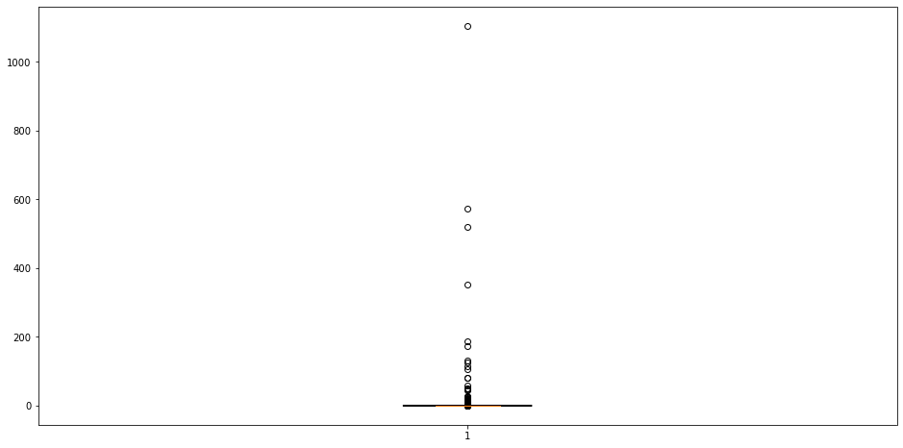
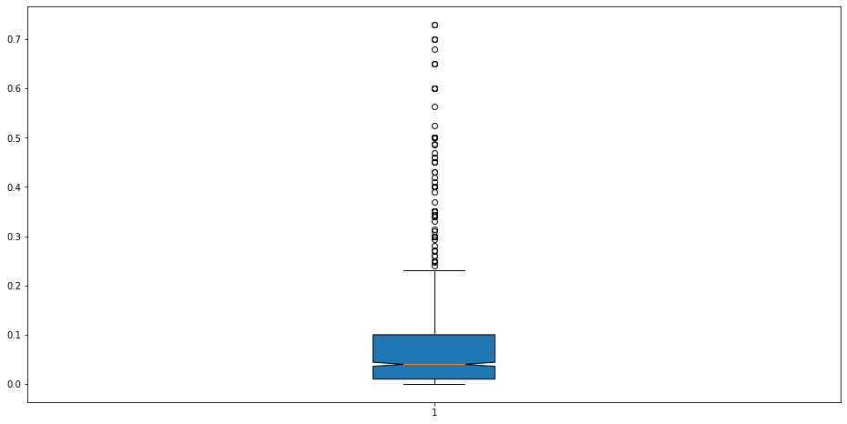
Appendix
Total burnt area box plot
Complete data | Without outliers

Slide 22
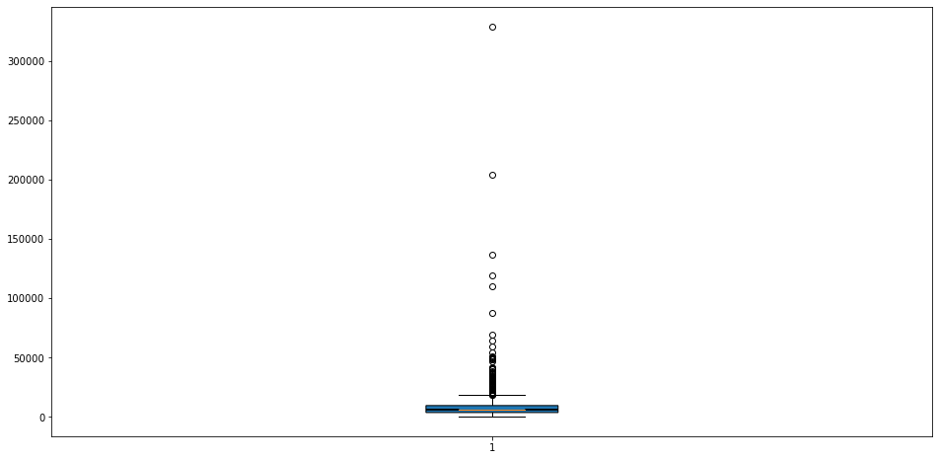
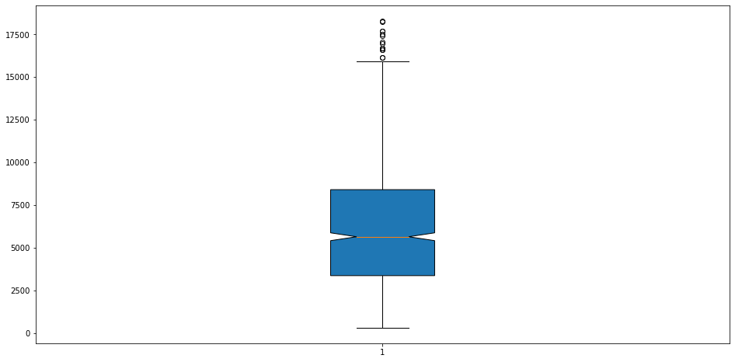
Appendix
Extinguish time box plot
Complete data | Without outliers

Slide 23

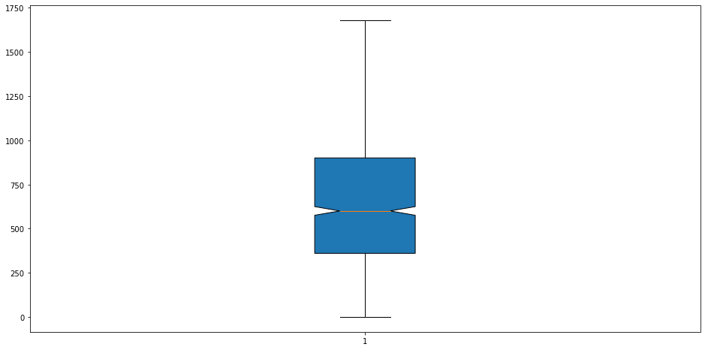
Appendix
Intervention time box plot
Complete data | Without outliers

