Slide 1
Wild Fires: Statistical Investigation
Fundamentos de Ciência e Engenharia de Dados – MDSE
Cátia Teixeira e Vasco Bartolomeu

Slide 2
Agenda
Research Question
Data Source
Data Exploration
Inferences
Conclusions
Look back and ahead

Slide 3
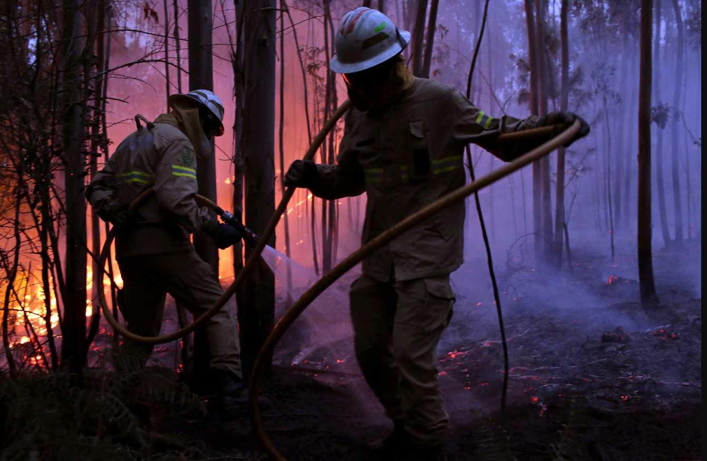
1. Research Question
Research Question
Source: NY Times

Slide 4
2. Data Source
Data was obtained via ICNF website and collected by ANPC.
The dataset includes information on wildfires occurring in Portugal territory, during the period of 2015.
ICNF: Instituto da Conservação da Natureza e Florestas
ANPC: Associação Nacional de Proteção Civil

Slide 5
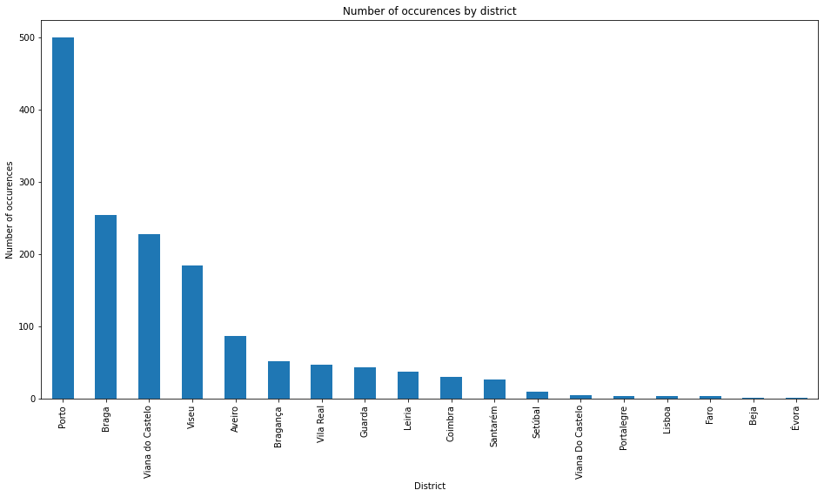
3. Data Exploration
Data preparation
abc

Slide 6
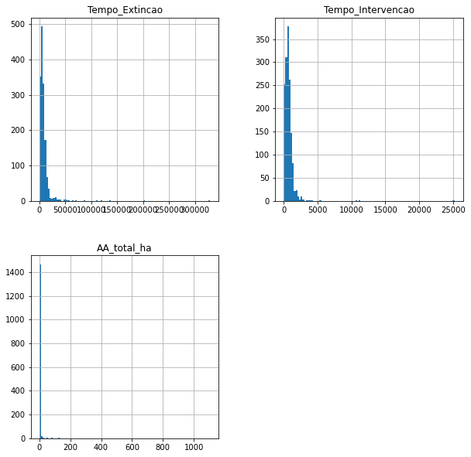
3. Data Exploration
Histograms
Not a normal distribution

Slide 7
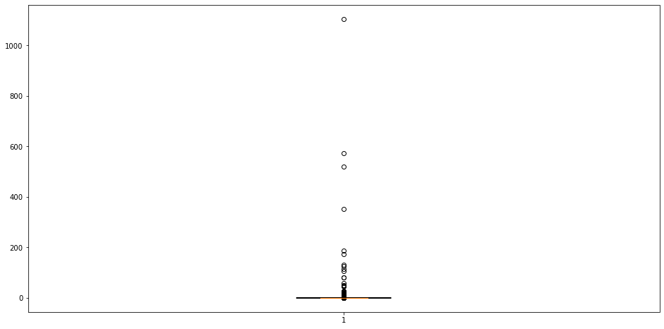
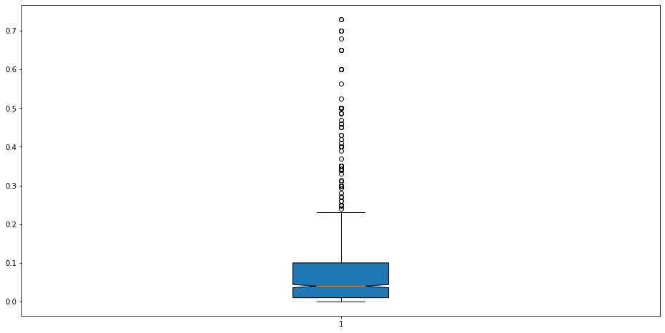
3. Data Exploration
Box plots – AA_total
Complete data | Without outliers

Slide 8
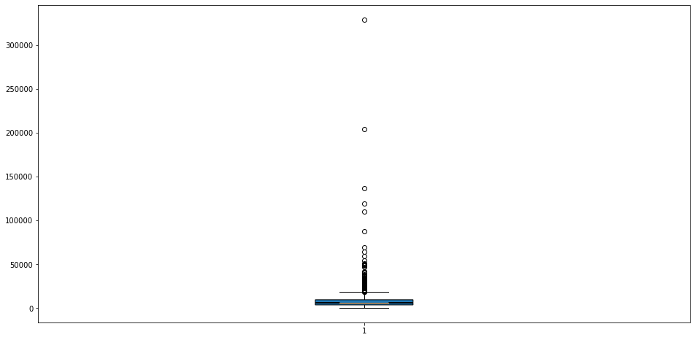
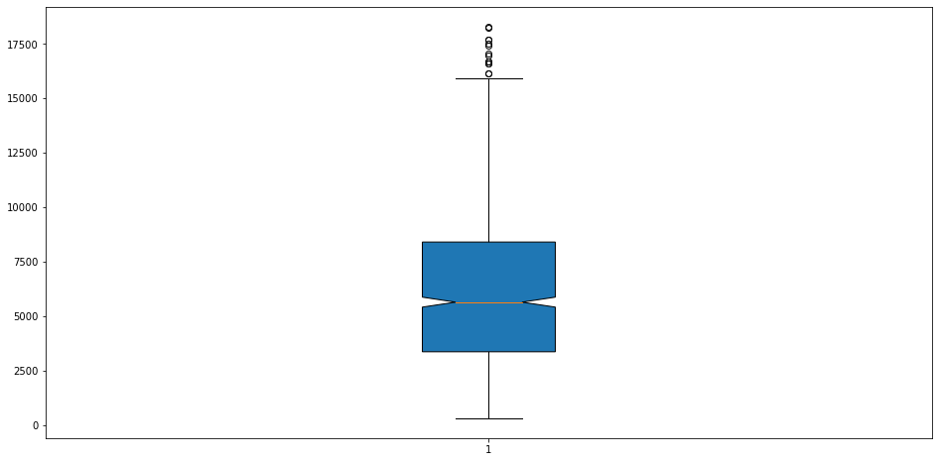
3. Data Exploration
Box plots – Tempo_Extincao
Complete data | Without outliers

Slide 9

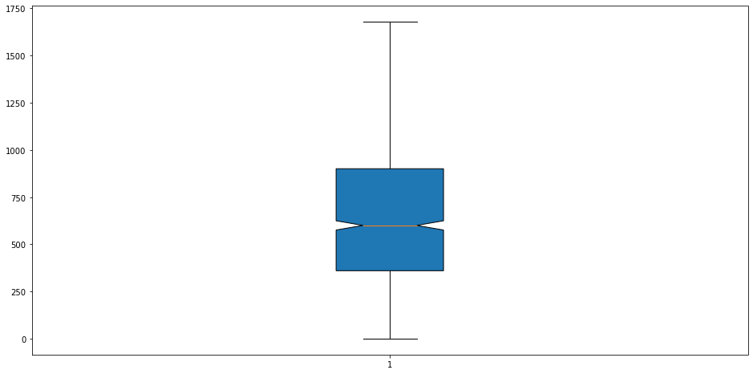
3. Data Exploration
Box plots – Tempo_Intervencao
Complete data | Without outliers

Slide 10
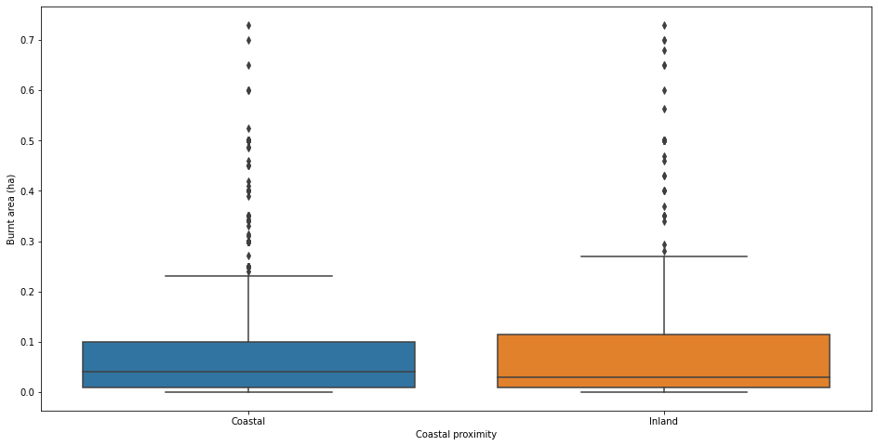
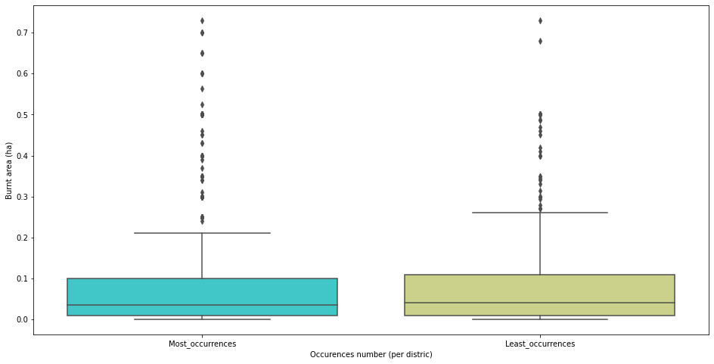
3. Data Exploration
Box plots – AA_total by groups
Coastal proximity | Occurrences number (per district)

Slide 11
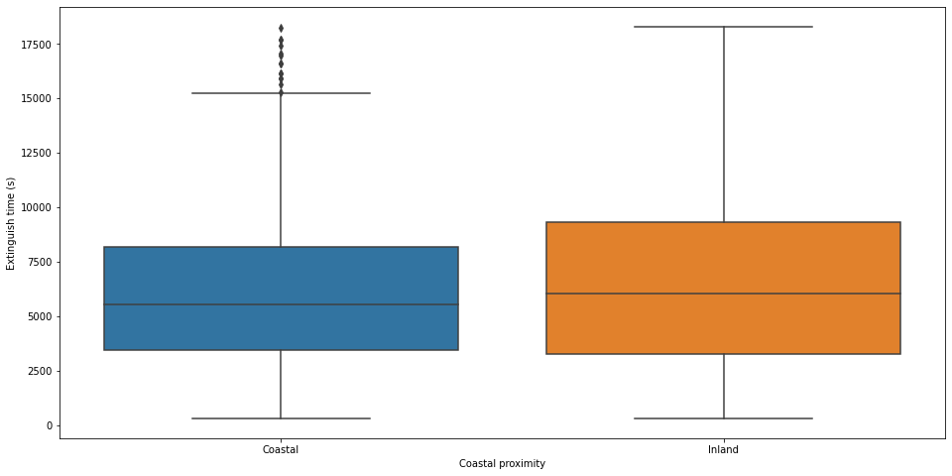
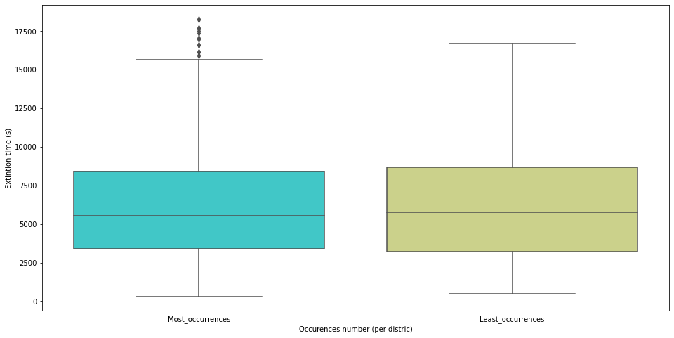
3. Data Exploration
Box plots – Tempo de Extinção by group
Coastal proximity | Occurrences number (per district)

Slide 12
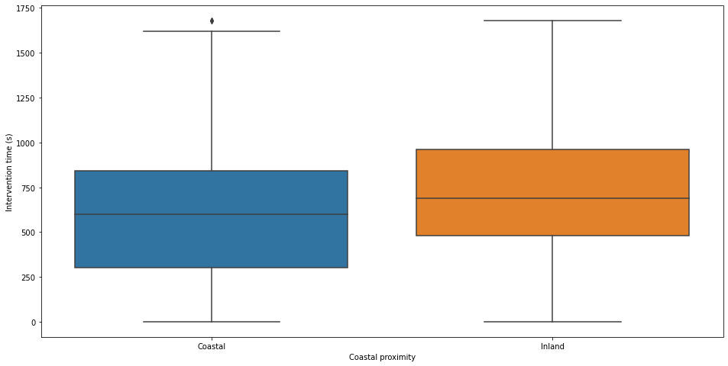
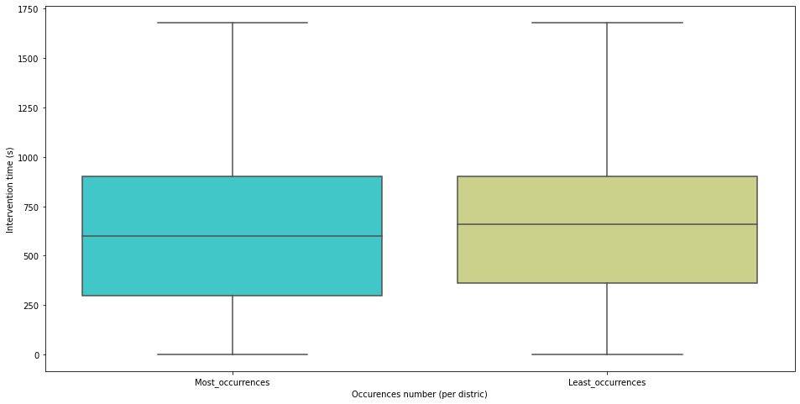
3. Data Exploration
Box plots – Tempo de intervenção by group
Coastal proximity | Occurrences number (per district)

Slide 13
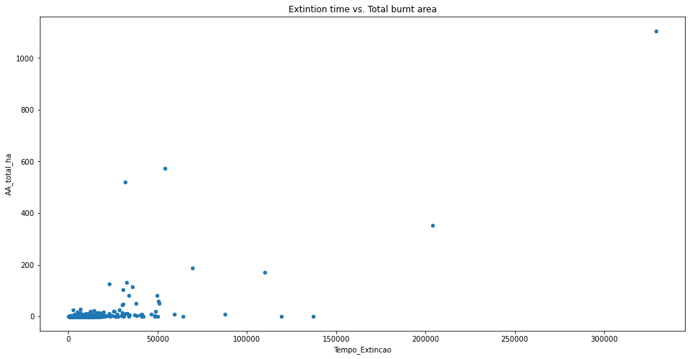
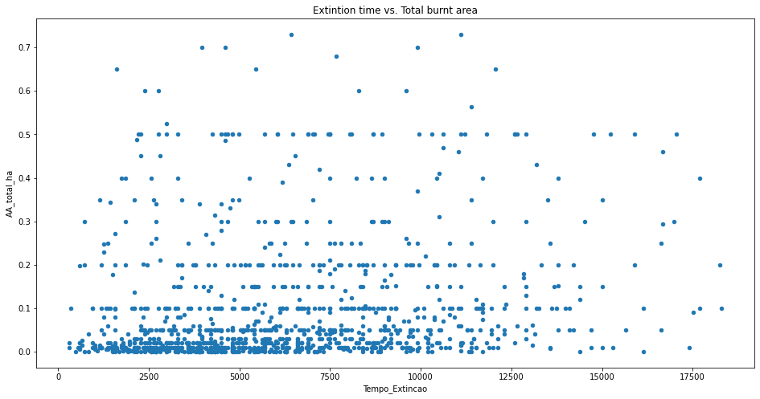
3. Data Exploration
Scatterplots – Extinction time vs total burnt area
Complete data | Without potential outliers

Slide 14
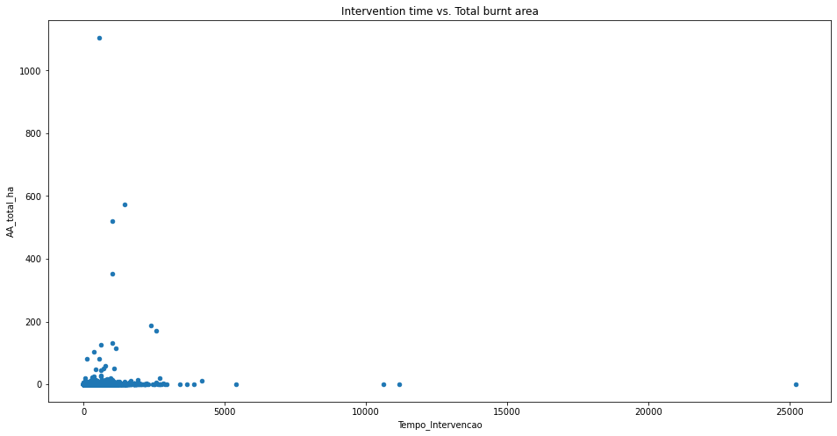
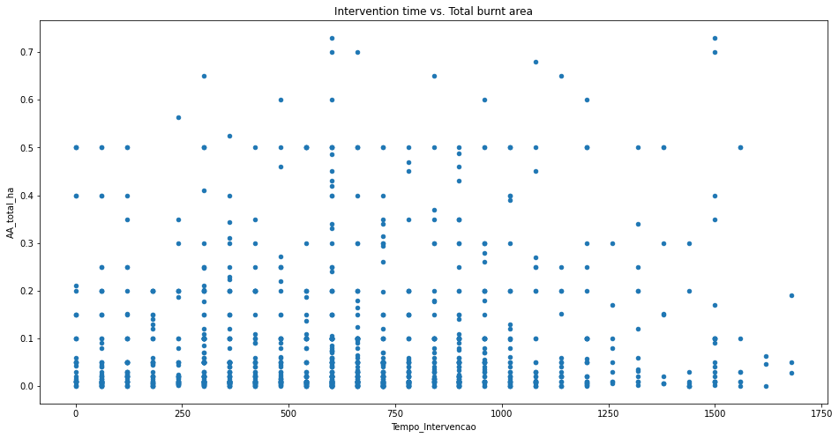
3. Data Exploration
Scatterplots –Intervention time vs total burnt area
Complete data | Without potential outliers

Slide 15
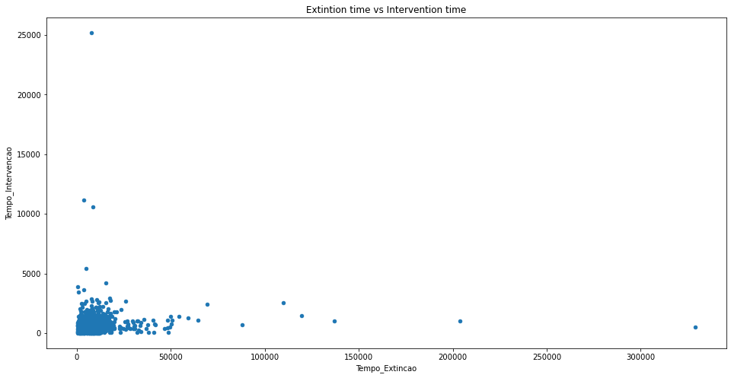
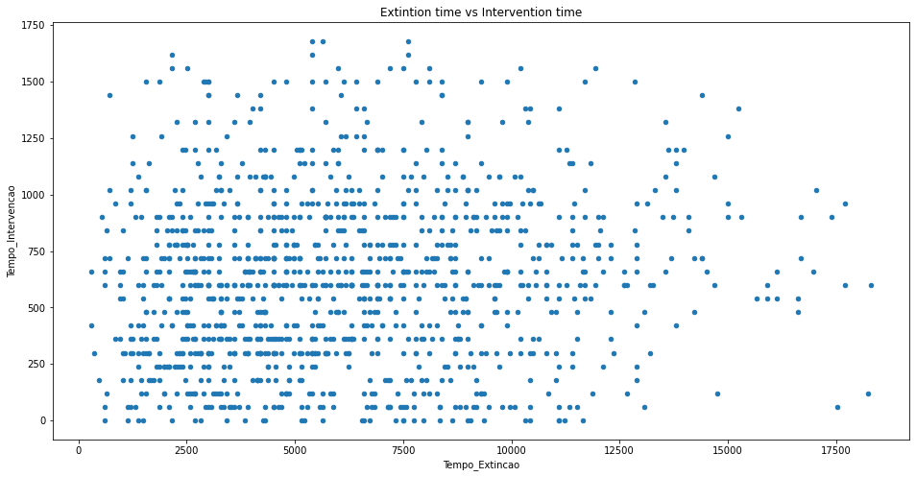
3. Data Exploration
Scatterplots – Extinction time vs Intervention Time
Complete data | Without potential outliers

Slide 16
4. Inferences
Do our variables follow a normal distribution?
Is there a significant relationship between our two categorical groups in terms of number of occurrences per group?
If yes, how strong is this relationship?
Is there a significant statistical difference between burnt areas according to our categorical groups?
Is there a correlation between our variables of interest?

Slide 17
4. Inferences
Do our variables follow a normal distribution?
Kolmogorov-Smirnov goodness of fit test
H0: The samples came from a population with a normal distribution
Since p-value is less than 0.05 we reject the null hypothesis for all variables.
variable | p-value
Total burnt area | 0.0
Extinction time | 0.0
Intervention time | 0.0
Our variables of interest do not follow a normal distribution
Non- parametric tests will be preferred to continue our investigation

Slide 18
4. Inferences
Is there a significant relationship between our two categorical groups in terms of number of occurrences per group?
Chi-Square
H0: No relation exists between the two variables.
Since p-value is less than 0.05 we reject the null hypothesis
 | Least Occurrences | Most Occurrences
Coastal | 169 | 929
Inland | 175 | 235
p-value | 5.83 x 10⁻²⁹
Our categorical variables have a relation between them
Coastal proximity occurrences’ number is related with number of occurrences of re-ignition fires higher and lower districts group.

Slide 19
4. Inferences
Given there is a relationship between our two categorical groups, how strong is this relationship?
Phi-Coefficient
Ranges from 0 to 1 (the closer to 1 the stronger the association)
 | Least Occurrences | Most Occurrences
Coastal | 169 | 929
Inland | 175 | 235
Χ² p-value | 5.83 x 10⁻²⁹
Φ coeff. | ≈ 0.29
Φ coefficient is very close to 0
The relation of occurrences between our categorical variable is very weak.

Slide 20
4. Inferences
Is there a significant statistical difference between burnt areas according to our categorical groups?
Mann-Whitney U
H0: The two populations are equal.
The test was repeated for batches of 20 samples at random, for each categorical.
 | Mean p-value
Burnt area and Coastal proximity | ≈ 0.48
Burnt area and Occurrences number (per district) | ≈ 0.16
With mean p-values obtained above 0.05 we ca’t reject the null hypotesis.
There is no evidence to say burnt area of coastal group is different from burnt area of interior group.
The same conclusion is valid for burnt area of higher occurrence districts group and lower occurrence districts group.

Slide 21
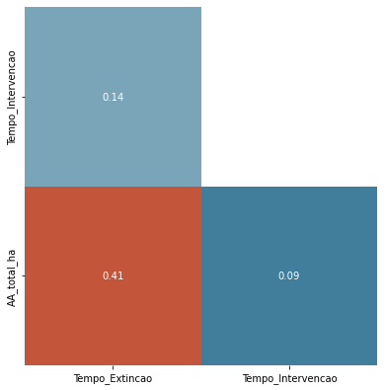

4. Inferences
Is there a correlation between our variables of interest?
Spearman correlation test
H0: There is no (monotonic) association between the two variables
Burnt area + Extinction time | Reject the null hypothesis; Positive correlation.
Burnt area + Intervention time | Reject the null hypothesis; Positive (weak) correlation.
Extinction time + Intervention time | Reject the null hypothesis; Positive (very weak) correlation.

Slide 22
5. Conclusions
Our variables of interest do not follow a normal distribution
Coastal proximity occurrences’ number is related with number of occurrences of re-ignition fires higher and lower districts group.
The relation of occurrences frequency between our categorical variable is very weak.
No evidence to say burnt area of coastal group is different from burnt area of interior group.
No evidence to say burnt area of higher occurrence districts group and lower occurrence districts group.
Burnt area + Extinction time: positive correlation
Burnt area + Intervention time: positive weak correlation
Extinction time + Intervention time positive very weak correlation

Slide 23
6. Look back and ahead
Research Question
Add your second bullet point here
Data Exploration
Inferences
Conclusion
Look back and ahead

