Slide 1
Wild Fires: Statistical Investigation
Fundamentos de Ciência e Engenharia de Dados – MDSE
Cátia Teixeira e Vasco Bartolomeu

Slide 2
Agenda
Research Question
Data Source
Data Exploration
Inferences
Conclusions
Look back and ahead

Slide 3
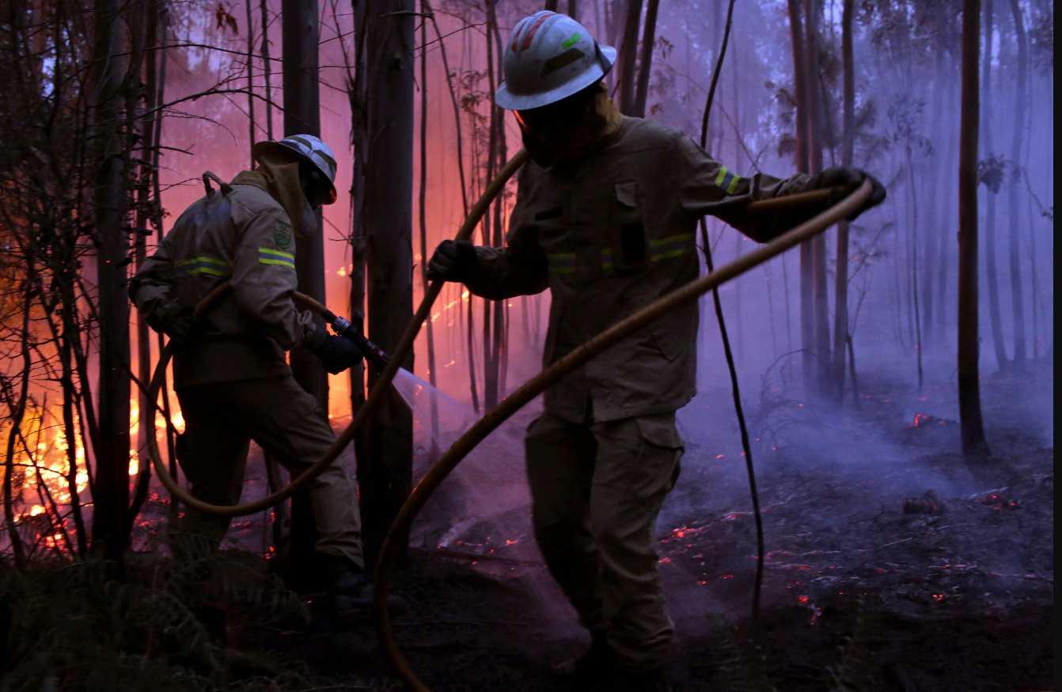
1. Research Question
Research Question
Add your second bullet point here
Data Exploration
Inferences
Conclusion
Look back and ahead
Source: NY Times

Slide 4
2. Data Source
Data was obtained via ICNF website and collected by ANPC.
The dataset includes information on wildfires occurring in Portugal territory, during the period of 2015.
ICNF: Instituto da Conservação da Natureza e Florestas
ANPC: Associação Nacional de Proteção Civil

Slide 5
2. Data Exploration
Research Question
Add your second bullet point here
Data Exploration
Inferences
Conclusion
Look back and ahead

Slide 6
3. Inferences
Research Question
Add your second bullet point here
Data Exploration
Inferences
Conclusion
Look back and ahead

Slide 7
4. Conclusions
Research Question
Add your second bullet point here
Data Exploration
Inferences
Conclusion
Look back and ahead

Slide 8
5. Look back and ahead
Research Question
Add your second bullet point here
Data Exploration
Inferences
Conclusion
Look back and ahead

Slide 9
Title and content layout with chart

Slide 10
Two content layout with table
First bullet point here
Second bullet point here
Third bullet point here
Class | Group 1 | Group 2
Class 1 | 82 | 95
Class 2 | 76 | 88
Class 3 | 84 | 90

Slide 11
Title and content layout with SmartArt
Step 1 Title
Task description
Step 2 Title
Task description
Step 3 Title
Task description

Slide 12
Add a Slide Title - 1

Slide 13
Add a Slide Title - 2

Slide 14
Add a Slide Title - 3

Slide 16
Add a Slide Title - 4

Slide 17
Add a Slide Title - 5

