Slide 1


MotorIST
T23
Miguel Raposo
Vasco Silva
Diogo Rodrigues
ist1112167
ist199132
ist1112192

Slide 2
Secure Document Format

Slide 3
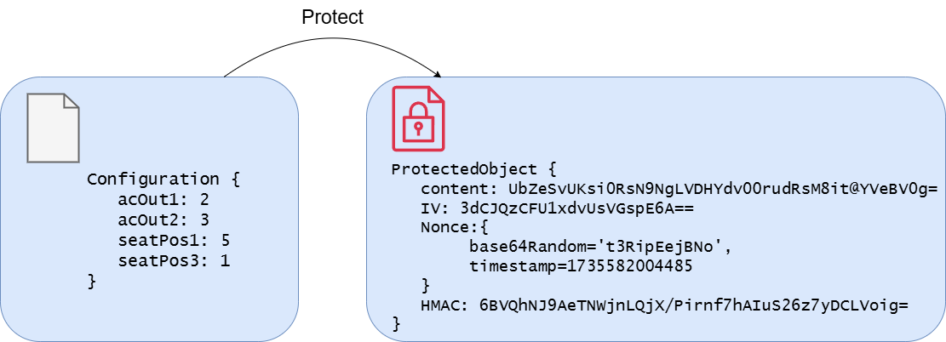
Secure Document Format
Confidentiality
Integrity
Authenticity
Authorization
AES/CBC/PKCS5 Padding
HMACSHA256

Slide 4
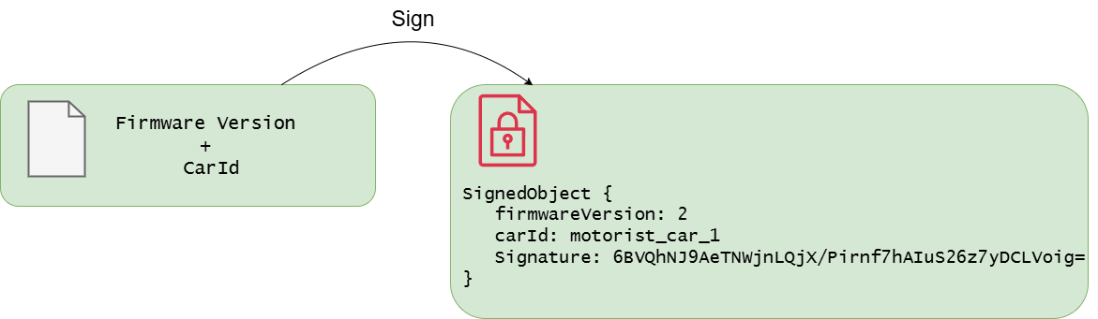
Signed Document
Non-Repudiation
Integrity
Authentication
RSA/SHA256

Slide 5
System Infrastructure

Slide 6
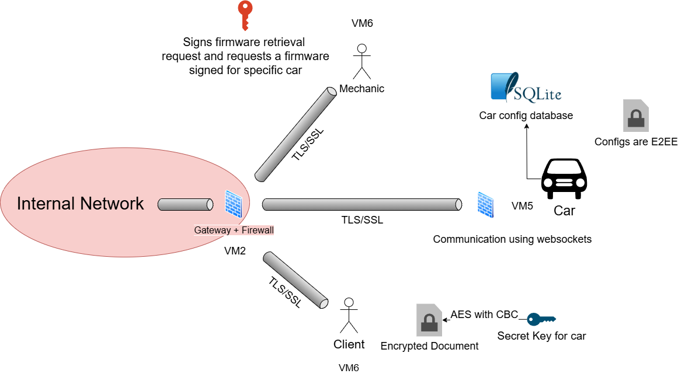
System Infrastructure

Slide 7
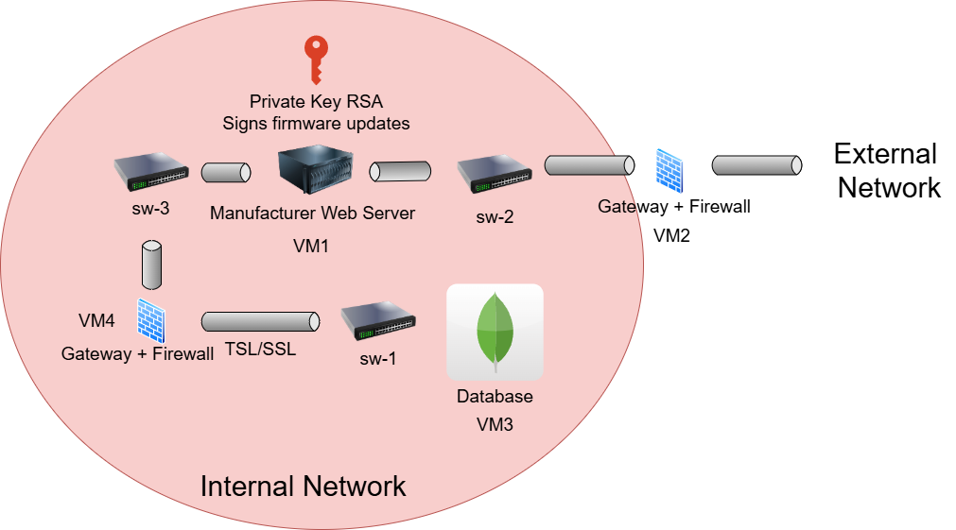
System Infrastructure

Slide 8
Secure Channels and Key Distribution

Slide 9
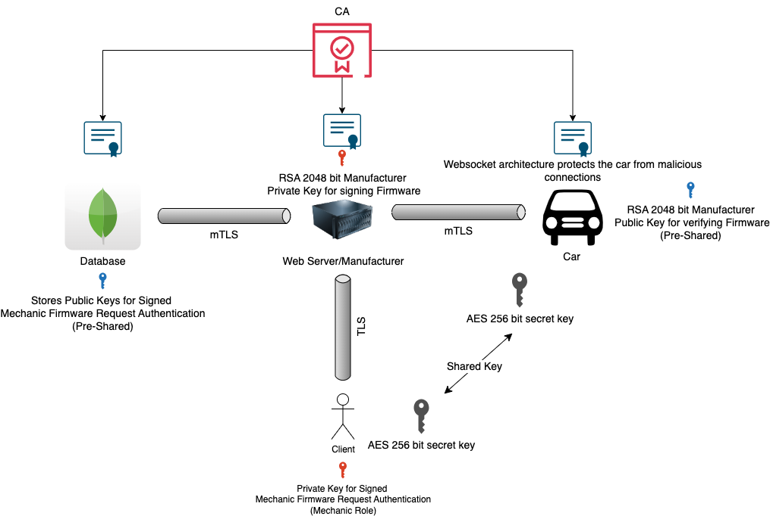
Secure Channels and Key Distribution

Slide 10
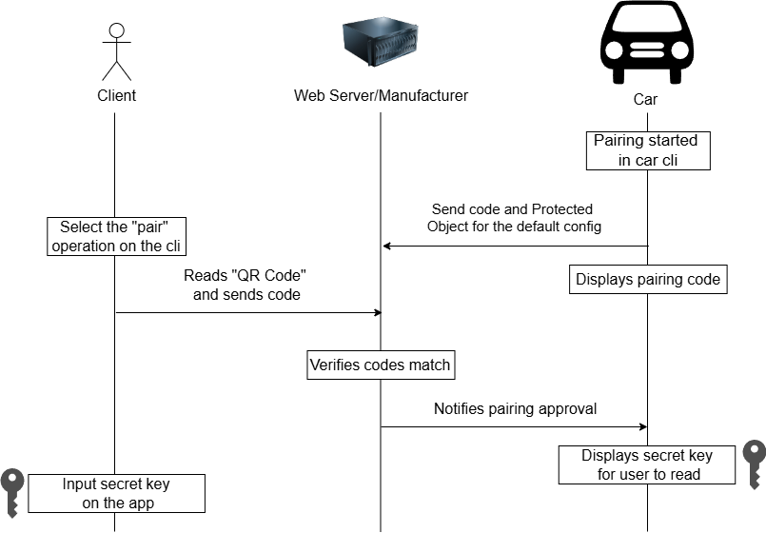
Secure Channels and Key Distribution

Slide 11
Security Challenge

Slide 12
Security Challenge
Goal:
Allow multiple users to share the same car while ensuring strict privacy and isolation of their individual configurations.
Solution:
Each user is assigned a unique secret key
The car maintains general information, which is relevant to all users
An append-only log file was introduced to record every action performed by users on the car

Slide 13
Results and Conclusions

Slide 14
Results and Conclusions
Results
Conclusions
Successfully solved all the security requirements and challenges
Simple but secure implementation of automotive application using modern cryptographic techniques

