Slide 1
Reinforcement Learning on FrozenLake using Q-Learning
Using Q-Learning Algorithm
Presented by: Shivam Korgaonkar
Roll No - 25ME11
Course: Applied Machine Learning
Date-16/05/2026

Slide 2
Introduction
Reinforcement Learning is a learning method where an agent learns by interacting with an environment.

Slide 3
Key Concepts
Agent
Environment
States
Actions
Rewards
Policy

Slide 4
FrozenLake Environment
4x4 Grid World
Start → Goal
Avoid Holes
Goal gives reward

Slide 5
Environment
S = Start
F = Frozen Surface
H = Hole
G = Goal
Example
S F F F
F H F H
F F F H
H F F G

Slide 6
States and Actions
States: 16
Actions:
Left, Down, Right, Up

Slide 7
Q-Learning
Uses Q-Table
Learns optimal policy
No dataset required

Slide 8
Q-Learning Formula
Q(s,a) = Q(s,a) + α [r + γ max Q(s',a') - Q(s,a)]

Slide 9
Exploration vs Exploitation
Exploration: Try new actions
Exploitation: Use learned actions
Epsilon-greedy strategy

Slide 10
Implementation
Initialize Q-table
Train for 1000 episodes
Update Q-values
Reduce epsilon

Slide 11
Results
Reward improves over time
Agent learns optimal path

Slide 12
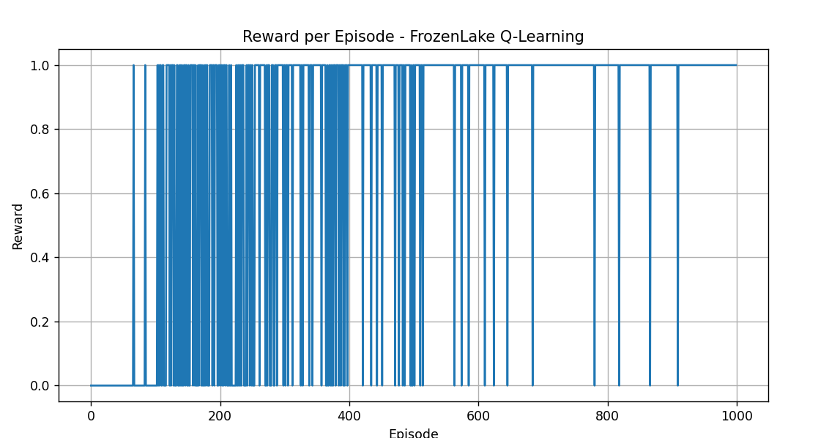
Sample Output
Episode 1 Reward = 0
Episode 500 Reward = 1
Episode 1000 Reward = 1

Slide 13
Conclusion and Future Scope
Agent learns through trial and error
Q-Learning finds best policy
No labeled data needed Future scopes
Deep Q Learning
Robotics
Game AI
Autonomous systems

