Slide 1
Multi Disease Prediction
Presented by
Vaseela Fathima R
MDTM35

Slide 2
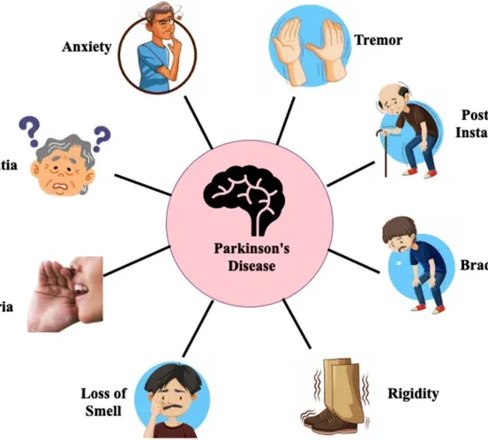
Disease 1
Parkinson

Slide 3
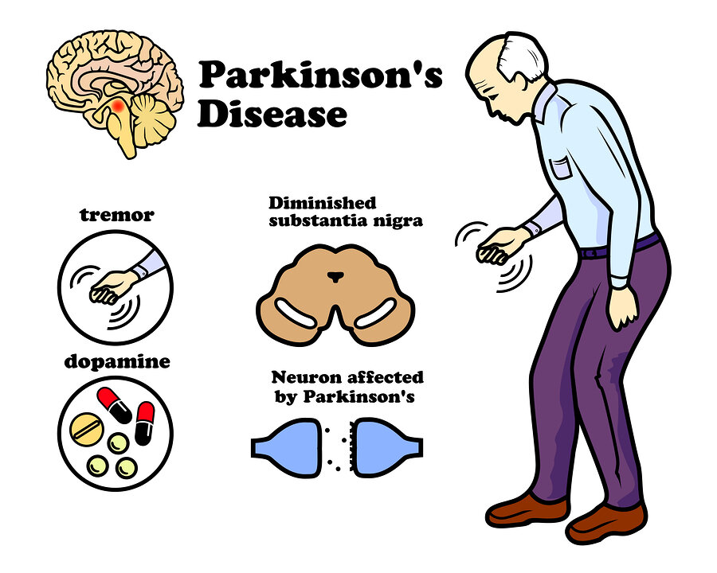
Parkinson's disease is a neurodegenerative disorder that primarily affects movement.

Slide 4
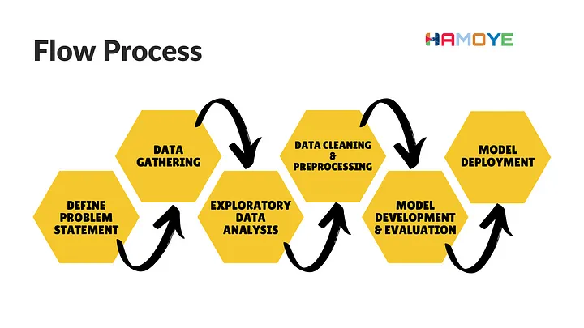
EDA for Analysis
It’s used for feature selection and target

Slide 5
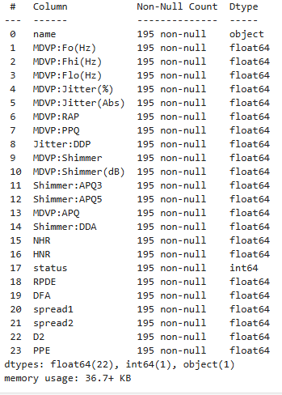
Parkinson Column:

Slide 6
Voice Jitter/Shimmer Features:
MDVP:Jitter(%)
MDVP:Jitter(Abs)
MDVP:RAP
MDVP:PPQ
Jitter:DDP
MDVP:Shimmer
MDVP:Shimmer(dB)
Shimmer:APQ3
Shimmer:APQ5
MDVP:APQ
Shimmer:DDA
Fundamental Frequency Features:
MDVP:Fo(Hz)
MDVP:Fhi(Hz)
MDVP:Flo(Hz)
Other Important Features:
HNR (Harmonics-to-Noise Ratio)
DFA (Detrended Fluctuation Analysis)
PPE (Pitch Period Entropy)

Slide 7
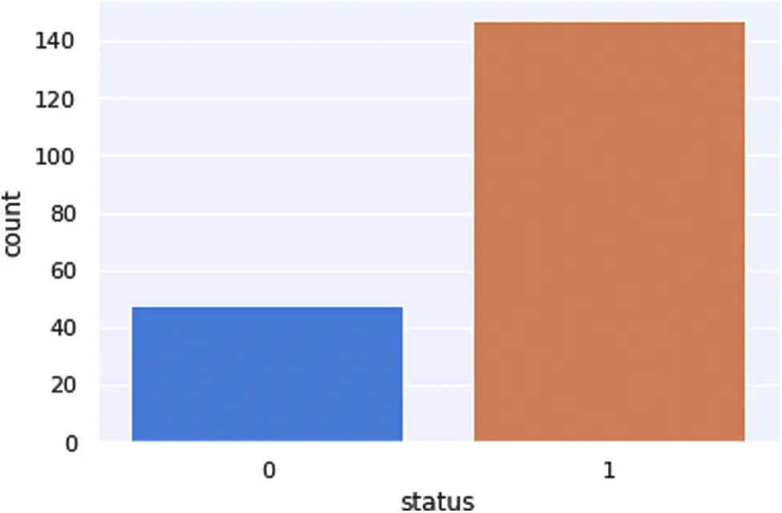
PD patient health status:
Enhancing your presentation

Slide 8
Insights of PD with ML Classifier
In this process, we are going to classify Parkinson’s disease with a machine learning classifier. First, we set the target of patient health status and count how many patients are available in this report. After checking the patient’s health status, we visualize the results graphically. The dataset was split into 80% for the training phase whereas 20% for the testing phase. In Fig. 14, 0 represents the healthy people who are 48 in the dataset, whereas 1 represents the patients who are 147 in the dataset.
▪ Number of Parkinson people in the dataset 147 (75.39%)
▪ Number of Healthy people in the dataset 48 (24.61%)

Slide 9
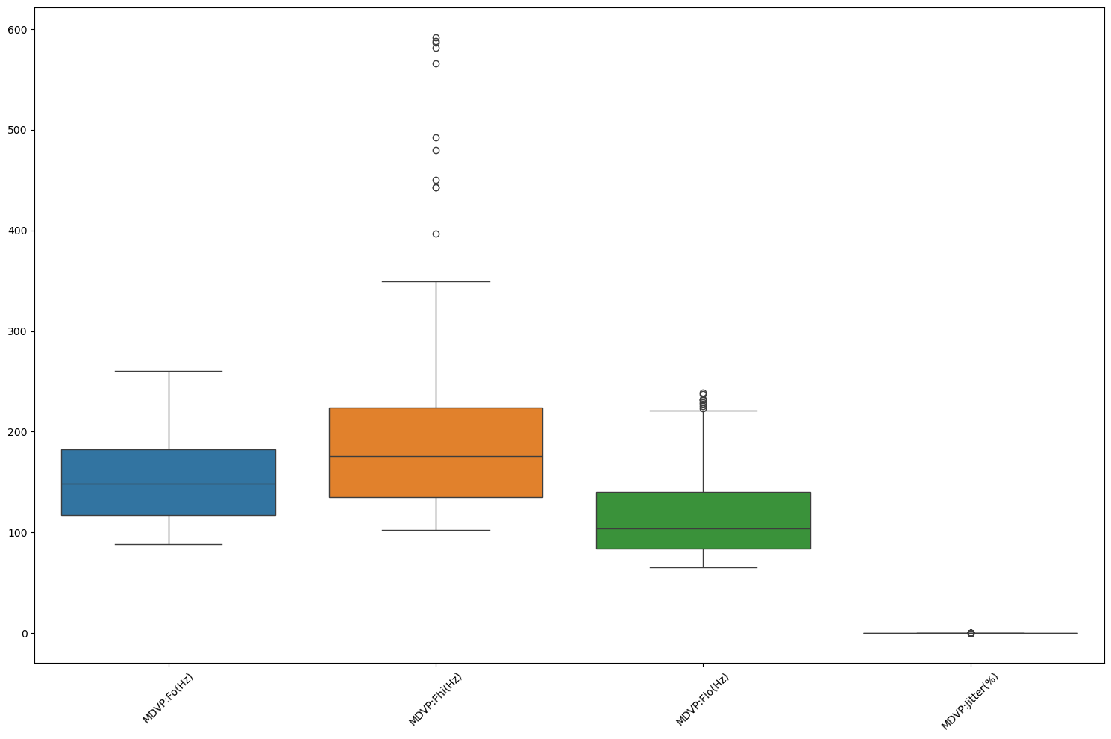
Bivariate Analysis for Outlier
Your ability to communicate effectively will leave a lasting impact on your audience
Effectively communicating involves not only delivering a message but also resonating with the experiences, values, and emotions of those listening

Slide 10
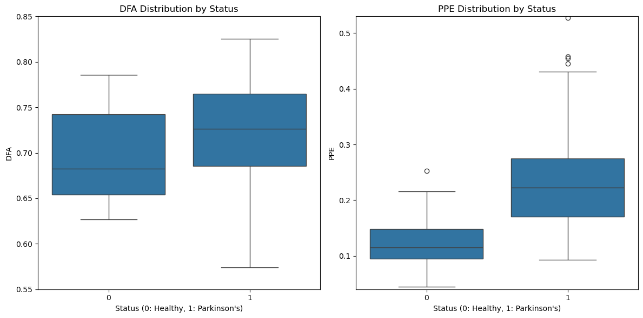
DFA and PPE Analysis:
Insights:
DFA: Healthy individuals (status = 0) may show more regular fluctuations in speech (lower DFA values), while individuals with Parkinson's (status = 1) may show more irregular fluctuations (higher DFA values).
PPE: Like DFA, individuals with Parkinson's disease may have higher PPE values, reflecting more irregularities in their pitch periods compared to healthy individuals.
These visualizations can help in understanding how Parkinson's affects the rhythm and flow of speech, which can be vital for diagnosing the disease based on voice data.

Slide 11
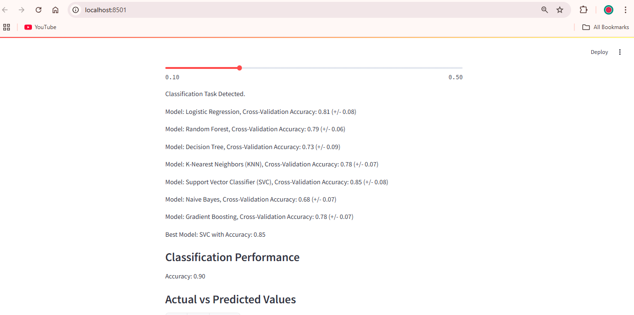
Multiple Output Classifier
Cross-validation to ensure robustness.

Slide 12
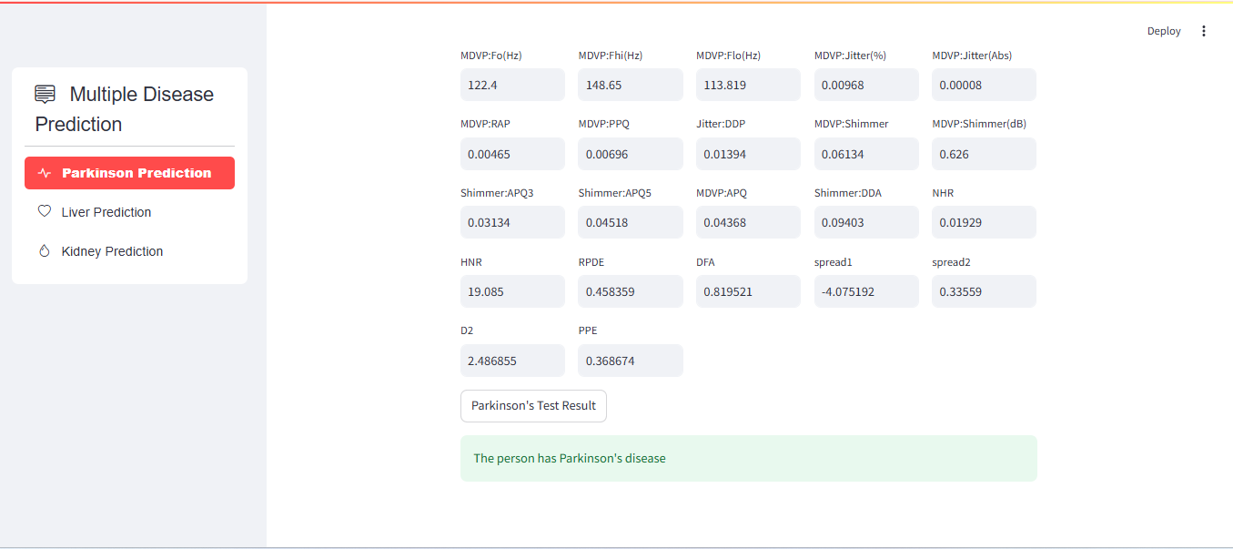
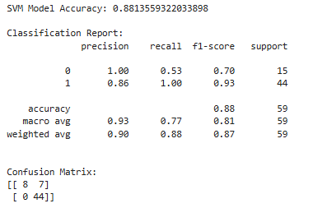
Final Output Page:
Cross Validate multiple classifier
Accuracy level : SVC

Slide 13

Kidney Prediction Disease 2:
Machine learning algorithms are used to build predictive models. These algorithms learn patterns in the data and can then predict the likelihood of someone developing kidney disease or the progression of the disease.

Slide 14
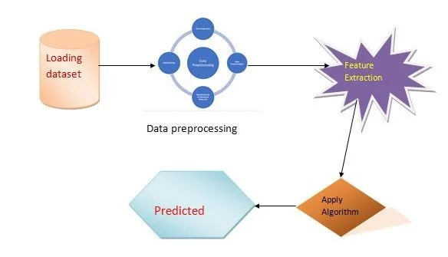
Flow :

Slide 15
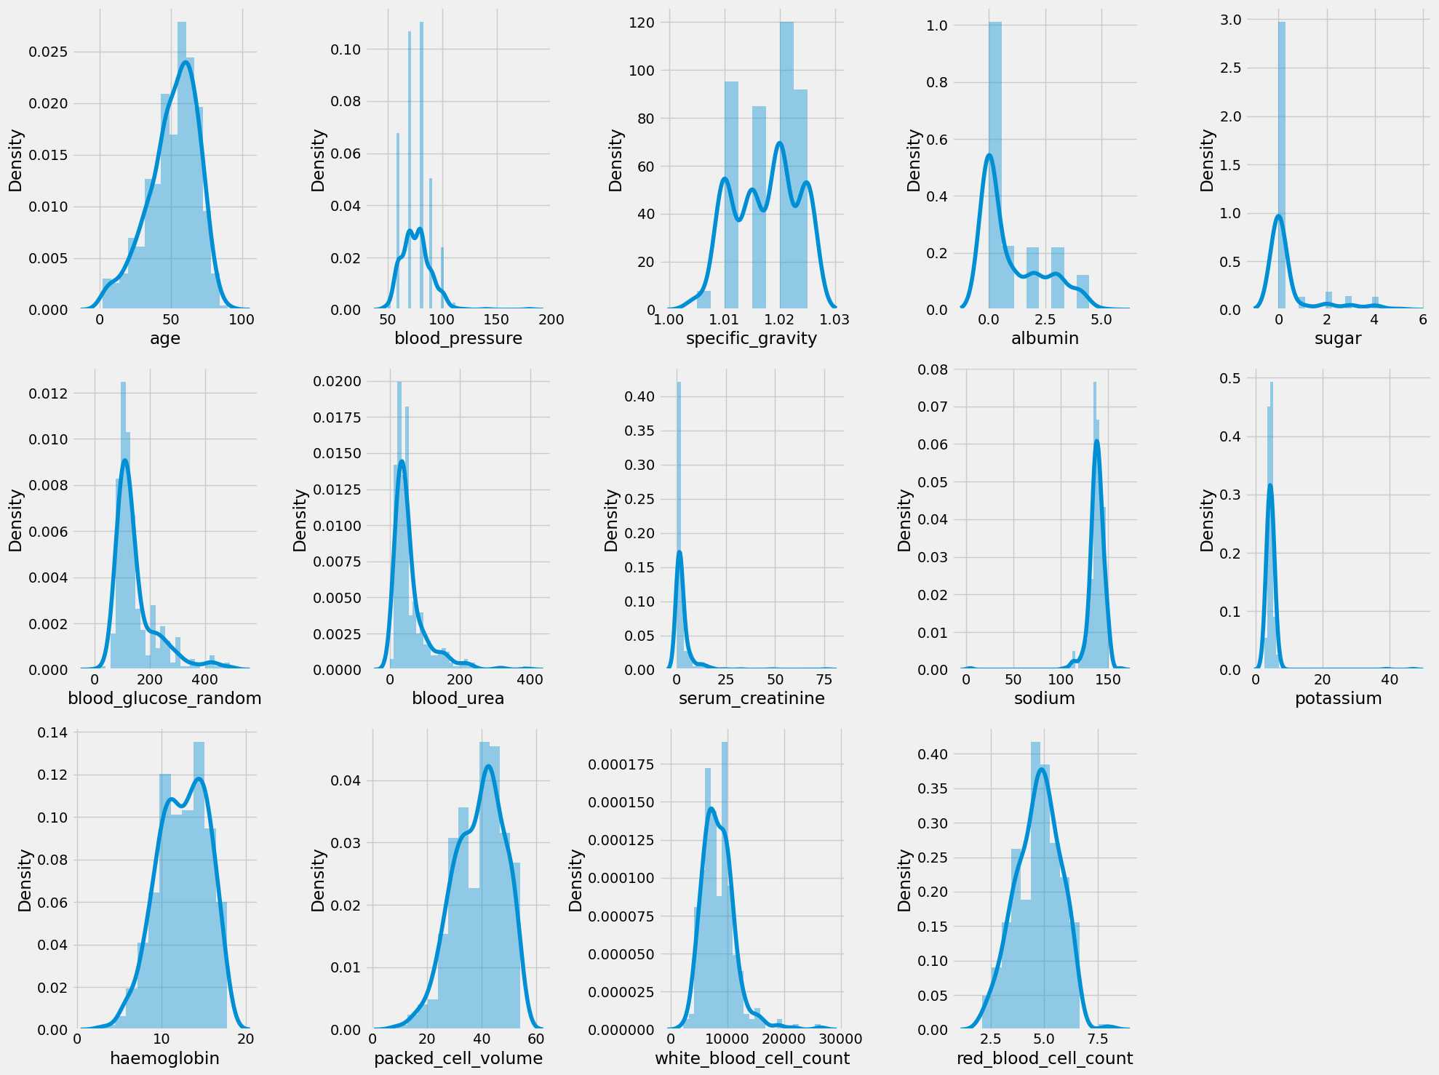
Visualizing Numerical Data Distributions: We visualize the distribution of numerical columns to identify skewed features.

Slide 16
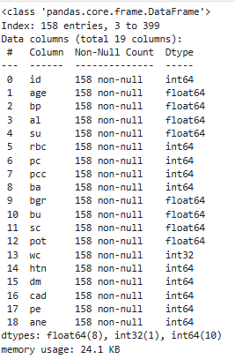
Selected Feature columns:

Slide 17
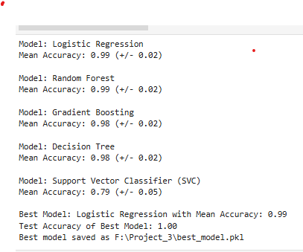
Best Model Selection
Best Model: Logistic Regression with a mean accuracy of 0.99.
Test Accuracy: The model achieved perfect accuracy (1.00) on the test set.
Insight: Logistic Regression is the most accurate and stable model for your dataset.
Caution: A test accuracy of 1.00 is rare and could indicate overfitting or a lack of diversity in the test set. Ensure the test set is representative and consider further validation.

Slide 18
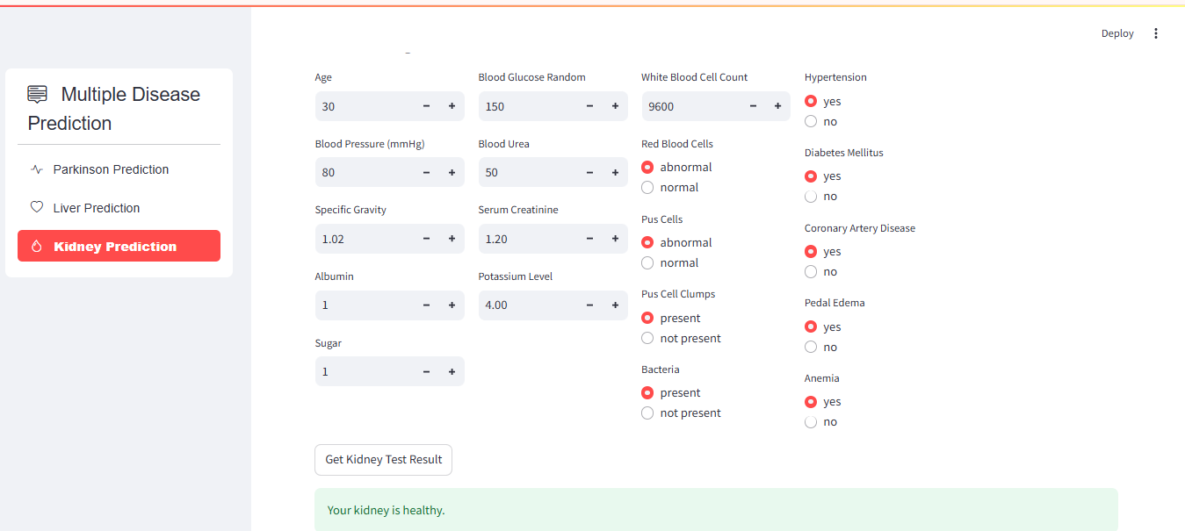
Kidney Prediction page:

Slide 19

Liver Prediction Disease 3:
Liver Disease Prediction system, we can use machine learning models to predict whether a patient has liver disease based on various health metrics.

Slide 20
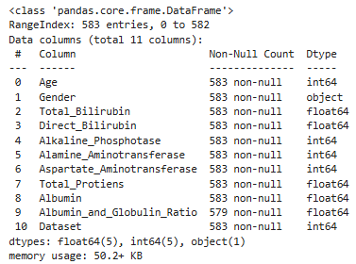
Data Column in Dataset:

Slide 21
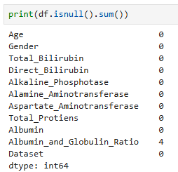
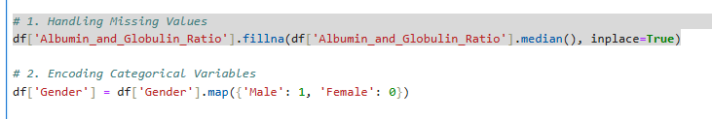
Preprocessing:
Missing values Detect and Treat:
Encoding Gender Column:

Slide 22
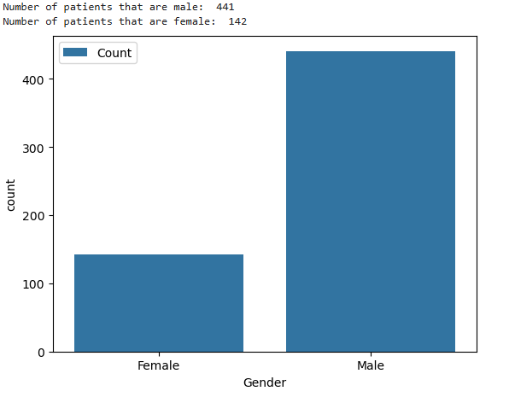
Target Column:

Slide 23
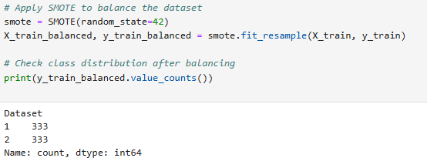
Balancing the Target:

Slide 24
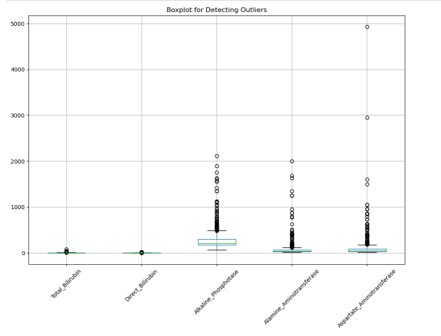
Detect the Outlier:

Slide 25
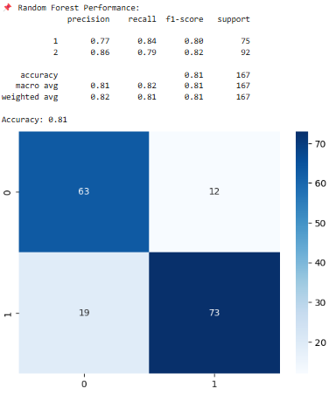
Model Training and Evaluation:

Slide 26
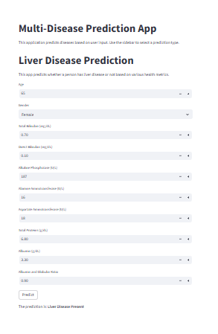
Final Output:
Prediction:

Slide 27
Thank you
Brita Tamm
502-555-0152
brita@firstupconsultants.com
www.firstupconsultants.com

