Slide 1
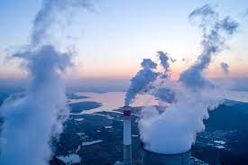
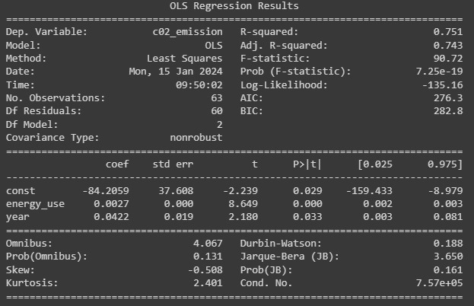
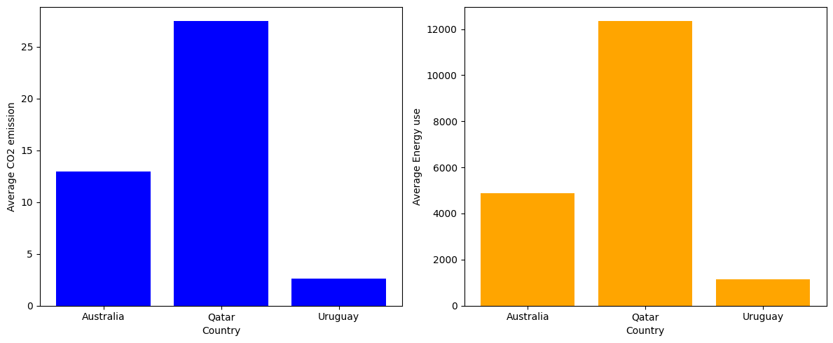
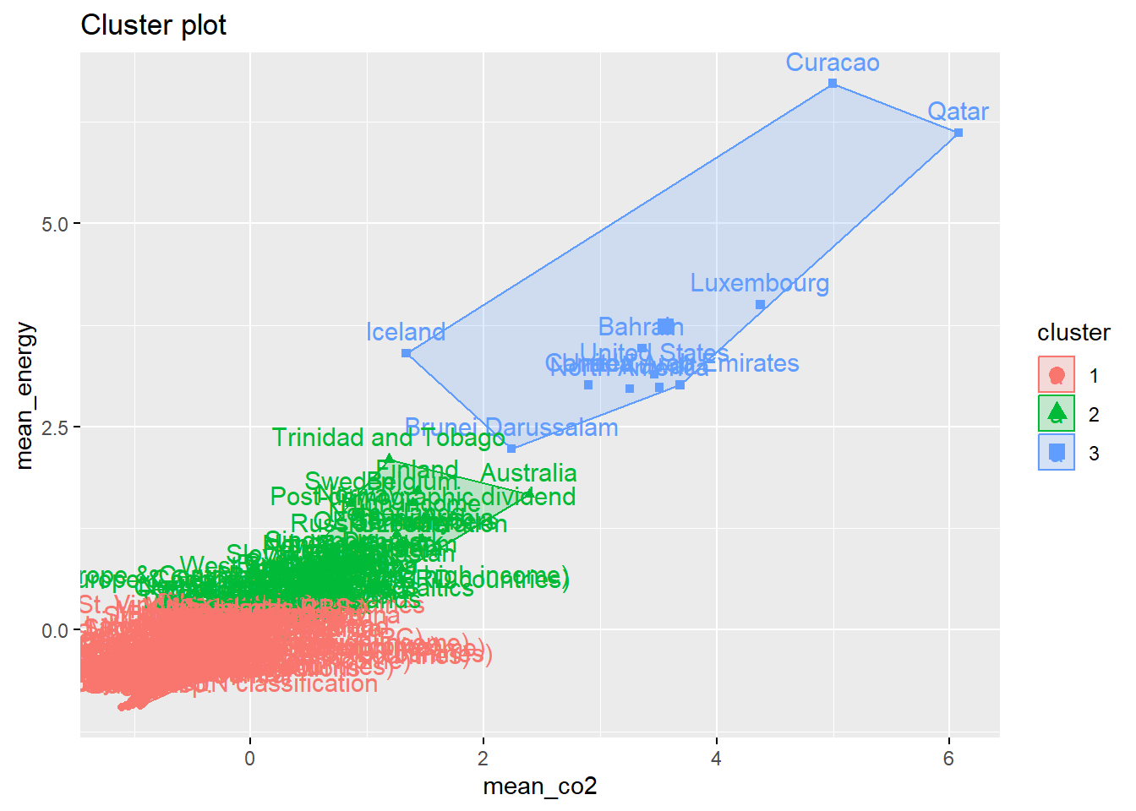
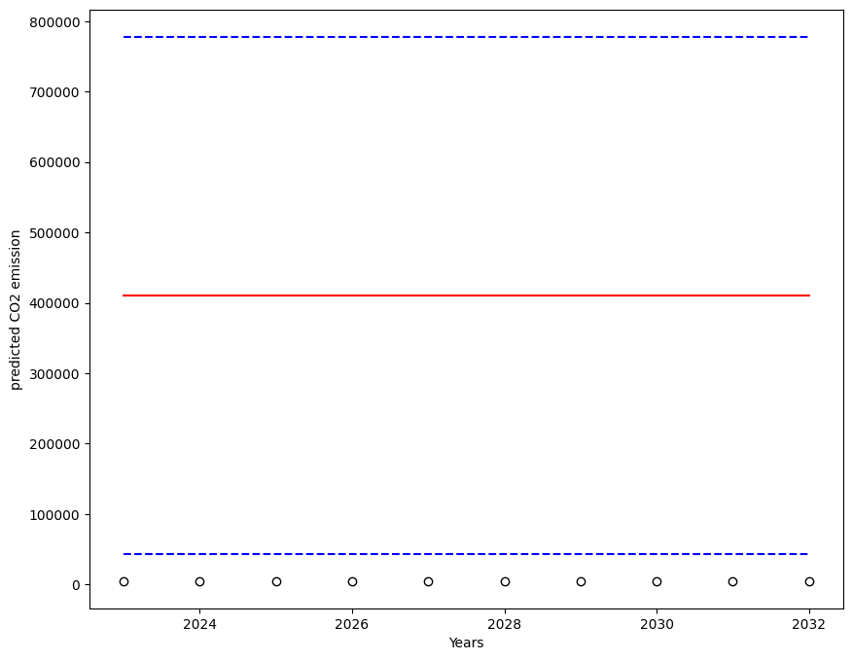
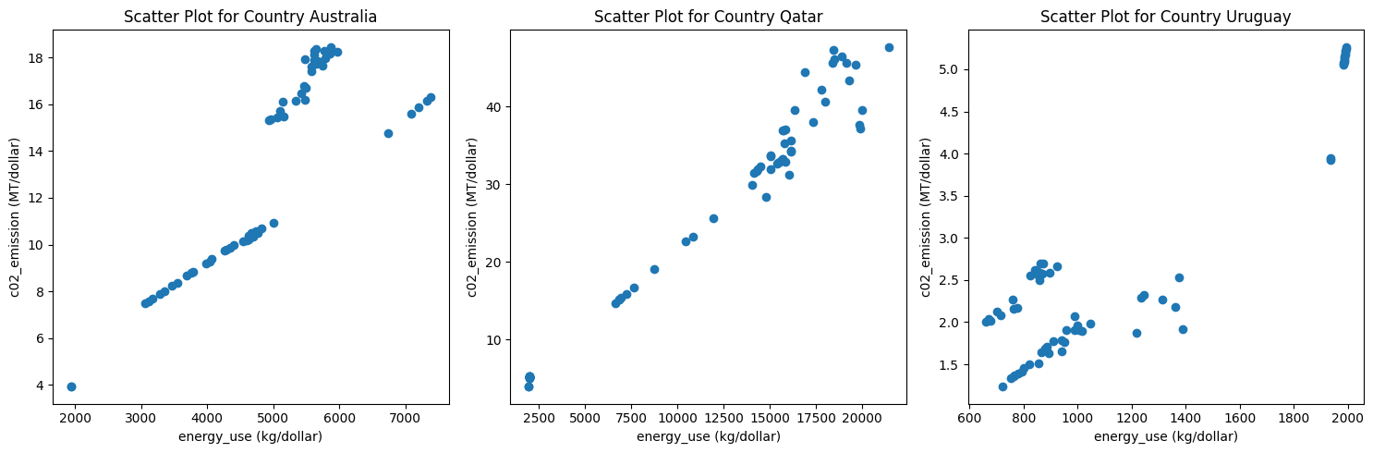
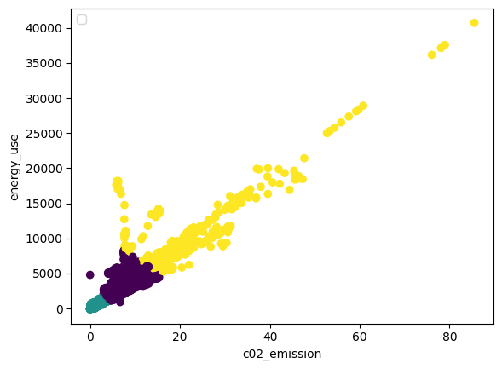
CLUSTERING AND FITTING
The C02 emission (MT/dollar) vs The energy use (Kg/Dollar)
Introduction
Descriptive Data analysis
Linear Regression Analysis
Over the recent past the C02 emissions has been on the increase, (Adedoyin et al. 2020)
2022 statistics estimate 38 metric tones of emission of C02 ( Friedlingstein et al. 2022)
The study seeks to cluster countries in terms of the CO2 emission per dollar and energy consumption (Kg/dollar)
Besides, the study ought to estimate the CO2 emission as a function of time and energy consumption
In each cluster, a country was selected Uruguay in Cluster 2 Australia in Cluster 1 Qatar in Cluster 3.
The average CO2 emission in Qatar was 26 MT/dollar, 13 MT/dollar for Australia, and 2.13MT/dollar for Uruguay
The average energy consumption in kg/dollar emission in Qatar was 12273, 4815 for Australia and 960 for Uruguay.
This confirms that cluster mild is cluster 2, moderate is cluster 2, and severe is cluster 3.
The aim was to fit CO2 emission as a function of time and energy consumption.
The result suggests an average increase in CO2 of 0.0422 with an increase in years, besides, a 0.0027 increase in CO2 is associated with a unit increase in energy.
Both year( time) and energy were significant predictor od CO2. The variability in year and energy was found to explain 75.1% of the variability in CO2.
Clustering of the CO2 emitter
The correlation analysis between CO2 and Energy use for the three clusters(countries)
10 years ahead Prediction of CO2 emission
> The world was found to be categorized into 3 clusters
The mild, moderate and severe C02 emitters
The mild are countries with an average 2.72 co2 and 1254.83 k/dollar
The averages for moderate are 10.32(metric tone per capital) and 956.67 kg/dollar.
on the other hand cluster three was countries with an average 17(metric tone/dollar) and 8277.89 kg/dollar.
> The ten steps ahead show a possible increase in CO2 emission.
For the next 10 years the CO2 emission is predicted to be approximately 400000 metric tons.
> The expected increase per year is insignificant and small.
In all three countries, the CO2 emission in metric Tone per Dollar (MT/dollar) was found to increase with the increase in energy consumption (kg/dollar).
However, there was high variability in CO2 emission for larger energy consumption in Qatar, compared to Austria and Uruguay.
References
Friedlingstein, P., O'sullivan, M., Jones, M. W., Andrew, R. M., Gregor, L., Hauck, J., ... & Zheng, B. (2022). Global carbon budget 2022. Earth System Science Data Discussions, 2022, 1-159.
Adedoyin, F., Ozturk, I., Abubakar, I., Kumeka, T., Folarin, O., & Bekun, F. V. (2020). Structural breaks in CO2 emissions: are they caused by climate change protests or other factors?. Journal of environmental management, 266, 110628

