Slide 1
Parallel Root
2 ways to utilize parallel processing in ROOT
- Implicit (by ROOT)
- Explicit (user-defined)
Better not to mix them up

Slide 2
Parallel Root
2 ways to utilize parallel processing in ROOT
- Implicit (by ROOT)
- Explicit (user-defined)
ROOT decides how parallelism is achieved e.g. how many threads are utilized

Slide 3
Parallel Root
2 ways to utilize parallel processing in ROOT
- Implicit (by ROOT)
- Explicit (user-defined)
ROOT decides how parallelism is achieved e.g. how many threads are utilized
ROOT objects have different safety levels. This requires extra caution

Slide 4
Thread Safety Level
- Different classes have different safety levels
Some need more caution than others
e.g. TTree and TFile objects:
only different instances should be accessed concurrently from different threads

Slide 5
Procedure
Axis X: numEvents Data (1e4, 1e5, 1e6)
Axis Y: Speedup relative to the ex.time of the sequential algorithm.
Label: Number of Processes (1, 2, 4, 8)
For each combination execute 5 times to derive the AVG for more accurate results
System Memory: 12GB
System Processor:Intel© Core™ i5-8250U CPU @ 1.60GHz × 4

Slide 6
TTree::Fill
Fill the same tree in same file
- files → fillTree*.C
- No way for multiple threads to
access safely the same tree and fill it in parallel
- Instead, work in individual objects and merge
Used: IMT(Implicit MultiThreading), OpenMP, MPI

Slide 7
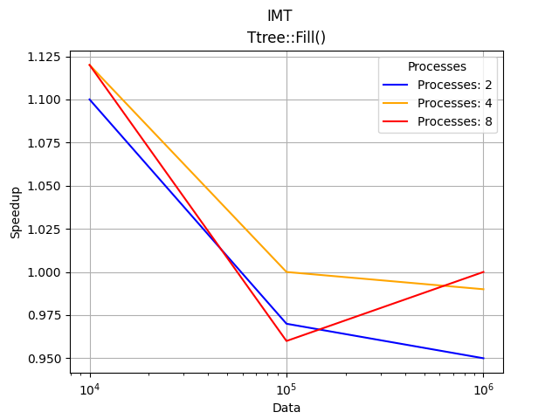
TTree::Fill + IMT
The user-defined numThreads is just a suggestion for ROOT.
This could explain the inconsistency (8 Processes) in this plot.
In any case, the difference is small.

Slide 8
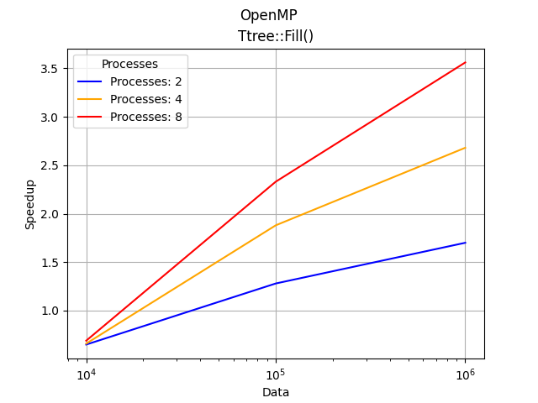
TTree::Fill + OpenMP
Good Scaling

Slide 9
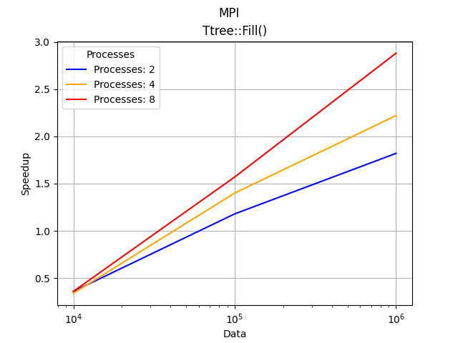
TTree::Fill + MPI
Good Scaling

Slide 10
Validation
Resulting trees are equal
Compared using the root-diff package
installation-link
Usage: root-diff -k <TreeName> file1.root file2.root

Slide 11
TH1F::Fill
Fill multiple histos in multiple files
- files → fillHist*.C
-Used: IMT, C++ <threads>, TprocessExecutor
- In this case, more processes mean more written files with histograms.

Slide 12
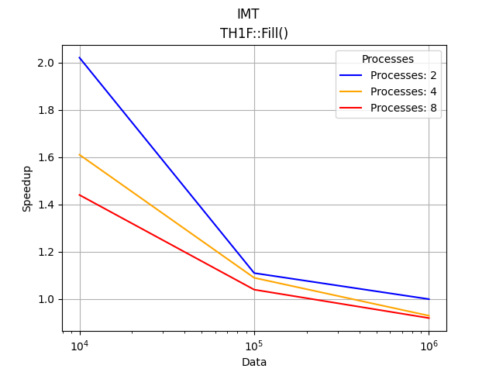
TH1F::Fill + IMT
IMT gives decreased speedup for increased number of Processes
or for increased number of Data

Slide 13
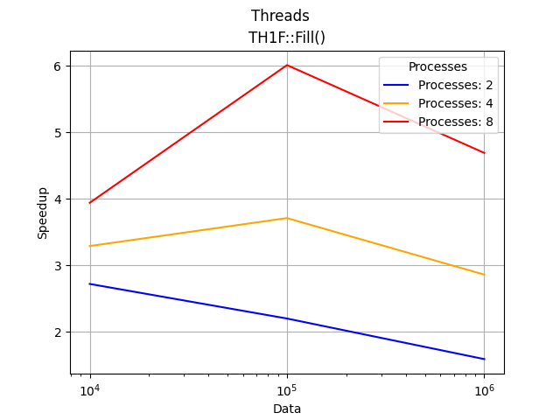
TH1F::Fill + <std::threads>
Performance peak for 1e5 number of Events
filled by 8 processes

Slide 14
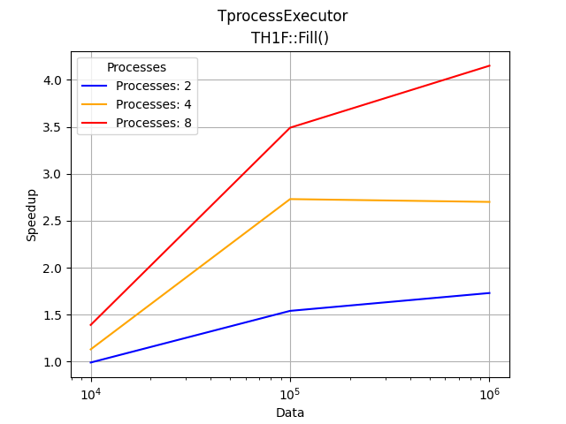
TH1F::Fill + TProcessExecutor
Good Scaling

