Slide 1
Particle Tracing Earth
Trial Simulations
Nonlinear interaction of energetic electrons with large amplitude chorus
J. Bortnik, 1 R. M. Thorne, 1 and U. S. Inan 2

Slide 2
Nonlinear WPI
Test particles
Population : 24
Linearly spaced : (0 – 2π)

Slide 3
Low latitude – Small Amplitude
Simulation constants:
-L_shell = 5
-aeq0_deg = 70
-Ekev0 = 168.3keV
-f_wave = 2000Hz
-ne0=10cm^-3
-theta0_deg = 0.001
-By_wave = 1pT (SMALL)
=> resonance (dh/dt = 0) @ lamda = -5 deg(LOW)

Slide 4
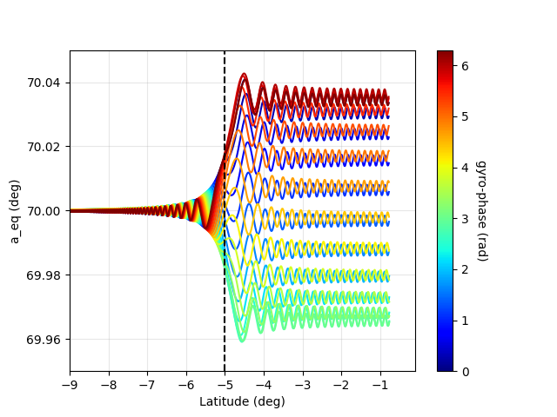
Low latitude – Small Amplitude
1pT
Execution time: < 0.53 seconds
(py is ~ 75)
System Hyperlink
Typical low-latitude WPI
(Stopped at equator)

Slide 5
Low latitude – Large Amplitude
Simulation constants:
Identical parameters and
-By_wave = 1nT (HIGH)
=> resonance (dh/dt = 0) @ lamda = -6.4 deg (LOW)

Slide 6
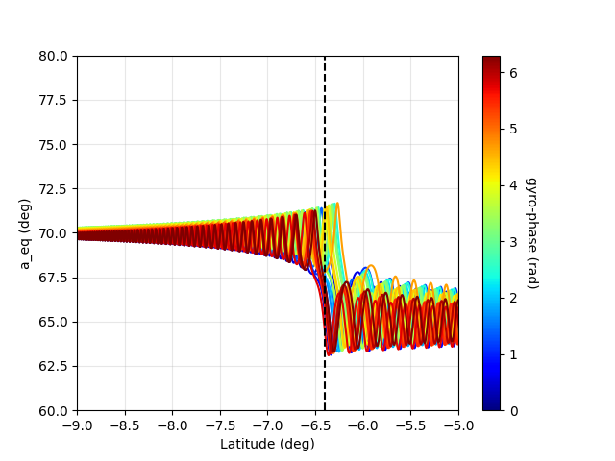
Low latitude – Large Amplitude
1 nT
Execution time: <0.47 seconds
Equatorial P.A change
Is more than before

Slide 7
High latitude – Large Amplitude
Oblique waves – Low density plasma
Simulation constants:
Identical parameters but
-By_wave = 1.4nT (HIGH)
-ne0 = 3cm ^-3(low density plasma)
-aeq0_deg = 20
-Ekev0=511
-theta0_deg=50(Oblique)
=> resonance (dh/dt = 0) @ lamda = 23 deg (HIGH)

Slide 8
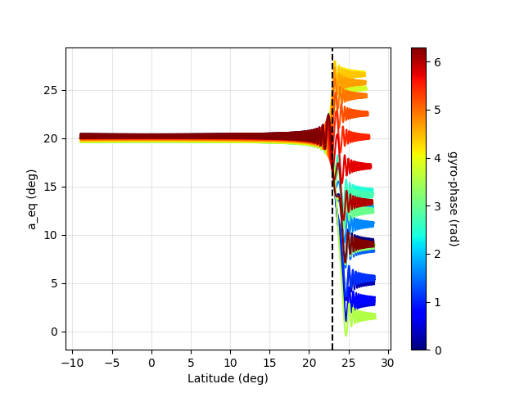
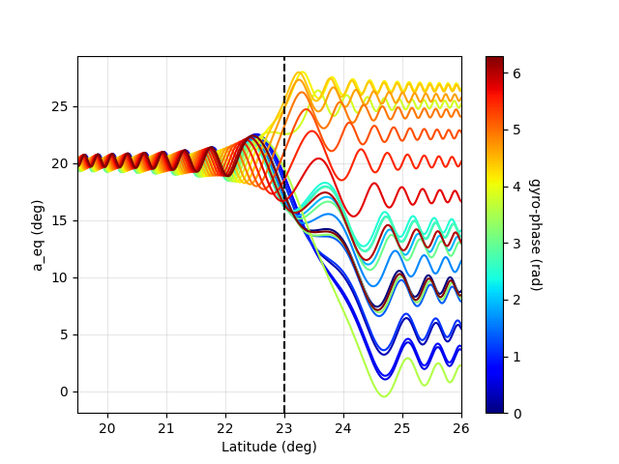
High latitude – Large Amplitude
Oblique waves – Low density plasma
Execution time: <5.6 seconds
(Execution doesn’t stop at equator)
Resonance should happen at
λ = 23deg
Equatorial P.A chages are more intense
but no phase trapping of particle.

Slide 9
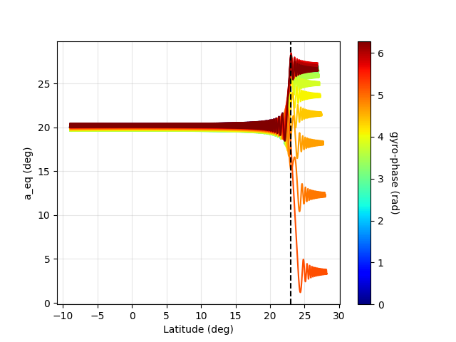
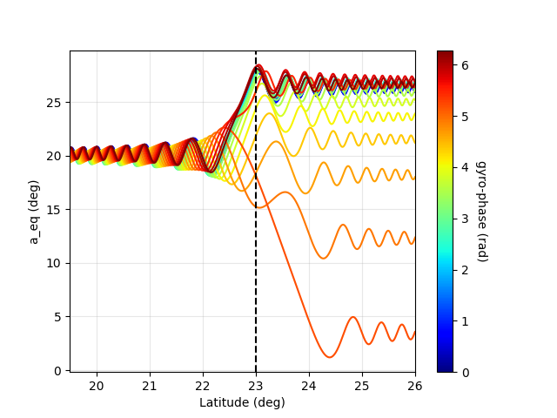
Same with 500kev

Slide 10
Arround 7π/12
Simulation constants:
Identical parameters as before
24 particles
Eta distribution from 90 to 120 degrees
Critical value is 7π/12 rads = 105 degrees
Step is 1.3043 degrees

Slide 11
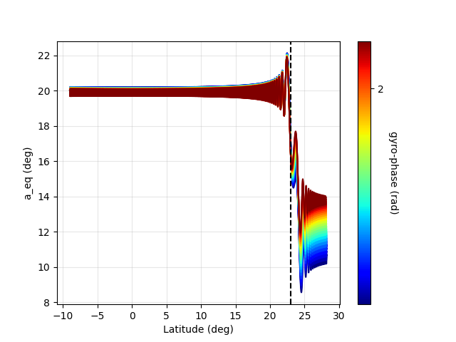
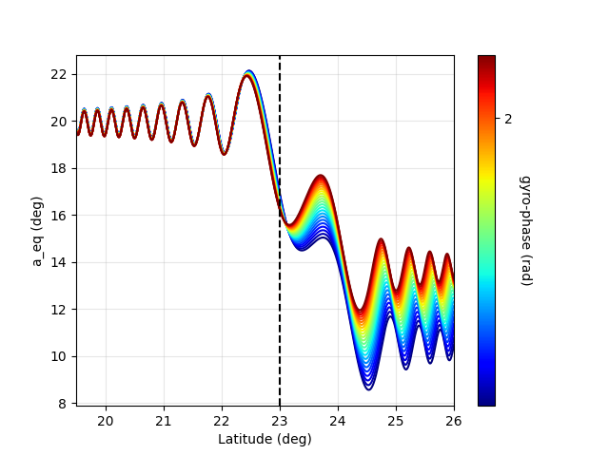
Arround 7π/12
Execution time: <5.6 seconds
(Execution doesn’t stop at equator)
Resonance should happen at
λ = 23deg
All particles exhibit “the same”
aeq change. (?)
No phase trapping.

