Slide 1
Particle Tracing Earth
Trial Simulations
Nonlinear interaction of energetic electrons with large amplitude chorus
J. Bortnik, 1 R. M. Thorne, 1 and U. S. Inan 2

Slide 2
WPI
Test particles
Population : 24
Linearly spaced : (0 – 2π)

Slide 3
Low latitude – Small Amplitude
Simulation constants:
-L_shell = 5
-aeq0_deg = 70
-Ekev0 = 168.3keV
-f_wave = 2000Hz
-ne0=10cm^-3
-theta0_deg = 0.001
-By_wave = 1pT (SMALL)
=> resonance (dh/dt = 0) @ lamda = -5 deg(LOW)

Slide 4
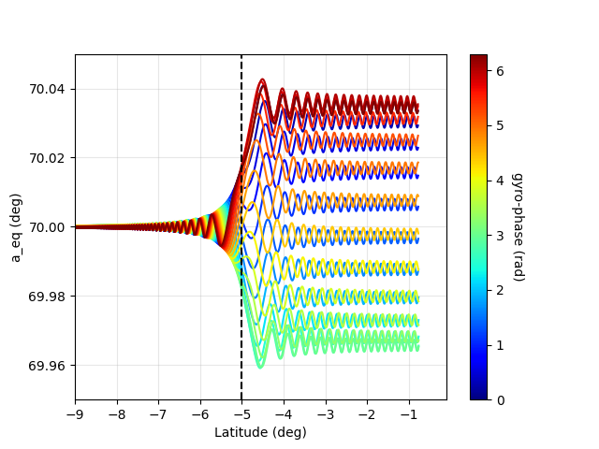
Low latitude – Small Amplitude
1pT
Execution time: < 0.53 seconds
(py is ~ 75)
System Hyperlink
Typical low-latitude WPI
(Stopped at equator)

Slide 5
Low latitude – Large Amplitude
Simulation constants:
Identical parameters and
-By_wave = 1nT (LARGE)
=> resonance (dh/dt = 0) @ lamda = -6.4 deg (LOW)

Slide 6
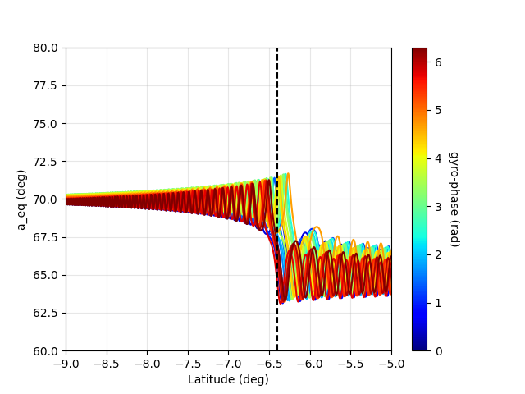
Low latitude – Large Amplitude
1 nT
Execution time: <0.47 seconds
Equatorial P.A change
Is more than before

Slide 7
Achieve non linearity
Simulation constants:
Same parameters other than:
-aeq0_deg=20
-lamda0_deg=-30
-Ekev0=500(LARGE)
-By_wave = 1nT (LARGE)
-ne0 = 3cm ^-3(low density plasma)
=> resonance (dh/dt = 0) @ lamda = 23 deg (HIGH)

Slide 8
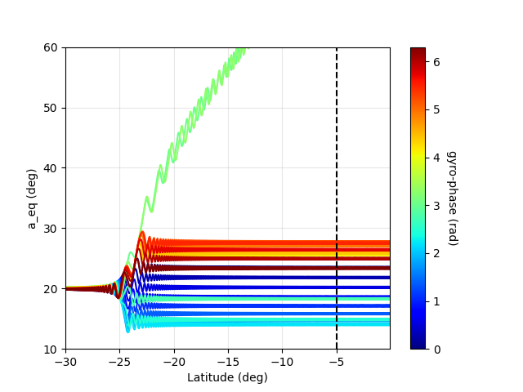
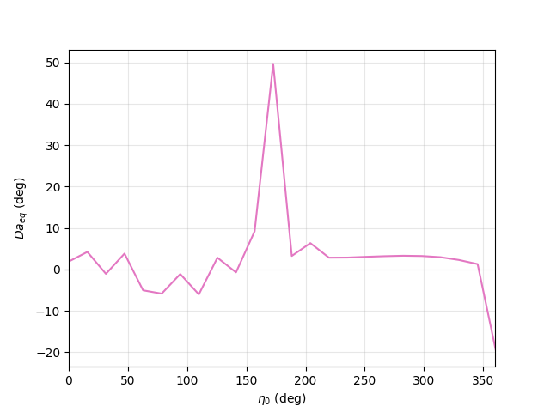
Achieve non linearity 24 particles
Execution time: ~0.57s
Phase traping.
Eta0 @ 3-3.5 rad

Slide 9
WPI
Test particles
Population : 60
Linearly spaced : (0 – 2π)

Slide 10
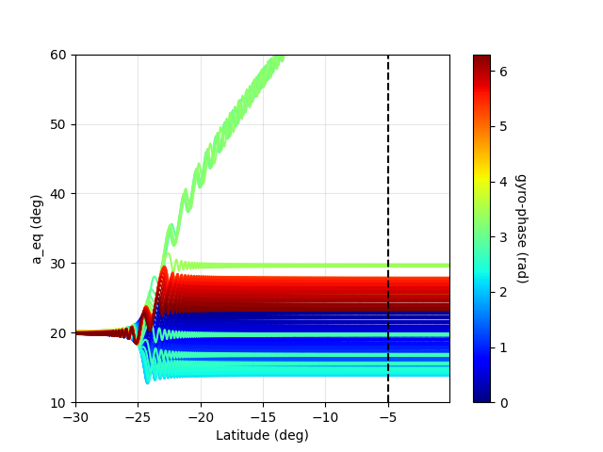
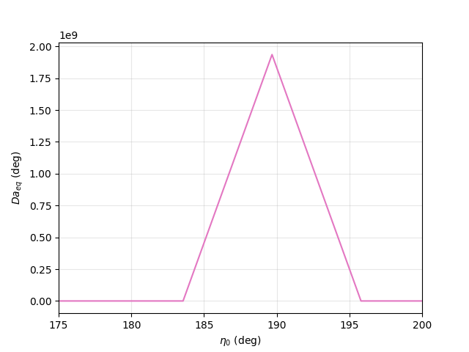
Achieve non linearity 60 particles
Execution time: ~1.5 s
Phase traping
Eta0 @ 3-3.5 rad

Slide 11
Around 189 deg(max Δa)
Test particles
Population : 24
Start : 189 - 360/24
Stop: 189 + 360/24

Slide 12
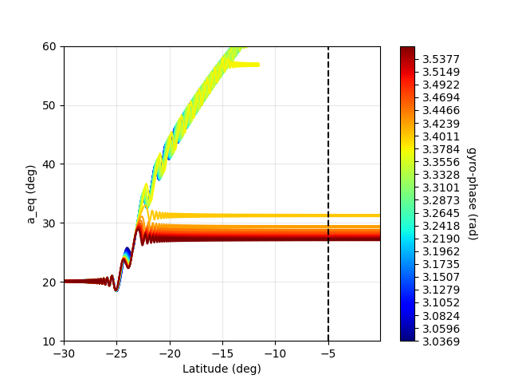
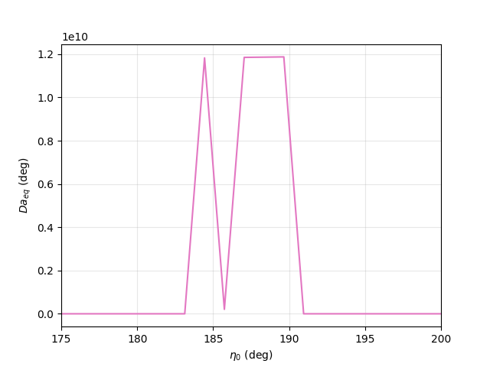
Arround 189 deg
Execution time: ~1.5 s
Phase traping
Eta0 @ 3-3.5 rad
Significant drop
@184.5 – 187 deg

Slide 13
Other simulations
(old) nothing special

Slide 14
High latitude – Large Amplitude
Oblique waves – Low density plasma
Simulation constants:
Identical parameters but
-By_wave = 1.4nT (LARGE)
-ne0 = 3cm ^-3(low density plasma)
-aeq0_deg = 20
-Ekev0=511
-theta0_deg=50(Oblique)
=> resonance (dh/dt = 0) @ lamda = 23 deg (HIGH)

Slide 15
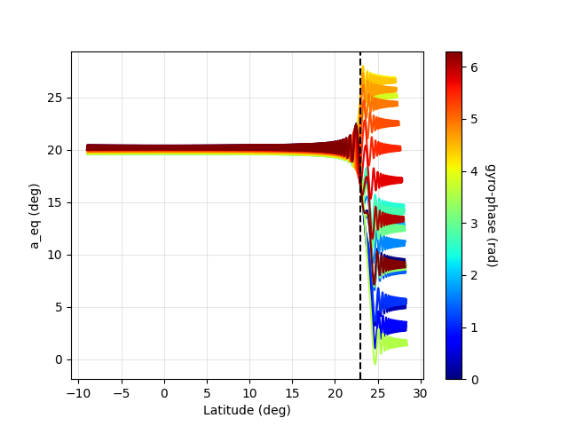
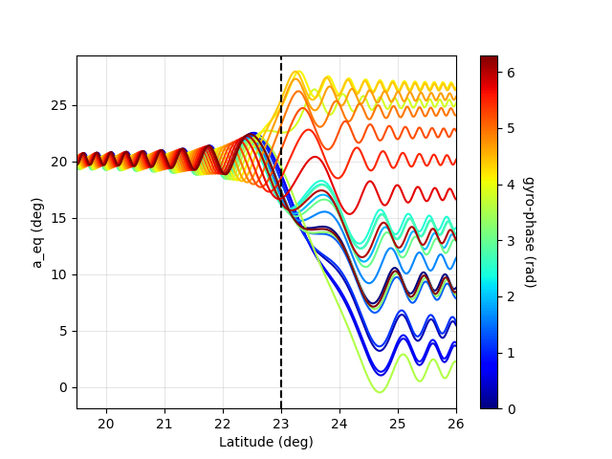
High latitude – Large Amplitude
Oblique waves – Low density plasma
Execution time: <5.6 seconds
(Execution doesn’t stop at equator)
Resonance should happen at
λ = 23deg
Equatorial P.A chages are more intense
but no phase trapping of particle.

Slide 16
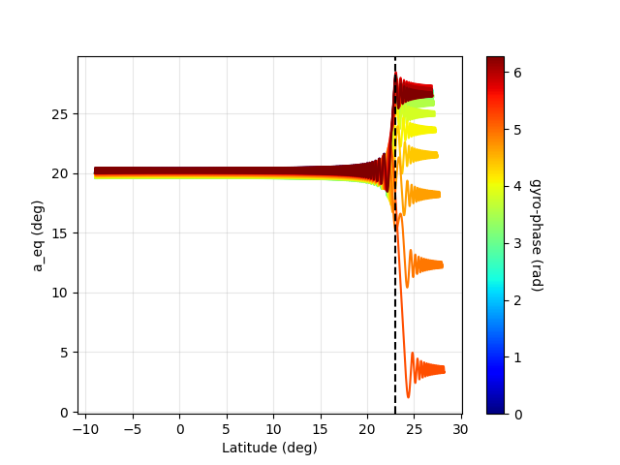
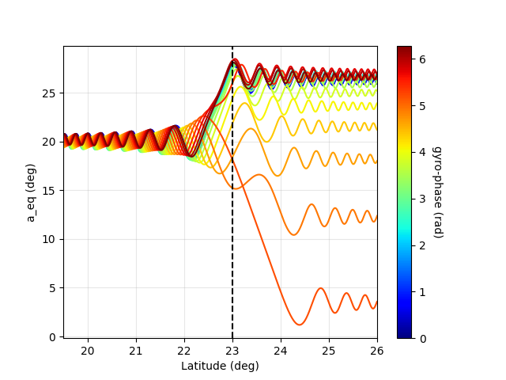
Same with 500kev

Slide 17
Arround 7π/12
Simulation constants:
Identical parameters as before
24 particles
Eta distribution from 90 to 120 degrees
Critical value is 7π/12 rads = 105 degrees
Step is 1.3043 degrees

Slide 18
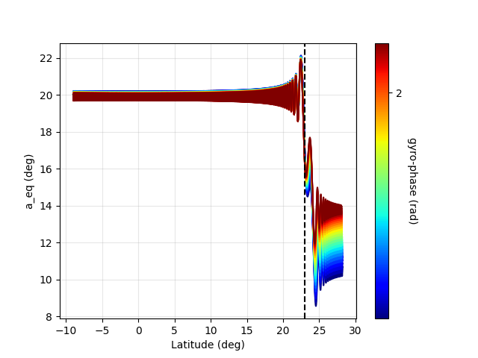
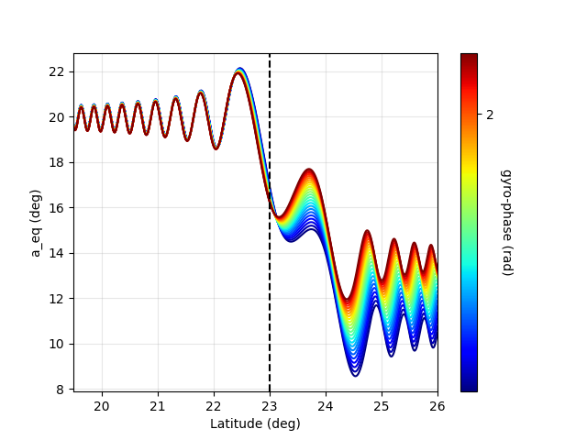
Arround 7π/12
Execution time: <5.6 seconds
(Execution doesn’t stop at equator)
Resonance should happen at
λ = 23deg
All particles exhibit “the same”
aeq change. (?)
No phase trapping.

