Slide 1
Particle Tracing Earth
Trial Simulations
Nonlinear interaction of energetic electrons with large amplitude chorus
J. Bortnik, 1 R. M. Thorne, 1 and U. S. Inan 2

Slide 2
Nonlinear WPI
Test particles
Population : 24
Linearly spaced : (0 – 2π)

Slide 3
Low latitude – Small Amplitude
Simulation constants:
-L_shell = 5
-aeq0_deg = 70
-Ekev0 = 168.3keV
-f_wave = 2000Hz
-ne0=10cm^-3
-theta0_deg = 0.001
-By_wave = 1pT (SMALL)
=> resonance (dh/dt = 0) @ lamda = -5 deg(LOW)

Slide 4
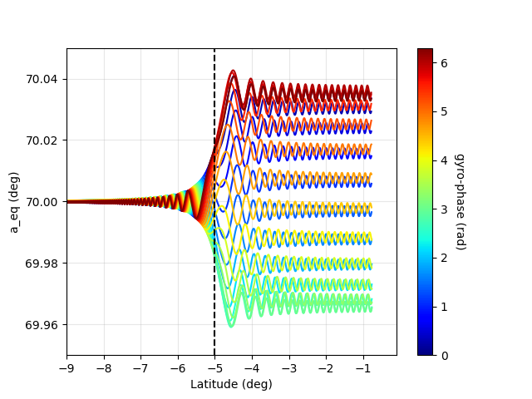
Low latitude – Small Amplitude
1pT
Execution time: < 0.53 seconds
(py is ~ 75)
System Hyperlink
Typical low-latitude WPI
(Stopped at equator)

Slide 5
Low latitude – Large Amplitude
Simulation constants:
Identical parameters and
-By_wave = 1nT (HIGH)
=> resonance (dh/dt = 0) @ lamda = -6.4 deg (LOW)

Slide 6
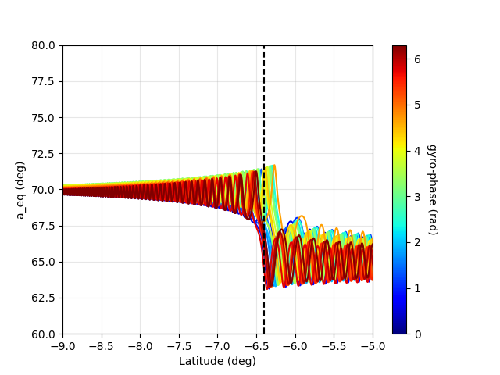
Low latitude – Large Amplitude
1 nT
Execution time: <0.47 seconds
Equatorial P.A change
Is more than before

Slide 7
High latitude – Large Amplitude
Oblique waves – Low density plasma
Simulation constants:
Identical parameters but
-By_wave = 1.4nT (HIGH)
-ne0 = 3cm ^-3(low density plasma)
-aeq0_deg = 20
-Ekev0=511
-theta0_deg=50(Oblique)
=> resonance (dh/dt = 0) @ lamda = 23 deg (HIGH)

Slide 8
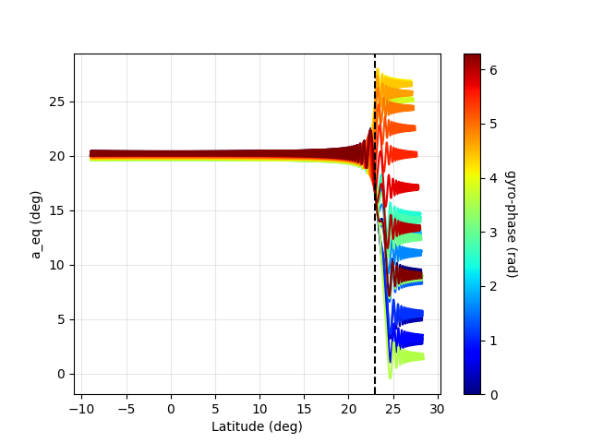
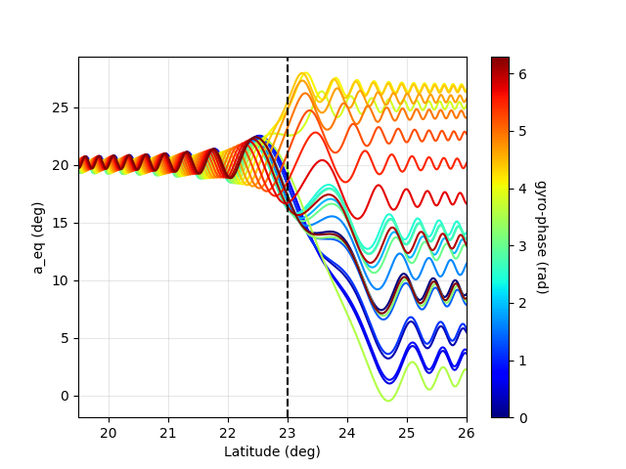
High latitude – Large Amplitude
Oblique waves – Low density plasma
Execution time: <5.6 seconds
(Execution doesn’t stop at equator)
Resonance should happen at
λ = 23deg
Equatorial P.A chages are more intense
but no phase trapping of particle.

Slide 9
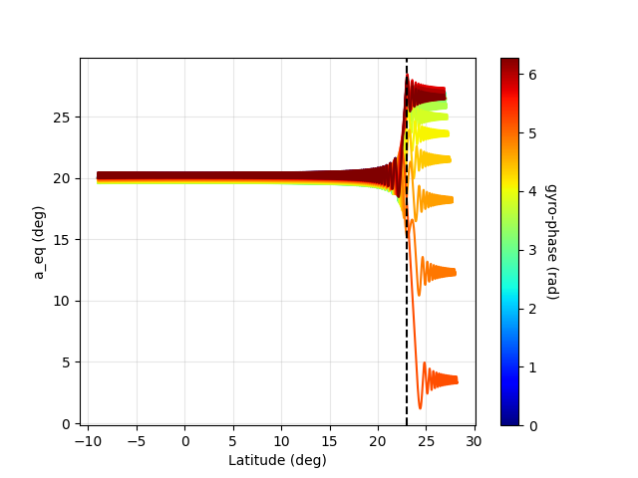
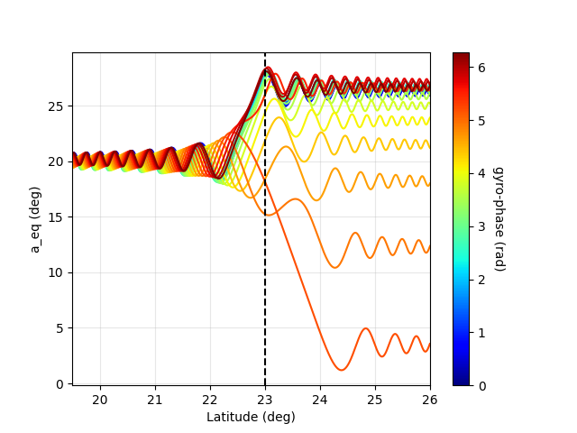
Same with 500kev

Slide 10
Arround 7π/12
Simulation constants:
Identical parameters as before
24 particles
Eta distribution from 90 to 120 degrees
Critical value is 7π/12 rads = 105 degrees
Step is 1.3043 degrees

Slide 11
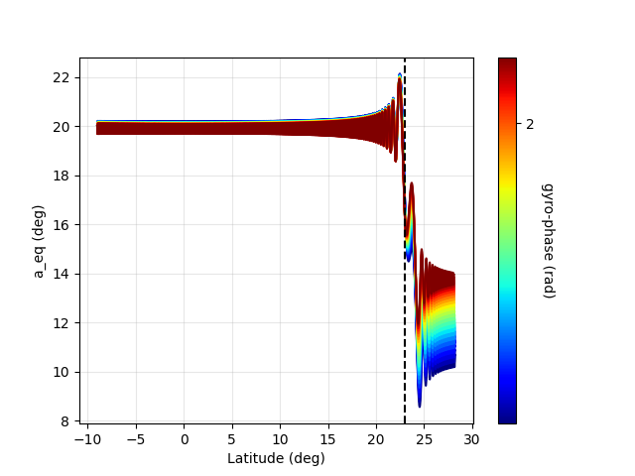
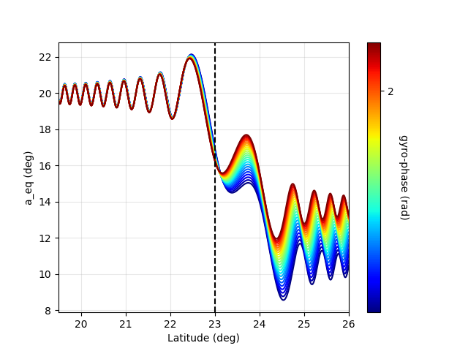
Arround 7π/12
Execution time: <5.6 seconds
(Execution doesn’t stop at equator)
Resonance should happen at
λ = 23deg
All particles exhibit “the same”
aeq change. (?)
No phase trapping.

Slide 12
Particle Tracing Earth
Trial Simulations
Updated 27/06
Nonlinear interaction of energetic electrons with large amplitude chorus
J. Bortnik, 1 R. M. Thorne, 1 and U. S. Inan 2

Slide 13
Particle distribution type
Test particles
Linearly spaced : (0 – 2π)

Slide 14
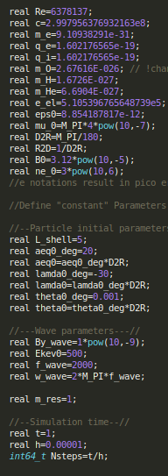
Achieve non linearity
Simulation Parameters:
-L_shell= 5
-theta0_deg = 0.001
-aeq0_deg=20
-lamda0_deg=-30
-Ekev0=500(LARGE)
-By_wave = 1nT (LARGE)
-ne0 = 3cm ^-3(low density plasma)
=> resonance (dh/dt = 0) @ lamda = 23 deg (HIGH)

Slide 15
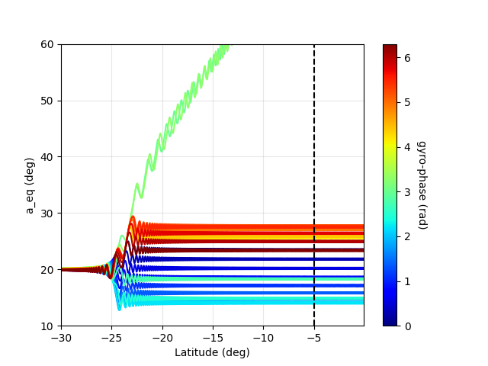
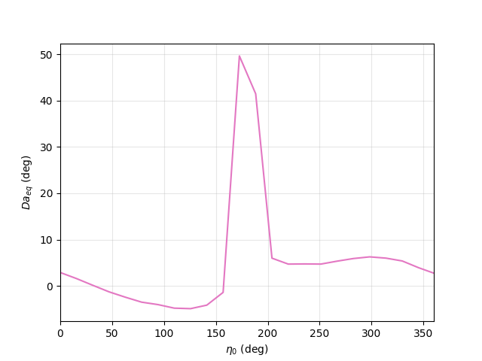
Achieve non linearity, 24 particles
Execution time: ~0.6s
System Hyperlink
Phase traping.
Eta0_deg @ 0-361
Max is @ 177.44 deg

Slide 16
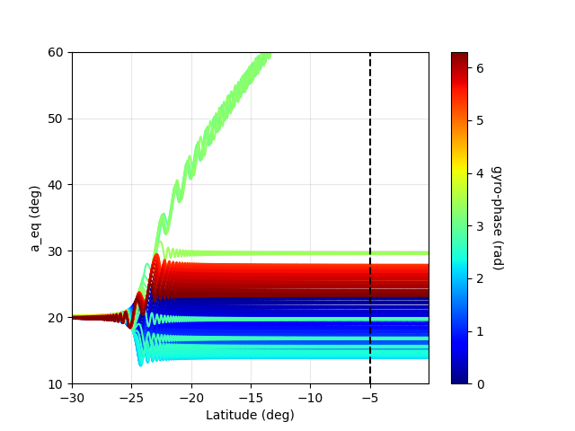
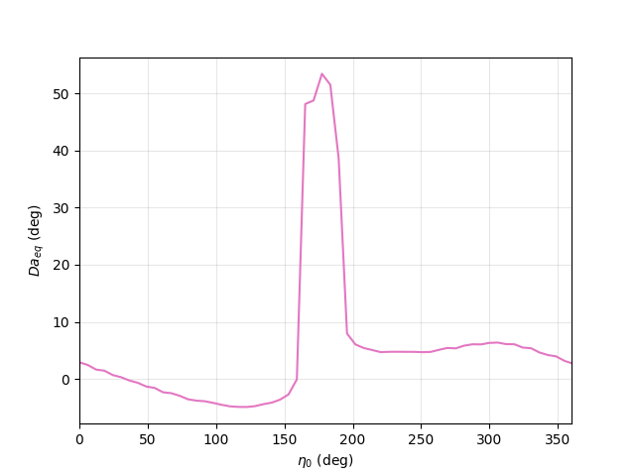
Achieve non linearity, 60 particles
Execution time: ~1.5 s
Phase traping
Eta0_deg @ 0-361
Max is @ 172.65 deg

Slide 17
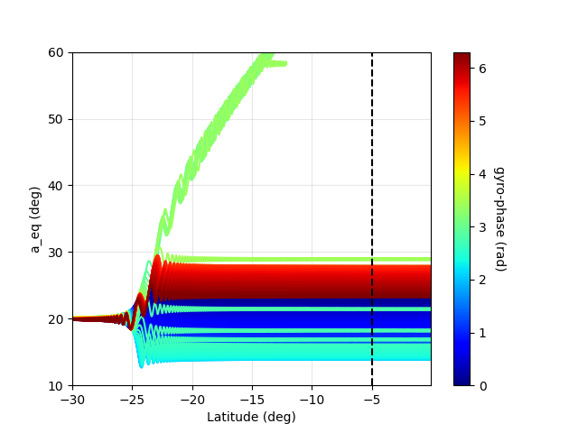
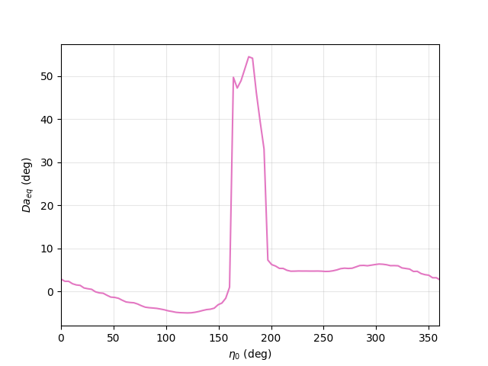
Achieve non linearity, 100 particles
Execution time: ~2.2 s
Phase traping
Eta0_deg @ 0-361
Max is @ 178.677 deg

Slide 18

Simulate around effective etas
Since we had max values @177.44 deg,172.65 deg,178.677 deg
Weighted average would be
=
176.16 deg
Test particles
Linearly spaced
Start: 176.16 – 360/population
Stop: 176.16 + 360/population

Slide 19
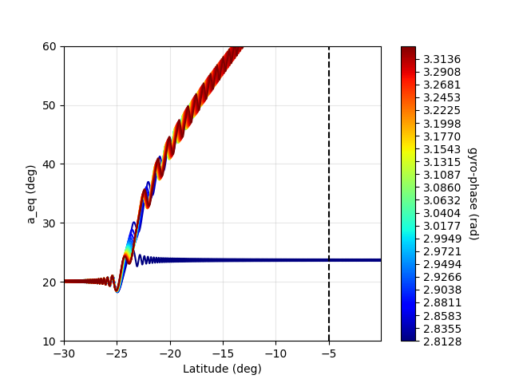
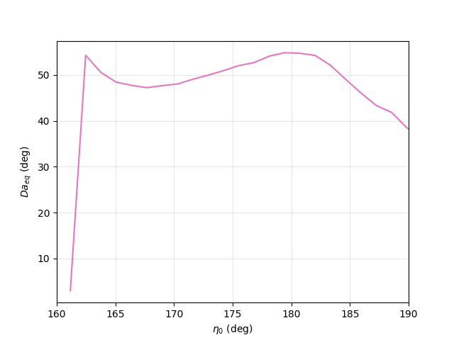
Arround 176.16 deg, 24 particles
Execution time: ~2.5 s
Eta0_deg @~ 161-191
Max is @ 179.42 deg
Almost all are trapped

Slide 20
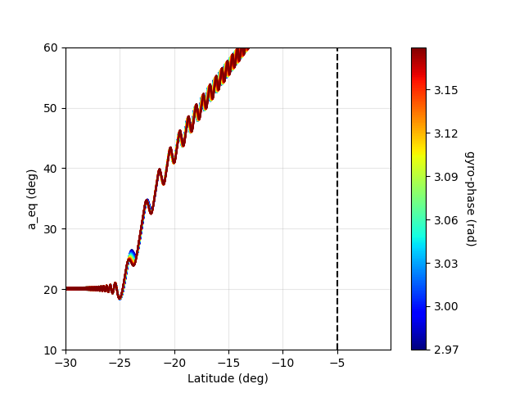
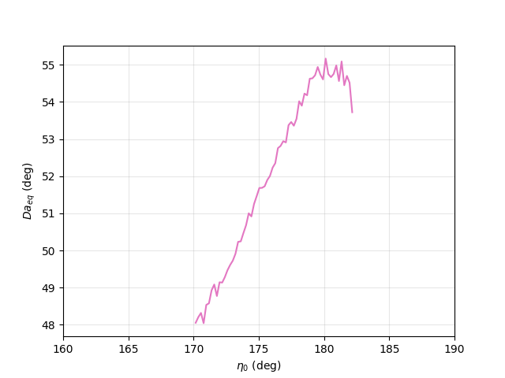
Arround 176.16 deg, 60 particles
Execution time: ~8 s
Eta0_deg @~ 170-182
Max is @ 180.126 deg
All trapped
Ascending Δa

Slide 21
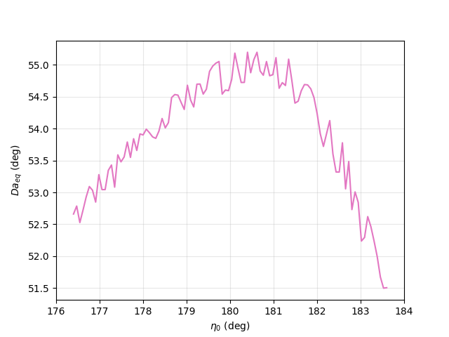
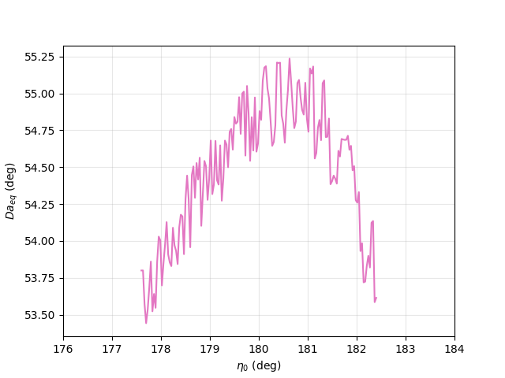
Arround 180 deg, 100 & 150 particles
100 Particles Eta0_deg@~176-184
Ex. time: ~10s Max is @ 180.4 deg
150 Particles Eta0_deg@~178-182
Ex.time: ~15s Max is @ 180.63

Slide 22
Particle Tracing Earth
Trial Simulations
Updated 19/07
Nonlinear interaction of energetic electrons with large amplitude chorus
J. Bortnik, 1 R. M. Thorne, 1 and U. S. Inan 2

Slide 23
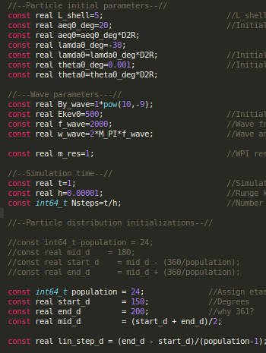
Parameters

Slide 24
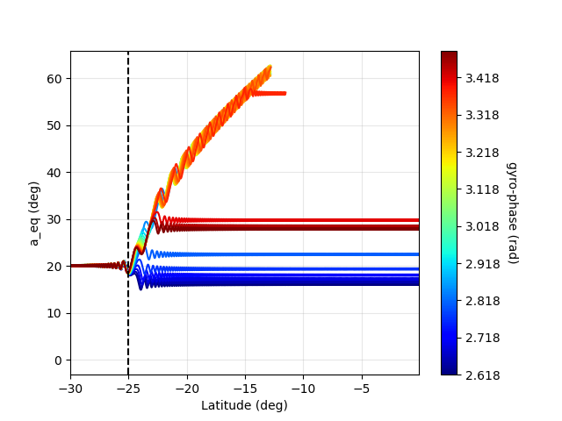
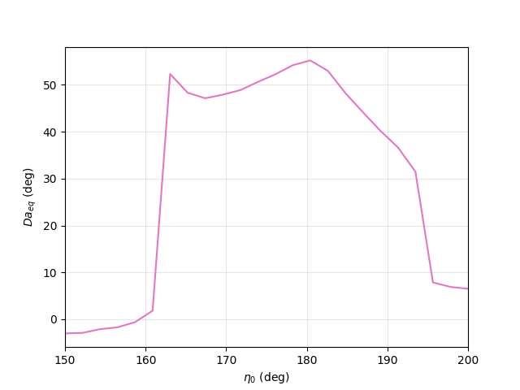
1nT, 24 particles eta0 150-200

Slide 25
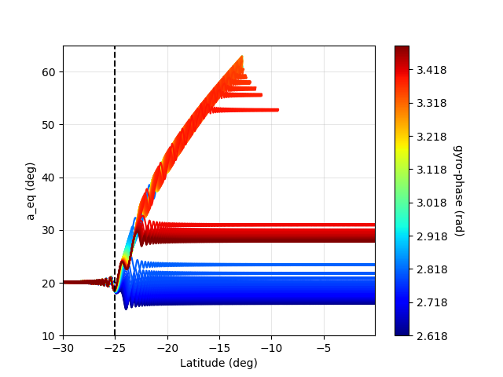
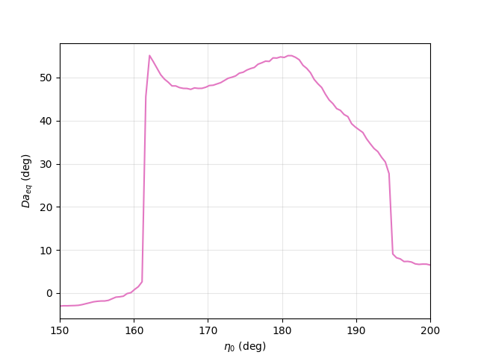
1nT, 100 particles eta0 150-200

Slide 26
Eta and aeq distribution.
Different initial aeq, gives different initial alpha which results in different initial speed and momentum of the particle.
Aeq0 → alpha0 → upar0,uper0 → ppar0,pper0

Slide 27
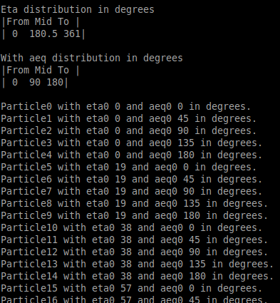
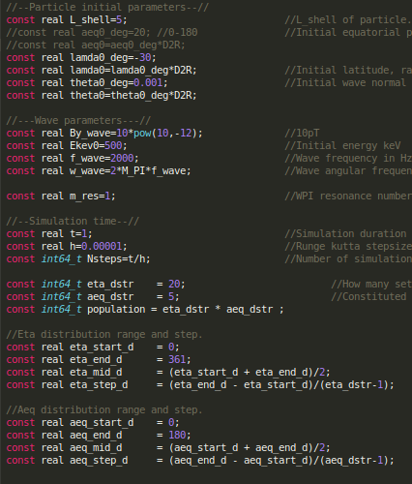
#1 Parameters
Gyrophases
linspace(0,361,20)
Aeq0
linspace(0,180,5)
Population
20*5=100

Slide 28
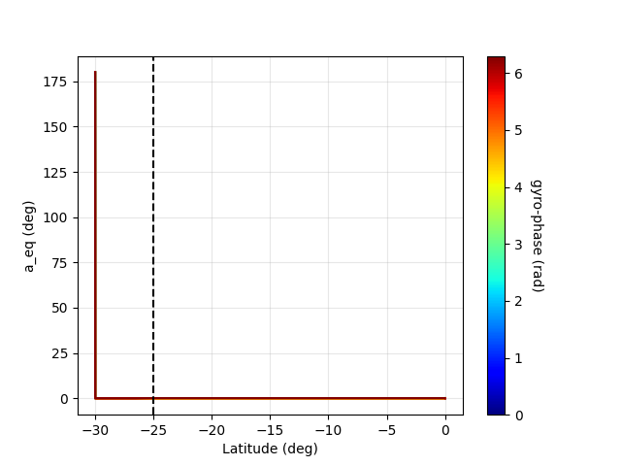
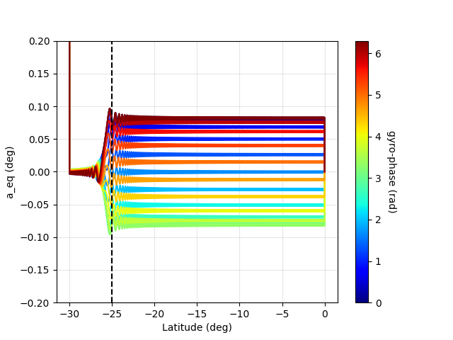
#1 Plots
Ex.time ~ 8.2s , 100 particles.
First plot shows that only particles with
aeq0 = 0 interact with the wave
aeq0=0 || 45 || 90 || 135 || 180

Slide 29
#2 Parameters
Same parameters as before with:
Gyrophases
linspace(0,361,20)
Aeq0
linspace(0,180,10)
Population
20*10=200

Slide 30
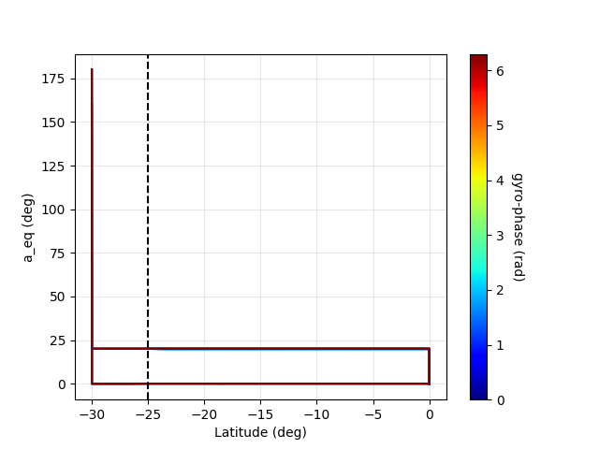
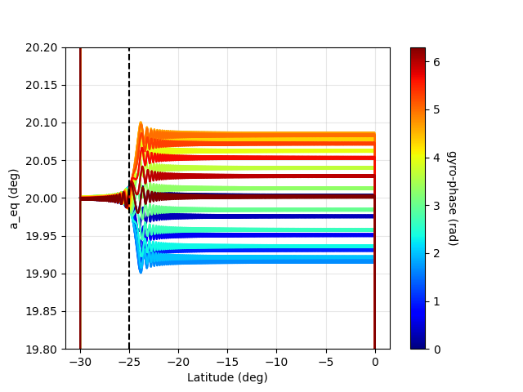
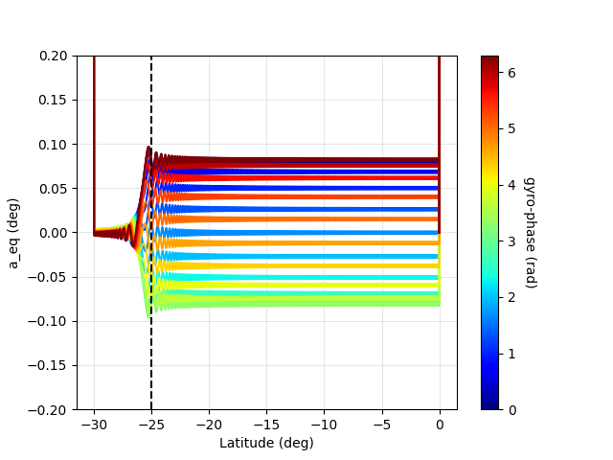
#2 Plots
Interaction only in particles with:
aeq0=0 && aeq0=20
Ex.time ~ 15s , 200 particles.
aeq0=0 || 20 || 40 || 60 || 80
100 || 120 || 140 || 160 ||180

Slide 31
#3 Parameters
Same parameters as before with:
Gyrophases
linspace(0,361,20)
Aeq0
linspace(0,90,10)
Population
20*10=200

Slide 32
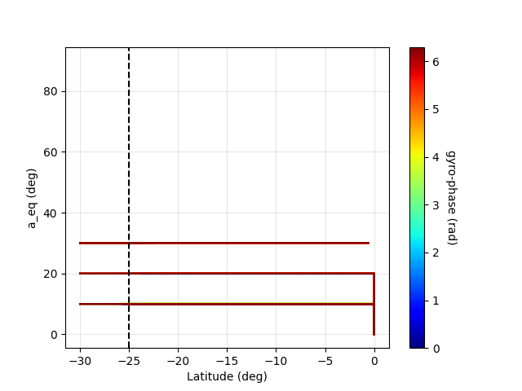
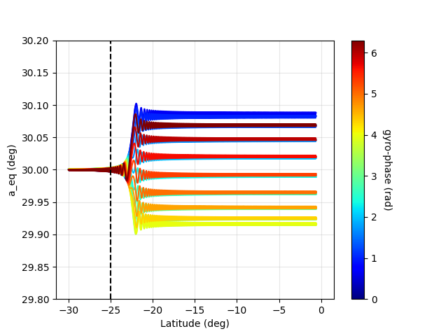
#3 Plots
Interaction only in particles with:
aeq0=10 && aeq0=20 &&
aeq0=30
Ex.time ~ 15s , 200 particles.
aeq0=0 || 10 || 20 || 30 || 40
50 || 60 || 70 || 80 ||90

Slide 33
#4 Parameters
Same parameters as before with:
Gyrophases
linspace(0,361,20)
Aeq0
linspace(0,45,10)
Population
20*10=200

Slide 34
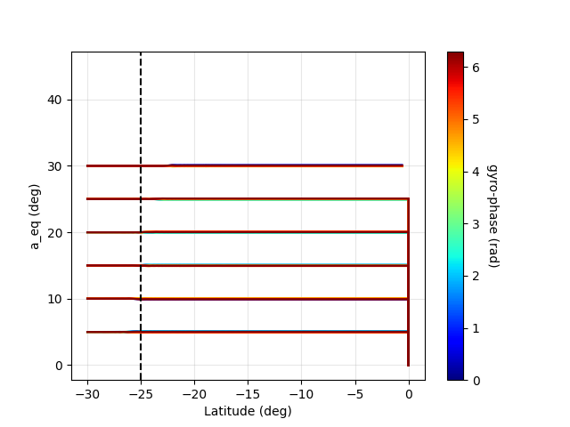
#4 Plots
Interaction only in particles with:
Aeq0=5,10,25,20,25,30.
Ex.time ~ 10s , 200 particles.
aeq0=0 || 5 || 10 || 15 || 20
25 || 30 || 35 || 40 ||45

Slide 35
#5 Parameters
Same parameters as before with:
Gyrophases
linspace(160,190,10).
Aeq0
linspace(0,45,20).
Population
20*10=200

Slide 36
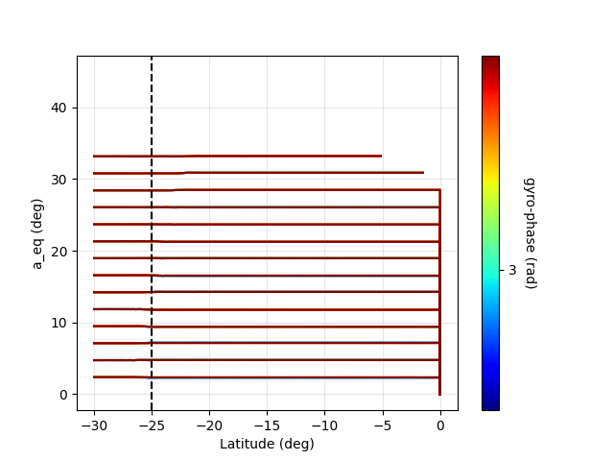
#5 Plots
All interact except
aeq0<~33 deg.
Ex.time ~ 8s , 200 particles.
Linearly spaced from 0 to 45.

Slide 37
#6 aeq range for interaction
Same parameters as before with:
Gyrophases
linspace(0,361,10).
Aeq0
linspace(30,45,20).
Population
20*10=200

Slide 38
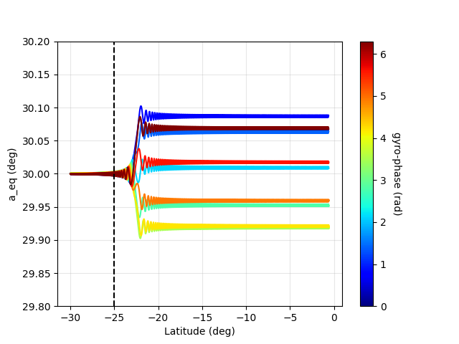
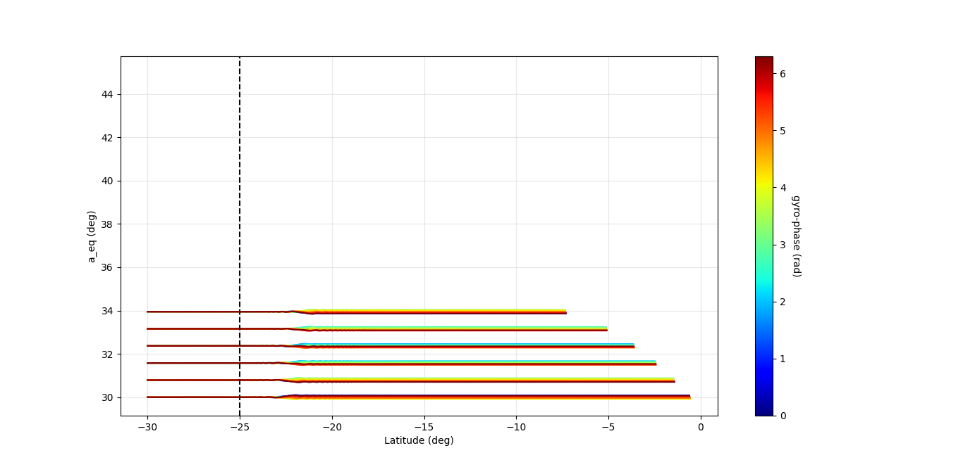
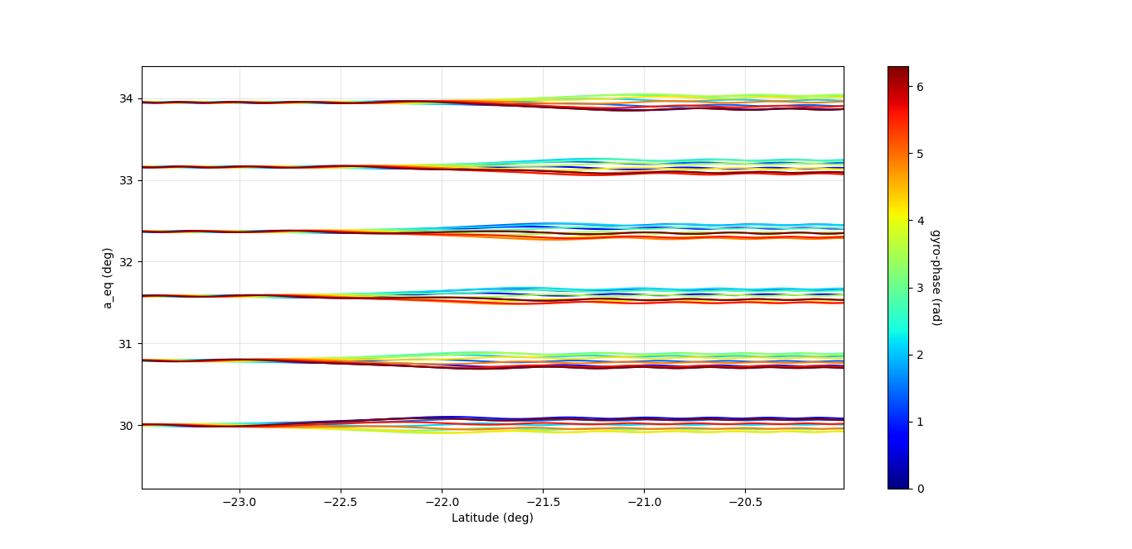
#6 Plots
Ex.time ~15s , 200 particles.
Aeq0 linspace(30,45,20).
Gyrophases linspace(0,361,10).
Interaction only <~34deg.

Slide 39

Eta and aeq distribution.
Different initial aeq, gives different initial alpha which results in different initial speed and momentum of the particle.
Aeq0 → alpha0 → upar0,uper0 → ppar0,pper0
Lamda0 and aeq0 determine the domain of alpha
(2.20 Bortnik) .

Slide 40
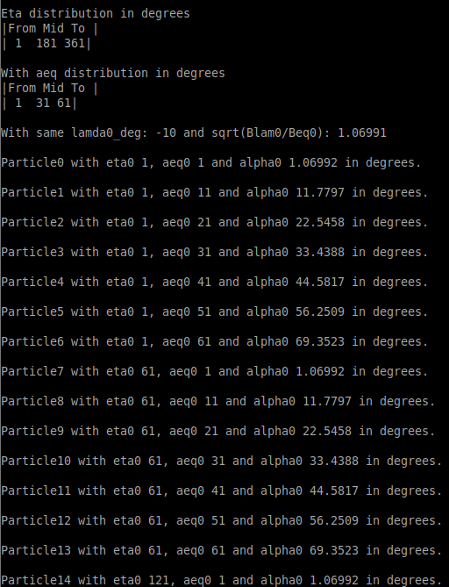
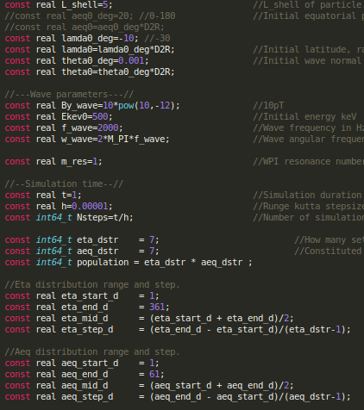
#7 Parameters
Lamda0 -10 degrees
eta_dstr 1-361 degrees
7 sets
(1||61||121||181||241||301||361)
aeq_dstr 1-61 degrees
7 particles/set
(1||11||21||31||41||51||61)

Slide 41
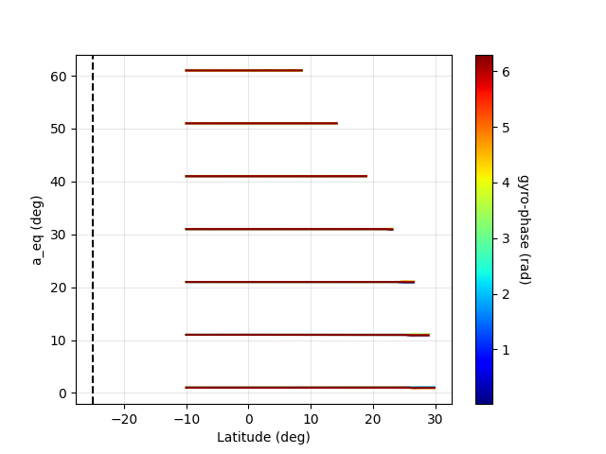
#7 Plots
Ex.time ~9.5 sec.
Don’t stop at equator.

Slide 42
