Slide 1

Virtual Keyboard
PSG INSTITUTE OF TECHNOLOGY AND APPLIED RESEARCH
A project done by,
Abhishek K (715514106002)
Arjhun M (715514106007)
Arullanandh S (715514106008)
Vasigaran S (715514106057)
Guided by,
Dr. G. Santhanamari AP(Sl.G) / ECE

Slide 2
Objectives
To design a virtual keyboard i.e. a keyboard without mechanical keys and functions by air typing.
To implement all functions of existing mechanical keyboards.
To improve performance and reduce cost in comparison with the existing virtual keyboards.
To increase portability.
To give a different perspective of laser keyboards.

Slide 3
LITERATURE SURVEY
SL.no | RESEARCH PAPER TITLE/ AUTHOR | METHODOLOGY | ISSUES TO BE ADDRESSED
1 | "Virtual keyboard: A human-computer interaction device based on laser and image processing"-Xiaolin Su,Yunzhou Zhang, Qingyang Zhao, Liang Gao Year:2015 | A CMOS image sensor is used to collect the sequential frames of fingertips keystroke. Every keystroke can be detected accurately by image processing including morphology principle and ellipse fitting | Keystroke deviation, resulting in fitting center falling unexpected region.
2 | “Keystroke recognition for virtual keyboard”- J. Mantyjarvi, J. Koivumaki, P. Vuor Year:2002 | An infrared (IR) transceiver array is used for detecting the proximity of a finger. Keystroke recognition accuracy is examined with k-nearest neighbor (k-NN) classifier while a multilayer perceptron (MLP) classifier is designed for online implementation. | The finger had to be held perpendicular to the surface of the keyboard.
3 | "Visual panel: virtual mouse keyboard and 3D controller with an ordinary piece of paper", -Z. Zhang, Y. Wu, Y. Shan et al.Year:2011 | The panel tracking continuously determines the projective mapping between the panel at the current position and the display, which in turn maps the tip position to the corresponding position on the display. | The keystroke detection action is triggered when the tip pointer stays immobile for a short duration of 1 second.
4 | "An asynchronously controlled EEG-based virtual keyboard: improvement of the spelling rate”,-R. Scherer, G. R. Muller, C. Neuper et al. Year:2004 | Asynchronously controlled three-class brain-computer inter- face-based spelling device virtual keyboard, operated by spontaneous electroencephalogram and modulated by motor imagery. | Asynchronous control can limit the usability of the system. Users do require more training

Slide 4
Block Diagram
NI MyRio
Lasers
PROCESSOR
A
B
C
D
(0,0)
(0,1)
(0,2)
(0,3)
(1,0)
(1,1)
G
(1,2)
(1,3)
E
F
H
I
(2,0)
(2,1)
(2,2)
L
J
K
(1,1)
M
(3,0)
N
(3,1)
(3,2)
(3,3)
O
P
LDR
F
LCD display
INPUT DEVICE
OUTPUT DEVICE

Slide 5
Proposed Virtual keyboard
In the proposed keyboard, LDR’s and lasers are placed in a matrix fashion in a cuboid shaped module. Each row has a laser at one end and LDR at the other. Similarly each column has a laser and LDR at the two ends.
When the light falls on the light dependent resistor (LDR), the voltage across LDR is more than 3 volts which is considered as logic ‘1’ (key detection is not identified).
If the light energy from laser diode is blocked then the voltage across LDR will be less than 3 volts which is considered as logic ‘0’ (key detection is identified).

Slide 6
`
When human hands are placed in the path of laser light to the LDR (intersection of the matrix) a respective key will be pressed and identified. In this way multiple keys can be mapped to the multiple intersections of the matrix.
Asynchronously the data from the LDR will gets updated in MyRIO. When a key is pressed inside the body of the keyboard, the values is sent to MyRIO, which validate and find the position pressed and send the character mapped to that particular location.
These values are mapped according to the standard “qwerty” keyboard. The keyboard can also be changed according to the user specification.

Slide 7
System Architecture
The proposed Virtual keyboard system consists of two modules:
Input module
Processing module
Input Module comprises of Lasers and LDR’s on a text entry Keyboard Module.
Processing module consists of NI myRIO processor.

Slide 8
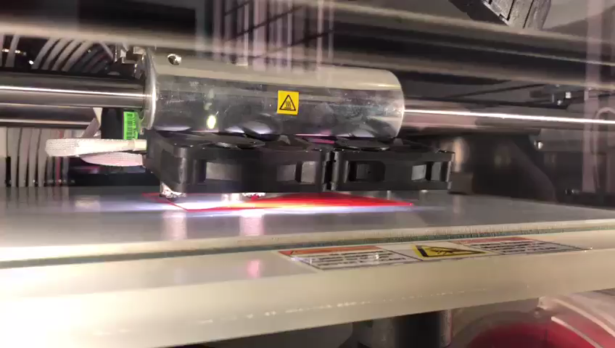
The Text entry keyboard module was built by 3d printing. The necessity for Three-dimensional printing arises for the sake of better accuracy and finishing.
Stereolithography (STL) is one of the file types that is used for 3D printing.
The modelling material is Red PLA or poly lactic acid, an organic thermoplastic.
PLA gives the product better structural integrity and offers a shinier and smoother appearance.

Slide 9
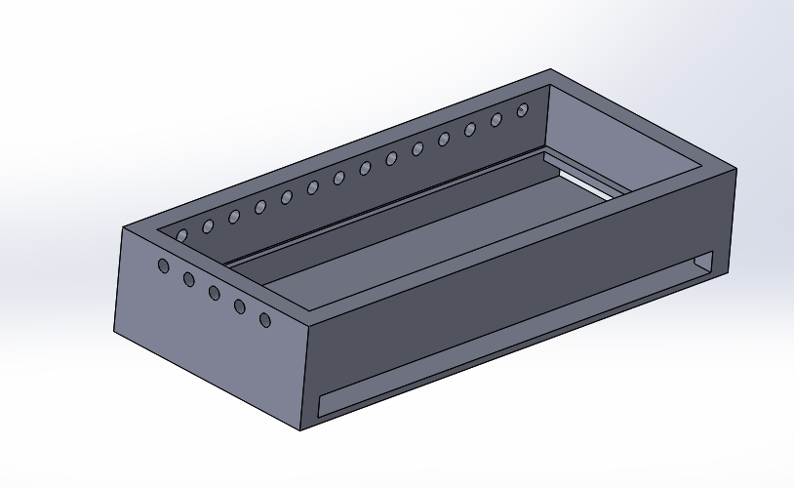
The model is cuboid in shape with one of the faces left open and the rest are covered.
There are 14 tiny slots on each of the two longer faces of the cuboid.
There are 5 similar slots on the each of the smaller faces of the cuboid.
The holes at the faces of the modelled material are to aid the insertion of lasers and LDR’s.
The position of the Laser and its opposite LDR slots are precisely aligned in a straight line

Slide 10
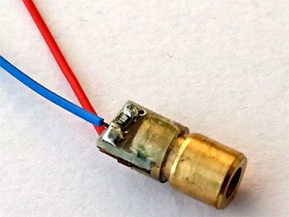
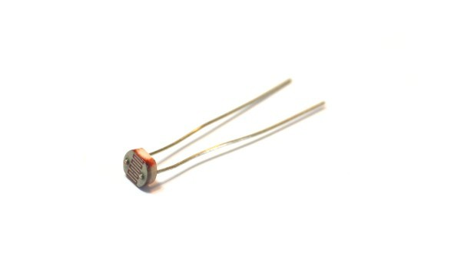
HARDWARE COMPONENTS
REES52 Red laser diodes 650nm
5mm Light Dependent Resistors

Slide 11
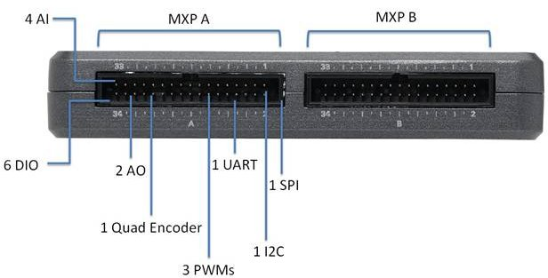
Processing module
The National Instruments MyRIO-1900 is a portable reconfigurable I/O (RIO) device used to design control robotics and mechatronics system. The hardware is based on Xilinx Zynq-7010 with a dual-core ARM Cortex-A9 processor .
The NI MyRIO microcontroller is programmed with a lab view code to differentiate the position of key presses.

Slide 12
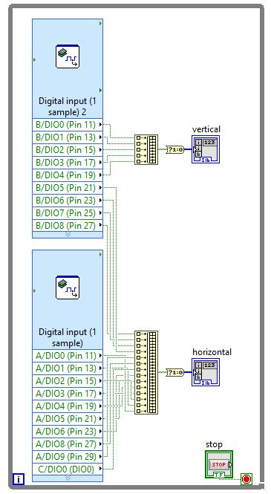
Workflow of code
First the VI specific to myRIO is used to get the data at that instant. The whole workflow is placed in a while loop so that data will be collected repeatedly at every instant. If this data input is taken individually and processed repeatedly, it will consume lot of time and is less efficient.
The program takes the input as the corresponding coordinates on the matrix that identifies a key press. Two arrays, one for horizontal rows and another for vertical columns are used to get data in rows and columns.

Slide 13
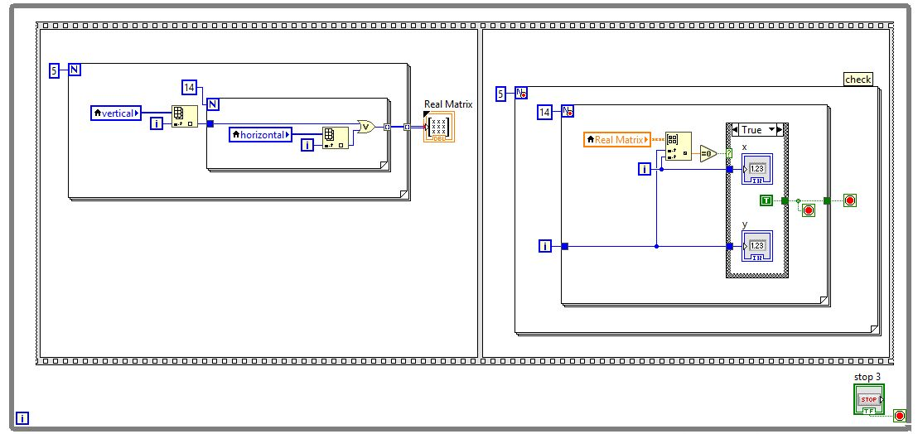
This part of the code is to convert the single dimension arrays into a matrix (two-dimensional array). We use an element selector to get the individual elements from the two arrays and place them in the matrix (i.e.) zeroth index of the two arrays are placed in (0,0) position of the matrix. The program thus takes the input as the corresponding coordinate of array, taken as variables as “x” and “y”.

Slide 14
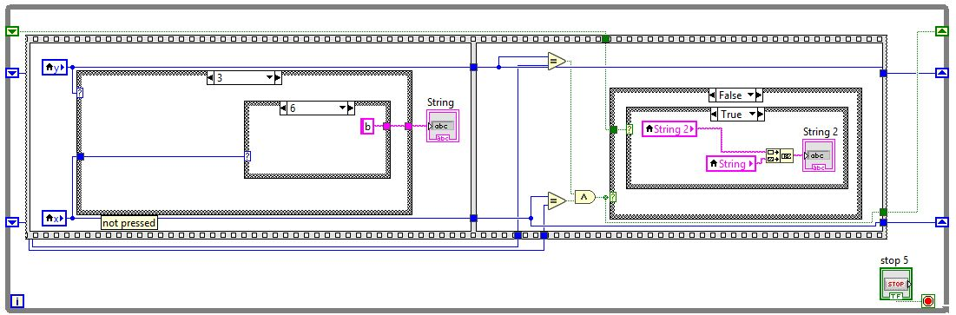
Every key in the keyboard is mapped to all the values of x and y with the help of nested switch statements. The same logic is used to concatenate all the key press to form a single string.

Slide 15
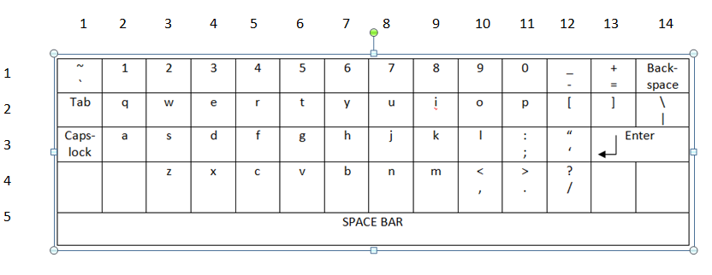
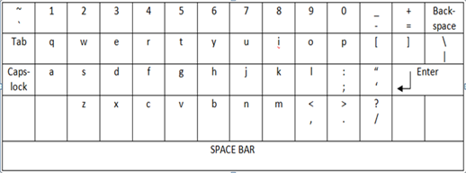
Layout for Key detection

Slide 16
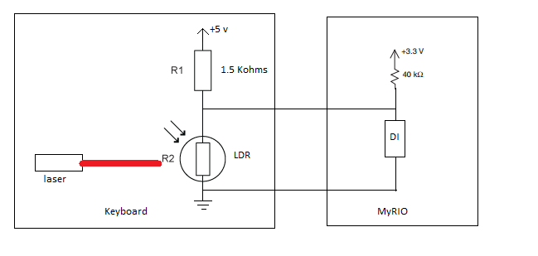
Connection of NI myRIO and LDR

Slide 17
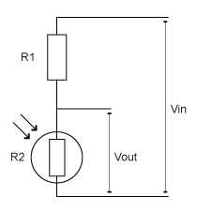

R1: 1.5 K ohms
R2: 20M ohm in dark and 300 ohms in Power greater than 11 watt
Vin: 5 volt
Vout: Given to digital input of NI myRIO with reference to ground
Formula
Vout = Vin (R2/(R1+R2))

Slide 18
Comparative study
Constraints | Existing method | Proposed method
Surface dependencies | Doesn't work on transparent and rough surface | Independent of surfaces
Surrounding light dependencies | Keyboard display does not work on bright lights | Independent of surrounding lights
Cost | Rs.10,000 (epic) to Rs.1,00,000 (xperia touch) | Not more than Rs.3500

Slide 19
Virtual Keyboard Test Suite
Keyboard response time
Key Accuracy test

Slide 20
Keyboard response time
Keyboard response time represents the time requirement in milliseconds by the keyboard to capture the key press and display the corresponding character on the screen.
In case of normal keyboard, the response time is a factor of the key debounce response, the scan rate, the internal CPU translation, the signalling speed, the interrupt latency of the main computer and the driver code.

Slide 21
Testing process
The keyboard response time is identified by subtracting the timestamp values at the position of the code, where the input is taken and another time stamp at the position of the code where the key is displayed.
Since it is a virtual keyboard the debouncing criteria is not applicable but additionally the lab view code pipeline execution time itself will add up to the keyboard response time.

Slide 22
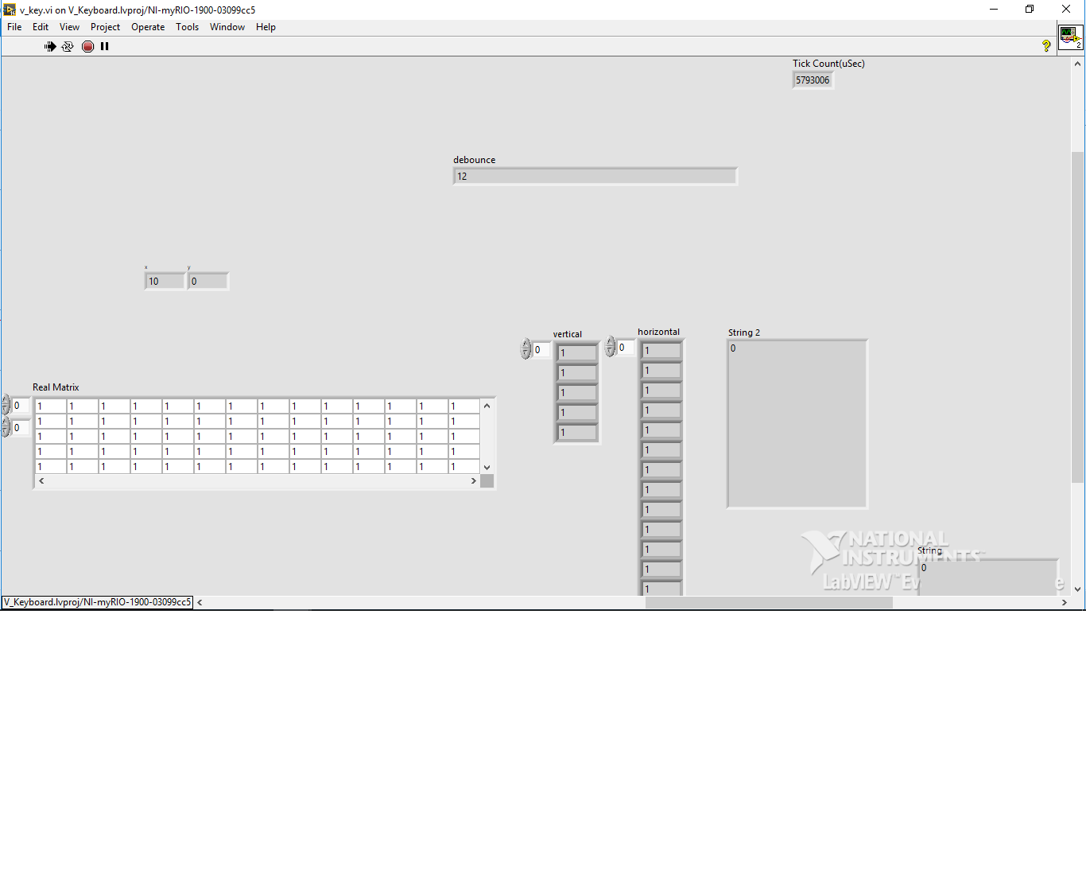
Screenshot of results

Slide 23
Test Results
Trials | Keyboard response time(in milliseconds)
Trial 1 | 6
Trial 2 | 8
Trial 3 | 12
Trial 4 | 9
Trial 5 | 8

Slide 24
Accuracy test
Virtual keyboards are vulnerable to “key stroke deviations”. There are different ways keystroke deviation may occur.
When we strike the keyboard in high frequency, the keystroke is easy to deviate. Repeated striking of the same key results in unexpected recognition due to deviations. Thus users cannot get the feedback just as striking a real keyboard.
If the finger tip almost falls in the expected key stroke position, the result turns out to be more accurate. When the finger tip falls in the position between the two keys , it might results in erroneous key recognition.

Slide 25
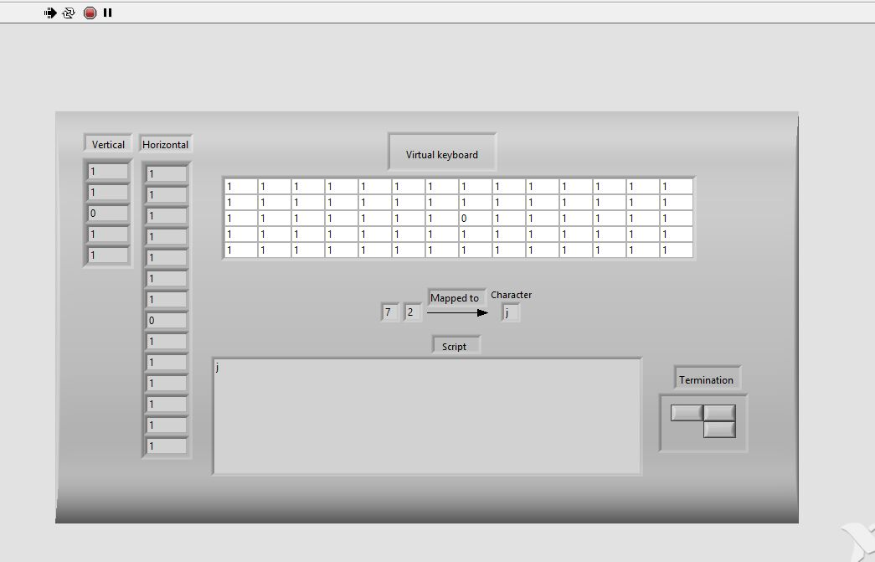
Testing process
Keys are selected at random and are typed repeatedly and then the key recognition statistics is collected.
This is repeated for single characters(number, letter, space) and multiple characters.

Slide 26
Test Results
Character | No of Trials | Accuracy= (no of success trials/ total no of trials)*100
“a” | 20 | 100%
“y” | 20 | 100%
“r” | 20 | 100%
“8” | 20 | 100%
“1” | 20 | 100%
“501” | 20 | 90%
“pqr” | 20 | 95%
Space bar | 20 | 100%

Slide 27
Observations
Our Virtual keyboard achieves a maximum key response time of 12 ms and on average response time of 8.6 ms.
The accuracy of the key recognition can be increased by optimizing the alignment of lasers and Light dependent Resistors.

Slide 28
Applications
Virtual keyboards may be used in some cases to reduce the risk of keystroke logging. For example, Westpac’s online banking service uses a virtual keyboard for the password entry, as does Treasury Direct. It is more difficult for malware to monitor the data entered via the virtual keyboard, than it is to monitor real keystrokes. Thus, it is difficult to spy on the data entered by users.
Virtual keyboard could become an important entity of augmented reality in the future.
The device can be programmed to display letters of any language and this is possible with the mapping of the letters of the language to the laser presses. Thus, the virtual keyboard acts a multiple language insertion device.

Slide 29
REFERENCES
1. Xiaolin su,Yunzhou Zhang, Qingyang Zhao, Liang Gao, "Virtual keyboard: A human-computer interaction device based on laser and image processing“, Published in IEEE International Conference on Cyber Technology in Automation, Control, and Intelligent Systems (CYBER),Year: 2015
2. J. Mantyjarvi, J. Koivumaki, P. Vuori, “Keystroke recognition for virtual keyboard” Published in IEEE International Conference on Multimedia and Expo, Year: 2002
3. Z. Zhang, Y. Wu, Y. Shan et al.,"Visual panel: virtual mouse keyboard and 3D controller with an ordinary piece of paper", Published in workshop on Perceptive user interfaces.Year: 2001
4. Hari Singh Dhillon, Rajesh Singla, Navleen Singh Rekhi, "EOG and EMG based virtual keyboard: A brain-computer interface“ Published in IEEE International Conference on Computer Science and Information Technology Year: 2009
5. R. Scherer, G. R. Muller, C. Neuper et al., "An asynchronously controlled EEG-based virtual keyboard: improvement of the spelling rate", Published in IEEE Transactions on Biomedical Engineering. Year:2004

Slide 30
6. H. Du, T. Oggier, F. Lustenberger et al., "A virtual keyboard based on true-3D optical ranging", Published in British Machine Vision Conference, Year:2005
7. Huan Du,, Edardo Chardon "A virtual keyboard system based on Multi-Level Feature Matching” Published in Conference on Human System Interactions Year: 2008
8. Hubert Cecotti A Multimodal Gaze-Controlled Virtual Keyboard Published in IEEE Transactions on Human-Machine Systems Year: 2016
9. Katz I, Gabayan K, Aghajan H "A Multi-Touch Surface Using Multiple Cameras”. Dept. of Electrical Engineering, Stanford University. Year: 2007.
10. F. Echtler, M. Huber, G. Klinker, “Shadow Tracking on Multi- Touch Tables", Germany.” Year: 2008

