Slide 1
VKeyBoard
PSG INSTITUTE OF TECHNOLOGY AND APPLIED RESEARCH
A project done by,
Abhishek K (715514106002)
Arjhun M (715514106007)
Vasigaran S (715514106057)
Arullanandh S (715514106008)
Guided by,
Dr. G. Santhanamari AP(Sl.G) / ECE

Slide 2
Objectives
To implement all functions of mechanical keyboards.
To increase portability.
To give a different perspective of laser keyboards.
To improve performance and reduce cost

Slide 3
LITERATURE SURVEY
SL.no | RESEARCH PAPER TITLE/ AUTHOR | METHODOLOGY | ISSUES TO BE ADDRESSED
1 | "Virtual keyboard: A human-computer interaction device based on laser and image processing"-Xiaolin Su,Yunzhou Zhang, Qingyang Zhao, Liang Gao Year:2015 | A CMOS image sensor is used to collect the sequential frames of fingertips keystroke. Every keystroke can be detected accurately by image processing including morphology principle and ellipse fitting | Keystroke deviation, resulting in fitting center falling unexpected region.
2 | “Keystroke recognition for virtual keyboard”- J. Mantyjarvi, J. Koivumaki, P. Vuor Year:2002 | An infrared (IR) transceiver array is used for detecting the proximity of a finger. Keystroke recognition accuracy is examined with k-nearest neighbor (k-NN) classifier while a multilayer perceptron (MLP) classifier is designed for online implementation. | The finger had to be held perpendicular to the surface of the keyboard.
3 | "Visual panel: virtual mouse keyboard and 3D controller with an ordinary piece of paper", -Z. Zhang, Y. Wu, Y. Shan et al.Year:2011 | The panel tracking continuously determines the projective mapping between the panel at the current position and the display, which in turn maps the tip position to the corresponding position on the display. | The keystroke detection action is triggered when the tip pointer stays immobile for a short duration of 1 second.
4 | "An asynchronously controlled EEG-based virtual keyboard: improvement of the spelling rate”,-R. Scherer, G. R. Muller, C. Neuper et al. Year:2004 | Asynchronously controlled three-class brain-computer inter- face-based spelling device virtual keyboard, operated by spontaneous electroencephalogram and modulated by motor imagery. | Asynchronous control can limit the usability of the system. Users do require more training

Slide 4
V keyboard test suite
Keyboard response time
Key Accuracy test

Slide 5
Keyboard response time
Keyboard response time represents the time requirement in milliseconds by the keyboard to capture the key press and display the corresponding character on the screen.
In case of normal keyboard, the response time is a factor of the key debounce response, the scan rate, the internal CPU translation, the signalling speed, the interrupt latency of the main computer and the driver code.

Slide 6
Testing process
The keyboard response time is identified by subtracting the timestamp values at the position of the code, where the input is taken and another time stamp at the position of the code where the key is displayed.
Since it is a virtual keyboard the debouncing criteria is not applicable but additionally the lab view code pipeline execution time itself will add up to the keyboard response time.

Slide 7
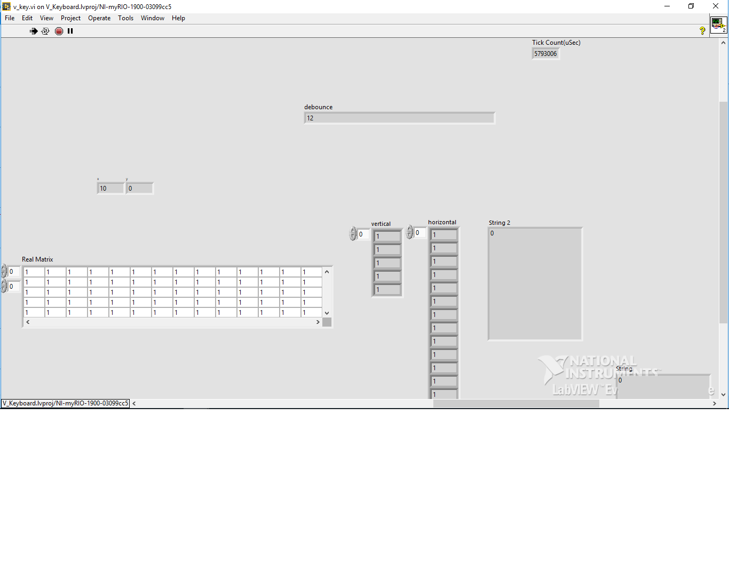
Screenshot of results

Slide 8
TEST RESULTS
Trials | Keyboard response time(in milliseconds)
Trial 1 | 6
Trial 2 | 8
Trial 3 | 12
Trial 4 | 9
Trial 5 | 8

Slide 9
Accuracy test
Virtual keyboards are vulnerable to “key stroke deviations”. There are different ways keystroke deviation may occur.
When we strike the keyboard in high frequency, the keystroke is easy to deviate. Repeated striking of the same key results in unexpected recognition due to deviations. Thus users cannot get the feedback just as striking a real keyboard.

Slide 10
Accuracy test
If the finger tip almost falls in the expected key stroke position, the result turns out to be more accurate. When the finger tip falls in the position between the two keys , it might results in erroneous key recognition.

Slide 11
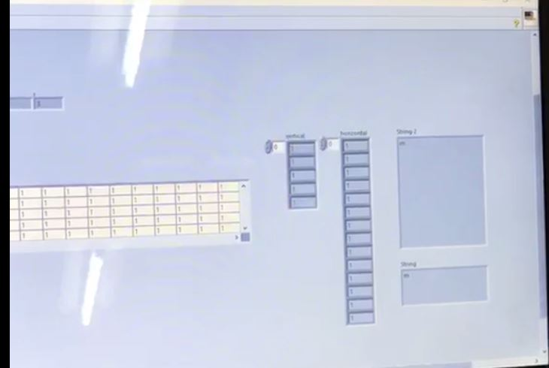
Testing process
Keys are selected at random and are typed repeatedly and then the key recognition statistics is collected.
This is repeated for single characters(number, letter, space) and multiple characters.

Slide 12
TEST RESULTS
Character | No of Trials | Accuracy= (no of success trials/ total no of trials)*100
“a” | 20 | 100%
“y” | 20 | 100%
“r” | 20 | 100%
“8” | 20 | 100%
“1” | 20 | 100%
“501” | 20 | 90%
“pqr” | 20 | 95%
Space bar | 20 | 100%

Slide 13
Observations
Our Virtual keyboard achieves a maximum key response time of 12 ms and on average response time of 8.6 ms.
The accuracy of the key recognition can be increased by optimizing the alignment of lasers and Light dependent Resistors.

Slide 14
REFERENCES
1. Xiaolin su,Yunzhou Zhang, Qingyang Zhao, Liang Gao, "Virtual keyboard: A human-computer interaction device based on laser and image processing“, Published in IEEE International Conference on Cyber Technology in Automation, Control, and Intelligent Systems (CYBER),Year: 2015
2. J. Mantyjarvi, J. Koivumaki, P. Vuori, “Keystroke recognition for virtual keyboard” Published in IEEE International Conference on Multimedia and Expo, Year: 2002
3. Z. Zhang, Y. Wu, Y. Shan et al.,"Visual panel: virtual mouse keyboard and 3D controller with an ordinary piece of paper", Published in workshop on Perceptive user interfaces.Year: 2001
4. Hari Singh Dhillon, Rajesh Singla, Navleen Singh Rekhi, "EOG and EMG based virtual keyboard: A brain-computer interface“ Published in IEEE International Conference on Computer Science and Information Technology Year: 2009
5. R. Scherer, G. R. Muller, C. Neuper et al., "An asynchronously controlled EEG-based virtual keyboard: improvement of the spelling rate", Published in IEEE Transactions on Biomedical Engineering. Year:2004

Slide 15
6. H. Du, T. Oggier, F. Lustenberger et al., "A virtual keyboard based on true-3D optical ranging", Published in British Machine Vision Conference, Year:2005
7. Huan Du,, Edardo Chardon "A virtual keyboard system based on Multi-Level Feature Matching” Published in Conference on Human System Interactions Year: 2008
8. Hubert Cecotti A Multimodal Gaze-Controlled Virtual Keyboard Published in IEEE Transactions on Human-Machine Systems Year: 2016
9. Katz I, Gabayan K, Aghajan H "A Multi-Touch Surface Using Multiple Cameras”. Dept. of Electrical Engineering, Stanford University. Year: 2007.
10. F. Echtler, M. Huber, G. Klinker, “Shadow Tracking on Multi- Touch Tables", Germany.” Year: 2008

