Slide 1
Who am I?
Vasil Veselinov
I have a degree of engineer-manager from University of Mining and Geology. I have been into programming for about a year and a half.

Slide 2

What I did as a final project?
COPYRIGHT

Slide 3


General functionality
Browse the site without registration:
-Search for articles by title and category;
-Top 5 sections for the most read news;
-Track article review count;
User:
-Registration;
-Login;
-Comments on articles;
-Votes for comment;
-Votes for article;
Admin:
-Creates articles;
-Uploads pictures;
-Operates the site's capabilities;

Slide 4
What technologies have I used?
JAVA programming language;
Maven for build tool;
Spring Framework for faster project development;
MySQL database server;
Lombok annotations for the basic methods (getters, setters, constructors);
BCrypt for encrypting passwords;
Design patterns: MVC, Singleton, DAO, DTO;
Web server Tomcat;

Slide 5
Entity / Relationship Diagram

Slide 6
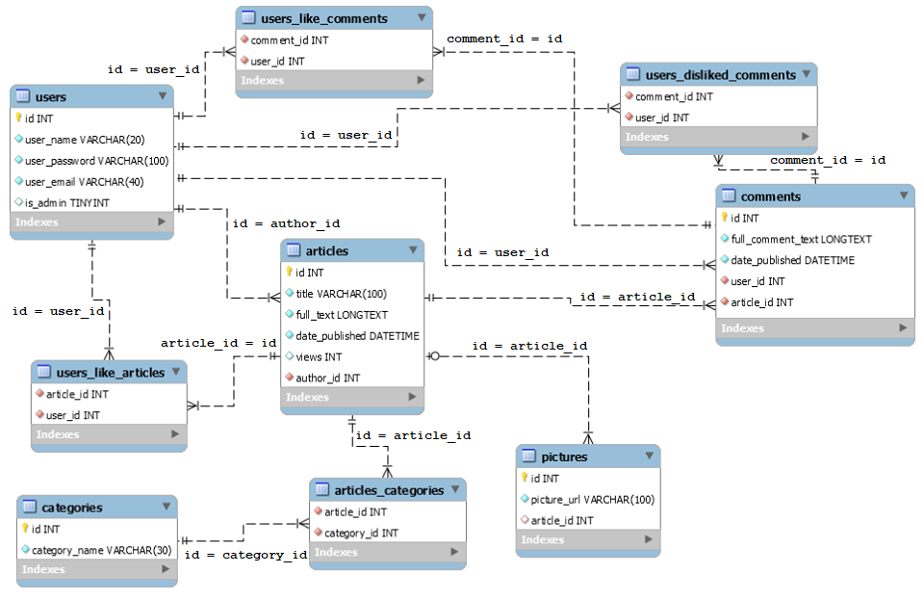

Slide 7
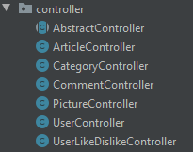
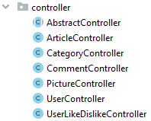
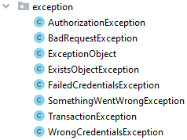
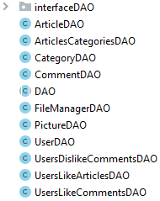
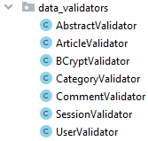
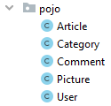
Class diagram
Controllers:
Exceptions:
Model :
DAO:
Validators:
POJO:

Slide 8
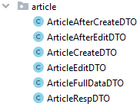

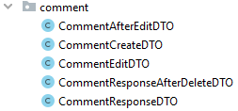


DTO:

Slide 9
DEMO

Slide 10
Thank you for the attention! Thank you, IT Talents Team, for giving me the opportunity to be here!

Slide 11


