Slide 1
Astro-INFORMATICS
Vasileios KOTTAS

Slide 2
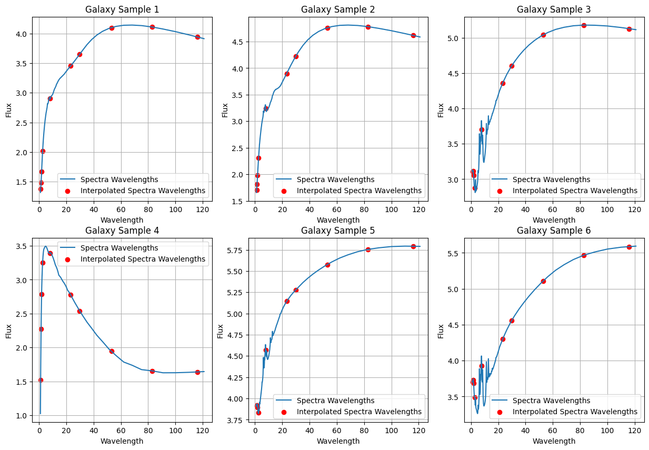
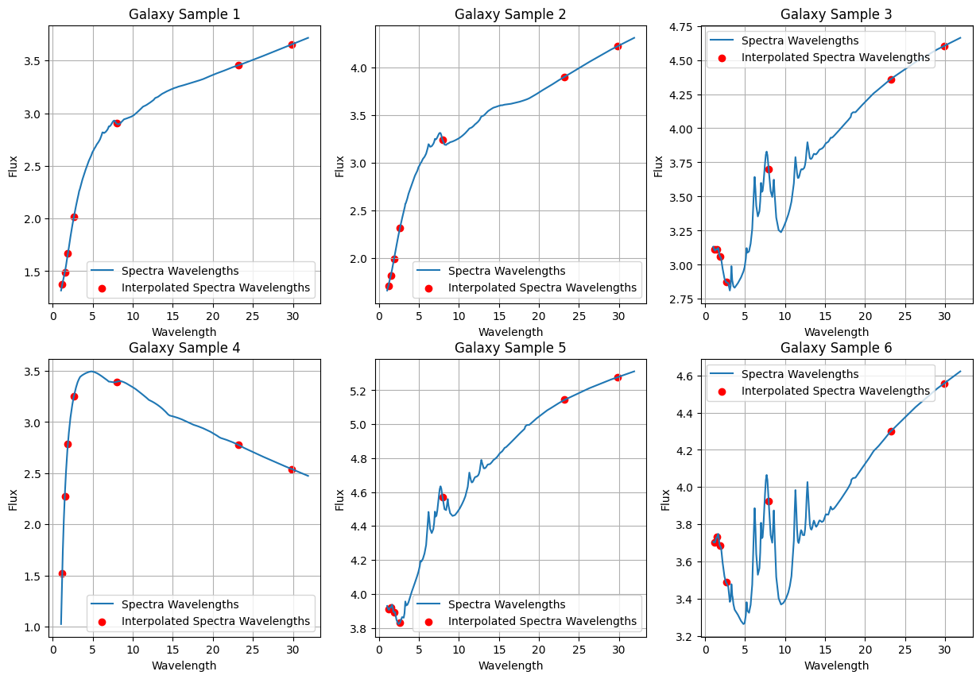

Data generation
To generate the data I used the Starburst, AGN ‘CYGNUS’, Spheroid and Polar Dust. Then by adding all the fluxes I get the total Galaxy flux, from the Starburst the wavelengths and then I apply logarithm to the fluxes. This gives me the spectra.
To get the photometry, I use the wavelengths from the filters. With the formula $λ_{obs}=\frac{λ_{rest}}{1+redshift}$, where the rest wavelength and the redshift are given by the filter files.
Then using the fluxes and the observed wavelengths I get the photometry data.
In the first picture we the whole wavelength range and in the second we see the values until 35μm, which present more details.

Slide 3
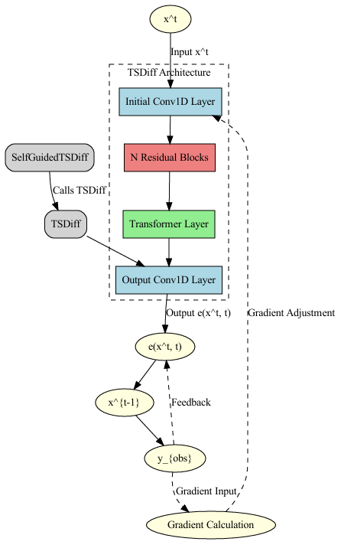
Diffusion model
The diffusion model can be seen in the first picture.
Self Guidance Core Idea: Utilizes Bayes' rule to guide the generative model towards observed time steps.
Computes the guidance term from the learned implicit distribution.
Techniques: Mean Square Self-Guidance: Approximates observed sequences using Gaussian distributions for efficient conditioning.

Slide 4
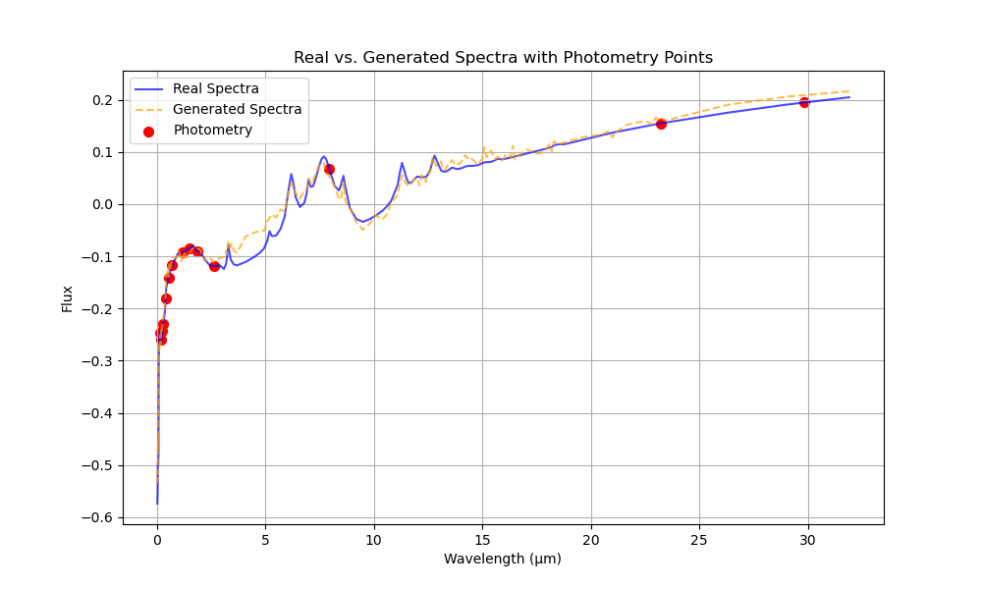
DIFFUSION TRAIN AND RESULTS
In the training process, the photometry data are fed into the model and then the loss function (MSE) uses the spectra to try and approach them. The optimizer that I use is the Adam, with learning rate 0.0001.
In the data I do a train, validation and test split of 70%, 10% and 20%.
In the picture we see the results.

Slide 5
GAN MODEL
Embedding and Recovery Networks:
The embedding network maps input time-series data into a lower-dimensional latent space, reducing complexity.
The recovery network reconstructs the original data from this latent representation.
Generator:
The generator creates synthetic data in the latent space by learning temporal dependencies.
It uses random noise and previous outputs to generate new sequences.
Discriminator:
The discriminator distinguishes between real and generated sequences in the latent space.
It evaluates whether the input sequence is real (from the dataset) or fake (from the generator).
Supervised Loss:
In addition to the adversarial loss, TimeGAN uses supervised learning to directly compare generated latent representations with actual data.
This ensures the generated sequences preserve stepwise temporal dependencies.

Slide 6
Testing The Prototype
  What worked? What did not work? Why?
  What materials need to be changed and/or kept? Why?
  Did the size of your prototype give you enough information to move forward with a final product? Why or why not?
  Did you have other people test your design and give you feedback? Why or why not?

Slide 7
Redesigning The Prototype
  Use the data from your testing to redesign with…
    Different materials
    Different builds
    Different sizes
  Write about or show images of your prototype redesigning process and result

Slide 8
Final Result
Once you have a final product, go back to your second slide and review the initial questions you answered
  Does your final prototype solve your problem for the person or people for whom it needs to be solved?
    If yes, WAY TO GO! But always think about if you can improve it even more!
    If no, copy this PowerPoint and start the problem/solution cycle again
Insert pictures of your final design
Discuss why this design solves the problem
Reflect on how you feel about the process from start to finish in this project

