Slide 1
Astro-Informatics
Diffusion and GAN models

Slide 2
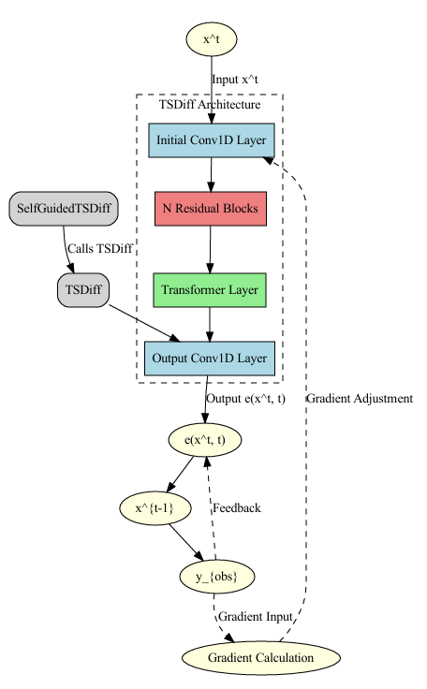
Model Architectures
A. Diffusion Model (TSDiff)
Purpose: TSDiff is a self-guiding diffusion model designed for probabilistic time series forecasting.
Architecture:
Initial and output Conv1D layers to process the time-series data.
A series of Residual Blocks to capture complex temporal dependencies in the data.
A Transformer layer to incorporate temporal attention, enhancing the model’s ability to focus on relevant time steps.
The model leverages self-guidance to conditionally predict series at inference, even though it is trained unconditionally.

Slide 3
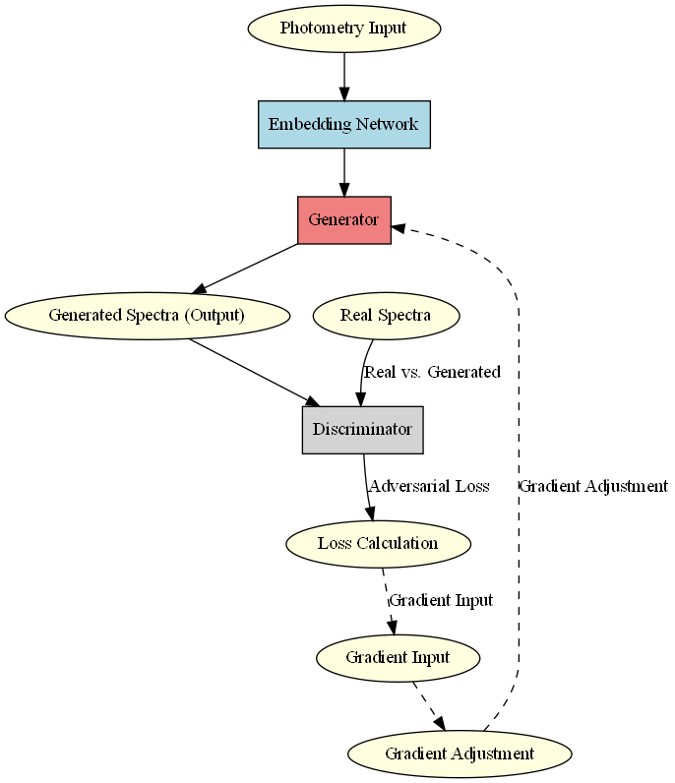
Model Architectures
Generative Adversarial Network (GAN)
Purpose: GANs are used to generate synthetic spectrometry data based on limited photometric inputs.
Architecture:
Generator: Takes photometry as input and learns to produce spectrometry spectra by generating realistic spectrometry data.
Discriminator: Distinguishes between real spectrometry data and the synthetic data generated by the Generator.
Embedding Network: Maps photometric features to a latent space, helping capture underlying structures in photometry and learning a representation that can be used to generate spectra.

Slide 4
Training Processes
Training TSDiff Diffusion Model
Unconditional Training:
TSDiff is initially trained without specific conditions, learning a probabilistic representation of the entire dataset (photometry).
Denoising Process: Through a sequence of steps, the model learns to reverse a Gaussian noise process, gradually refining noisy data back into a realistic spectrum.
Observation Self-Guidance:
During inference, self-guidance is used to incorporate photometric points into the diffusion process, guiding the model to generate realistic spectrometry conditioned on these photometric observations.
Refinement:
TSDiff can refine its predictions by using photometric data as an anchor, ensuring that generated spectra align with the observed photometric points.

Slide 5
Training Processes
Generative Adversarial Network (GAN)
Mapping Photometry to Spectrometry:
The GAN’s Generator learns a transformation from low-resolution photometry to high-resolution spectrometry by learning to match spectral characteristics seen in training data.
Discriminative Training:
The Discriminator ensures that the Generator outputs spectra that not only match photometric points but also maintain realistic distributions and spectral features.
Embedding and Reconstruction:
By mapping photometry into an embedding space, the GAN leverages latent features that correlate with spectral characteristics, enabling it to reconstruct high-fidelity spectrometry.

Slide 6
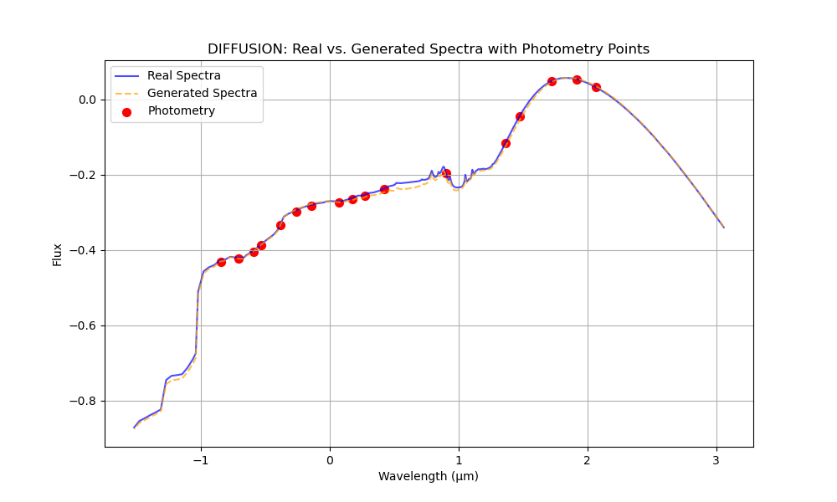
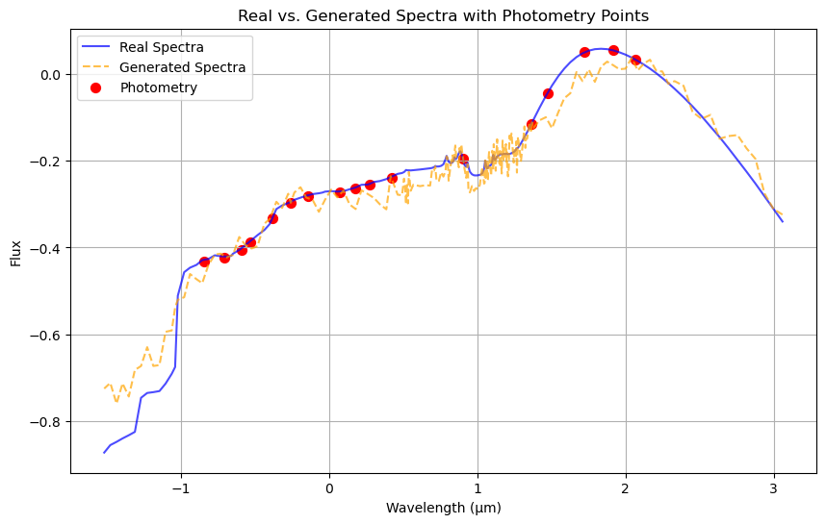
Results

Slide 7
CSDI VS TSDiff
CSDI (Conditional Score-based Diffusion for Imputation)
Strength: CSDI is well-suited for tasks involving imputation of missing values within time series. It is highly effective when part of a sequence is missing and needs to be filled based on observed values within the same data distribution.
Limitation: Since CSDI is specifically designed for conditional imputation (predicting values that are “missing” from a time series), it may not be as effective in generating new, high-resolution outputs from lower-resolution inputs like photometry-to-spectrometry task. CSDI expects input and output distributions to be similar, so it might struggle with extrapolating from a coarse set of photometry wavelengths to the denser spectrometry wavelengths.
TSDiff (Self-Guiding Diffusion Models for Forecasting and Generation)
Strength: TSDiff is designed for probabilistic generation and forecasting, allowing for unconditional training with task conditioning only during inference. This setup aligns well with generating data from a lower input, making it possible to create a new spectrometry spectrum from photometry data by applying the self-guidance conditioning mechanism.
Advantage: TSDiff’s flexibility to forecast or generate outputs at a higher resolution (e.g., creating 203 spectrometry points from 17 photometry points) makes it more adaptable to your dataset.

