Slide 1

University of Science Novi Sad
CLASSIFICATION OF RACING PIGEONS BASED ON ANALYSIS OF PIGEON’S EYE
Student: Vasilije Simonović
Professor: Sanja Brdar

Slide 2
TABLE OF CONTENTS:
ABOUT RACING PIGEONS
OVERVIEW OF THE PROJECT
DATA PROCCESING
CREATION OF THE MODEL
RESULT AND PREDICTION
APPLICATION

Slide 3
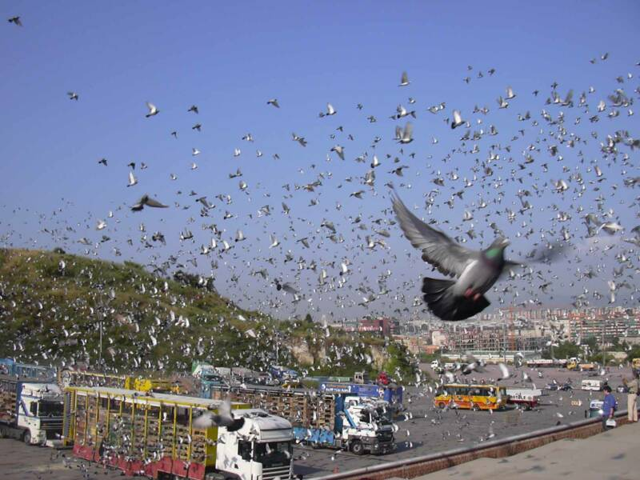
ABOUT RACING PIGEONS
Racing pigeons are birds that have the ability to return to their loft from a distance of 0-1000km. Earlier, the army used them as fast and safe transmitters of important messages. Today they are popular all over the world and they are used for racing. This sport is most popular in Belgium, Netherlands and Germany. The races function in a way that each fancier bring their pigeons to the club, where the pigeons are basketed into a truck that drives them and releases them at the place determined by the flight plan. 100,000 pigeons can be released at the same place

Slide 4
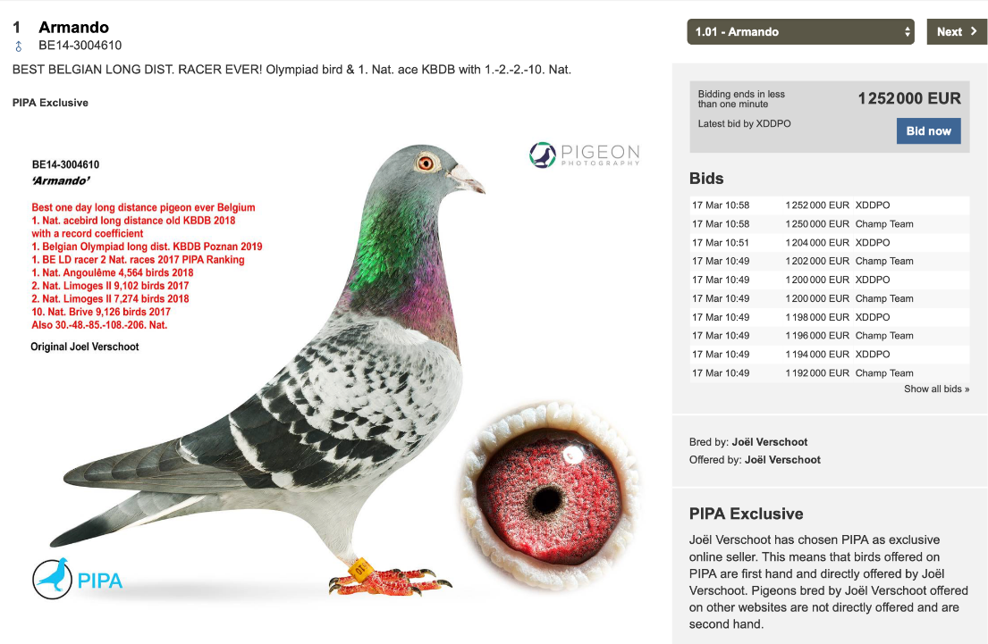
ABOUT RACING PIGEONS
Each pigeon returns home to its owner. When pigeon arrived home, electronic ring on tis feet shows exact time when the pigeon arrived. After that, average speed is being taken and the list of fastest pigeons is being made. Some of the racing pigeons are being sold after they’re finished with racing career. Some of them are being sold for an enormous price.

Slide 5
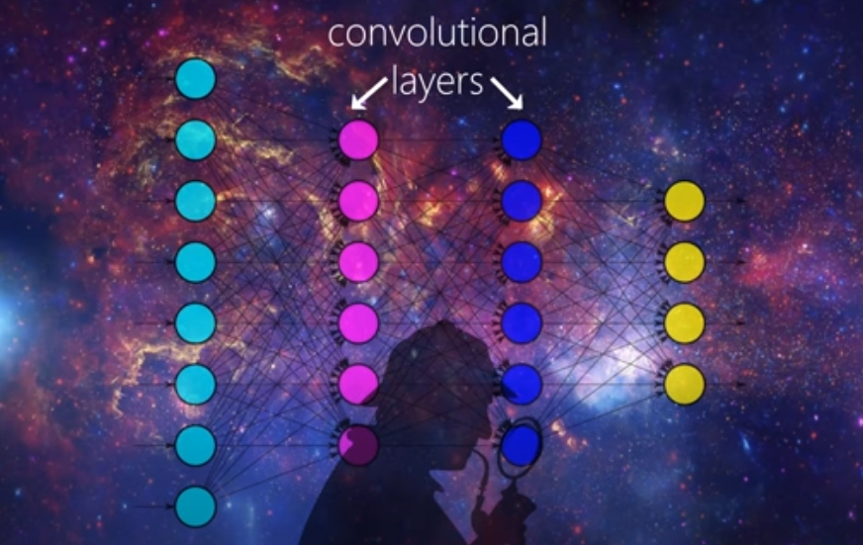
OVERVIEW
The goal of the project is to classify the pigeon as good or bad based on the RGB picture of the eye. Training data were separated into two classes (good and bad) based on the results that pigeons achieved in competitions.

Slide 6
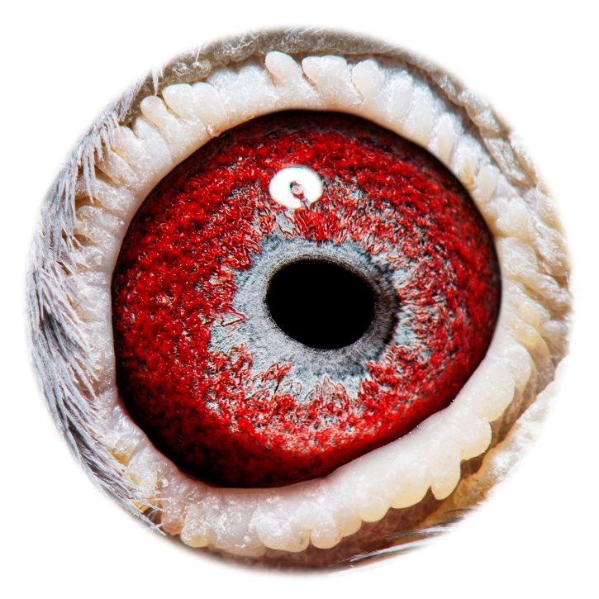
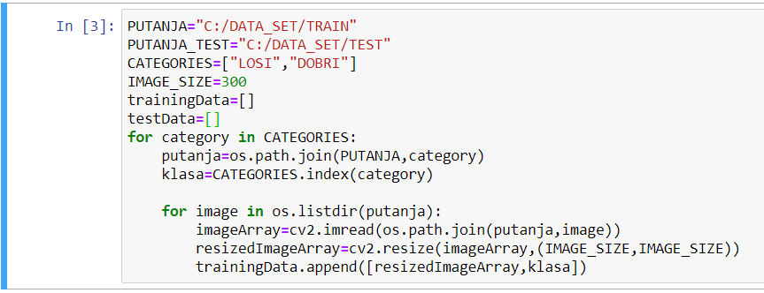
DATA PROCCESING
After being uploaded from the file, photos are proccesed. Size of the photo is changed and every label of the photo from training and test set is memorised. Pixel values are given in interval(0,1), ie. normalization of the set is done by dividing the pixel with the maximum value (255)
Resolution
3860 x 3860

Slide 7
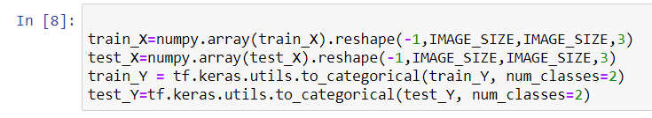
CREATION OF THE MODEL
Importing necessary packages
We turn labels into categorical

Slide 8
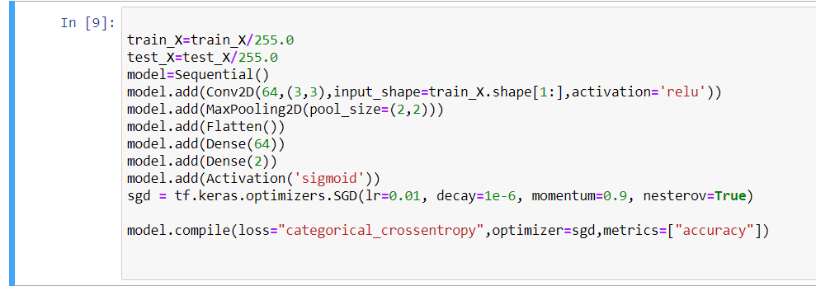
CREATION OF THE MODEL
After normalization of data we are creating model

Slide 9
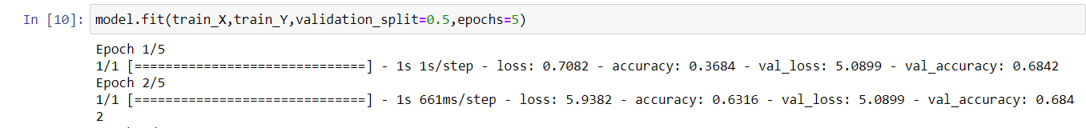
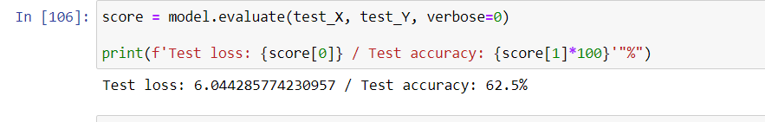
RESULT AND PREDICTION
Due to a small data set, our model is being fully precise right after second epoch
After training of the model, test set is classified and the result is obtained. The result shows the accuracy of 62,5%

Slide 10
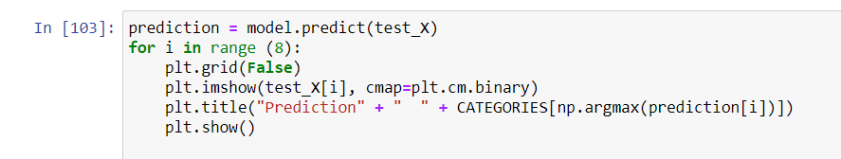
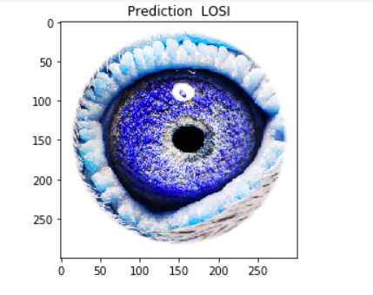
RESULT AND PREDICTION
Prediction for a few test photos
Results for a pigeon that’s been classified as “bad”

Slide 11
APPLICATION
This idea has various applications. Using this model, it can be determined whether the pigeon is good or not. That can drastically change its value in auctions. Since we can find numerous pigeons in auctions, we can find a good pigeon at a low price, and also avoid buying expencive pigeons if it is determined that they are not good.

Slide 12
THANK YOU FOR YOUR ATTENTION!

