Slide 1

Task 5
Computational Genomics
Jelena Dubak 2020/3256
Vasilije Becić 2020/3201
School of Electrical Engineering, University of Belgrade, 2022

Slide 2

Goal
Implement aligner using Seed&Extend
FM Index with BWT seed queries
Global alignment for the rest
Compare best results against BWA-MEM tool for parameter values
Match [0,1,2]
Mismatch [-3,-2]
Gap [-7,-5]

Slide 3

Our implementation

Slide 4
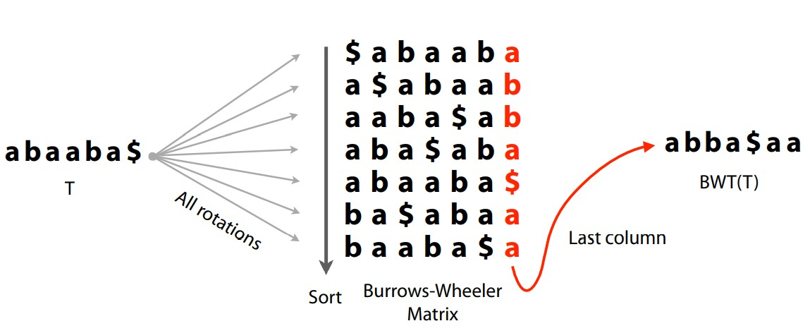
Burrows-Wheeler transform
Reversible string permutation
Usefull for compression
First and last column of BWT matrix used for FM index structure

Slide 5
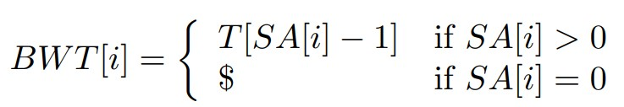
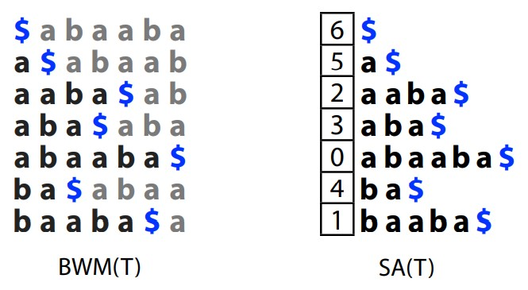
Implementation for the task
Traditional implementation given in the classes
Uses Suffix array indexes
Only improvement done for code
Usage of python function sorted(array) instead of array.sort() – faster for larger strings

Slide 6
FM index
Used for fast string querying
Offline
Traditional implementation given in the classes
BWT and rest of the FM index structure initialization
Query algorithm
Structure
BWT for compressed first column and transformed last column
Tally matrix for occurences
C matrix
Indexes from SA

Slide 7
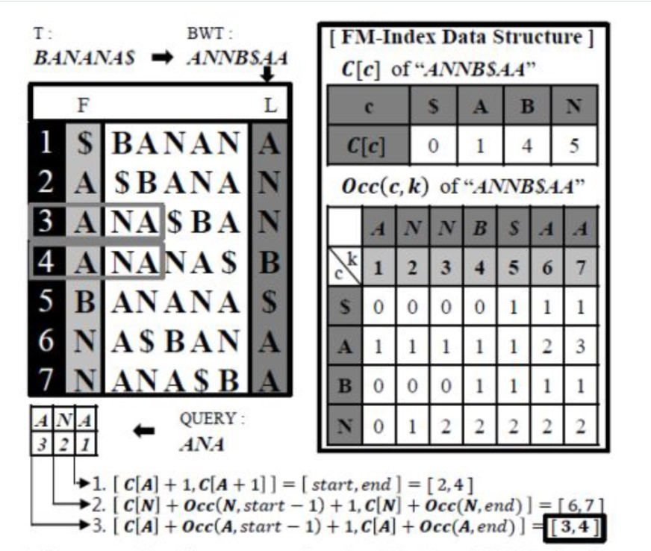

Slide 8
Global alignment
Needleman-Wunsch algorithm
Used in the task for alignment score calculations and edit transcripts
Scoring matrix data passed as arguments
Main parts:
Scoring matrix
Global alignment
Traceback

Slide 9
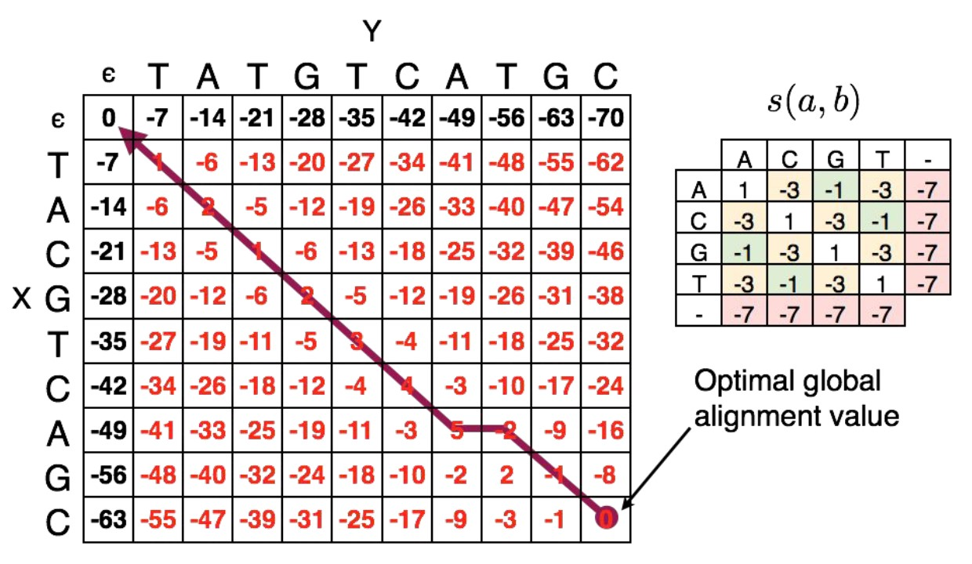

Global alignment

Slide 10
Main program
Inputs
Fasta file
Fastq file
Program
Initialization (uses the fact that FM Index is offline)
Seed and extend algorithm
Ran for each read
Via FM index query finds seed positions
Via Aligner calculates scores and edit transcripts
Sorts positions by scores
Outputs
Parameters above, for each read

Slide 11
Difficulties
Test files given by the task ran too slow and used too much memory
Seen on local environment (our laptops)
Also seen on Seven Bridges Cancer Genomics Cloud platform (CGC)
Ran via Data Cruncher Jupyter

Slide 12
Runs
Smaller test files used for analysis
Found on CGC
Ran for task parameters on CGC Jupyter
For validation, only best scores taken into account
Results stored in the files

Slide 13
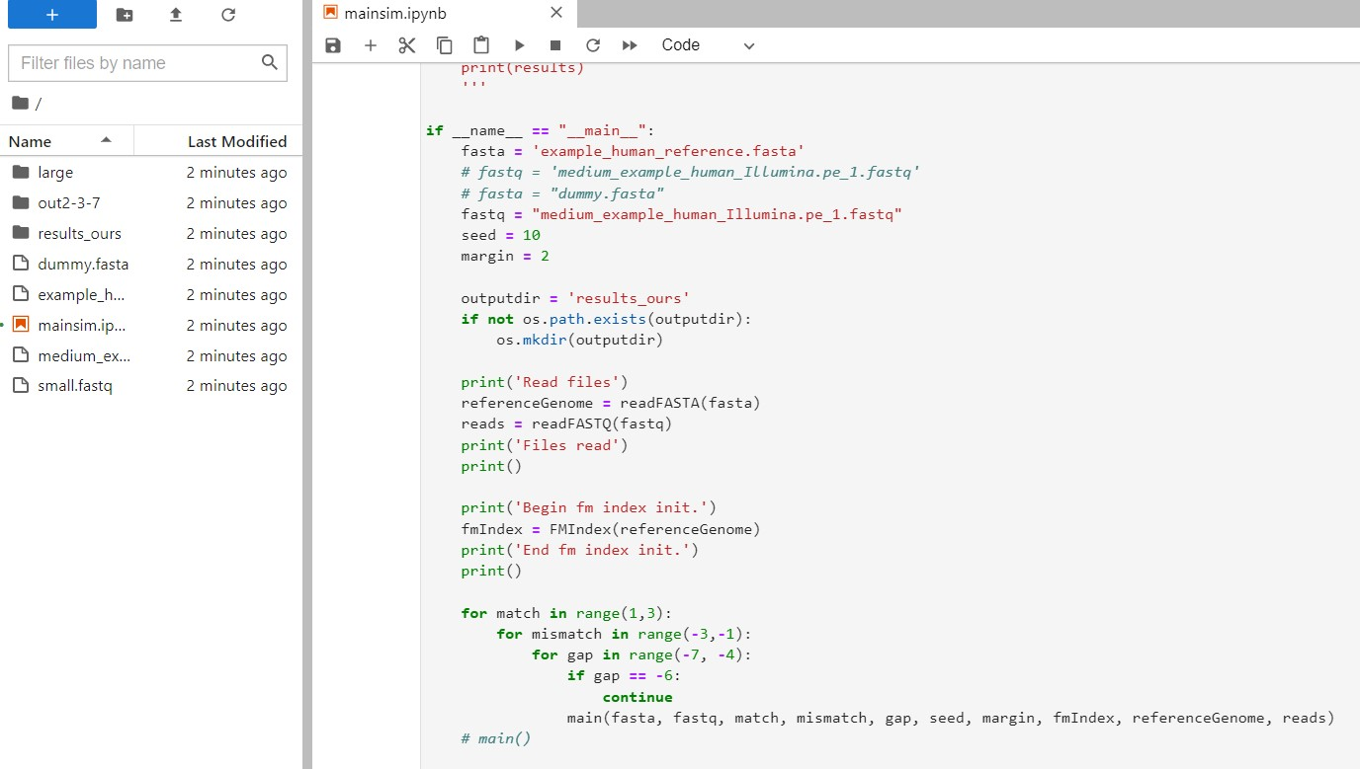

Slide 14

BWA MEM

Slide 15
BWA tools
CGC platform tools
BWA INDEX
bwa index [fasta file]
Output: tar for fasta file with its index
BWA MEM Bundle
bwa mem [fasta.tar from above] [fastq] [options] > [sam file]

Slide 16
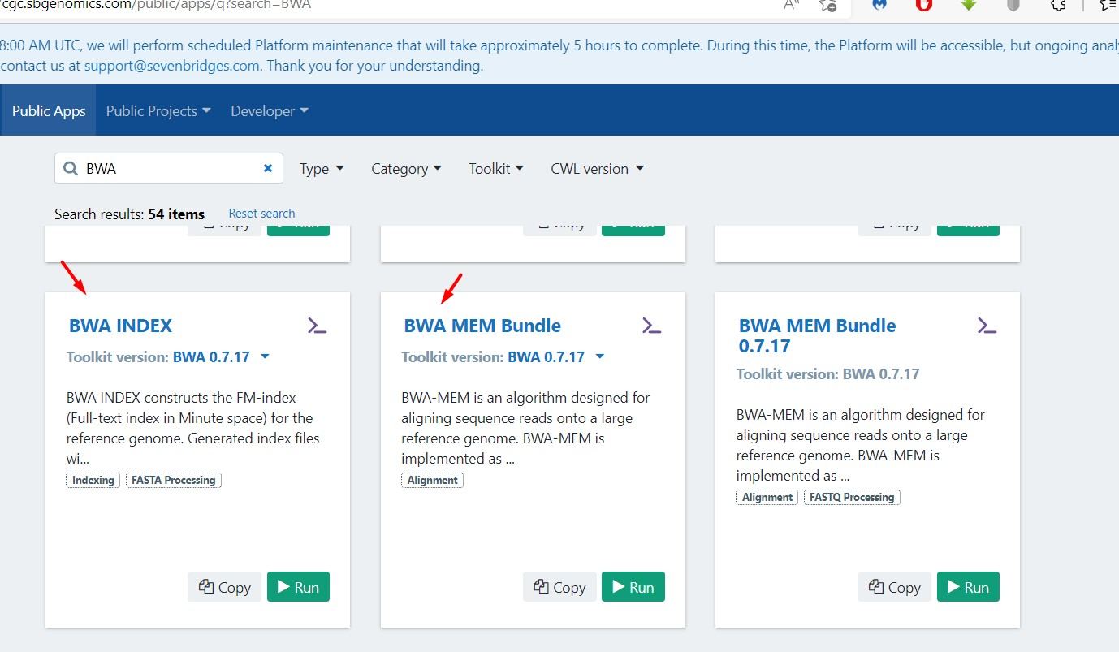

Slide 17
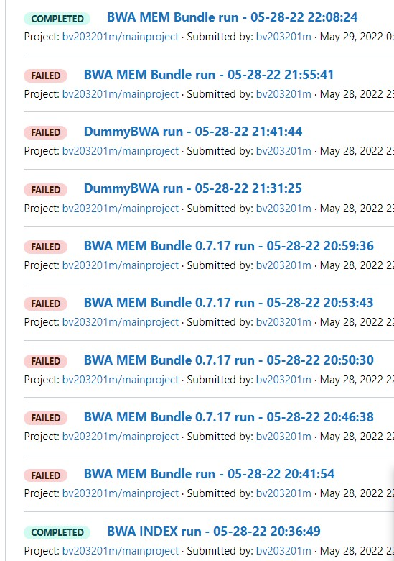
Example of runs (and errors while we figured out what was wrong…)

Slide 18
Difficulties
Errors for match value of 0
Also checked for other bwa mem tools built via Dockerfile on our local machines and ran via Docker Desktop on Windows Linux-Subsystem
Match value of zero therefore not taken into account for our program validation

Slide 19

Results and analysis

Slide 20
Analysis results
Legend: (match-mismatch-gap)
Results for 12 random taken reads (all other are more or less similar)

Slide 21
read | Our program | BWA
SRR316957.3748 | 23 | 76
SRR316957.176167 | 56 | 76
SRR316957.13555 | 53 | 191
SRR316957.404169 | 56 | 76
SRR316957.10370 | 39 | 321
SRR316957.92287 | 47 | 264
SRR316957.518689 | 50 | 187
SRR316957.1063205 | 45 | 210
SRR316957.1016179 | 47 | 342
SRR316957.866299 | 53 | 129
SRR316957.958299 | 53 | 262
SRR316957.949607 | 42 | 160
read | Our program | BWA
SRR316957.3748 | 7 | 76
SRR316957.176167 | 52 | 76
SRR316957.13555 | 49 | 239
SRR316957.404169 | 52 | 76
SRR316957.10370 | 31 | 423
SRR316957.92287 | 43 | 342
SRR316957.518689 | 46 | 233
SRR316957.1063205 | 37 | 266
SRR316957.1016179 | 43 | 454
SRR316957.866299 | 49 | 151
SRR316957.958299 | 49 | 340
SRR316957.949607 | 34 | 196

Slide 22
read | Our program | BWA
SRR316957.3748 | 23 | 76
SRR316957.176167 | 56 | 76
SRR316957.13555 | 52 | 212
SRR316957.404169 | 56 | 76
SRR316957.10370 | 37 | 367
SRR316957.92287 | 44 | 299
SRR316957.518689 | 48 | 207
SRR316957.1063205 | 45 | 234
SRR316957.1016179 | 44 | 389
SRR316957.866299 | 52 | 138
SRR316957.958299 | 52 | 299
SRR316957.949607 | 41 | 176
read | Our program | BWA
SRR316957.3748 | 7 | 76
SRR316957.176167 | 52 | 76
SRR316957.13555 | 48 | 259
SRR316957.404169 | 52 | 76
SRR316957.10370 | 29 | 469
SRR316957.92287 | 40 | 377
SRR316957.518689 | 44 | 253
SRR316957.1063205 | 37 | 289
SRR316957.1016179 | 40 | 501
SRR316957.866299 | 48 | 160
SRR316957.958299 | 48 | 377
SRR316957.949607 | 33 | 212

Slide 23
read | Our program | BWA
SRR316957.3748 | 86 | 152
SRR316957.176167 | 102 | 152
SRR316957.13555 | 118 | 224
SRR316957.404169 | 122 | 152
SRR316957.10370 | 102 | 305
SRR316957.92287 | 110 | 269
SRR316957.518689 | 114 | 221
SRR316957.1063205 | 110 | 236
SRR316957.1016179 | 110 | 320
SRR316957.866299 | 118 | 185
SRR316957.958299 | 118 | 269
SRR316957.949607 | 106 | 206
read | Our program | BWA
SRR316957.3748 | 70 | 152
SRR316957.176167 | 94 | 152
SRR316957.13555 | 114 | 272
SRR316957.404169 | 118 | 152
SRR316957.10370 | 94 | 407
SRR316957.92287 | 106 | 347
SRR316957.518689 | 110 | 267
SRR316957.1063205 | 102 | 292
SRR316957.1016179 | 106 | 432
SRR316957.866299 | 114 | 207
SRR316957.958299 | 114 | 347
SRR316957.949607 | 98 | 242

Slide 24
read | Our program | BWA
SRR316957.3748 | 86 | 152
SRR316957.176167 | 122 | 152
SRR316957.13555 | 117 | 243
SRR316957.404169 | 122 | 152
SRR316957.10370 | 100 | 342
SRR316957.92287 | 107 | 299
SRR316957.518689 | 112 | 240
SRR316957.1063205 | 110 | 257
SRR316957.1016179 | 107 | 356
SRR316957.866299 | 117 | 194
SRR316957.958299 | 117 | 296
SRR316957.949607 | 105 | 218
read | Our program | BWA
SRR316957.3748 | 70 | 152
SRR316957.176167 | 118 | 152
SRR316957.13555 | 113 | 291
SRR316957.404169 | 118 | 152
SRR316957.10370 | 92 | 444
SRR316957.92287 | 103 | 377
SRR316957.518689 | 108 | 286
SRR316957.1063205 | 102 | 313
SRR316957.1016179 | 103 | 470
SRR316957.866299 | 113 | 216
SRR316957.958299 | 113 | 374
SRR316957.949607 | 97 | 252

Slide 25

Тhank you
for your attention!

Slide 26


