Slide 1
Task 5
Genetic informatics
Jelena Dubak
Vasilije Becić 2020/3201

Slide 2
Goal
Implement aligner using Seed&Extend
FM Index seed queries
Global alignment for the rest
Compare best results against BWA-MEM tool for parameter values
Match [0,1,2]
Mismatch [-3,-2]
Gap [-7,-5]

Slide 3
Our implementation

Slide 4
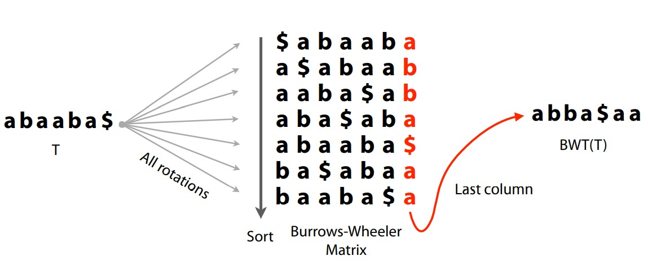
Burrows-Wheeler transform
Reversible string permutation
Usefull for compression
First and last column of BWT matrix used for FM index structure

Slide 5
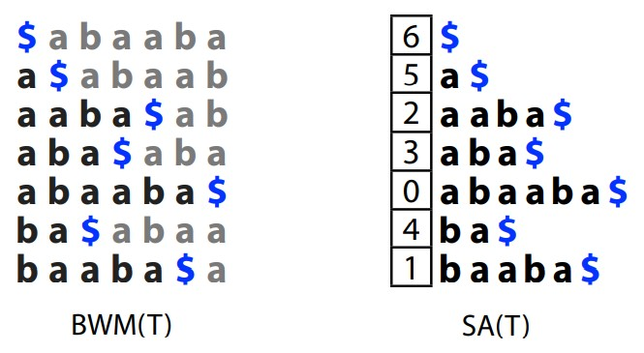
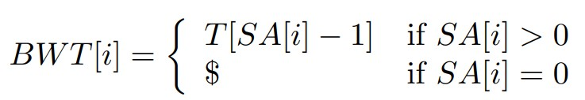
Implementation for the task
Traditional implementation given in the classes
Uses Suffix array indexes
Only improvement done for code
Usage of python function sorted(array) instead of array.sort() – faster for larger strings

Slide 6
FM index
Used for fast string querying
Offline
Traditional implementation given in the classes
BWT and rest of the FM index structure initialization
Query algorithm
Structure
BWT for compressed first column and transformed last column
Tally matrix for occurences
C matrix
Indexes from SA

Slide 7
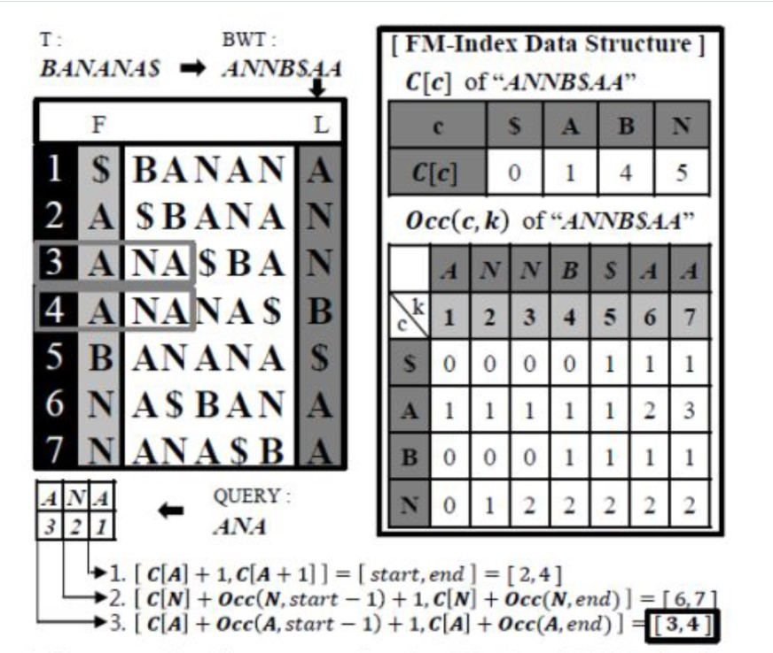

Slide 8
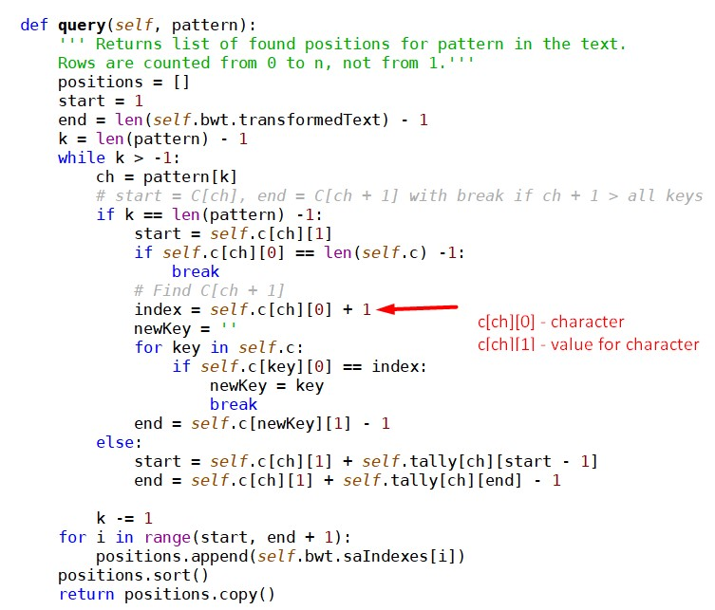
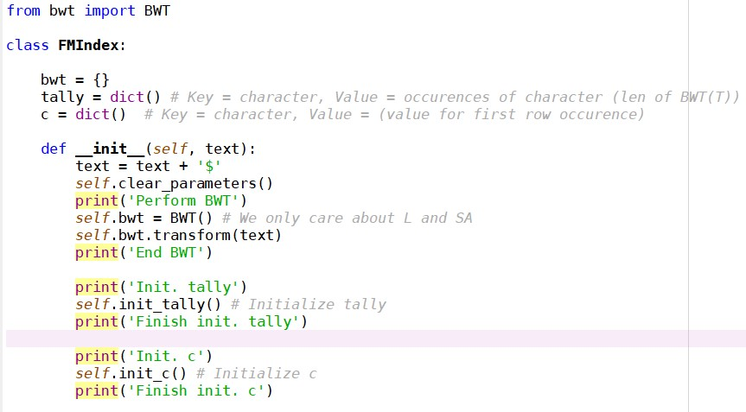
Initialization first, query after principle – offline algorithm

Slide 9
Global alignment
Needleman-Wunsch algorithm
Used in the task for alignment score calculations and edit transcripts
Scoring matrix data passed as arguments
Main parts:
Scoring matrix
Global alignment
Traceback

Slide 10
Main program
Inputs
Fasta file
Fastq file
Program
Initialization (uses the fact that FM Index is offline)
Seed and extend algorithm
Runed for each read
Via FM index query finds seed positions
Via Aligner calculates scores and edit transcripts
Sorts positions by best scores
Outputs
Parameters above, for each read

Slide 11
Difficulties
Test files given by the task runed too slow and used too much memory
Seen on local environment (our laptops)
Also seen on Seven Bridges Cancer Genomics Cloud platform (CGC)
Runed via Data Cruncher Jypter

Slide 12
Runs
Smaller test files used for analysis
Found on CGC
Runed for task parameters on CGC Jupyter
For validation, only best scores taken into account
Results stored in the files

Slide 13
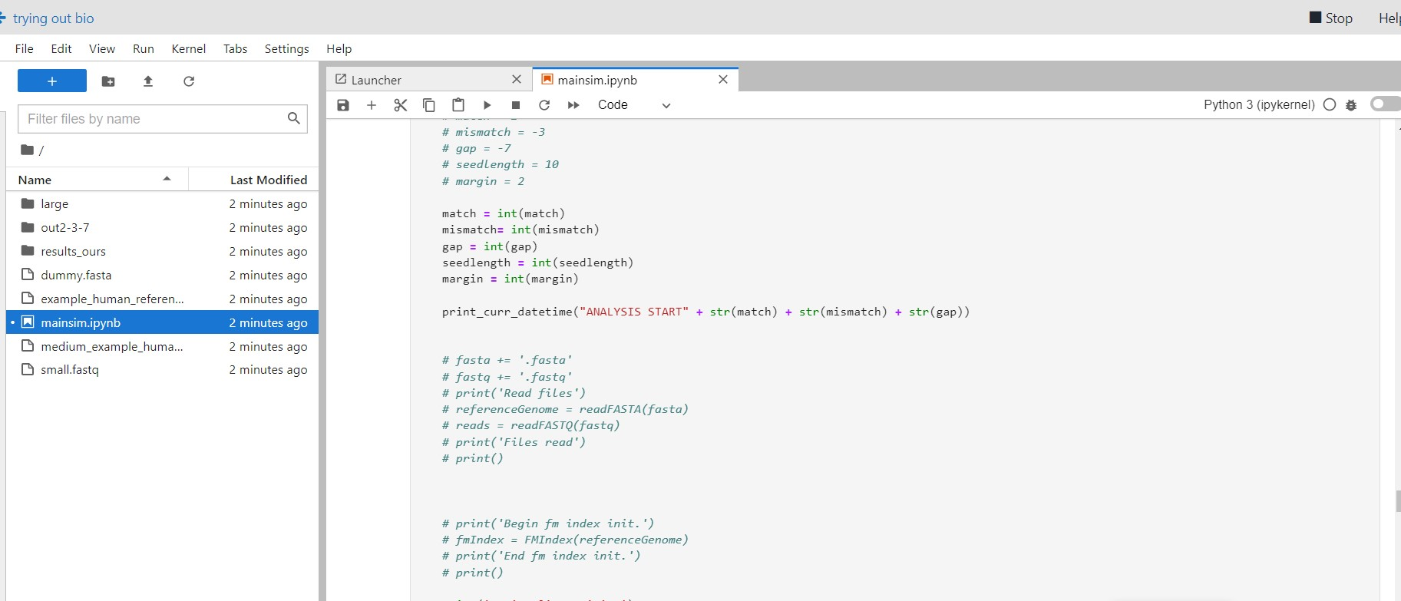

Slide 14
BWA MEM

Slide 15
BWA tool
CGC platform tools
BWA INDEX
bwa index [fasta file]
Output: tar for fasta file with its index
BWA MEM Bundle
bwa mem [fasta.tar from above] [fastq] [options] > [sam file]

Slide 16
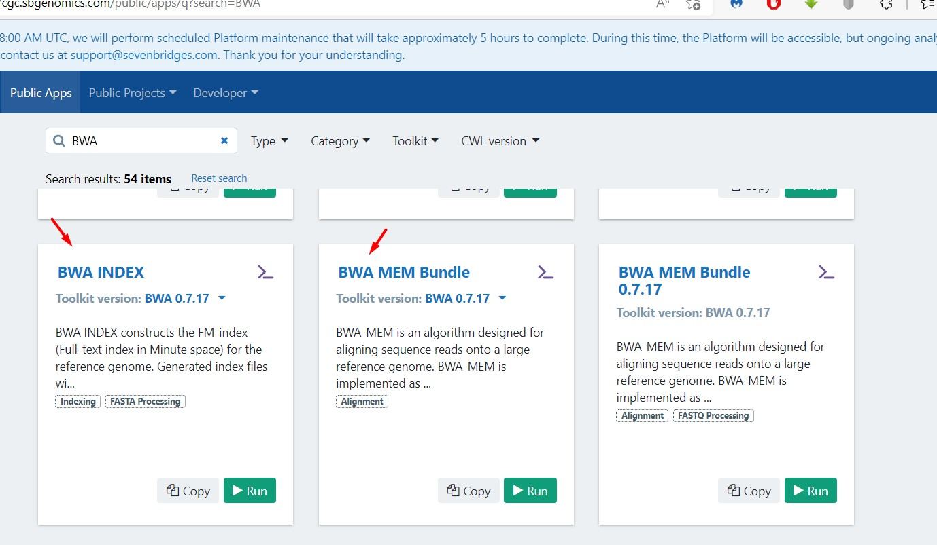

Slide 17
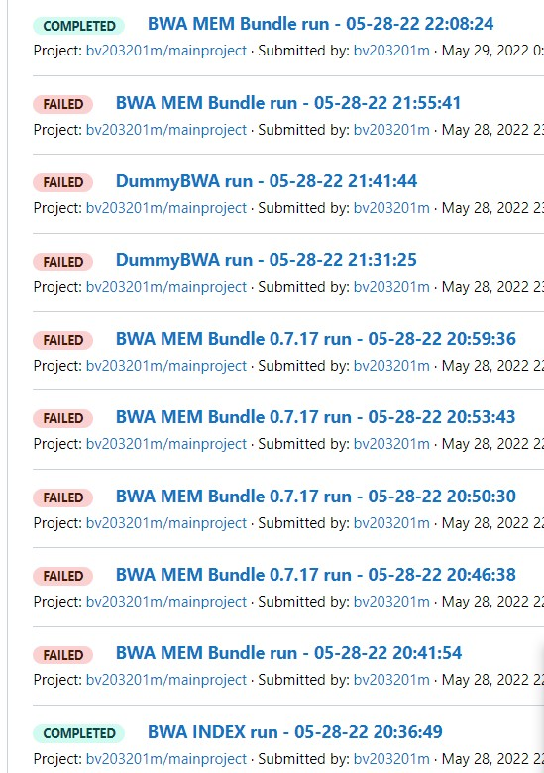
Example of runs (and errors while we figured out what was wrong…)

Slide 18
Difficulties
Errors for match value of 0
Also checked for other bwa mem tools built via Dockerfile on our local machines and runed via Docker Desktop on Windows Linux-Subsystem
Match value of zero therefore not taken into account for our program validation

Slide 19
Results and analysis

Slide 20
Analysis results

Slide 22


