Slide 1

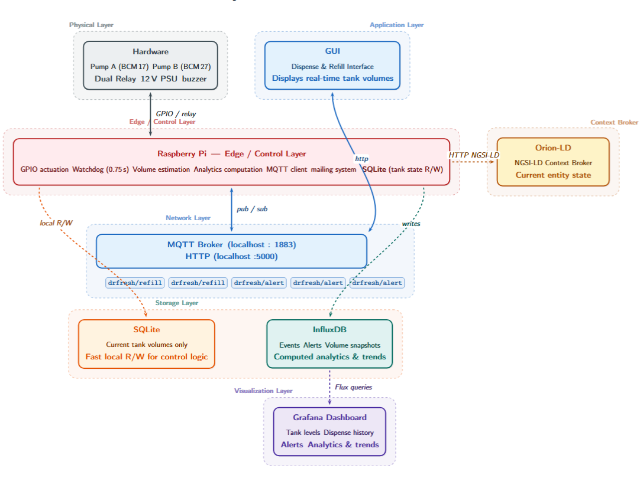
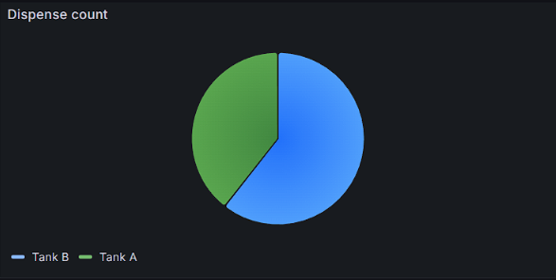
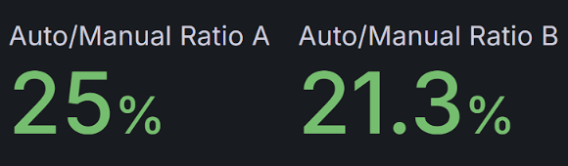
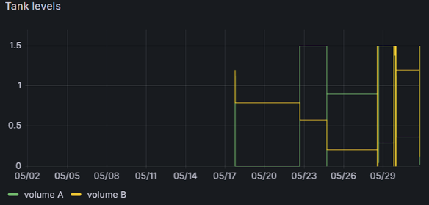
[Smart Drinks Dispenser]
ECE490 IoT & Apps Workshop
[DrFresh] | [Ούζας Βασίλειος, Αλίνο Παπαγιάννης]
System Architecture / Data Flow
Problem / Use Case
Main Components
Hardware: [RPi / double 6-12V pumps / 5V active buzzer / 12V dual relay module]
Software: [Python / HTML/ CSS/ JavaScript]
Protocols: [MQTT / HTTP / NGSI-LD]
Storage: [SQLite / InfluxDB]
We all hate that feeling when we are at the office and we visit the water cooler/dispenser at the office only to find it barely or completely empty.
That’s why we at DrFresh came up with an iot system that help us monitor beverage dispensing, notifies in time when the reservoir levels are low and give us preference statistics
Key users / environment
Demo Scenario
A perfect solution for work spaces, schools, offices and small businesses
Example: Try connecting to 10.24.4.20:5000 on your compute/mobile device over HTTP. Let one person to try and make an “auto dispense” from tank A. Observe:
Now let someone else to try and make a “manual dispense” from tank B. Observe the tank levels:
Keep this pace until you see the low tank notification. Let someone press the refill button and observe the tank’s level inside the GUI. Check the corresponding MQTT topics.
Data path example
[Tank A volume drops below 0.3L] → [processing (on PI)] → [storage(InfluxDB)] → [notification on GUI/MQTT/GMAIL/Grafana visualization ] →[you can no longer dispense from A]
*please make sure you are taking part in the demo alongside the presenters for clear instructions. The GUI can not handle multiple users

