Slide 1
Image Captioning using Deep Learning models
Vasilis Stavrianoudakis
mtn2215

Slide 2
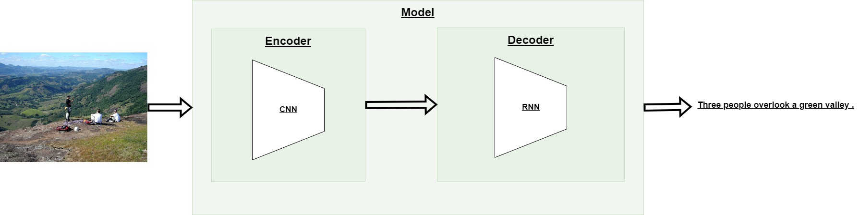
Model Overview
Train Encoder – Decoder end-to-end.
Decoder stops generating after: max number of words or a specific symbol.
Number of classes = number of unique words in the vocabulary.

Slide 3
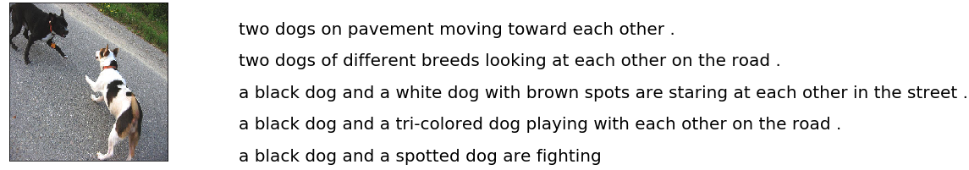
Dataset Overview
Dataset: Flickr-8K
Approximately 8K images.
5 captions per image, approximately 40K captions.

Slide 4
Preprocessing

Slide 5
Datasets Creation
Keep one caption per image (the smallest in length).
Now, every image–caption pair is unique.
Split randomly into three sets.
Training set: 6.400 image-caption pairs.
Validation, Test set: 810 image-caption pairs.

Slide 6
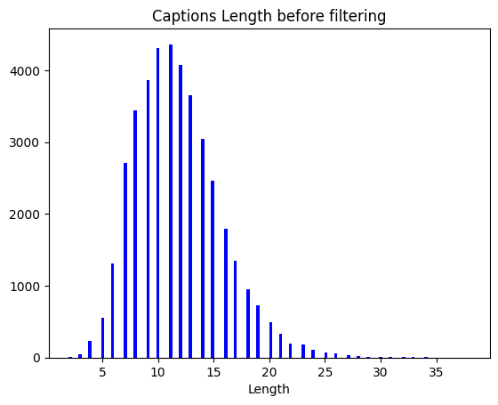
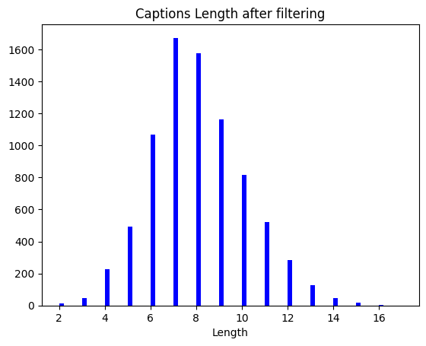
Datasets Creation

Slide 7
Images
Resize to 256x256.
Normalize each pixel value to [0, 1].
Save the preprocessed images.
Use threads to preprocess the whole dataset.

Slide 8
Captions
Convert to lowercase.
«A girl going into a wooden building .» → « a girl going into a wooden building .»
Replace «#» with «number» and «&» with «and».
«Closeup of football player # 25 .» → «closeup of football player number 25 .»
«A brown & white greyhound dog sniffs the snow .» → «a brown and white greyhound dog sniffs the snow .»
Convert all numbers to words.
«Closeup of football player # 25 .» → «closeup of football player number twenty-five .»
Remove everything that it’s in parentheses.
«its a distorted lens ( almost fish eye ) of a teenage boy skateboarding on a concrete block .» → «its a distorted lens of a teenage boy skateboarding on a concrete block .»
Remove symbols: «;!:()».
«A man just caught a fish and it is feisty !» → «a man just caught a fish and it is feisty»
Use “.” as the end-of-generation symbol.

Slide 9
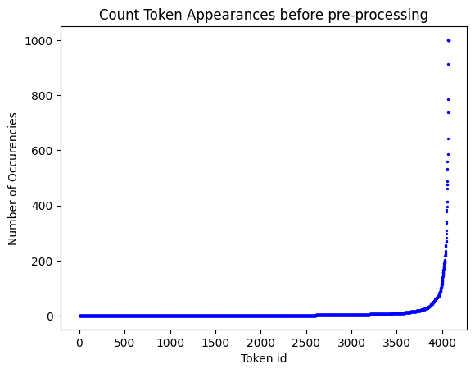
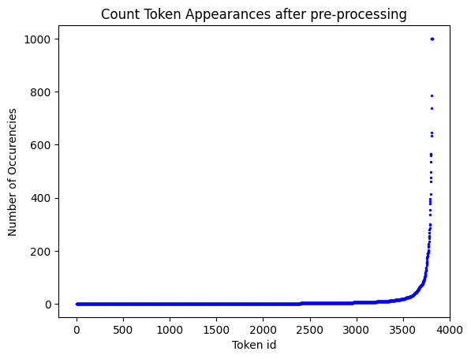
Captions

Slide 10
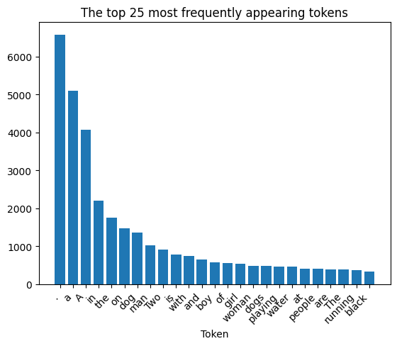
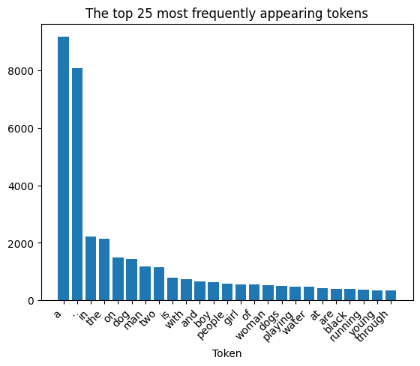
Captions
Before preprocessing
After preprocessing

Slide 11
Captions
Remove token “a”.
Creates a major imbalance.
Does not affect the meaning of a sentence.
More than 2.500 tokens appear only once. Very few appear more times.
This means some classes are very rare!
Create the vocabulary from the training set captions.
Only consider a token if it appears more than 10 times.
Replace all other tokens with “<UNK>”.
Number of classes = number of unique tokens = ~500.

Slide 12
Model Implementations

Slide 13
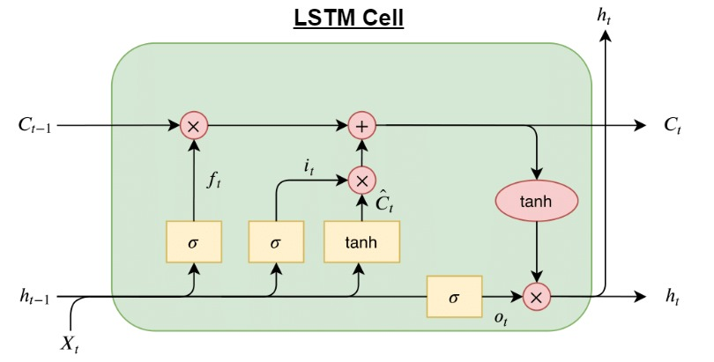
Model Implementations

Slide 14
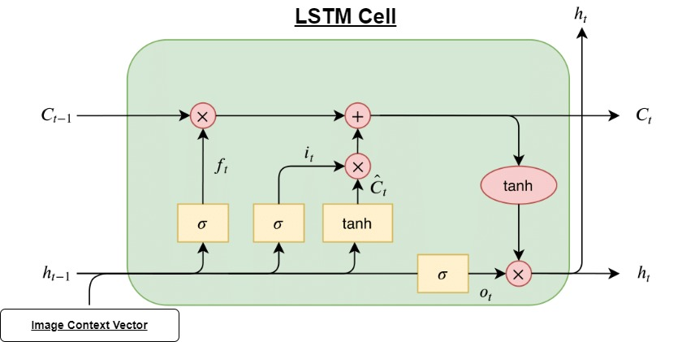
Image Context as Embedding input

Slide 15
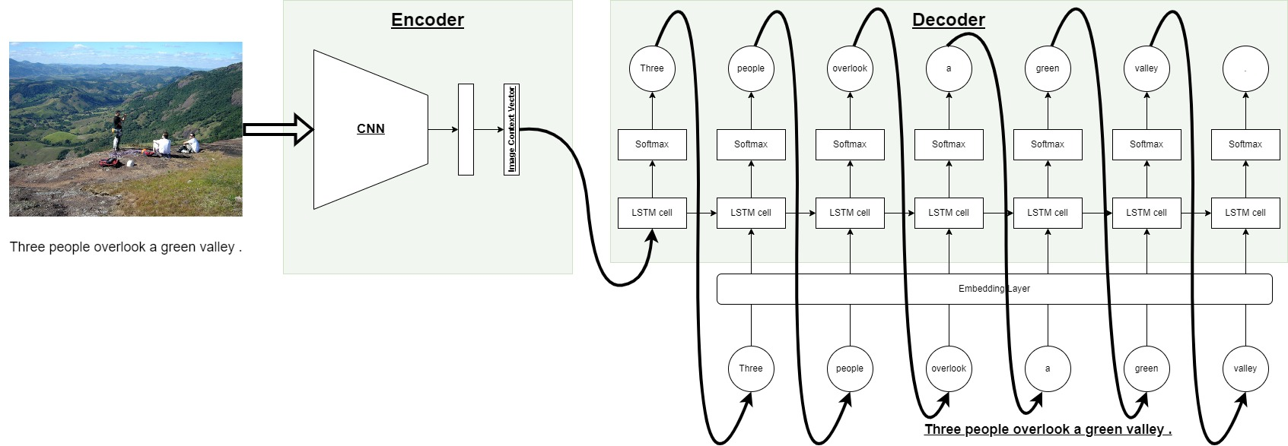
Image Context as Embedding input - Inference

Slide 16
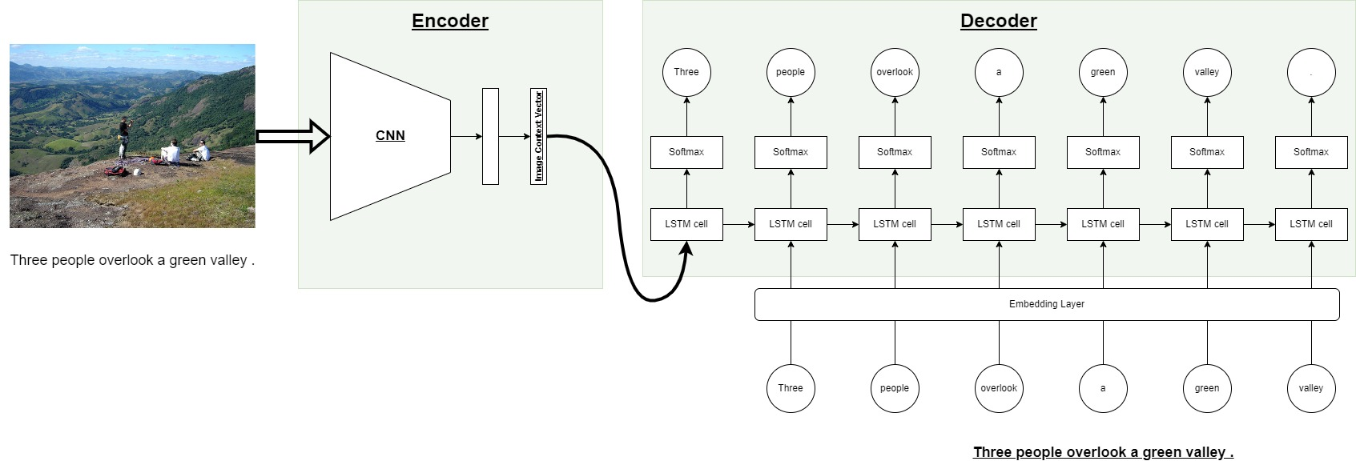
Image Context as Embedding input - Training

Slide 17
Image Context as Embedding input
Pros:
Relatively easy to implement.
Can scale the model without a problem. Image context is part of the input sequence and not part of the model.
Cons:
Image context vector must have the same dimension as word embeddings.
They are relatively small vectors.
Each image gets to be represented by a few values.

Slide 18
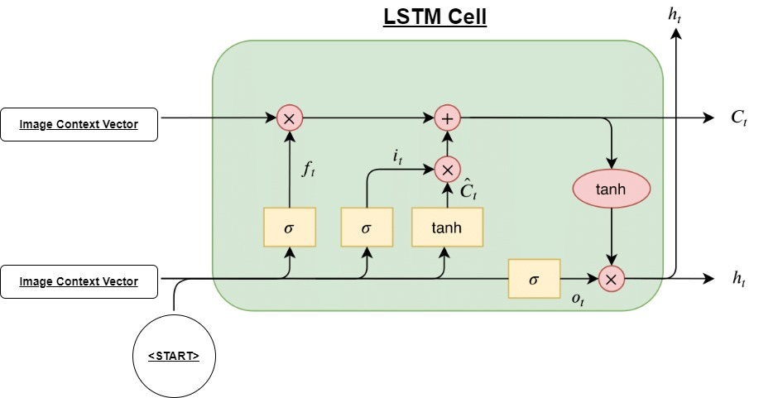
Image Context as Gate input

Slide 19
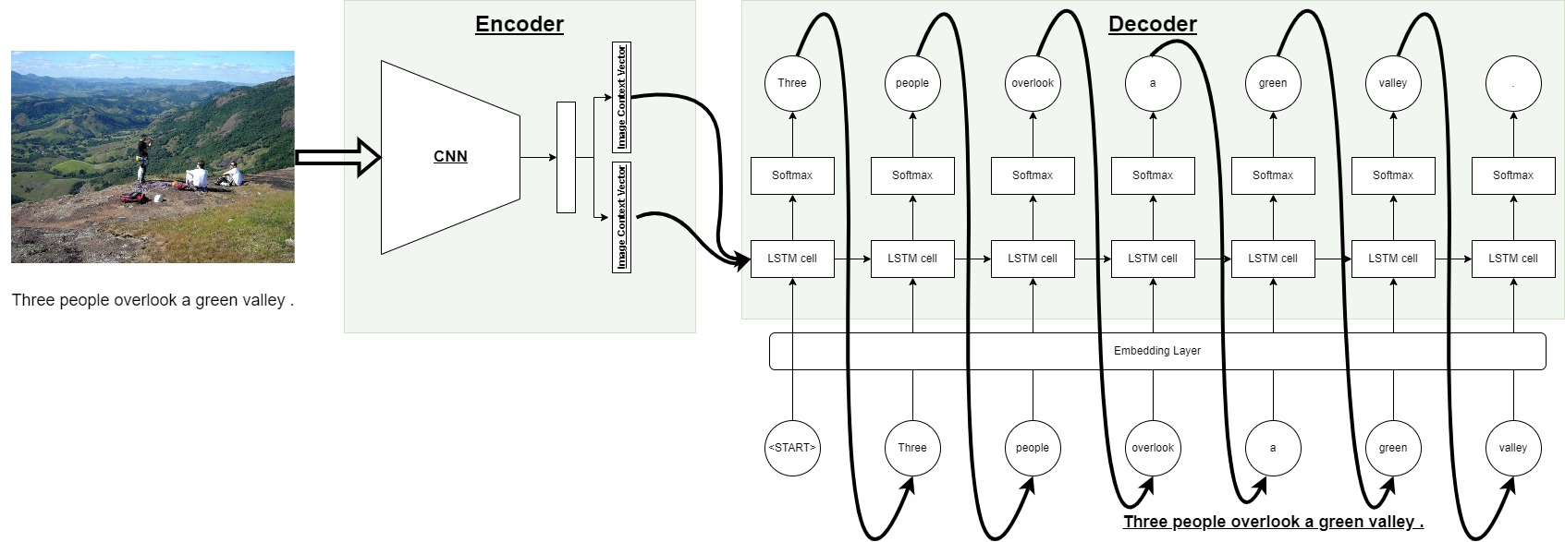
Image Context as Gate input - Inference

Slide 20
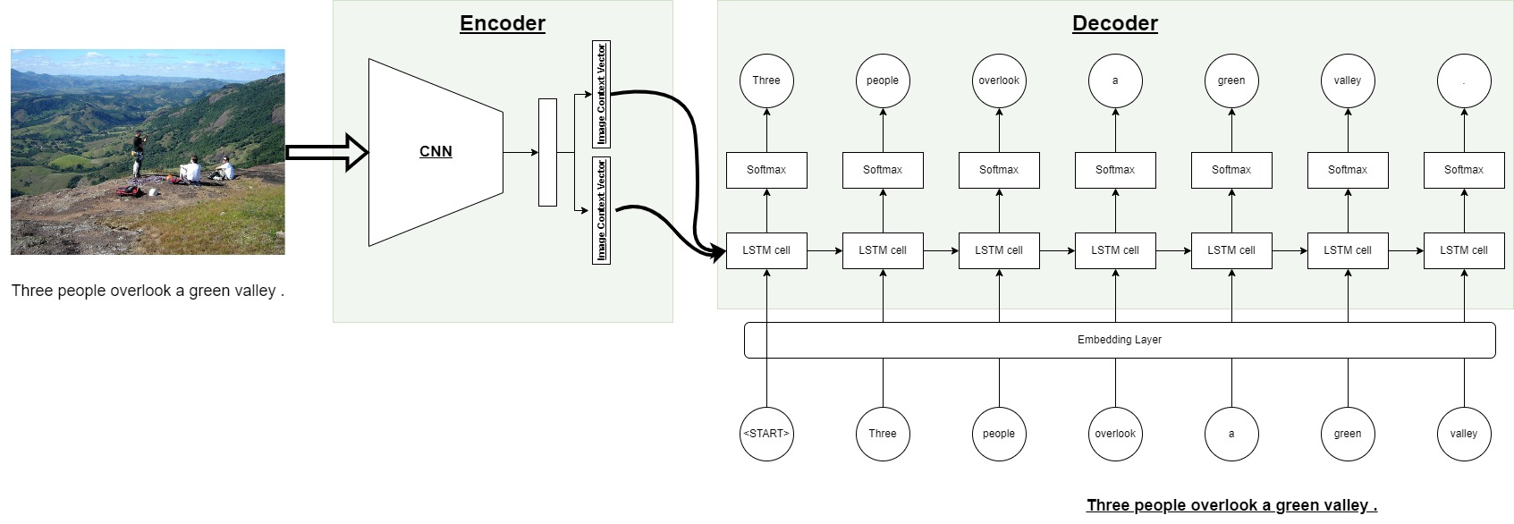
Image Context as Gate input - Training

Slide 21
Image Context as Gate input
Encoder must produce two image context vectors. One for each gate.
Must use a special token as the first input. The “<START>”.

Slide 22
Comparison

Slide 23
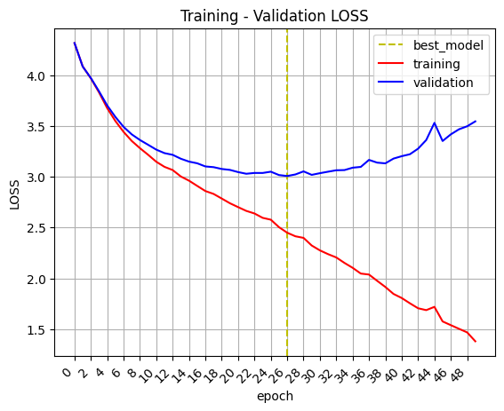
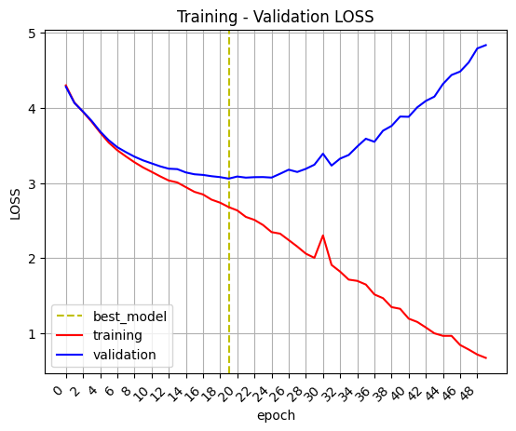
Image Context as Embedding Input
Image Context as Gate Input

Slide 24
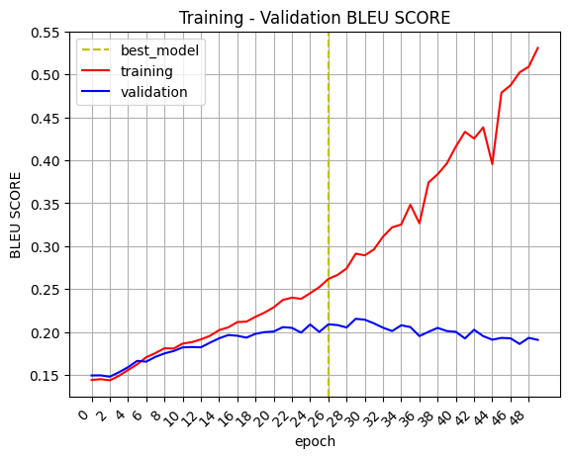
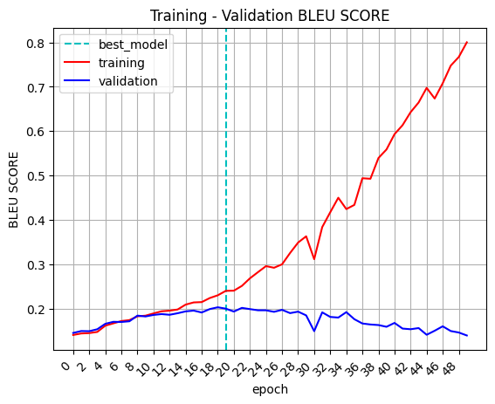
Image Context as Embedding Input
Image Context as Gate Input
Test loss: 2.907, Test bleu: 0.21
Test loss: 2.962, Test bleu: 0.2

Slide 25
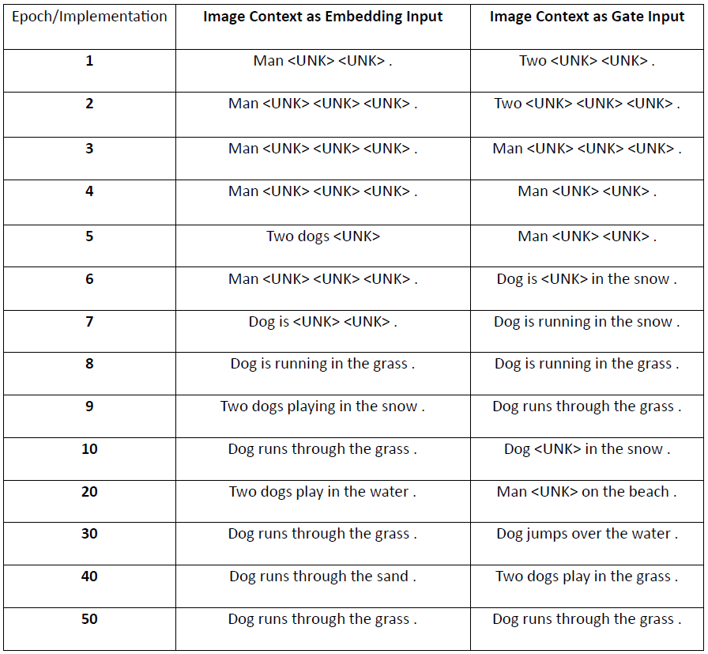
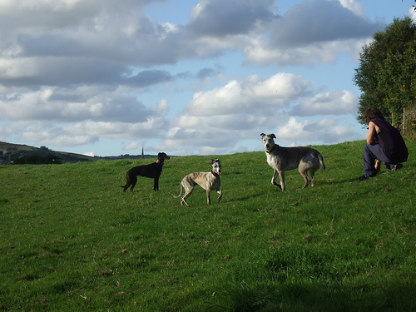
Comparison
Get a random image from the validation set and show how the caption progresses.
True caption: “three dogs on grassy hill .”

Slide 26
Comparison
Models perform almost the same.
Models overfit.
Dataset is way too small for this task. This affects loss and BLEU score.
Keep the second implementation (Image Context as Gate Input).

Slide 27
Test set Results

Slide 28
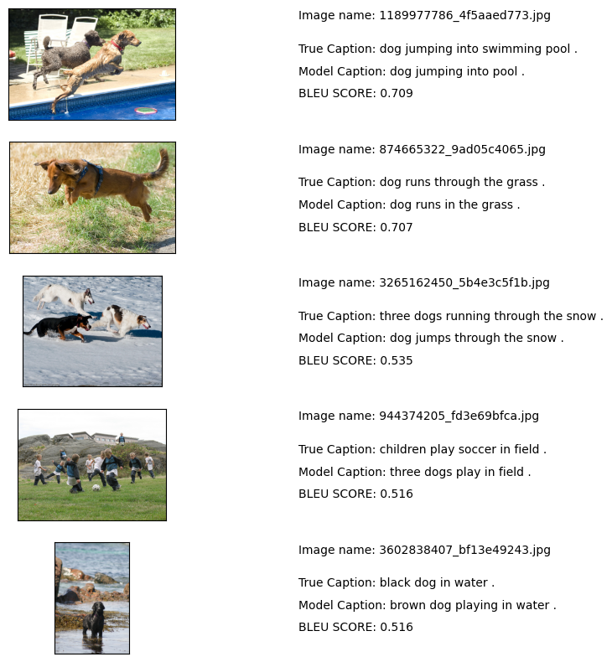
Images with the highest BLEU score

Slide 29
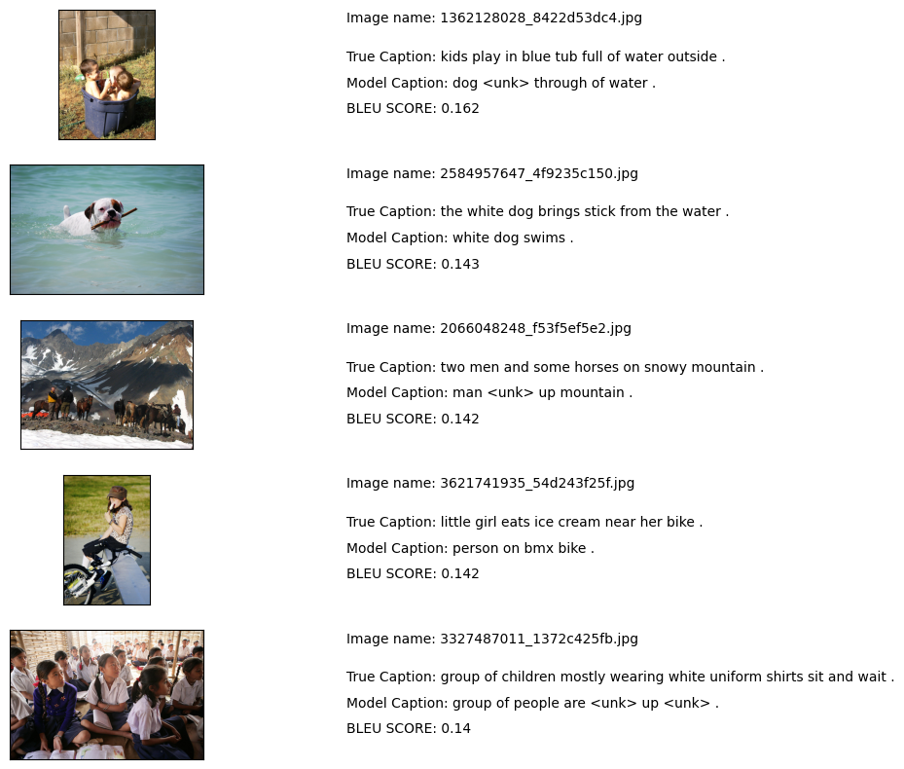
Images with the lowest BLEU score
Model seems to “recognize” the context inside an image.

Slide 30
Tests and Improvements

Slide 31
Tests and Improvements
Use pre-trained word embeddings.
GloVe embeddings: 6B and 42B, with vector size = 300.
Could not freeze the embeddings because backpropagation must reach the Encoder too!
Did not improve the results!
Replace Cross Entropy with Asymmetric Loss¹¯².
ASL can help with the class imbalance problem.
Slightly improved the results!

Slide 32
Thank you!

