Slide 1
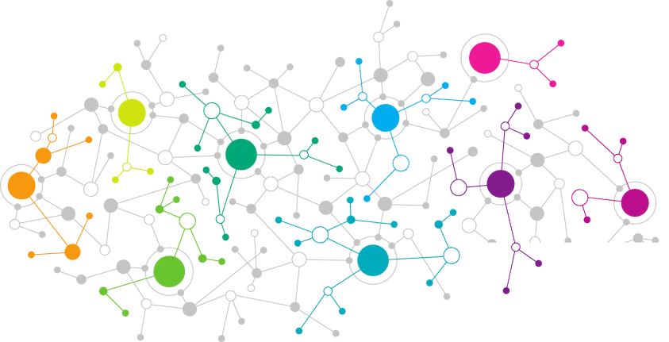

efood
Assignment

Slide 2
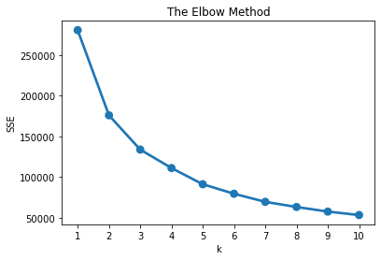
Part I
01
Approach based on frequency and order value
Keep only Breakfast orders
2. Sum up Data and create new variables
Recency
Frequency
AverageBasket
MonetaryValue
3. Run K-Means algorithm and use elbow method

Slide 3
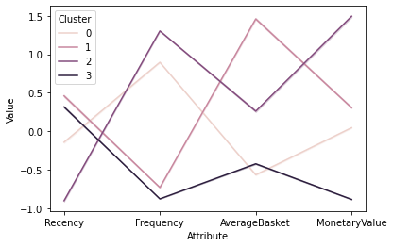

Part I
01
Approach based on frequency and order value
Select 4 customer segments
Group and plot feature variables
Evaluate results and find the best segment to target
Which segment to target?
It depends on what type of marketing campaign we want to run
Profit related
I would propose to target Customers of Segment 1. They are customers of great potential. They are old and they don’t use efood app frequent, but when they use it, their basket has great value. If we succeed to enable and engage them, through a marketing campaign we will gain greater profit, than all others.
2. Loyalty related
I would propose to target Customers of segment 0. They are old and frequent customers, but with small baskets. As the online delivery market has a lot of competition, a loyalty campaign would be useful to keep these customers happy.

Slide 4


Part I I
01
Team Development Plan
Alex
Alex is ready for the next step. He needs a new challenge to be motivated. He will be the first team member that will be assigned to new, custom, and challenging projects. Data Science projects would be a really good option. For this reason, I would propose a python course to improve his hard skills.
Belinda
Belinda has the same level of experience and knowledge as Alex. For this reason, to avoid any inconvenience I would propose the same plan. Python would be a good asset for her. Of course, I should also explain that compliance with Jira is essential for the next step and shows the professionalism needed for it.

Slide 5


Part I I
01
Team Development Plan
Chris
Chris has a good technical background. He should work closely with different business teams. I would offer him a circle placement to different teams to have the opportunity to learn the business from them and help them both in terms of data automation/ manipulation or in data visualization.
Demi
Demi is the junior team member. I would propose to do the data visualization, because she is good at this part and she can build up confidence. In parallel she should improve her technical background through data preparation using SQL.

Slide 6
Part I I
01
Customer Lifetime Value prediction
Data
Data modelling
Presentation
1. Meeting with the team. Describe the project.
1. Alex will check and evaluate survival analysis and Lifetime Value prediction algorithms
1. Alex will prepare the presentation with the help of Belinda, if needed
2. Ask team members for data suggestions based on their expertise (Alex sales, Belinda marketing). Alex and Belinda will be responsible for data gathering and manipulation.
2. We will discuss the results of this research with Belinda and we will conclude to a solution.
2. I will review the results and the presentation.
3. Alex will finally present to the relevant stakeholders, having my full support when needed.
3. Alex will run the model
3. Evaluate data and conclude to those that will be used in the next phase

Slide 7
Thank You

