Slide 1
Supply Prediction
Team Crack the Base

Slide 2
15%
12%
Comments about lack of car availability
Of requests lost due to long car finding time

Slide 3
Problem solved
Predict whether the given trip is the last trip of the driver today
Accuracy:
AUC: 88.7% on test set
Baseline: 67.4%

Slide 4
Last trip of the driver today
Target Variable
1 = After the given ride a driver won’t make any rides within X hours (we took X = 8)
0 = otherwise

Slide 5

revenue
Number of Requests
% Served
Price
X
X
Depends
on Supply

Slide 6
Problem Context
Starting
Working
Drivers
Quitting
Prediction
Mitigation
Actions
6

Slide 7
Model Description
Model: Binary classification, XGBoost
Dataset: Drivers’ 1 months history
Train
Validation
Test
3 weeks
1 week
Top features (3 / 22):
Number of rides per 1 GH
Current session duration
Number of orders in session by now

Slide 8
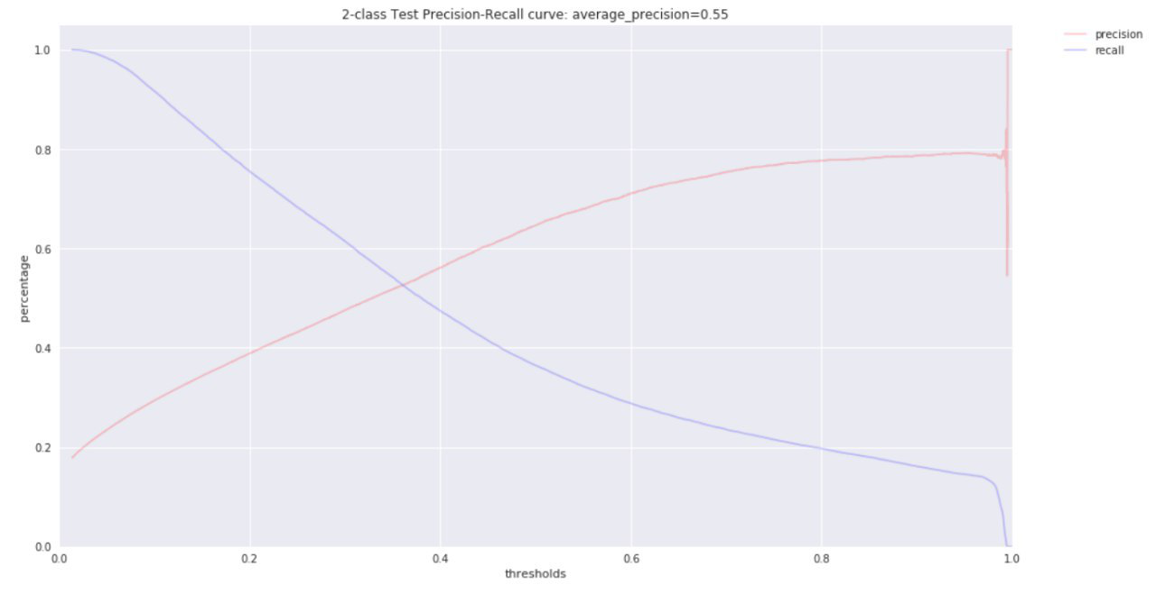
Model Results
Recall (80%)
Precision (20%)
0,8
AUC 88,7% on test set
Baseline: 67,4%

Slide 9
Potential applications
“Wisely” prevent driver from leaving the route
Suggest a nearby driver to relocate for more revenue

Slide 10
Next steps
Improve model accuracy adding more data
Geo
History
Rating of driver
Start predicting organic increase of drivers
Match with demand prediction for wiser recommendations

Slide 11
Thank you!

Slide 12
“Gett doesn’t have a supply prediction now”

Slide 13
Reactive approach
Earnings goals
Showing next ride during current One
Texting on behalf of woman
Gamification
Hiding destination
http://www.complex.com/life/2017/04/uber-5-tricks-keep-drivers-on-road

Slide 14
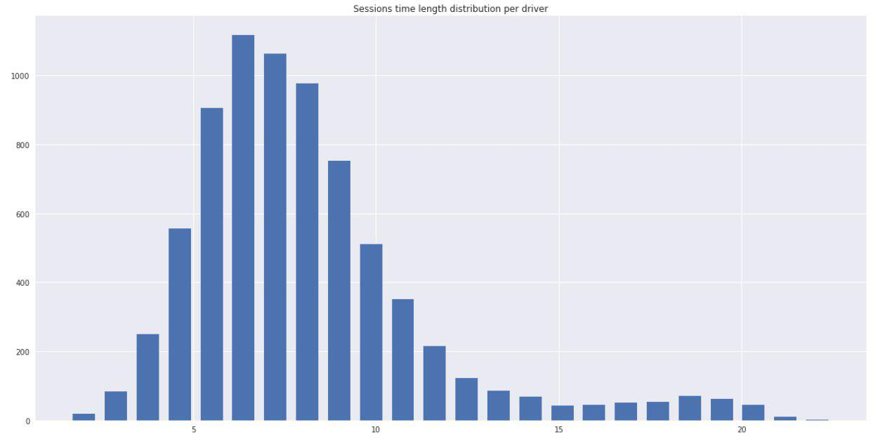
Any room for growth?
«Almost 85% of taxi drivers in Moscow have to overtime and stay on road up to 16-18 hours a day to at least earn their living»
Russian federation of car owners, https://iz.ru/news/605242
VS
«More than half of drivers (…) use the app less than 10 hours a week.»
Uber, https://www.usatoday.com/story/money/cars/2017/07/10/some-uber-drivers-work-dangerously-long-shifts/103090682/
Answer: YES
Mean working time: 8,5 hours
Standard deviation: 3,2 hours
Comment: based on orders_drivers.csv dataset; statistics taken per driver
8,5

Slide 15
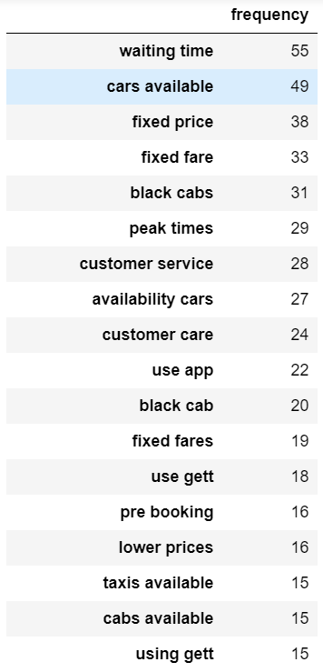

Slide 16
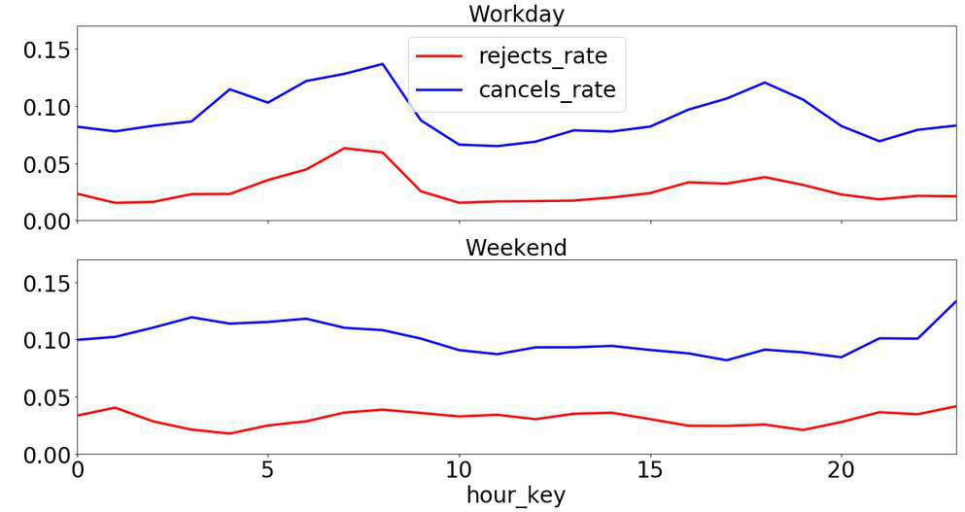
User drop rate

Slide 17
Dataset info
1. Outliners:
Eleminate information about ('driver_gk'= 2561):
Rejected 191392
Cancelled 136306
Completed 0
2. Train/Validation/Test split:
Train/Validation - offers before '2017-09-23 00:00:00', stratified split - 0.2;
Test - offers after '2017-09-23 00:00:00';
Train class distribution:
1 - 91237, 0.151144
0 - 512404, 0.848856
Validation class distribution:
1 - 22809, 0.151142
0 - 128102, 0.848858
Test class distribution:
1 - 26240, 0.139193
0 - 162275, 0.860807

Slide 18
Dataset info
Baseline
"mean_reject_rate" for each driver
roc_auc_score = 0.674
Model
Top features:
rides_per_1_GH
mean_reject
session_time_length
session_orders_count
order_hour
total_ride_duration
Total - 22 features
Model - xgboost:
Params:
'max_depth':9
'min_child_weight': 5
'eta':0.1
'subsample': 0.8
'alpha': 0.1
'num_round': 50
train-auc:0.929 eval-auc:0.921 test-auc:0.887

Slide 19
5. Precision/Recall best point:
Validation:
precision=0.99
recall=0.2
Test:
precision=0.8
recall=0.2

