Slide 1
FLOW: OpenAi Agents SDK + MCP
AI Bootcamp 2025
Vasilii Bologov
Oleg Seifullin

Slide 2
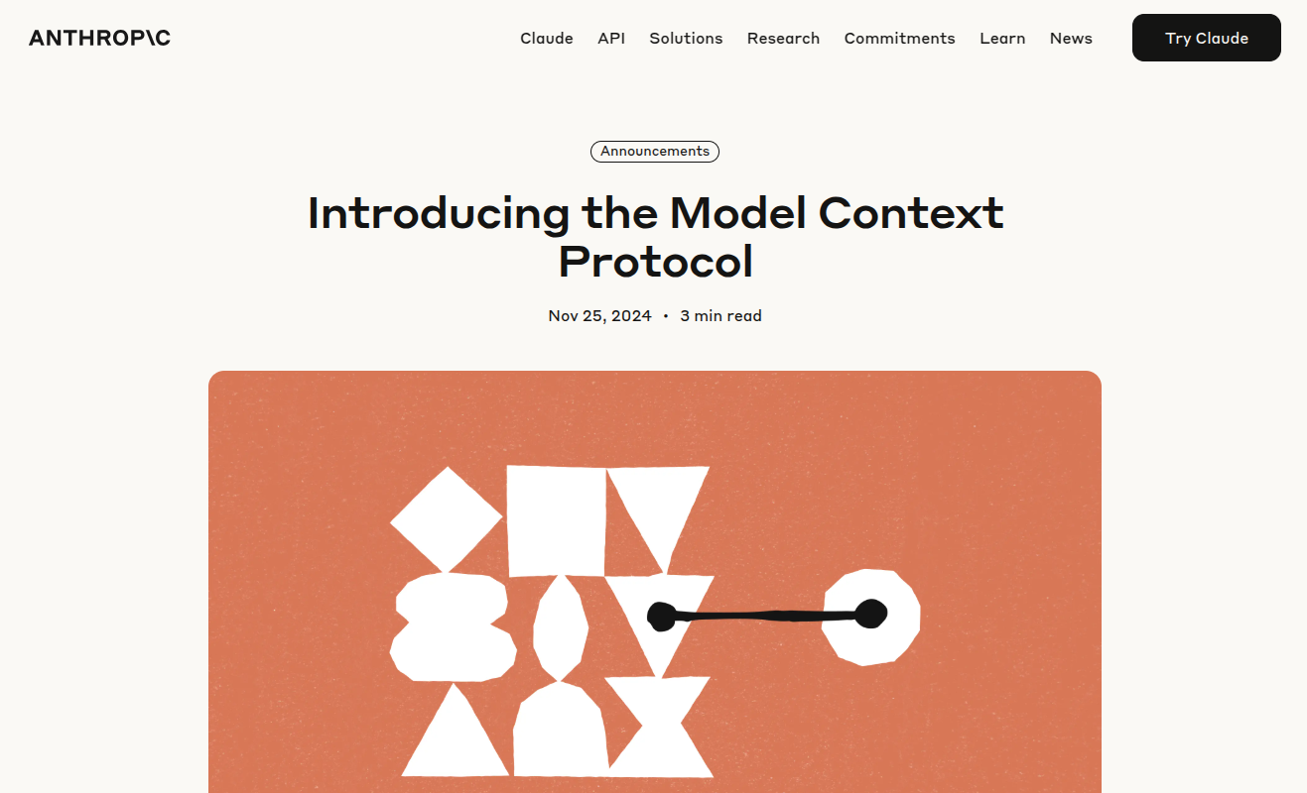
01
MCP

Slide 3
MCP?
MCP stands for Model Context Protocol. It's an open standard that provides a universal way for AI models, particularly large language models (LLMs).

Slide 4
Standardization
Key Components
Benefits
Inspiration
MCP standardizes how AI models access and utilize external resources, making it easier to build and deploy AI applications
MCP includes specifications, SDKs, and reference implementations to guide developers in building and integrating with MCP-enabled tools and services.
MCP simplifies the development of AI agents, enables secure cross-agent collaboration, and promotes the creation of portable toolsets for AI applications.
MCP takes inspiration from the Language Server Protocol (LSP), which is widely used for code editors and IDEs.

Slide 5
What's the trubble?
MCP is a fairly new and raw technology for building agents and does not provide sufficient stability and diversity (for example, in programming languages)

Slide 6
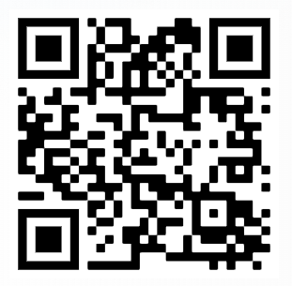
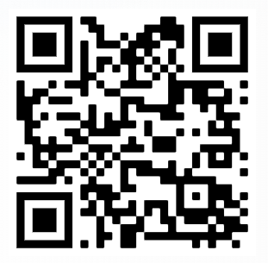
LINKS
GitHub
Anthropic
https://www.anthropic.com/news/model-context-protocol
https://github.com/modelcontextprotocol/python-sdk

Slide 7
02
OpenAI
Agents SDK

Slide 8
OpenAI Agents SDK
The OpenAI Agents SDK enables you to build agentic AI apps in a lightweight, easy-to-use package with very few abstractions. It's a production-ready upgrade of our previous experimentation for agents, Swarm.

Slide 9
Dolor Sit
Agents, which are LLMs equipped with instructions and tools
Handoffs, which allow agents to delegate to other agents for specific tasks
Guardrails, which enable the inputs to agents to be validated

Slide 10
What's the trubble?
Agents SDK is an even newer and more raw library than even MCP. It only works on pure Python.

Slide 11

LINKS
OpenAI Agents SDK
https://openai.github.io/openai-agents-python/

Slide 12
03
Let's do it together

Slide 13
How does this work

Slide 14
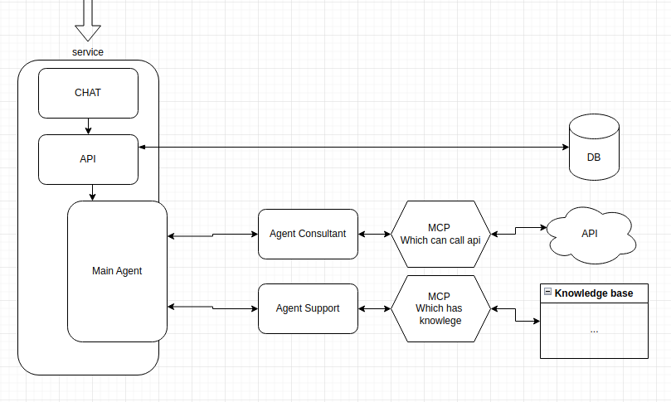
SCHEME

Slide 15
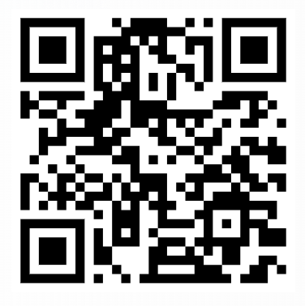
RESULT
Prototipe
Prototipe
Prototipe
https://ai-chat-service.azurewebsites.net/

Slide 16
THANK YOU

