Slide 1
XCR-2
Технология работы
Презентация - 3

Slide 2
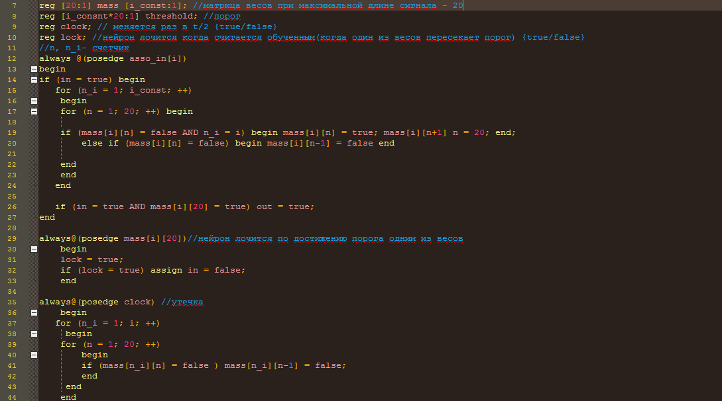

Slide 3
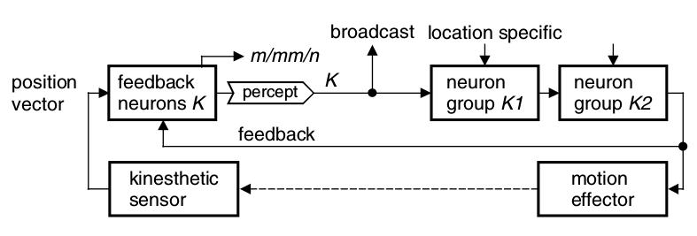
Kinestetic perseption

Slide 4
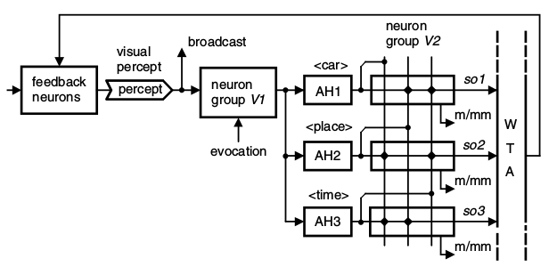
Short-term memory

Slide 5
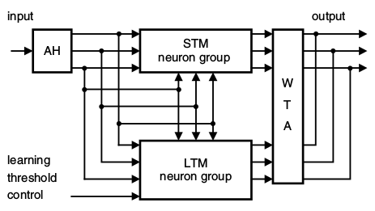
Long-term memory

Slide 6
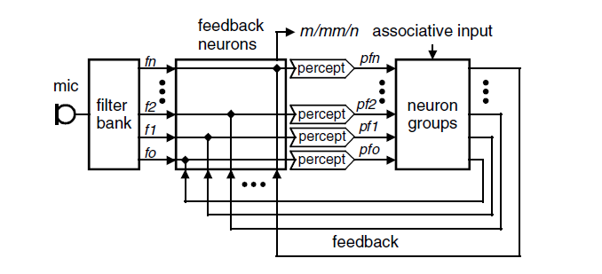
The Sound Perception
The perception of frequencies (simplified)

Slide 7
Speech Recognition Scheme
associative input
WM8731
f₁
pf₁
filter bank
feature detector
f₂
feedback neurons
pf₂
neuron groups
ADC
mic
f₃
pf₃
Analog-to-digital converter
Band-pass filter
Rectifier
Low-pass filter
feedback

Slide 8
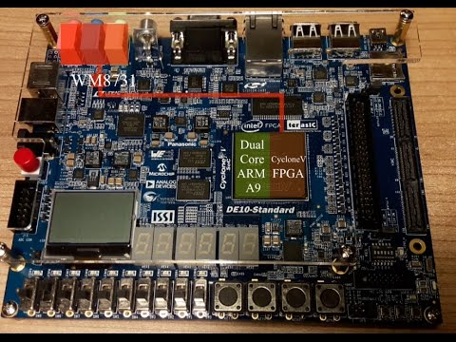
Analog-to-digital converter
WM8731 - Portable Internet Audio CODEC
Stereo 24-bit multi-bit sigma delta ADC
Digital audio input word lengths from 16-32 bits
Sampling rates from 8kHz to 96kHz
Programmable Audio Data Interface - I2S, Left, Right Justified

Slide 9
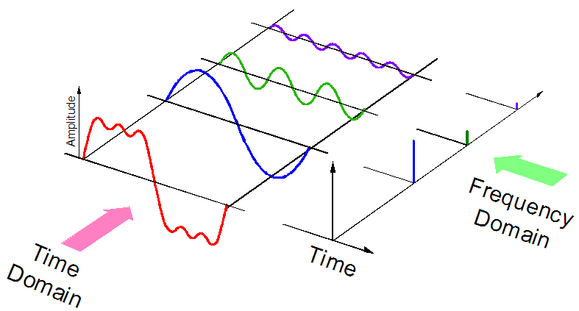
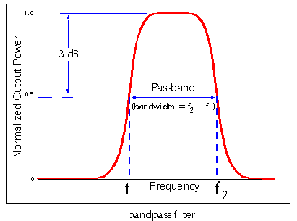
Signal processing
After ADC – digital signal d(t)
Problem: how to get d(freq) function?
Solution:
Fourier Transformation
Band-pass filters using
Resonator banks using
Our approach: band-pass filters using

Slide 10
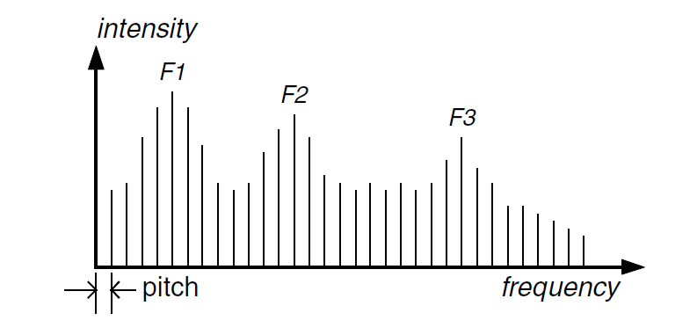
Feature detecting
After Filter bank – digital signal d(freq)
Problem: how to get features?
Solution: using of human voice properties (Vowels Formants)
pitch – fundamental frequency
male voice: 80–200 Hz
female voice: 150–350 Hz
Formant is a concentration of acoustic energy around a particular frequency in the speech wave
Red ->
Green ->
Blue ->

Slide 11
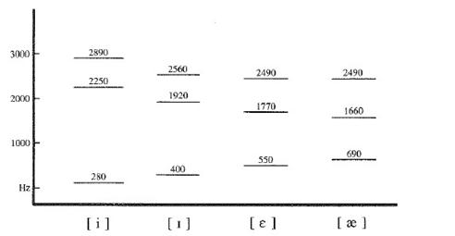
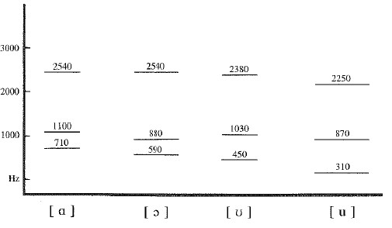
Feature Detecting. Formants
2<n<=4
Red ->
Green ->
Blue ->
Two Formants – too few
Four Formants – always enough
frequency
frequency

Slide 12
Detailed Scheme of Sound Signal Processing
Analog signal, s(t)
Digital signal, d(t)
Digital signal, d(freq)
Sound wave
WM8731
red
filter bank
feature detector
green
feedback neuron
ADC
blue
mic
Analog-to-digital converter
Band-pass filter
Rectifier
Low-pass filter
Formants
of vowels
FPGA

Slide 13
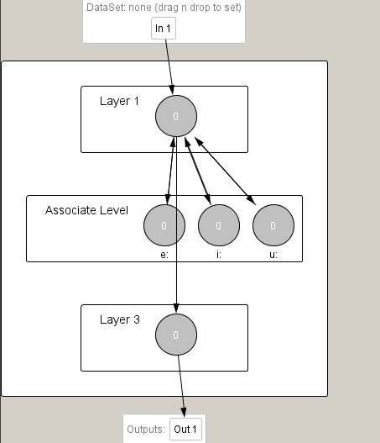
Feedback neuron
Обучение по Хеббу: При возбуждении ассоциативного нейрона вес его связи увеличивается, вес остальных уменьшается
При достижении порога – нейрон считается обученным
Рост весов ограничен ||ω||₂ < c (с = 4)

